Slide 1
HSG5 Input to Trigger Workshop
Ricardo Gonçalo (RHUL)

Slide 2
Introduction
We were asked for input for the Trigger Workshop next week
One of the issues are the lepton triggers for high lumi ( 1-2 x 10³⁴cm⁻²s⁻¹ ):
Single lepton triggers will likely be ≈30 GeV for electrons and ≈25 GeV for muons.
Di-lepton triggers @ 2x10³⁴:
2e trigger ≈20 GeV + 20 GeV
2μ trigger ≈13 GeV + 13 GeV
The first question is how much we would loose from the tighter thresholds.
This probably affects WH and ttH semileptonic harder than other channels
Muon p_{T} cut can stay almost the same, but the offline electron p_{T} cut will need to go to ≥30GeV (on at least one lepton)
Alternatives to single lepton trigger (if we see a large impact):
WH->lνbb: combined lepton+jets trigger (possibly with b-tagging).
Downside: the trigger jet thresholds would impact on the offline jet cuts
ZH->llbb: impact should be smaller
ttH (single-lepton channel): lepton+jets (incl. b-tagging?), lepton+HT

Slide 3
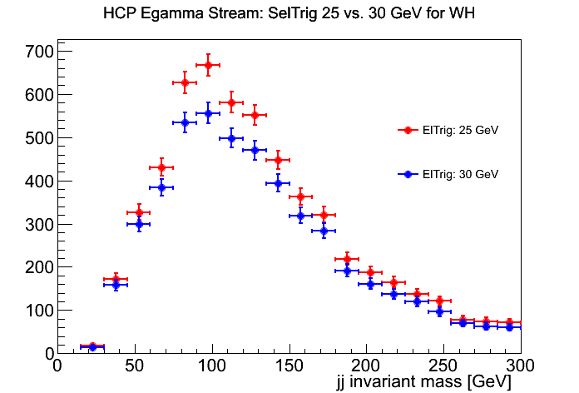
Impact on HSG5 analyses
Following slides: HCP/Top2012 analyses with offline electron p_{T} cut at 30GeV
Study by Manuel Proissl below:
WH: e/gamma rate ≈10% lower

Slide 4
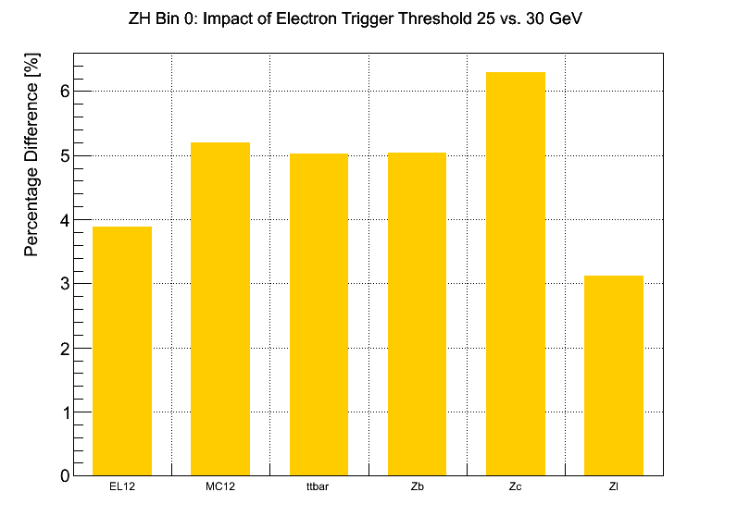
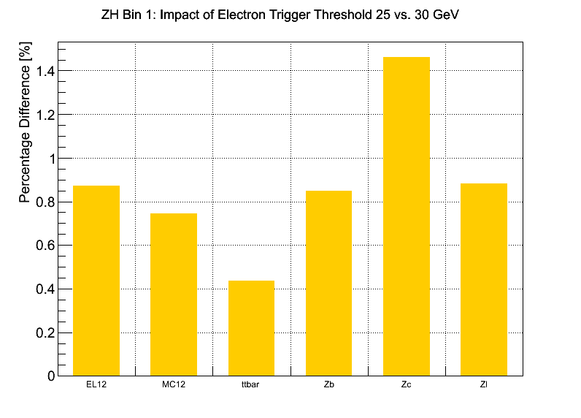
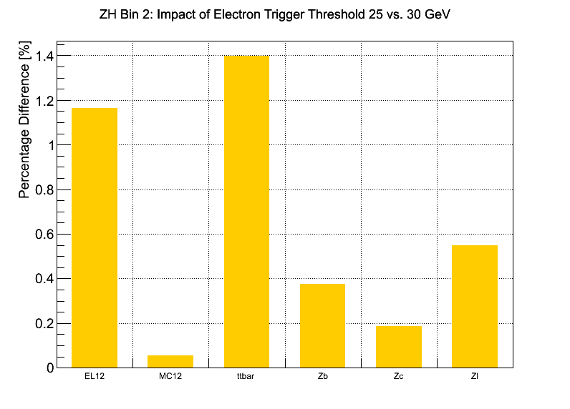
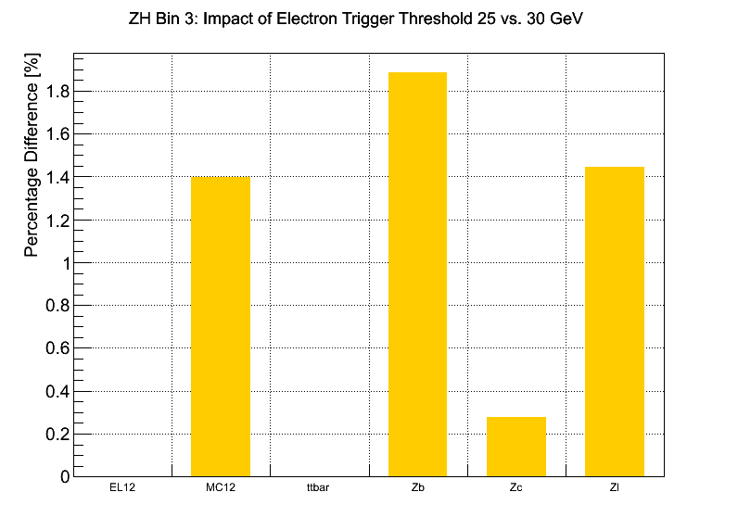
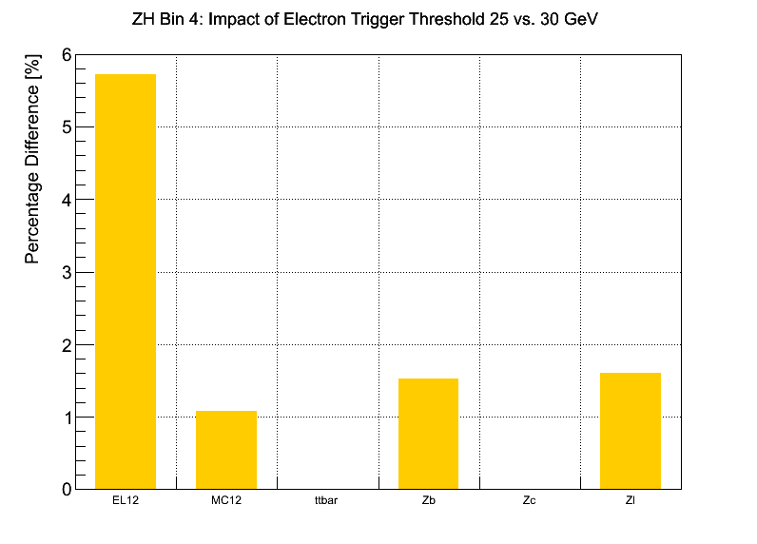
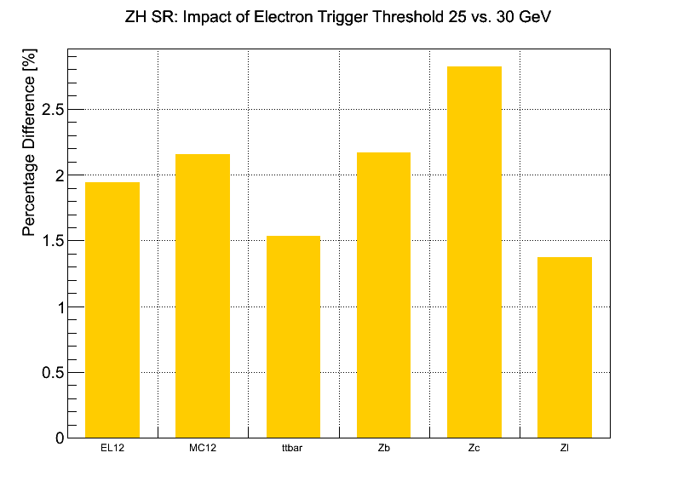
ZH->llbb
Small drop in acceptance
Eff.drop (%) | Bin 0 | Bin 1 | Bin 2 | Bin 3 | Bin 4 | Inclusive
Top + V+jets | 5.2 | 0.75 | 0.05 | 1.4 | 1.1 | 2.15

Slide 5
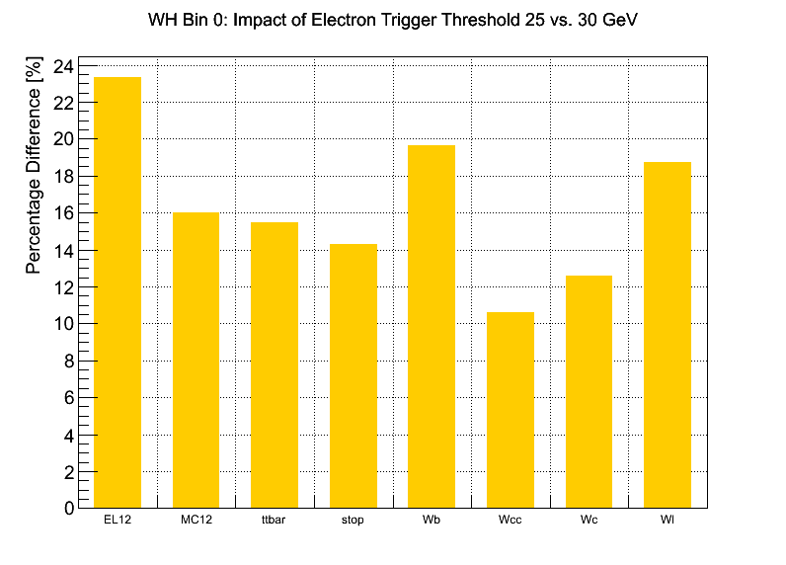
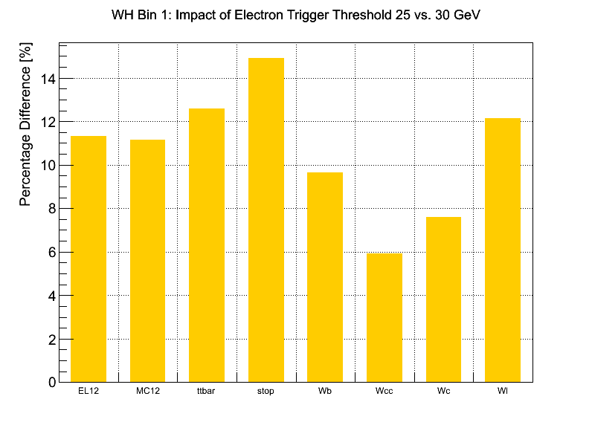
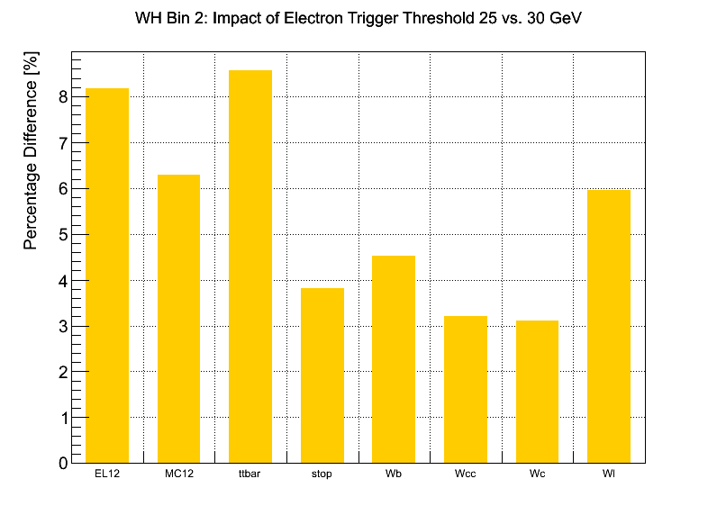
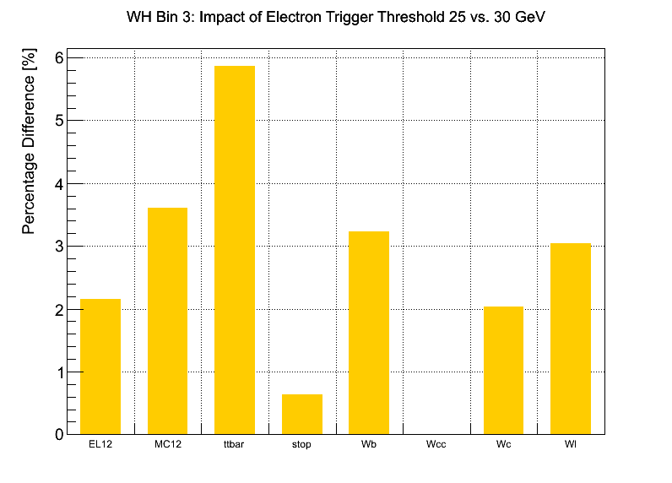
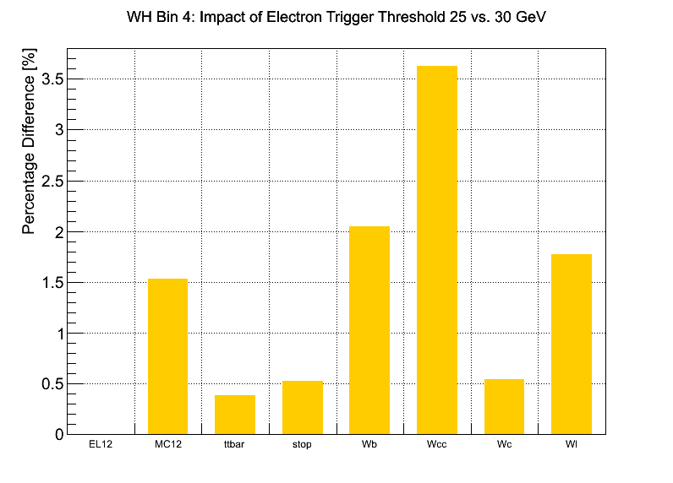
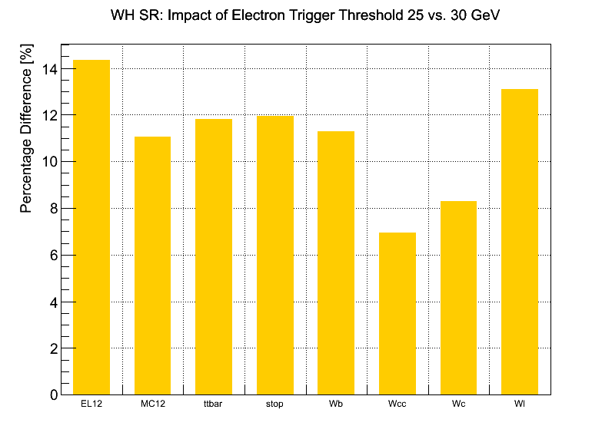
WH->lνbb
Small drop in acceptance similar for all backgr
Eff.drop (%) | Bin 0 | Bin 1 | Bin 2 | Bin 3 | Bin 4 | Inclusive
Top + V+jets | 16 | 11 | 6.5 | 3.6 | 1.5 | 11

Slide 6
ttH lepton+jets and di-lepton
Study by Leonid Serkin
pTjet > 25GeV cut (may change for analysis)
Increased offline pT(e) cut to 30GeV
≈10% loss in lepton+jets acceptance
≈8% loss in di-lepton acceptence
Drop in S/√B of 4% from 0.0419 to 0.0403
In ≥ 4 jet bin (and E_{T}^{miss} > 30GeV, M_{T}^{W} > 30GeV analysis cuts)

