Slide 1
H->bb Note Plans for Summer
Ricardo Gonçalo (RHUL)
HSG5 H->bb weekly meeting, 28 June 2011

Slide 2
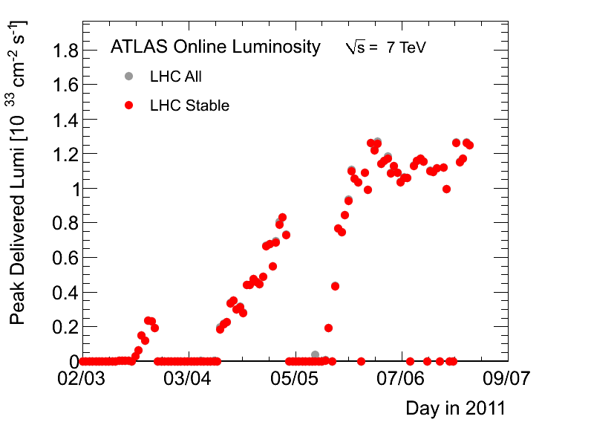
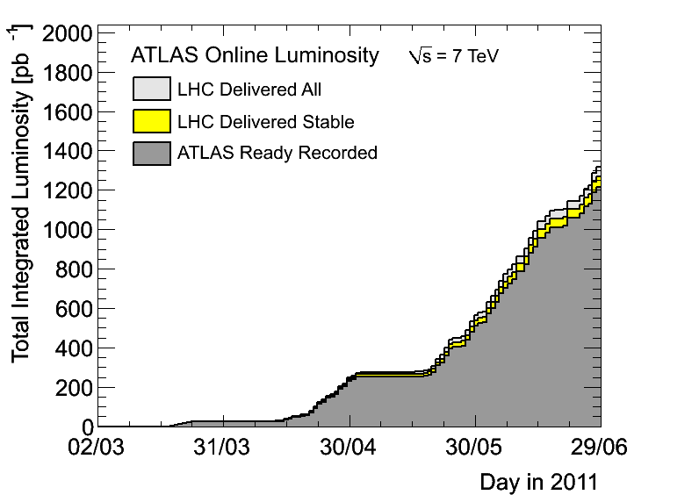
News! News! News!
About 1.2 fb⁻¹ collected with stable beams so far (1.27 fb⁻¹ delivered)
Peak lumi stable at around 1.26x10³³cm⁻²s⁻¹
30 – 50pb⁻¹ per day (peak so far was 60pb⁻¹)
1318 colliding bunches

Slide 3
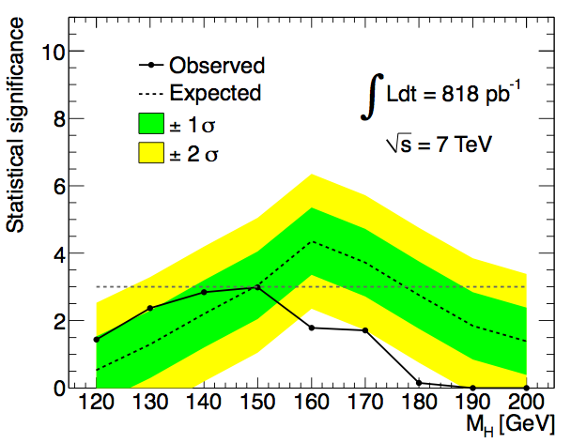
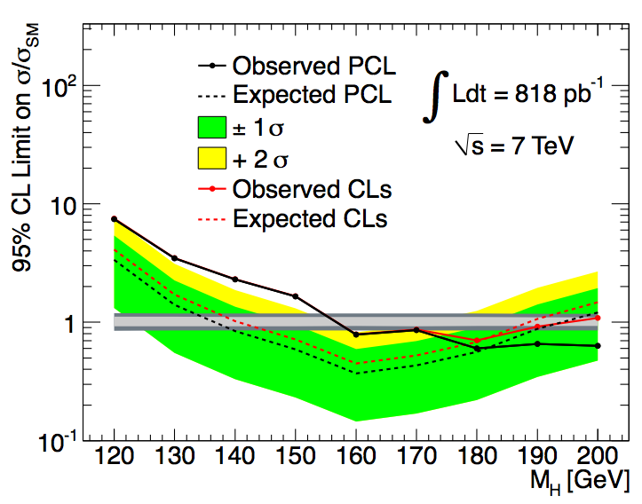
News! News! News!
H -> WW -> lνlν excess
Excess in data in all channels being investigated
See Magda Cheltowska’s talk last week:https://indico.cern.ch/getFile.py/access?contribId=7&resId=0&materialId=slides&confId=143469
Cross checks between several analyses, event scans, the works
Open issues:
Problem with the top background
Wrong tau polarization in MC
Mismodeling of the low pT electrons

Slide 4
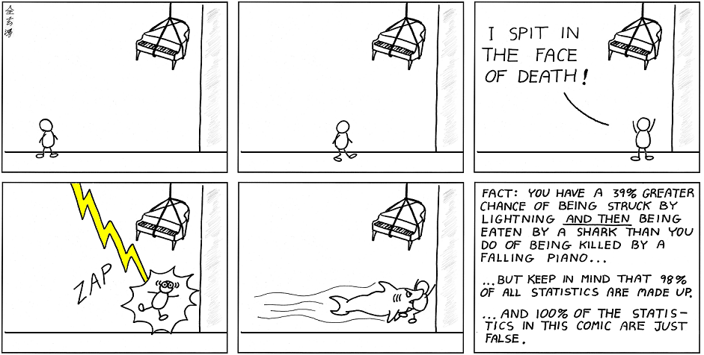
News! News! News!
Statistics Forum
All ATLAS results for summer conferences should be made using CLs
(All except analyses with a Bayesian history and Bayesian usage in CMS)

Slide 5
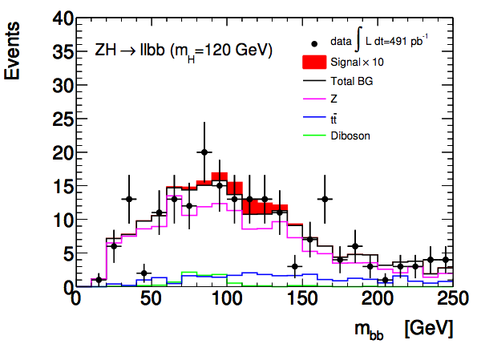
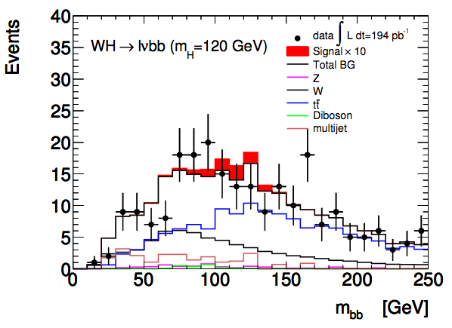
WH/ZH Note
Second meeting with the editorial board last week
Next meeting right after weekly meeting today
Note available in CDS: http://cdsweb.cern.ch/record/1307560?ln=en
List of authors to be updated soon (sorry, mea culpa)
Our deadlines next…

Slide 6
Last call for EPS
Leandro (ATLAS Week)
June 23rd: final “analysis update”
Assumes ~ 7-10 days to run full analysis
Data taken up to June 18th available with GRL (recorded L=1 fb⁻¹);
Jul 5th: Drafts submitted to EdBoard
Early drafts should be circulated to the EdBoard earlier; very similar to PLHC
Final drafts on Jul 8th to PC;
Jul 9th: last circulation of Papers/Notes
Run again the full analysis to include the data after June 26th , at least for benchmark analyses? (technical stop on June 29th^{th}, for ~10 days)
Jul 15th: last approval meetings
Present the circulated results and the ones obtained updating the analysis
Jul 18th: conclude sign-offs of Papers/CONF Notes
Assumes 1 week for EdBoard and two sign-offs from PC/PubComm/Mngt
18→20: 3 days contingency
Jul 21st: EPS Conference
This particular schedule can be adopted only for a few Papers and/or Notes (searches or more in general luminosity sensitive)
Expect a “hot period” during next two weeks fully dominated by CONF/Paper approval meetings

Slide 7
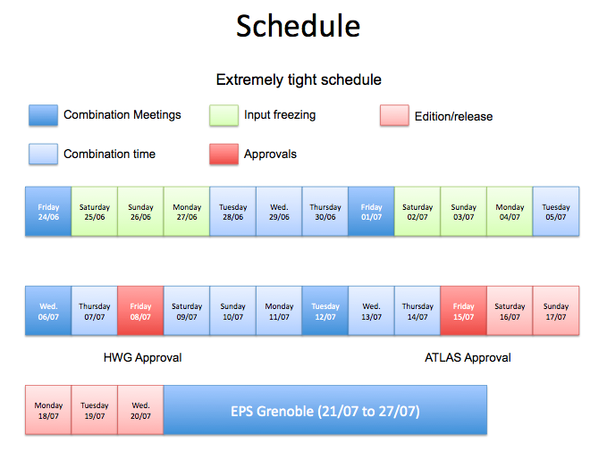
Schedule for Setting Limits
Combination meeting: https://indico.cern.ch/conferenceDisplay.py?confId=144353
Inputs need to be:
Available today (28th June) – to have limits for INT note approval by Ed.board and Higgs WG on 30th
On 30th June – approval and final decision on whether to include in SM Higgs combination
Frozen by 4th July for Higgs approval on the 8th July
Interpolated inputs ready right after Higgs WH approval for input to ATLAS SM Higgs combination
ATLAS approval on 15th July

Slide 8
JVF-fixed D3PDs
Still need analysis cross check! – cut-flow comparison between different analyses
SMWZ D3PDs were produced by Haifeng with the bugfix for the Jet Vertex Fraction bug
Contain data from run 178044 (22 March 2011) to run 183021 (2 June)
Total (data+MC) is 2.7 TB
Listed in https://twiki.cern.ch/twiki/bin/view/Main/PrivateD3PDWithJVFFix
Transferred to UKI-LT2-RHUL_LOCALGROUPDISK
Should be accessible to everyone; let me know in case of problems
More samples were produced and now being transferred to grid
Thanks to Jonas for helping with remaining samples!

Slide 9
Submitted abstract to Lepton Photon 2011 in Mumbai, starting August 22nd
ATLAS abstracts:https://indico.cern.ch/conferenceDisplay.py?confId=143052
If accepted, will be presented by Koloina Randrianarivony who volunteered for this

Slide 10
Other issues…
PAT group has a vision…
See Karsten Koeneke’s talk in ATLAS Week

Slide 11
Backup

Slide 12
WH/ZH Note: Missing Ingredients
Moving to MC10b: done
b tagging:
Need advanced tagger for increased background rejection
Efficiency scale factors almost done
Calibration & fake rate: preliminary on week of 20th June - will re-do analysis with final numbers
IP3D+SV1, 60% efficiency working point
Jet Vertex Fraction:
Fix exists but applicable only to AOD-based analyses – i.e. only one analysis in our group
D3PDs including the bug fix exist for part of the 2011 run – being transferred to Grid site
Validation?
Editorial board:
Richard Bateley (chair)
Alex Read
Emmanuel Lemonier
Niels van Eldik
Good 1st meeting with Ed.Board
QCD background (incl. bb, cc):
Almost there
One feature to be understood in anti-track isolation QCD background in electron channel
Watch this space!
Systematics:
First estimates done – dominated by b-tagging uncertainty (around 30%)
SM Higgs combination:
Need to produce inputs for SM Higgs combination

Slide 13
https://indico.cern.ch/getFile.py/access?contribId=66&sessionId=8&resId=1&materialId=slides&confId=141246

Slide 14
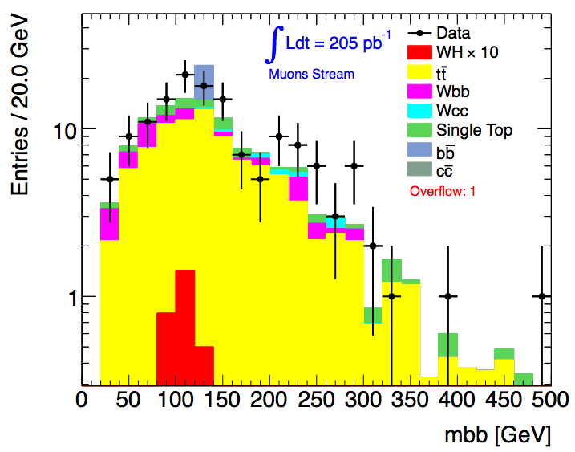
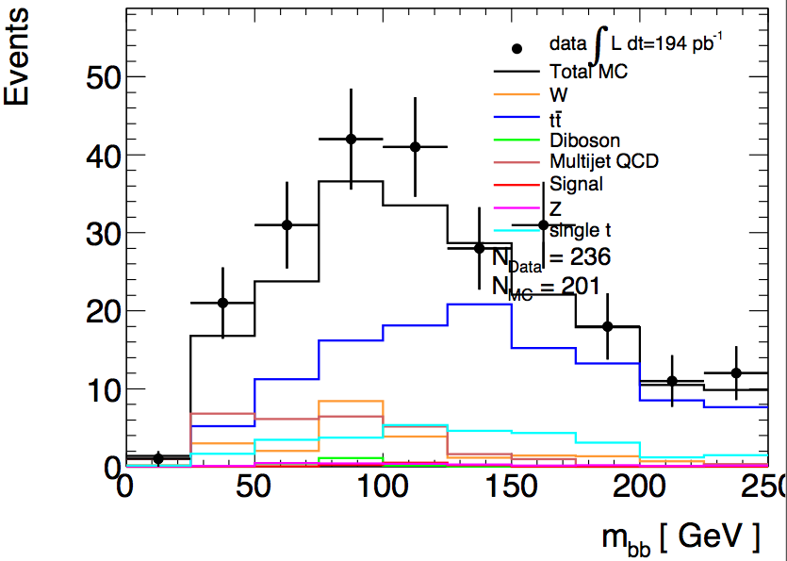
Do we need a JVF cut?
In principle yes!…
Need to use cut N_{jets} = 2 to suppress tt background; use N_{jets} = 3 as tt control region
So must suppress spurious jets from pileup…
Njets < 4
All backgrounds from Monte Carlo
bb and cc MC clearly not enough
Njets = 2
QCD background from data
Before last scale factor (1-b sideband)
Lianliang Ma
Paul Thompson

Slide 15
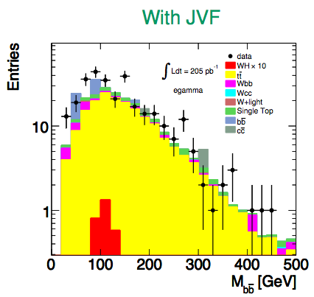
Do we need a JVF cut?
In fact, not using the Jet Vertex Fraction seems to have a significant effect on Njets
But a small effect after all cuts…
 | data | tt MC
No JVF cut | 303 | 200
JVF > 0.75 | 300 | 185
Haifeng Li
Haifeng Li

Slide 16
WH/ZH Note: Outlook
Skeleton draft of INT note should be available now…
Then a couple of weeks to finish details of QCD BG determination and interact with Editorial Board
Expect some changes to cuts etc during this
Dataset frozen on 22 June (I think)
Preliminary b-tagging calibrations around same time
Aim for Higgs approval at end of June
Last iteration with final b-tagging calibrations on…
Circulate note to ATLAS for CONF approval in early July for approval in time for EPS

