Slide 1

H->bb: plans and EPS post-mortem
Ricardo Gonçalo (RHUL)
HSG5 H->bb weekly meeting, 26 July 2011

Slide 2
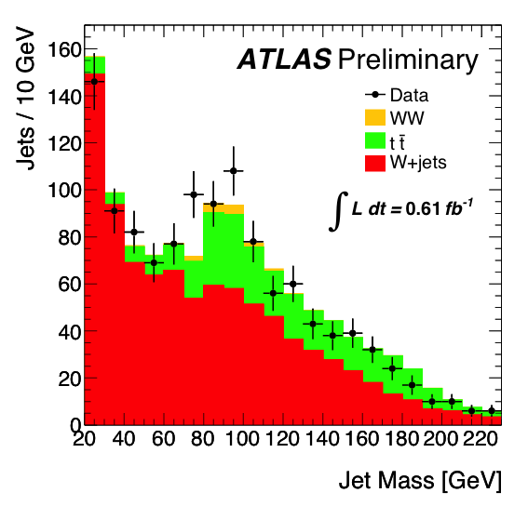
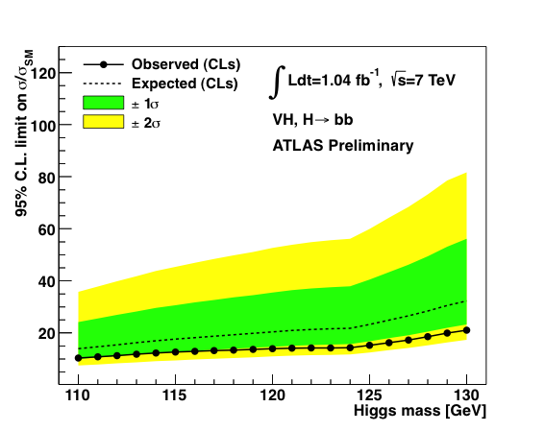
General Impresions
It’s good that we presented these results for several reasons:
  We showed it can be done!... (first time for the LHC) And now we have baseline to build on
  It was nicely done in several ways – data-driven estimates of worst backgrounds etc
  We showed that boosted VH is within reach
  Important to have a cross check for H->γγ
  Results included in ATLAS SM Higgs combination
What is missing:
  Real sensitivity – we’re only at 10-15 times the SM
The way forward:
  Space for improvement in WH/ZH
  Include other channels
  Try to move higher in mass reach (but cannot do much)
  See next slides…
Concerns
  Current results: small screw-up in limits (obs vs exp) needs to be understood
  Near future: not much time! Waiting to see how much low mass excluded by Tevatron
  Sociological: keeping people focused on this – need to get activity going again after EPS madness

Slide 3
Post-mortem of WH/ZH results
M_{bb} resolution is extremely poor
  Should try to get a peak, but this needs work on jet (and b-jet) energy scale
  Try to think about this together with jet/E_{T}^{miss} people
  Could we improve other things in jet reco to improve m_{bb}?
  In ZH->llbb could try to use ll vs bb p_{T} balance to do in-situ calibration?
B-tagging systematic uncertainty dominates by far
  16% vs 7-9% for JES and ≈1-2% others
  Should be possible to improve this, since the error is dominated by the statistics used in b-tagging studies
  Would improve limits by up to 25-30%
  Think about this with b-tagging people
Limits: must get help from roostats experts to understand the difference between expected and observed
WH cuts on exactly 2 jets
  A lot of signal is lost there – can it be improved?
WH backgrounds:
  Top and W+jets background estimate using simultaneous template fit to m_{bb} sidebands (<80GeV and 140-250GeV)
  Probably should try to also constrain jet energy scale from this fit
  JES changes m_{bb} distribution and could affect normalization of backgrounds
  In light of H->WW results, should move upper sideband to e.g. 160-250GeV – at m_{H}=150GeV, σ*BR already 1/10 of value at 115GeV, but H->WW and H->bb resolution is very broad
  Can top background be reduced further?
ZH background from Z+bb seems irreducible – can it be improved?

Slide 4
WH/ZH analysis plans
We can still try to improve cut based analysis:
  Get a m_{bb} peak, improve b-tagging systematics, constrain JES in WH, etc…
  Reduce top background in WH:
    Try using looser leptons or extending lepton id to forward region to veto tt->lvlvbb
    Loosen jet η cut (at |η|<2.5 now) and maybe p_{T} cut to veto tt->lvjjbb/jjjjjbb
  But… must keep pileup and JVF in mind
Reduce Z+bb background in ZH? Would probably need a clever new variable like cos*θ
Then clearly we should include multivariate methods
  Used intensively by Tevatron
  e.g. use NN to target top background – may allow to relax 2-jet cut in WH
  NN may also help in rejecting Z+bb background in ZH?
  See if MV method can improve existing b-tagging
Add more channels!
  Can something be done with ZH->ννbb? Very good channel in Tevatron, but complex and mature analysis
    Academia Sinica group plans to work on this But trigger is the crucial part
  Boosted VH is clearly the next thing to push! WH->lνbb and ZH->llbb, but also ZH->ννbb
    UCL and Edinburgh working on this – should be enough manpower now, but need to get results soon
  ttH has been slowly building up in Glasgow – will push for this to happen together with Chris

Slide 5
Technical issues
ZH benefitted from HSG2 DAOD skims, but WH suffered from painful running on data
Need to push for WH skims – will follow up with Kostas & Co.
In contrast to other groups we don't have an error due to LO/NLO on the signal. Need to get NLO signal MC
Also need to re-do WH samples at 110 and 140 since the current ones were done with a lepton filter by mistake
Should also other mass points:
Get 135 for WH and ZH since we have 130 and 140
Should we try to extend to 150 GeV in light of H->WW results? Almost no sensitivity, but could prove useful later

Slide 6
People and plans
Most of the group could not do the EPS analysis because of the JVF bug: only people running on AODs could continue the analysis in time
Now need to recover rest of the group and get everyone up to speed again
  Liverpool/Birmingham in shape
  Academia Sinica, LMU, Lisbon and Wisconsin need to pick up the thread but may be ok
  UCL and Edinburgh need to push on boosted VH, also Academia Sinica on boosted ZH->ννbb
  Glasgow needs to push on ttH, IFAE may also still be interested
  Victoria and Wisconsin keep activity in VBF H->bb, but difficult channel
  Several other people waiting in the aisles could perhaps be motivated
Plans:
Assuming the Tevatron don’t exclude up to 130GeV ;-) … We should try to have a paper late this year and one or more CONF notes as support material for that

