Slide 1
Introduction
Ricardo Gonçalo (RHUL)
Higgs Weekly Meeting – 19 April 2012

Slide 2
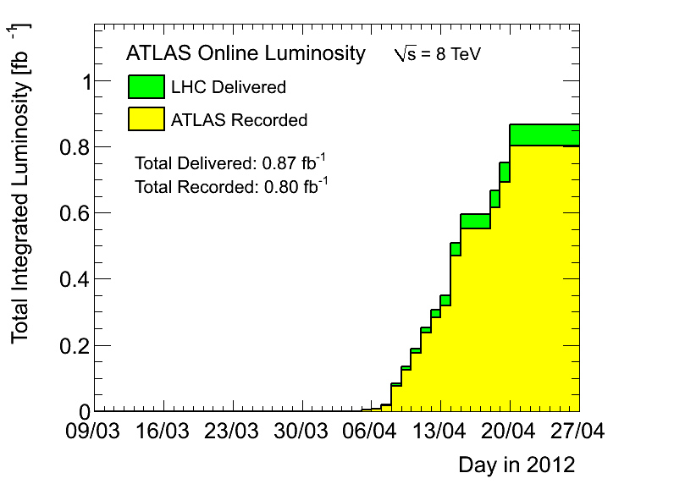
News! News! News!
LHC: technical stop
Peak <evts>/bunch crossing 20 – 25
Peak stable lumi 5.12x10³³cm⁻²s⁻¹
Lumi with stable beams 0.80fb⁻¹
≈ 0.15fb⁻¹ collected since last week

Slide 3
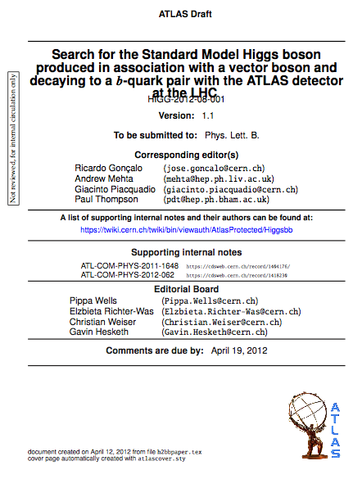
News! News! News!
H->bb analysis approved by to go for second circulation
https://cdsweb.cern.ch/record/1440266
Current version in CDS for last updates and reading by EB
https://cdsweb.cern.ch/record/1439564?ln=en
Should be circulated soon (next few days)
Congratulations everyone! ☺
What next:
Second circulation
1 week of comments by collaboration and management
Second reading
Send to journal
More comments…
Publication!

Slide 4
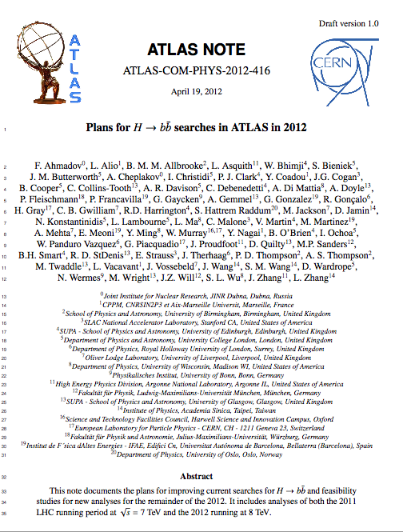
Internal note with 2012 plans - I
After discussing with Sandra and Eilam:
Cannot make fully detailed note
We don’t have enough information to predict 2012 changes
Argument was taken into account
Should still make “declaration of intentions” for 2012 analyses
Useful to prepare roadmap but no legal bound to detailed cuts (impossible)
To be ready for 10th May
Content:
WH/ZH
Boosted VH
ttH
MWT? VBF? MSSM bH?
I will prepare note and send questions/sections to each analysis group
ATL-COM-PHYS-2012-416

Slide 5
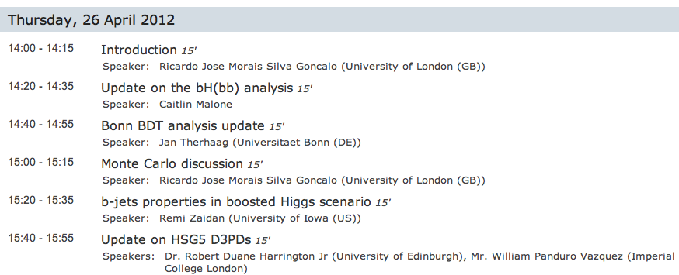
Today…
Need to have MC discussion – at 3pm to have Tatsuya’s help

Slide 6
Bonus slides

Slide 7
Planning for 2012 analyses
No rest for the weary!…
Next issue for the whole group is an internal note on plans for 2012 analyses
The plan is not completely clear to me yet (e.g. which MC to use)
But main goal is to make unbiased decisions:
Decide on cuts and strategy before looking at new data
Should take this as an opportunity to think ahead:
Boosted VH analyses and how to merge with inclusive
ttH, VBF, BSM analyses (see e.g. Javier and Merlin’s talk today)
Use of MVAs (see e.g. Jan’s talk today)
Study trigger constraints and where we can gain signal (ongoing)
Needs from MC: generators, where MC improvements can help most – e.g. W+jets background, N_{jets} and p_{T}^{W} description, where can theory help?
CP performance gains needed: b-tagging, bJES, MET (see e.g. Jike’s and David’s talk)
Remember WH/ZH analyses are now systematics limited!
How to optimize analyses to prepare for 125GeV Higgs property measurements?

Slide 8
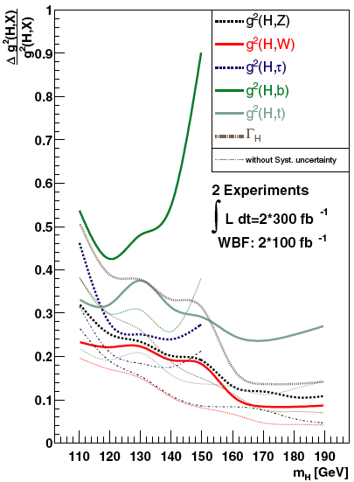
Higgs couplings
Fit Higgs couplings using all available final states and injecting some theory assumption, i.e. Γ_{V} ≤ Γ_{V}SM (V=W,Z)
Δg²_{VV}/g²_{VV} can be determined with an uncertainty of ~ 20% (2x300/fb)
Δg²_{bb}/g²_{bb} can be determined with an uncertainty of ~ 40% (2x300/fb)
Find the optimal point in the luminosity-pileup plane to perform the best measurements in particular for H→bb and H→ττ?
M. Duhrssen PHYSICAL REVIEW D 70, 113009 (2004)

Slide 9
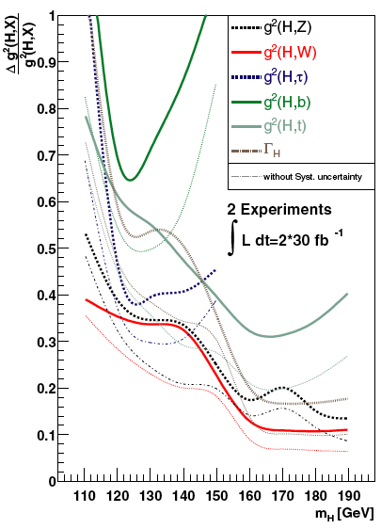
Higgs couplings with up to 2012 data
Fit Higgs couplings using all available possible final states and injecting some theory assumption, i.e. Γ_{V} ≤ Γ_{V}SM (V=W,Z)
Δg²_{VV}/g²_{VV} can be determined with an uncertainty of ~ 35% (2x30/fb)
Δg²_{bb}/g²_{bb} can be determined with an uncertainty of ~ 65% (2x30/fb)

Slide 10
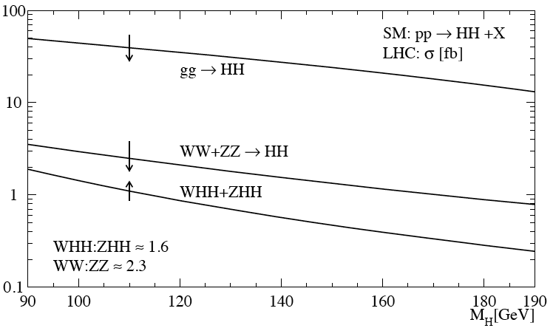
Higgs self-couplings
A complete verification of the Standard Model prediction requires the measurements of the Higgs self-couplings.
Trilinear and quartic interactions
Direct trilinear interaction: H*→HH
SM: g = 3m²_{H}/v
Processes of interest: gg → HH, VBF qq→qqHH, associated production (ttH,VH)
Most interesting final state so far studied: HH→WWWW→lνjj lνjj
http://arxiv.org/abs/hep-ph/9904287v1
ggF cross section: ~30/fb
Quartic interactions: very likely not feasable at the LHC/HL-LHC, but it is worth to review this process as well
SM: g = 3m²_{H}/v²
Recent internal studies done in ATLAS by A. Dahlhoff and M. Duhrssen (based on fast simulation).

