Slide 1
H->bb Weekly Meeting
Ricardo Gonçalo (RHUL)
HSG5 H->bb Weekly Meeting, 26 April 2011

Slide 2
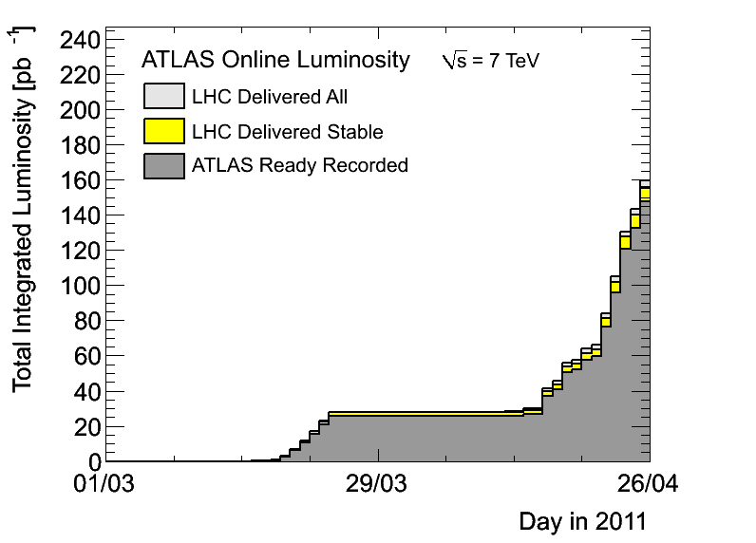
News! News! News!
About 147 pb⁻¹ collected with stable beams so far
50ns bunch spacing
480 colliding bunches
Typical peak pileup values around 10-14 collisions per bunch crossing

Slide 3
News! News! News!
Meeting in the last few weeks (anything we should know?):
LHC Physics Center (LPCC): Status of Higgs and BSM searches at the LHC on April 11-12: https://indico.cern.ch/conferenceDisplay.py?confId=127277
Workshop on combined performance for 2011, on 14 April: https://indico.cern.ch/conferenceDisplay.py?confId=132123
New meeting on procedures for statistical interpretation of ATLAS results on April 15: https://indico.cern.ch/conferenceDisplay.py?confId=132499
Coming up: 4th workshop on Higgs Cross Sections for the LHC at BNL on May 4-6: http://www.bnl.gov/hcs/

Slide 4
News! News! News!
Theory & generators:
Wbb production in POWHEG now implemented: https://indico.cern.ch/conferenceDisplay.py?confId=136045
Download code from: http://powhegbox.mib.infn.it
HDECAY 3.60 released: http://people.web.psi.ch/spira/hdecay/
Releases & data:
2011 reprocessing plans listed here: https://twiki.cern.ch/twiki/bin/view/Atlas/ReleaseReprocessing2011Planning
Analysis for Summer conferences to be done with rel.16
Data taken up to ≈1 August will later be reprocessed with rel.17
List of deliverables for rel. 17: https://twiki.cern.ch/twiki/bin/view/Atlas/DeliverablesForRelease17
Not clear about Pixel re-clusterization, but should be in rel.17
MC11 – decisions on geometry, B-field map etc for MC generation: https://twiki.cern.ch/twiki/bin/view/Atlas/MC11
Evgen with 16.6.X.Y and reco with 17 as part of reprocessing campaign after summer conferences

Slide 5
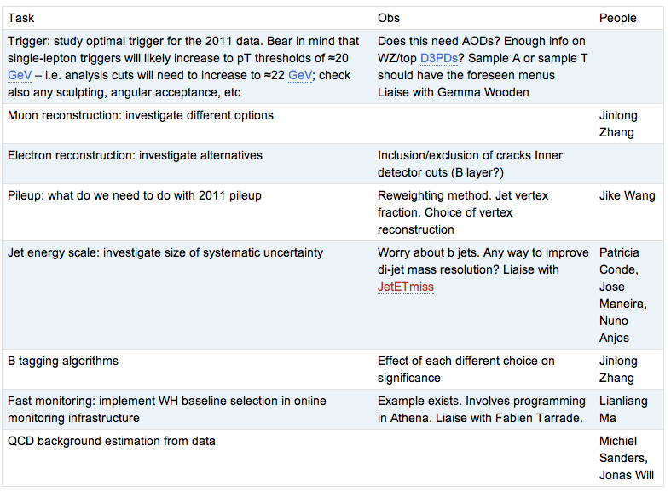
WH Task List
https://twiki.cern.ch/twiki/bin/view/AtlasProtected/WHNoteSummer2011#Analysis_Tasks

Slide 6
Milestones & other issues
Fast monitoring plots – Wisconsin following up: progress?
Dubna:
Already in 3 weeks!
Final rehearsal from our side on May 10
https://indico.cern.ch:443:443/conferenceDisplay.py?confId=124954
Reminder of Summer conferences:
Data estimates from February seem to be on track!
PLHC 2011: 6 June (http://www.pg.infn.it/plhc2011/) L ≈ 0.6 fb⁻¹
EPS-HEP 2011: 21 July (http://eps-hep2011.eu/) L ≈ 1 fb⁻¹

Slide 7
Backup

Slide 9
Date | Milestones wish list
17 May | Dubna workshop – analysis frozen After this: add data to un-boosted analysis and prepare for result approval Concentrate more effort on boosted VH with a view to obtaining results quickly
10 May | Review results with 2011 data from cut-based and multivariate analyses
3 May | Margin for dealing with unforeseen problems
26 April | Start looking at 2011 data if enough is available. Any surprises? How does the MC describe the new data? By now we should have a reasonable idea of results from the multivariate analysis
19 April | End of 2 weeks of beam scrubbing. (I’m away for Easter)
12 April | By now we should have a reasonable idea of the exclusion of the cut-based analysis First report on MVA preliminary results – establish plan for getting results by Dubna
5 April | Identify the worst systematics and discuss any possible improvements: Any changes needed in analysis cuts? Any study necessary for corrections to some systematic effect? Multivariate analysis: iterate on preselection cuts, methods, questions Assign tasks – divide the work to achieve better results!
29 March | Establish analysis cuts: If possible as result of optimization Use 2010 data to develop cuts and show that data is well described by background MC Start evaluating systematics
22 March | Iterate on analysis cuts – why is each cut applied at each particular value? Start iteration on multivariate methods to improve analysis

Slide 10
Reconstruction issues
Muon CP group recommendations for release 16:
Reconstruction efficiency and isolation efficiency scale factors, momentum smearing functions
https://twiki.cern.ch/twiki/bin/view/AtlasProtected/MCPAnalysisGuidelinesRel16
Jet/Etmiss recommendations for jet cleaning in release 16:
Medium jet cleaning should give similar rejection to rel 15 cleaning but with better efficiency
Tight jet cleaning should not be used – still under discussion
https://twiki.cern.ch/twiki/bin/view/AtlasProtected/HowToCleanJets#Bad_jets_rel16_data
New!: Final b-tagging calibrations for release 16 based on full 2010 data:
https://twiki.cern.ch/twiki/bin/view/AtlasProtected/Analysis16
e/gamma recommendations for energy scale and resolution in release 16:
https://twiki.cern.ch/twiki/bin/view/AtlasProtected/EnergyScaleResolutionRecommendations
And rescaler tool: https://twiki.cern.ch/twiki/bin/view/AtlasProtected/EnergyRescaler
Standard Model W/Z group baseline selection for release 16 (next 4 slides):
See discussion in W/Z group Sharepoint
Also, finer points (and perhaps the not so fine) still being discussed

