Slide 1
Introduction
Ricardo Goncalo
HSG5 H->bb weekly meeting, 25 October 2011

Slide 2
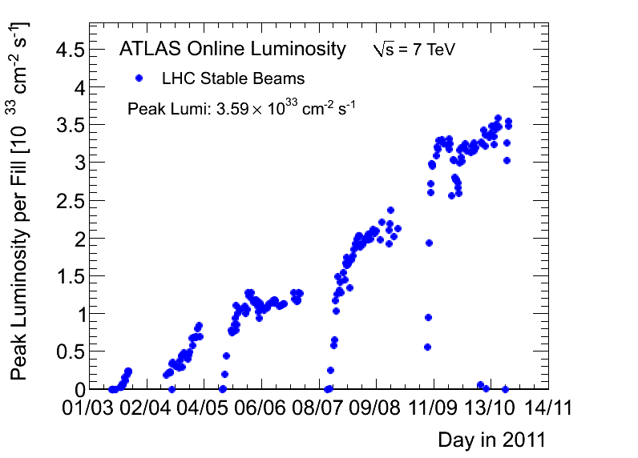
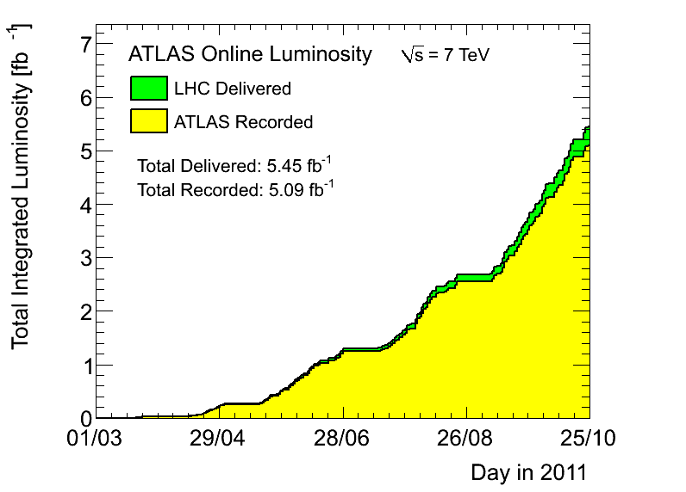
News! News! News!
Peak stable lumi stable 3.59x10³³cm⁻²s⁻¹
5.09 fb⁻¹ with stable beams collected so far – 21 pb⁻¹ collected last week
5.45 fb⁻¹ delivered
p-p run almost finished: until Saturday evening…
Bottom line is ≈ 5 fb⁻¹ of analysis-quality data for 2011!!

Slide 3
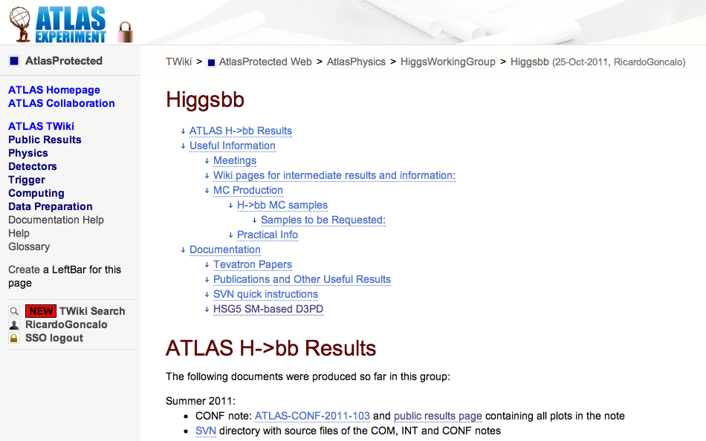
News! News! News!
We have a brand new HSG5 group for H->bb!
New twiki (in progress):
https://twiki.cern.ch/twiki/bin/view/AtlasProtected/Higgsbb

Slide 4
2012 Trigger Menu
Stefano Rosati

Slide 5
Plan for Christmas Results
We were asked to provide list of high-priority samples
≈23M events including new signal and existing/new background
MC11b production lost 1 week due to trigger menu problems
This means production will start only ≈ end of next week
Sample priorities:
H->γγ, H->WW will be priority 0
Our high priority samples will be priority 1 – should start to be produced around 14th Nov
Should converge this week on full list of samples for MC11b
Possible dates:
Higgs approval: week of 21 Nov
ATLAS approval: week of 5 Dec
CERN Council December:
Monday (p.m.) 12
Scientific Policy Committee
Tuesday (a.m.) 13
Scientific Policy Committee
Wednesday 14
Finance Committee
Thursday 15
Restricted Council Session
Friday 16
Open Session of Council

Slide 6
Backup

Slide 7
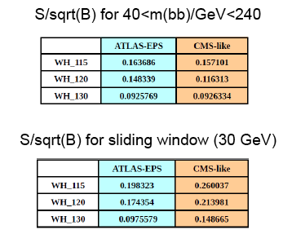
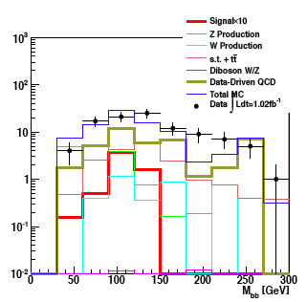
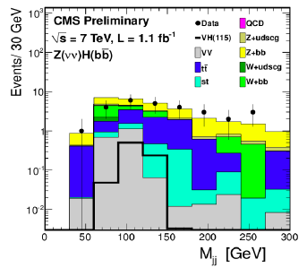
ATLAS-CMS comparisons
Jonas and Jike have emulated CMS’s cuts in WH->lνbb and ZH->ννbb
Differences not yet clear – need to continue to pursue this
Similar significances in WH ->lνbb when applying mass window cut
But very different event numbers – by factor 10-100 depending on channel
CMS seems to get a lower QCD background than us in ZH->ννbb
WH->lνbb

Slide 8
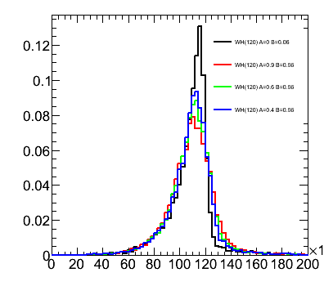
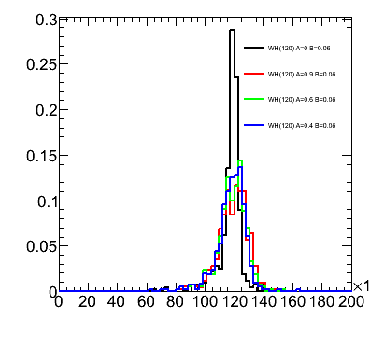
Performance studies
Main systematics are jet and b-tagging related
Current tasks listed in Wiki
More questions than answers at the moment, but pursuing several threads:
Jet resolution:
We seem to be affected by out-of-cone losses
Will try different jets
B-tagging:
Find how much improvement needed to reduce syst
Improve MC statistics term of b-tagging uncertainty with AFII – requesting some AFII validation samples
Differences between hadronic and semileptonic b-jets

Slide 9
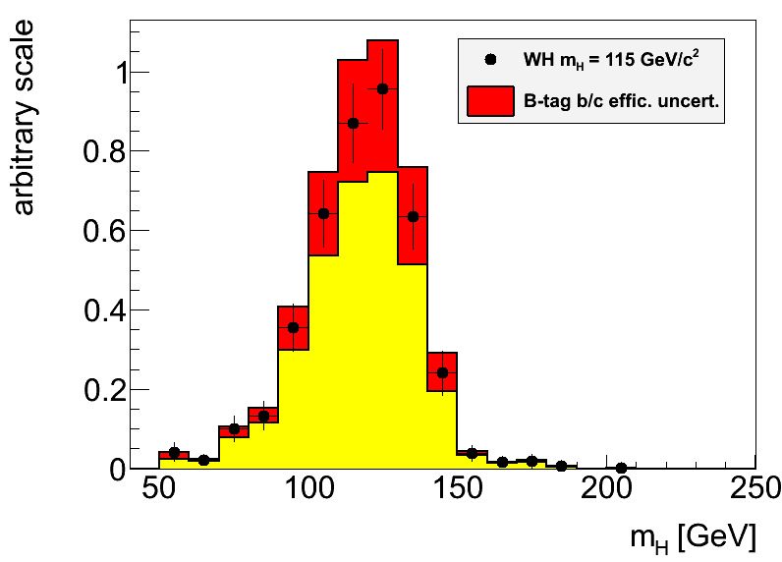
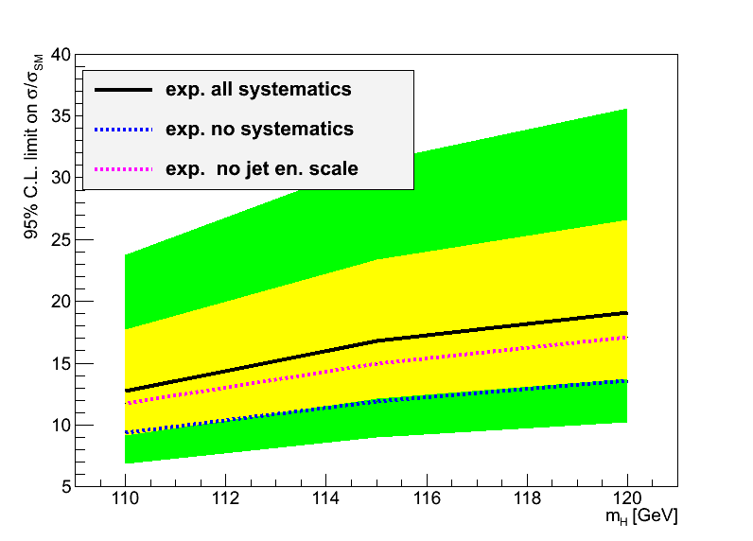
Hgbb – Reconstruction Performance
Main limitations from jet reconstruction and b-tagging uncertainties
Try to improve b-tagging efficiency/fake rate uncertainty:
Dominant uncertainty on signal yield in EPS analyses
Try to optimize di-jet mass resolution:
A sharper peak improves analysis sensitivity (10% width reduction ≈4% limit improvement)
Try to reduce jet energy scale uncertainty:
Large effect in limit through changes in m_{bb} shape

Slide 10
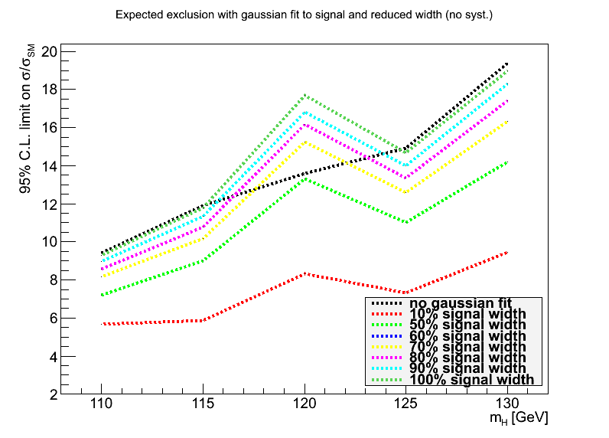
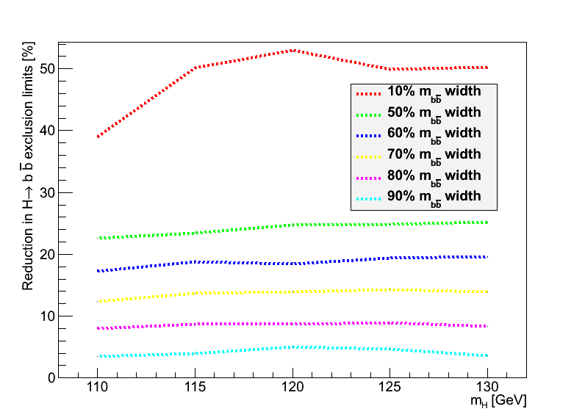
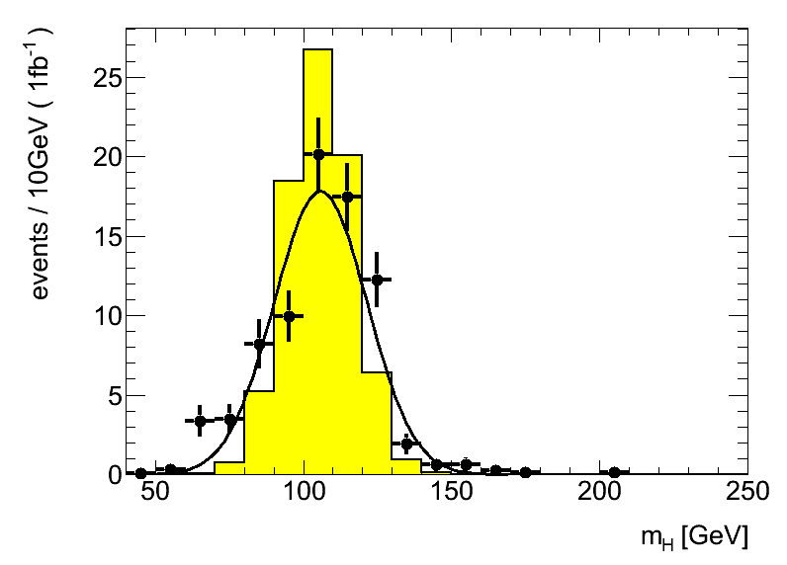
Backup
Replaced signal with fitted Gaussian to manipulate signal width
Estimated improvement in limits (1fb⁻¹) with reduced signal width
Reduction to 80% gives 8% improved limits (magenta line, bottom left)

Slide 11
1. Di-jet mass resolution:
Truth-level study, using partons (a similar study using truth jets would also be interesting). To be done for either WH or ZH channels, signal only would be enough.The idea is: 1. apply kinematic cuts to leptons and quarks similar to the analysis cuts - to look at a similar region of phase space 2. calculate the invariant mass of the two b quarks coming from the Higgs boson decay 3. determine the bb mass resolution 4. smear the parton transverse energies by some amount and go back to 2. The aim is to find by the (b-jet) energy scale uncertainty corresponding to a given value of the bb mass uncertainty. To define some numbers: the m(bb) uncertainty is around 20GeV. It would be interesting to know how much the jet energy resolution would need to decrease to make this 5%, 10%, 20% and 30% better.It would also be interesting to smear the quark directions. This should be a second-order effect for the un-boosted case but should be relevant for the boosted case.

Slide 12
2. B-tagging efficiency uncertainty:
Analysis-level study. Find how much the b-tagging efficiency uncertainty should be, to make the systematic uncertainty comparable to other systematic uncertainties.In the EPS analysis, the systematic uncertainty in the number of selected events, arising from the b-tagging (b/c efficiency & light fake rate), was 17% for WH and 16 for ZH. This was the dominant systematic uncertainty in both cases and the sub-leading systematic was 3% and 9%, respectively for WH and ZH.The idea is to run the analysis a few times with different values of the b/c efficiency uncertainty and the light fake rates (say, 80%, 60%, 40% of the official values to make it simple) and find what the corresponding systematic uncertainty would be on the signal yield.

Slide 13
3. Validate Atlfast II description of pTrel for b-tagging improvements
The b-tagging uncertainty is the one of the dominant uncertainties affecting the H->bb analyses. The estimated uncertainty itself is affected by several systematic uncertainties, and crucially by the MC statistics in the mu+jet samples used to determine the b-tagging scale factors. A solution for this would be to use fast simulation (Atlfast II) to get enough statistics. But this simulation needs to be verified against full simulation.So, this task aims to: compare the description of important quantities in AFII files against the same variable in full simulation files. The most important variable is "pTrel" for muons found inside a jet cone. This is the relative transverse momentum of muons with respect to the jet they belong to. of the The files to use are Jx samples filtered with a muon filter ("Jx*mufixed", with a filter selecting muons with pT>3GeV). Equivalent files need to be requested with AFII (to be done soon by Ricardo).

Slide 14
4. Differences between hadronic and semileptonic B decays
This is another of the important uncertainties affecting the b-tagging efficiency determination (as the study above). A term of the b-tagging efficiency uncertainty accounts for differences between jets arising from hadronic and semileptonic B decays. But this area remains under studied. It would be important to identify variables which show marked differences between these two types of jets, and could lead to differences in b-tagging efficiency. And to quantify the differences. Examples of possible variables to examine are the number of tracks, leading track pT fraction, Sum(pTtrack)/ET, etc.This task is not very well defined. Please get in touch with Ricardo

Slide 15
MC requests
Inclusive and boosted H->bb samples for MC11b:
Herwig++ in Powheg
Mass points: M_{H} = 110, 115, 120, 125, 130, 135, 140, 145, 150 GeV
WH->lνbb, ZH->llbb, ZH->ννbb
Both boosted and inclusive for each mass
Approved for production – still in waiting list for MC11b production (delays in MC11a)
Other samples:
Wbb, Zbb
ZH, WZ, WW -> lljj and llbb final states
Gluon-fusion H->bb
See Junichi’s page: https://twiki.cern.ch/twiki/bin/view/AtlasProtected/HSG5Higgs2bbFinalState#H_bb_MC_samples

