Slide 1
Introduction
Ricardo Gonçalo (RHUL)
HSG5 Workshop at JINR, Dubna, 10 May 2011

Slide 2
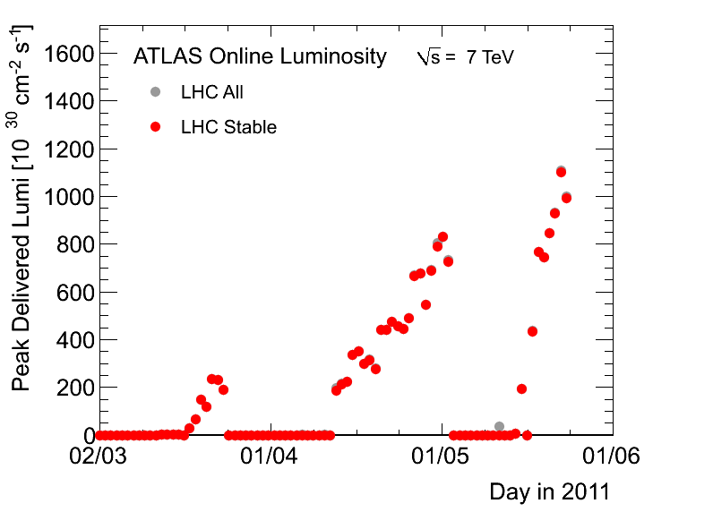
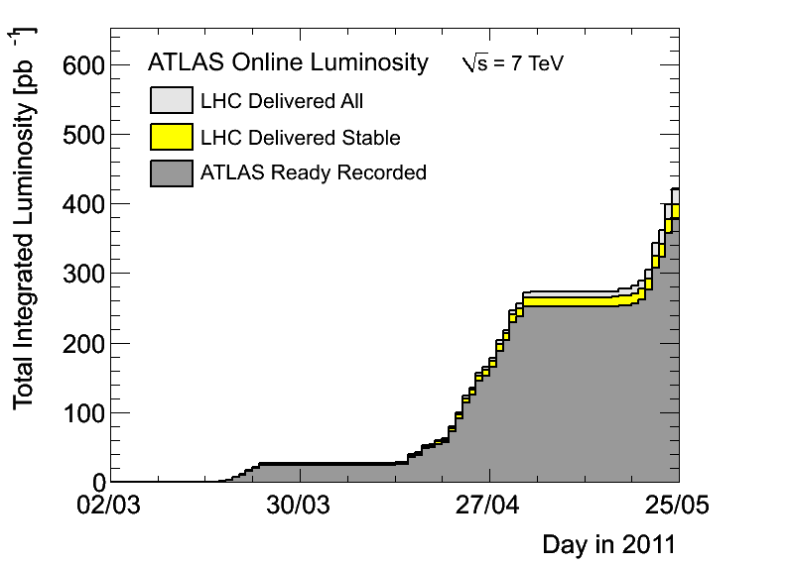
News! News! News!
Currently in technical stop – no changes since last week
About 0.38 fb⁻¹ collected with stable beams so far
Lumi up to ≈1.1x10³³cm⁻²s⁻¹
Peak pileup stays ≈ 10 collisions per bunch crossing
Up to 1200 filled bunches

Slide 3
LHC Plans
From M.Aleksa’s talk in TDAQ week: https://indico.cern.ch/getFile.py/access?contribId=51&sessionId=1&resId=1&materialId=slides&confId=112739
Intensity ramp up:
Up to 1380 bunches in 3-4 weeks
Expect peak luminosity of up to 1.6x10³³cm⁻²s⁻¹, µ around 6 (in average)
After that maybe slowly optimizing bunch charge and emittance
Could lead us up to 5x10³³cm⁻²s⁻¹ in a O(months) if all goes well

Slide 4
MC requests for H->bb
Current list in Junichi’s page here: https://twiki.cern.ch/twiki/bin/view/AtlasProtected/HiggsWGHSG5Dataset7TeV
Currently:
e/mu/tau decays in WH and ZH for Higgs masses 115, 120, 125, 130
ttH single-leptonic (e/mu) with same mH values
WH (e/mu/tau) with e/mu filter with mH at the same values for high stats training samples
WH and ZH with inclusive W/Z decays with mH=120
ZH->vvbb with mH=120GeV
Boosted VH samples: WH, W->inclusive, H->bb, Pt(H)>150GeV, Pt(W)>100GeV with 1e/mu filter, mH=120
Requesting the following:
Un-boosted channels:
Low Higgs-mass WH, ZH and ttH for interpolating limits: mH=110 GeV and 140GeV
ttH at the same mass points with t->bW->tau... Inclusive ttH sample at 120GeV
Basically same generators, numbers of events, etc as we already use
Boosted Higgs:
WH, W->e/mu/tau+nu, H->bb, pt(H)>100GeV, Pt(W)>100GeV with 1e/mu filter, mH=110/120/130
ZH, Z->2e/2mu/2tau, H->bb, pt(H)>100GeV, Pt(W)>100GeV, mH=110/120/130
ZH, Z->2nu, H->bb, pt(H)>100GeV, Pt(W)>100GeV, mH=110/120/130

Slide 5
Higgs SM Combination
No finished ATLAS plans for an internal Higgs channel combination for Summer yet
CMS combination deadline is 29th June.
Assume same deadline for an ATLAS combination for EPS
Means analysis approval only up to Higgs WG
Do we want to/should we try to take part?

Slide 6
Backup

Slide 7
Poster abstract for EPS-HEP
H->bb searches with the ATLAS detector at the LHC
The H -> bb channel is extremely important for the observation of a Higgs boson signal at the LHC. In the Standard Model, this channel would provide a significant contribution to the Higgs boson search in the low mass region, where this decay mode constitutes the dominant Higgs decay channel. Due to the enormous jet production cross-section at the LHC, the search must target channels where the Higgs boson is produced in association with a weak boson, a pair of top quarks, or jets separated by a rapidity gap. It also requires complex techniques to reconstruct the signal and separate it from an overwhelmingly large background. We present the status of Higgs searches in the H->bb channel currently being performed within ATLAS.
In case it’s accepted we’ll need a candidate to present it at EPS
Please let me know by email before Friday if you would like to do this
Will randomly choose a presenter from candidates

Slide 8
Conferences:
for EPS-HEP, focus on papers instead of notes
Higgs approvals for EPS-HEP: 20th – 25th July
https://indico.cern.ch/getFile.py/access?contribId=0&resId=0&materialId=slides&confId=136406

Slide 9
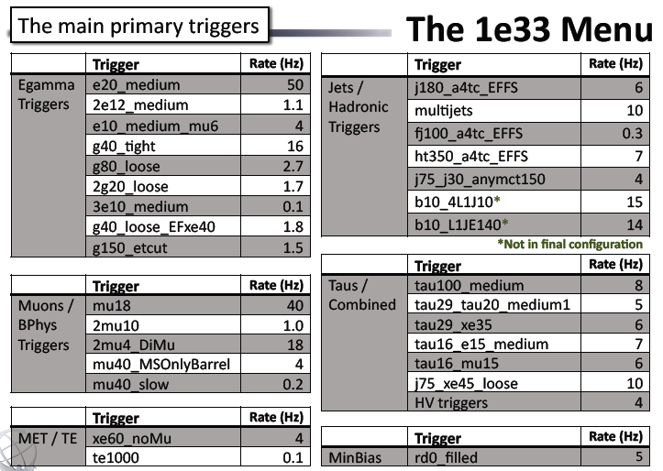

Slide 10
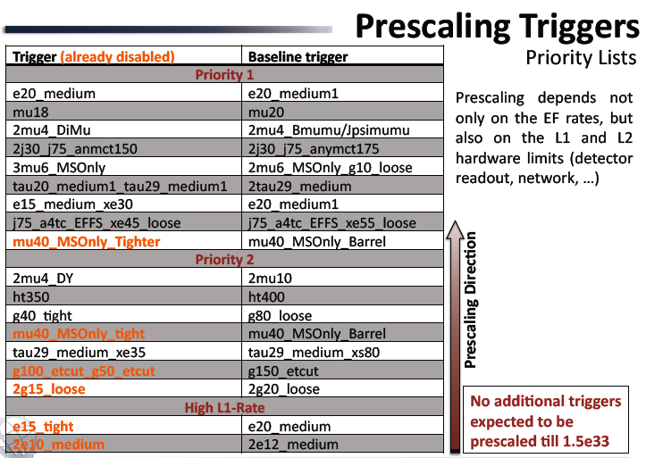

Slide 11
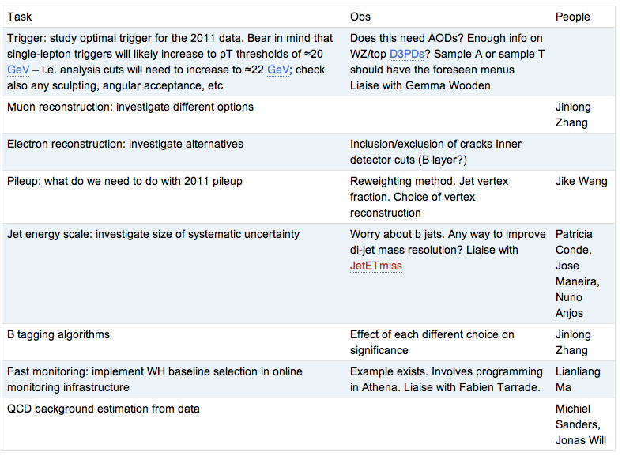
WH Task List
https://twiki.cern.ch/twiki/bin/view/AtlasProtected/WHNoteSummer2011#Analysis_Tasks

Slide 12
Reconstruction issues
Muon CP group recommendations for release 16:
Reconstruction efficiency and isolation efficiency scale factors, momentum smearing functions
https://twiki.cern.ch/twiki/bin/view/AtlasProtected/MCPAnalysisGuidelinesRel16
Jet/Etmiss recommendations for jet cleaning in release 16:
Medium jet cleaning should give similar rejection to rel 15 cleaning but with better efficiency
Tight jet cleaning should not be used – still under discussion
https://twiki.cern.ch/twiki/bin/view/AtlasProtected/HowToCleanJets#Bad_jets_rel16_data
New!: Final b-tagging calibrations for release 16 based on full 2010 data:
https://twiki.cern.ch/twiki/bin/view/AtlasProtected/Analysis16
e/gamma recommendations for energy scale and resolution in release 16:
https://twiki.cern.ch/twiki/bin/view/AtlasProtected/EnergyScaleResolutionRecommendations
And rescaler tool: https://twiki.cern.ch/twiki/bin/view/AtlasProtected/EnergyRescaler
Standard Model W/Z group baseline selection for release 16 (next 4 slides):
See discussion in W/Z group Sharepoint
Also, finer points (and perhaps the not so fine) still being discussed

