Slide 1
H->bb Weekly Meeting
Ricardo Gonçalo (RHUL)
HSG5 H->bb weekly meeting, 23 August 2011

Slide 2
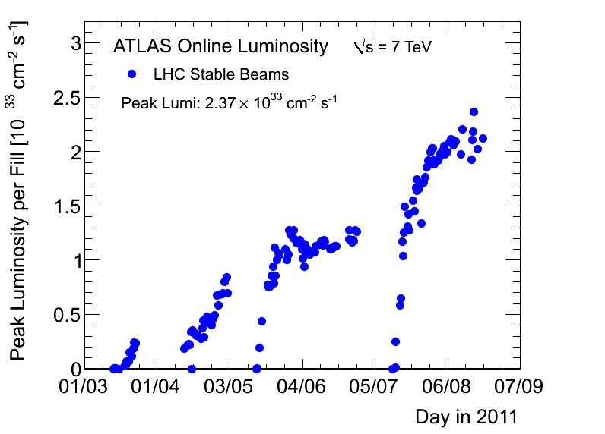
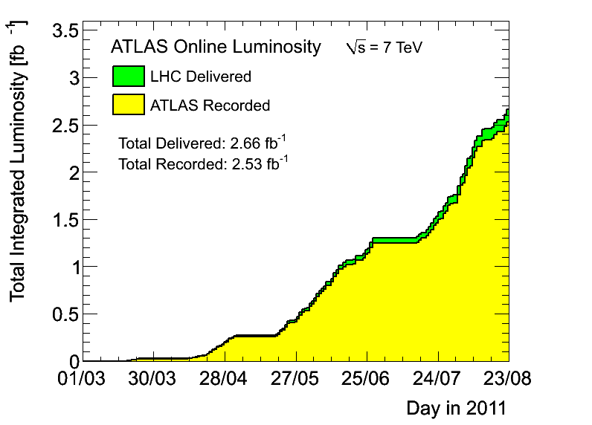
News! News! News!
Peak stable lumi 2.37x10³³cm⁻²s⁻¹
2.5fb⁻¹ with stable beams collected so far
Peak pileup around 12 – 13
1380 bunches in the machine – maximum for 50ns

Slide 3
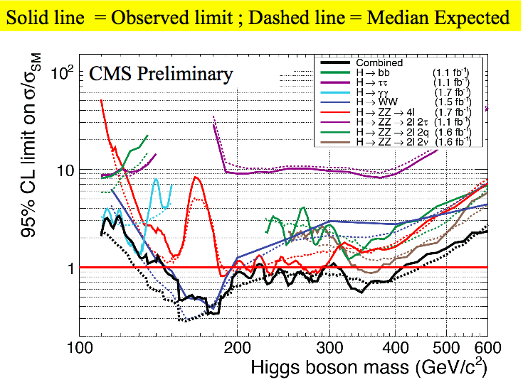
CMS H->bb results
CMS new results for Lepton-Photon available yesterday
Include H->bb exclusion limits: 6xSM @ m_{H}=115GeV up to ≈15xSM @ 135GeV (expected)
Could not find public note on it (checked again this morning)
Differences to our current results:
Include ZH->ννbb
Multivariate analyses
B-tagging optimized for high-p_{T}
(possibly) double b-tagging inside jets
Cut on vector boson p_{T} (but no substructure analysis)

Slide 4
NEW: CMS H->bb at Lepton Photon
Vivek Sharma – LP2011

Slide 5
Monte Carlo samples
To be able to produce new results quickly must try to plan for rel.16 analysis with data up to rel.17 switchover
MC10b samples needed for this:
Signal: complement existing mass points for inclusive analysis, add boosted mass points and ZH->ννbb
Background: Z+jets, W+jets
Need to converge on generators and final sample composition
EVO meeting to arrive at a complete list – propose tomorrow morning

Slide 6
Data skims for H->bb – DPD train
We need to have data skims to avoid pain of running over too much data – both for inclusive and boosted analyses (ZH inclusive already using HSG2 skims)
Plan to join the DPD train:
The code to produce DAODs or D3PDs should be in AtlasPhysics cache and fully tested
The production needs to be done with a single Reco_trf.py instruction (fully tested standalone)
Write the data to Higgs group space
DPD production done in Tier1 from AODs
Skims should be small enough for this to make sense
Latest news: D3PD for boosted analysis being tested at Edinburgh and UCL
Requested new package goes to production release
Intended name is NTUP_HSG5BOOST
More details on this next week

Slide 7
H->bb trigger studies for upgrade LoI
Upgrade Letter of Intent being prepared for October
WH->lνbb is one of the Higgs benchmarks
Concentrate on SM for now and study Higgs properties with 300fb⁻¹ if light Higgs is found
Meeting last Tuesday concentrated on this: https://indico.cern.ch/conferenceDisplay.py?confId=151142
MC samples exist:https://twiki.cern.ch/twiki/bin/viewauth/Atlas/UpgradeSimulation2011LoI
Need one or two volunteers to do WH trigger studies for phase 1 upgrade with help from Stefania and me
Main requirement is availability during next 2 months
Will give OTP and may contribute to student qualification
If interested please contact me and Stefania (xella@nbi.dk) and cc Eilam and Bill

Slide 8
Upcoming workshops
Physics Analysis Tools workshop:
From 26 to 30 September at CERN
https://indico.cern.ch/conferenceDisplay.py?ovw=True&confId=149202
Fast simulation workshop
Fast simulation will be more and more needed with increased statistics
Already successfully used for SUSY results for EPS
Workshop dedicated to fast simulations and the new integrated simulation framework on 7th September 2011:
https://indico.cern.ch/conferenceDisplay.py?confId=150893

Slide 9
Backup Slides

Slide 10
Trigger! Be worried! Be very worried!
Disabled or prescaled from run 186873:
2b10_medium_4L1J10
2b10_medium_L1_2J10J50
2b10_medium_3L1J20
2e12_medium
2mu4_DiMu
3b15_loose_4L1J15
3j75_a4tc_EFFS
L1FJ75_NoAlg
e15_medium_e12_medium
e20_loose
e20_loose1
e20_looseTrk
e20_medium
e20_medium1
e20_medium2
e20_medium_SiTrk
e20_medium_TRT
e7_tight_e14_etcut_Jpsi
g40_loose_EFxe40_noMu
ht350_a4tc_EFFS_L2je255
j100_a4tc_EFFS_ht350
j75_2j30_a4tc_EFSF_ht350
j75_j30_a4tc_EFFS_anymct150
j75_j30_a4tc_EFFS_anymct175
mu15i_medium
tau100_medium
tau125_medium
tau16_loose tau16_loose_e15_medium
tau16_loose_mu15
tau16_medium_mu10 tau29_loose
Higher-threshold triggers in use since period K
3x10³³ prescale set used since 4th August, run 186873
Several combined MET chains and and L1_MU10 unprescaled in last part of each fill
Single-electron triggers will use isolation
Problem for fake electron background estimation
Nice page from Will Bell (top group) with list of planned studies: https://twiki.cern.ch/twiki/bin/view/AtlasProtected/FakeLeptonTriggers
A new sample T was just produced for trigger studies
Using AtlasTrigMC 16.6.7.7.1 cache; AMI tag: r2597
Sample names start with "valid”: valid1.*.recon.AOD.e598_s933_s946_r2597_tid…
Useful for looking at recent changes for the 3e33 menu (e.g. e22_medium, e22_medium1, etc)
Similar sample may be produced with 17.0.X.Y if there’s enough popular demand
See: https://twiki.cern.ch/twiki/bin/viewauth/Atlas/TriggerSampleT

Slide 11
Post-mortem of WH/ZH results
M_{bb} resolution is extremely poor
Should try to get a peak, but this needs work on jet (and b-jet) energy scale
Try to think about this together with jet/E_{T}^{miss} people
Could we improve other things in jet reco to improve m_{bb}?
In ZH->llbb could try to use ll vs bb p_{T} balance to do in-situ calibration?
B-tagging systematic uncertainty dominates by far
16% vs 7-9% for JES and ≈1-2% others
Should be possible to improve this, since the error is dominated by the statistics used in b-tagging studies
Would improve limits by up to 25-30%
Think about this with b-tagging people
Limits: must get help from roostats experts to understand the difference between expected and observed
WH cuts on exactly 2 jets
A lot of signal is lost there – can it be improved?
WH backgrounds:
Top and W+jets background estimate using simultaneous template fit to m_{bb} sidebands (<80GeV and 140-250GeV)
Probably should try to also constrain jet energy scale from this fit
JES changes m_{bb} distribution and could affect normalization of backgrounds
In light of H->WW results, should move upper sideband to e.g. 160-250GeV – at m_{H}=150GeV, σ*BR already 1/10 of value at 115GeV, but H->WW and H->bb resolution is very broad
Can top background be reduced further?
ZH background from Z+bb seems irreducible – can it be improved?

Slide 12
WH/ZH analysis plans
We can still try to improve cut based analysis:
Get a m_{bb} peak, improve b-tagging systematics, constrain JES in WH, etc…
Reduce top background in WH:
Try using looser leptons or extending lepton id to forward region to veto tt->lvlvbb
Loosen jet η cut (at |η|<2.5 now) and maybe p_{T} cut to veto tt->lvjjbb/jjjjjbb
But… must keep pileup and JVF in mind
Reduce Z+bb background in ZH? Would probably need a clever new variable like cos*θ
Then clearly we should include multivariate methods
Used intensively by Tevatron
e.g. use NN to target top background – may allow to relax 2-jet cut in WH
NN may also help in rejecting Z+bb background in ZH?
See if MV method can improve existing b-tagging
Add more channels!
Can something be done with ZH->ννbb? Very good channel in Tevatron, but complex and mature analysis
Academia Sinica group plans to work on this But trigger is the crucial part
Boosted VH is clearly the next thing to push! WH->lνbb and ZH->llbb, but also ZH->ννbb
UCL and Edinburgh working on this – should be enough manpower now, but need to get results soon
ttH has been slowly building up in Glasgow – will push for this to happen together with Chris

Slide 13
Boosted VH Data Format
Had a phone meeting two weeks ago to discuss a common D3PD format for boosted VH analyses
Will use “official” Jet/ETmiss D3PD maker code by Bertrand Capleau to produce SM W/Z D3PDs including jet substructure variables
https://twiki.cern.ch/twiki/bin/view/AtlasProtected/GroomedJetsD3PD
Filtered Cambridge-Aachen jets and their constituent jets etc
Need to run b-tagging on sub-jets
Edinburgh (Robert H.) working on this with help from UCL
Then the idea is to make data skims to ease running on new data

