Slide 1
Introduction
Ricardo Goncalo
HSG5 H->bb weekly meeting, 22 November 2011

Slide 2
News! News! News!
First meeting of the Jet Substructure and Jet-by-Jet Tagging group: https://indico.cern.ch/conferenceDisplay.py?confId=163049
Boosted Higgs analyses please make sure tofollow these meetings closely!
Open EB today (2pm, replacing ATLAS Weekly) will focus on LHC running scenarios for 2012: https://indico.cern.ch/conferenceDisplay.py?confId=106722
5th LHC Higgs cross section workshophttp://events.lal.in2p3.fr/conferences/LHC-Higgs-Workshop/

Slide 3
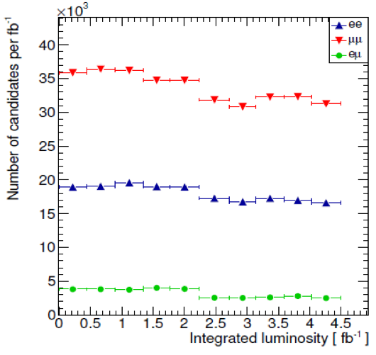
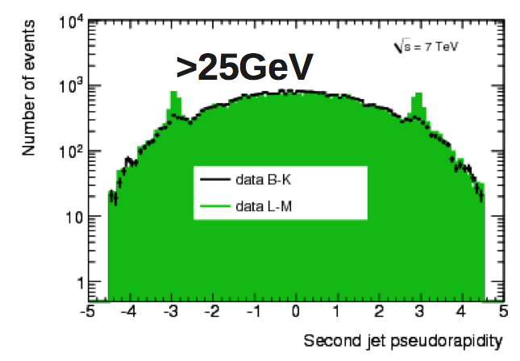
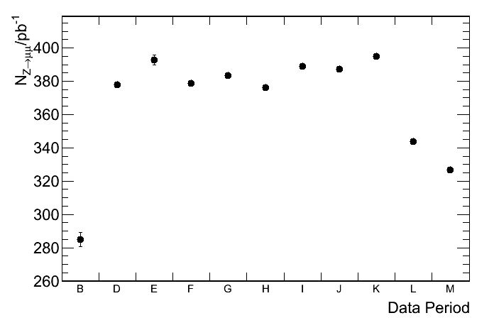
2011 Data Issues
Period dependence of rates
Top right: ll events in H->WW analysis
Bottom right: Z->μμ in H->4l analysis
Staco Comb+Segment-tag; p_{T}>20GeV; rel. trackIsolation(ΔR<0.2)<0.15
Bottom left: “ears” at |η|=3 have been growing?
Effect decreases with increasing jet p_{T}
https://indico.cern.ch/getFile.py/access?contribId=7&resId=0&materialId=1&confId=163361

Slide 4
December Note(?)
First editorial board meeting – introduced issue
Not yet done:
Run on all 2011 data (missed part of period M and some other data files)
Run on MC11b datasets – status?
Move to METRefFinal done in analysis software but unchecked
Apply recommended electron fudge factors (appeared on Friday – see text file attached to agenda)
Treatment of inefficiency due to bad muon trigger region in period L (trigger muon scale factors appeared on Saturday – attached to agenda)
Points of concern/to follow up
Availability of MC11b datasets
Vertex multiplicity/MET/pile-up due to pythia 8 minbias events in mc11 (ongoing)
Data/MC agreement in 0-jet bin of WH analysis (note analysis cut on Njet>2)
b-tagging scale factors - p_{T}-dependence may sculpt signal, especially due to bin edges
Jet systematics – recommendations?
Reminder of timeline:
Higgs approval: aim for 25, but no margin!
Circulation to ATLAS for 1 week for comments (up to 2 Dec. at latest)
Can be reduced to 3 days if we find a nice peak at 115 GeV, confirmed by H->γγ ☺
Public presentation plus 1 week for last comments (9 Dec. at latest)
CERN Council meeting starts 12 December

Slide 5
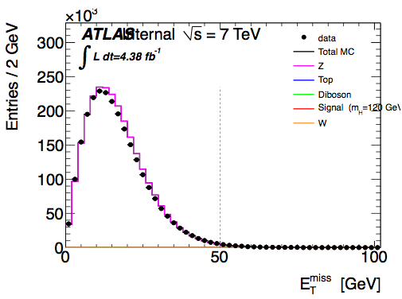
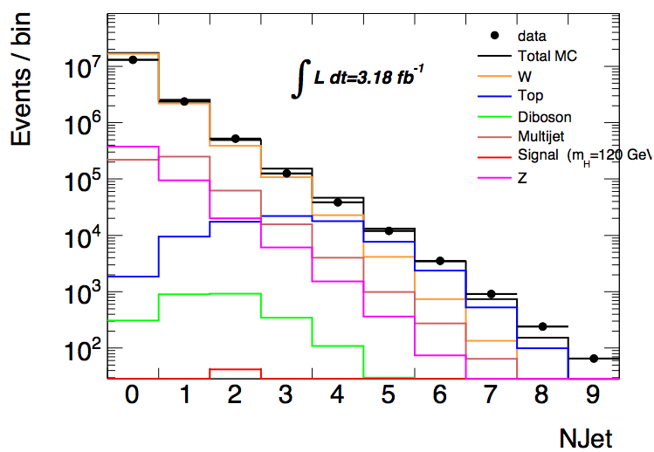
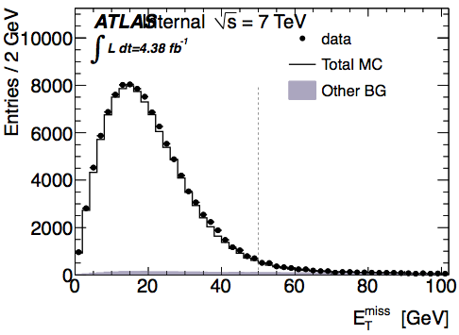
MC11 vs release 17 data
A.Mehta
E_{T}^{miss} in release 17 – MC11a
In ZH analysis (fake E_{T}^{miss}) effect only visible before cut on N_{jets} ≥ 2 – p_{T}^{jet} > 25 GeV
Seems to confirm soft activity as source of mismatch
Means we’re dominated by jet energy deposition and not sensitive to soft activity
Suggests use of cut on MET significance (E_{T}^{miss}/√ΣE_{T}) to avoid problem
Disagreement (≈x2) in WH for Njets = 0
But no vertex reweighting applied yet etc etc
Not there in ZH
Z ➔ ll
No Njets cut
Z ➔ ll
Njets ≥ 2

Slide 6
Backup

