Slide 1
H->bb Weekly Meeting
Ricardo Gonçalo (RHUL)
HSG5 H->bb Weekly Meeting, 22 February 2011

Slide 2
News! News! News!
We have beams again! ATLAS and the LHC showing signs of life during the last week!
See today’s Weekly for MC production plans and news from restart
Muon CP group recommendations for release 16:
Reconstruction efficiency and isolation efficiency scale factors, momentum smearing functions
https://twiki.cern.ch/twiki/bin/view/AtlasProtected/MCPAnalysisGuidelinesRel16
Jet/Etmiss recommendations for jet cleaning in release 16:
Medium jet cleaning should give similar rejection to rel 15 cleaning but with better efficiency
Tight jet cleaning should not be used – still under discussion
https://twiki.cern.ch/twiki/bin/view/AtlasProtected/HowToCleanJets#Bad_jets_rel16_data
Preliminary b-tagging calibrations for release 16 based on full 2010 data:
https://twiki.cern.ch/twiki/bin/view/AtlasProtected/Analysis16
e/gamma recommendations for energy scale and resolution in release 16:
https://twiki.cern.ch/twiki/bin/view/AtlasProtected/EnergyScaleResolutionRecommendations
And rescaler tool: https://twiki.cern.ch/twiki/bin/view/AtlasProtected/EnergyRescaler
Other:
HSG5 Workshop in Dubna – 17th – 19th May 2011:
http://indico.cern.ch/conferenceDisplay.py?confId=124954
Instructions for obtaining Visas in Geneva consulate will be available soon
Will be the last check point for Summer CONF notes before approval process

Slide 3
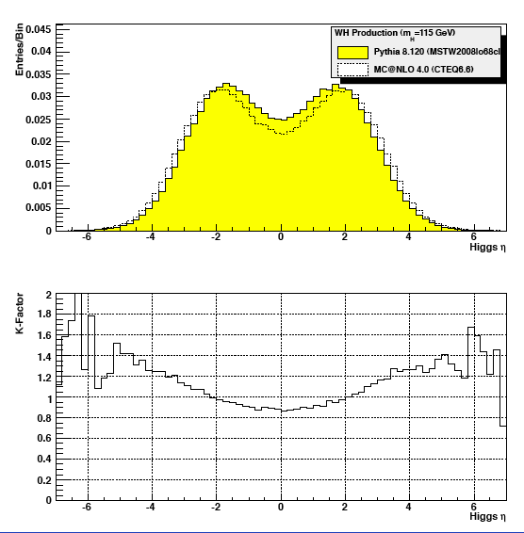
LHC Higgs Cross Section Working Group
H→bb meeting:
Good attendance by theorists
Presentations from CMS & us
First differential K factors for WH and ttH production shown by C. Potter
LHC Higgs Cross Section Group wiki

Slide 4
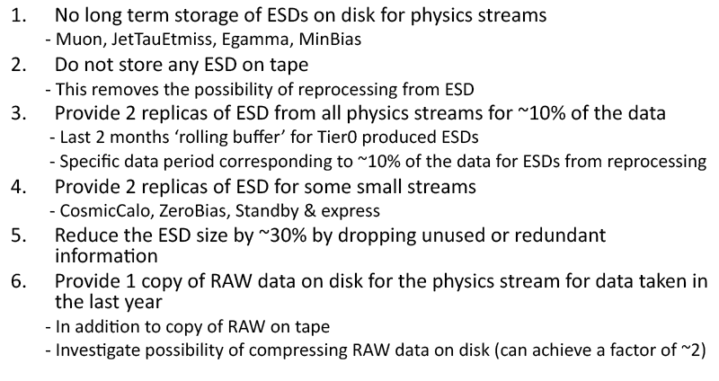
Proposal for Life without the ESD:
See J.Boyd’s talk in the weekly (2 weeks ago): http://indico.cern.ch/conferenceDisplay.py?confId=119624
If you rely on ESDs please make sure to follow this discussion
Subscribe to hn-atlas-primary-dpd-content@cern.ch

Slide 5
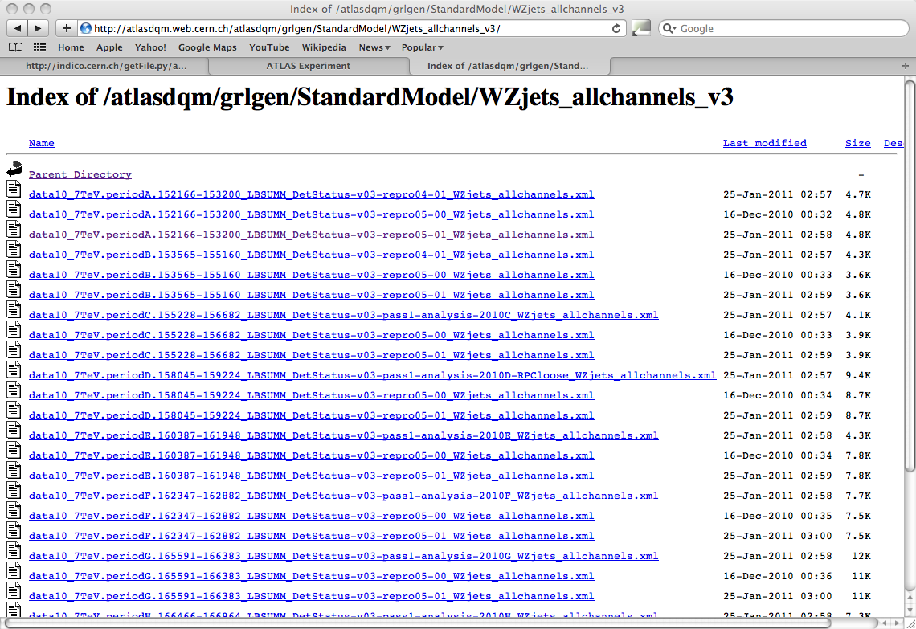
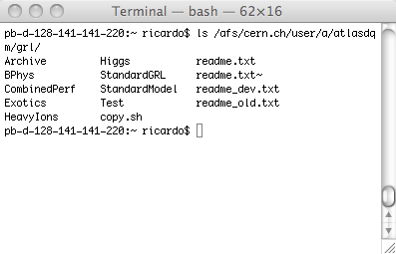
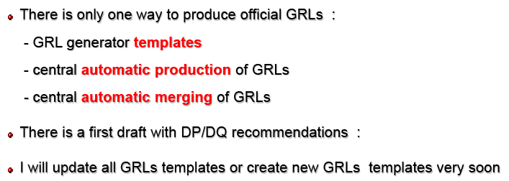
Good Run List
GRLs produced by automatic production can be found at: http://atlasdqm.web.cern.ch/atlasdqm/grlgen/
Templates can be found at: /afs/cern.ch/user/a/atlasdqm/grl/
Will need to investigate if we can use a standard GRL – volunteers?

Slide 6
Fast Monitoring
Idea is to receive early warning when there is something interesting in the data
…better than getting a late warning from the other side of the ring ☺
Not to make plots of control regions – we have the regular monitoring for that
Not to do the analysis in real time – no final corrections, systematic uncertainties etc
Note that not seeing a signal does not mean it is not there, and vice versa!...
Implications are that it should be stable and robust selection focusing on signal region
Several open technical/organizational questions at the moment:
Where to run: Tier0, CAF or CERN Tier1
Other Tier1/2/3 would require too much bandwidth for AOD/D3PD/DAOD transfer
What data format:
D3PD:
Serious complications from D3PD versioning and stability - D3PDs not stable until long after data collection
D3PD size also a problem – would need to be produced from recent AODs as they are produced
Which D3PD – many different varieties and would require different analysis applications starting from different inputs
AOD:
Would need to implement analysis selection in Athena! (IWithin monitoring framework?)
Less versioning complications – could use stable Tier0 cache used for production
Could produce DAOD for selected events – would allow easy subsequent analysis, producing event displays etc
When plans are more clear will need someone to implement/coordinate this for our group

Slide 7
Backup

