Slide 1
H->bb Note Plans for Summer
Ricardo Gonçalo (RHUL)
HSG5 H->bb weekly meeting, 21 June 2011

Slide 2
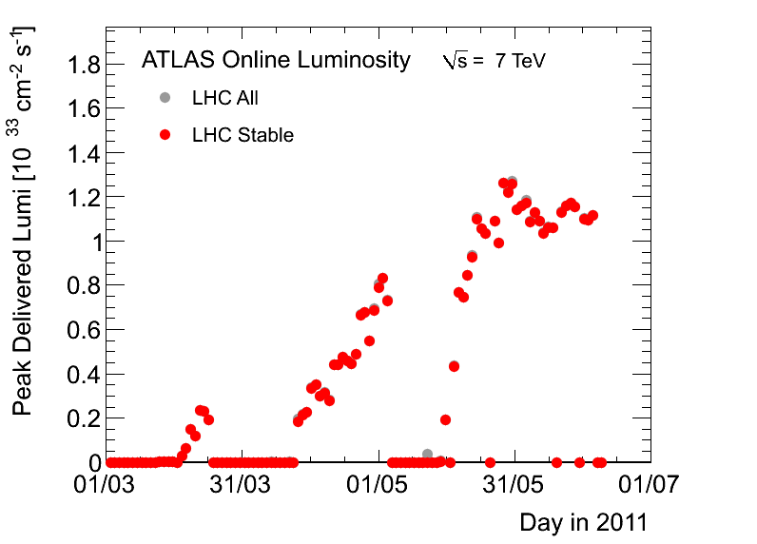
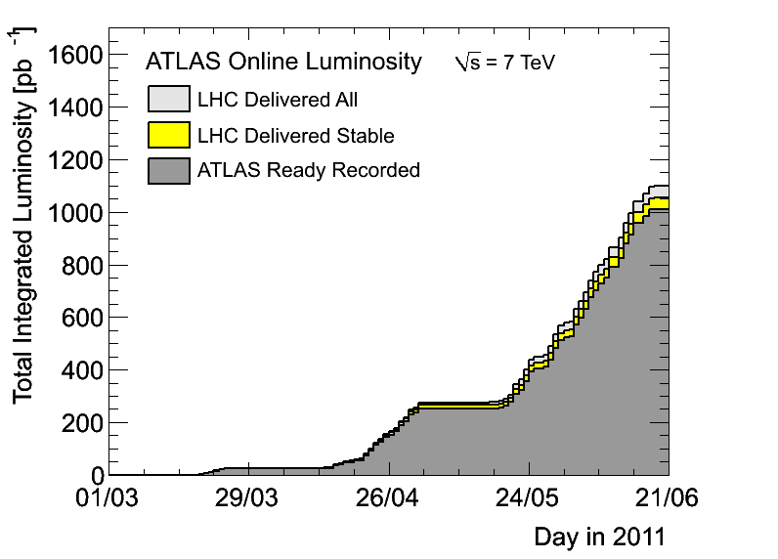
News! News! News!
About 1.01 fb⁻¹ collected with stable beams so far (1.06 fb⁻¹ delivered)
Peak lumi 1.26x10³³cm⁻²s⁻¹
30 – 50pb⁻¹ per day
Fabiola

Slide 3
F.Zimmermann (ATLAS Week): https://indico.cern.ch/getFile.py/access?contribId=66&sessionId=8&resId=1&materialId=slides&confId=141246

Slide 4
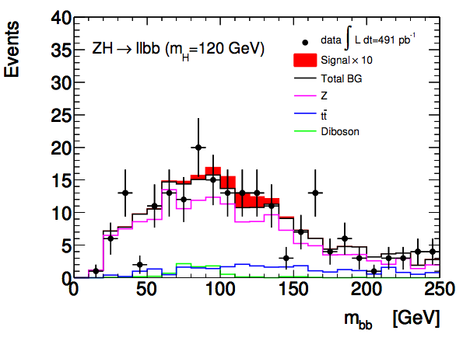
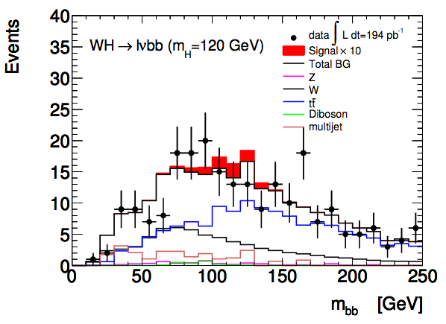
WH/ZH Note
First meeting with the editorial board on Friday last week:https://indico.cern.ch/conferenceDisplay.py?confId=143697
Many thanks to everyone who connected to the meeting!
Initial feedback from Ed.board already in first version of INT note
Note available in CDS (re-used old CDS record): http://cdsweb.cern.ch/record/1307560?ln=en
List of authors to be updated soon
Next Ed.board meeting on Thursday (10:30-12 CET) – next steps described in: https://twiki.cern.ch/twiki/bin/view/AtlasProtected/HSG5ConfNoteSteps2011#CONF_note

Slide 5
WH/ZH Note: Missing Ingredients
Moving to MC10b: done
b tagging:
Need advanced tagger for increased background rejection
Efficiency scale factors almost done
Calibration & fake rate: preliminary on week of 20th June - will re-do analysis with final numbers
IP3D+SV1, 60% efficiency working point
Jet Vertex Fraction:
Fix exists but applicable only to AOD-based analyses – i.e. only one analysis in our group
D3PDs including the bug fix exist for part of the 2011 run – being transferred to Grid site
Validation?
Editorial board:
Richard Bateley (chair)
Alex Read
Emmanuel Lemonier
Niels van Eldik
Good 1st meeting with Ed.Board
QCD background (incl. bb, cc):
Almost there
One feature to be understood in anti-track isolation QCD background in electron channel
Watch this space!
Systematics:
First estimates done – dominated by b-tagging uncertainty (around 30%)
SM Higgs combination:
Need to produce inputs for SM Higgs combination

Slide 6
JVF-fixed D3PDs
SMWZ D3PDs were produced by Wisconsin with the bugfix for the Jet Vertex Fraction bug
Contain data from run 178044 (22 March 2011) to run 183021 (2 June)
Total (data+MC) is 2.7 TB
Listed in https://twiki.cern.ch/twiki/bin/view/Main/PrivateD3PDWithJVFFix
Transferred to UKI-LT2-RHUL_LOCALGROUPDISK
Should be accessible to everyone; please try it and let me know in case of problems (several datasets still being transferred)

Slide 7
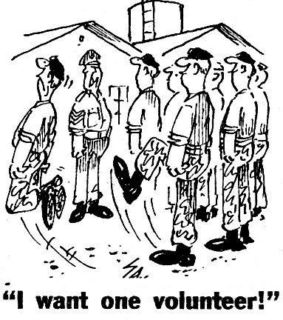
Need someone to give summary talk at Higgs WG tomorrow – volunteers?

Slide 8
Backup

Slide 9
https://indico.cern.ch/getFile.py/access?contribId=66&sessionId=8&resId=1&materialId=slides&confId=141246

Slide 10
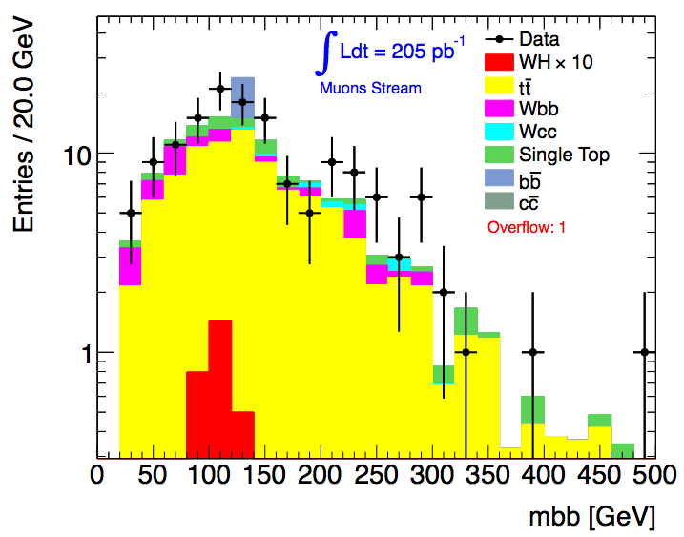
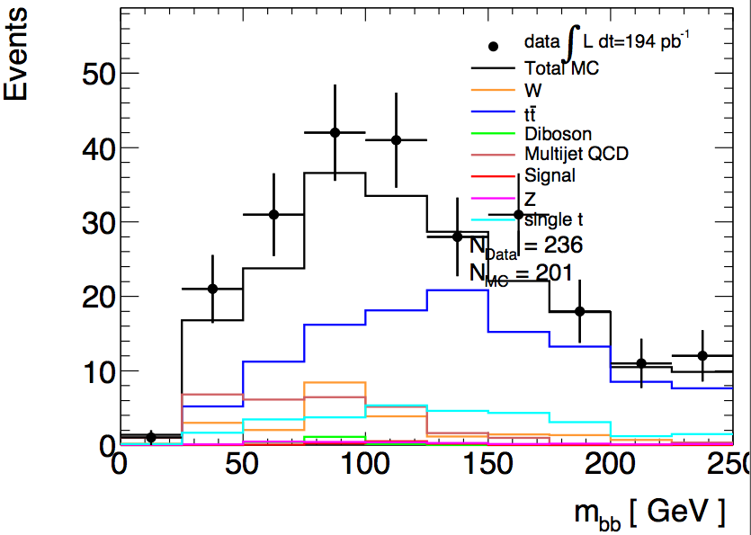
Do we need a JVF cut?
In principle yes!…
Need to use cut N_{jets} = 2 to suppress tt background; use N_{jets} = 3 as tt control region
So must suppress spurious jets from pileup…
Njets < 4
All backgrounds from Monte Carlo
bb and cc MC clearly not enough
Njets = 2
QCD background from data
Before last scale factor (1-b sideband)
Lianliang Ma
Paul Thompson

Slide 11
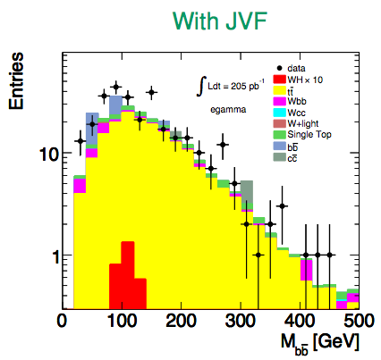
Do we need a JVF cut?
In fact, not using the Jet Vertex Fraction seems to have a significant effect on Njets
But a small effect after all cuts…
 | data | tt MC
No JVF cut | 303 | 200
JVF > 0.75 | 300 | 185
Haifeng Li
Haifeng Li

Slide 12
WH/ZH Note: Outlook
Skeleton draft of INT note should be available now…
Then a couple of weeks to finish details of QCD BG determination and interact with Editorial Board
Expect some changes to cuts etc during this
Dataset frozen on 22 June (I think)
Preliminary b-tagging calibrations around same time
Aim for Higgs approval at end of June
Last iteration with final b-tagging calibrations on…
Circulate note to ATLAS for CONF approval in early July for approval in time for EPS

