Slide 1
H->bb Weekly Meeting
Ricardo Gonçalo (RHUL)
HSG5 H->bb weekly meeting, 20 September 2011

Slide 2
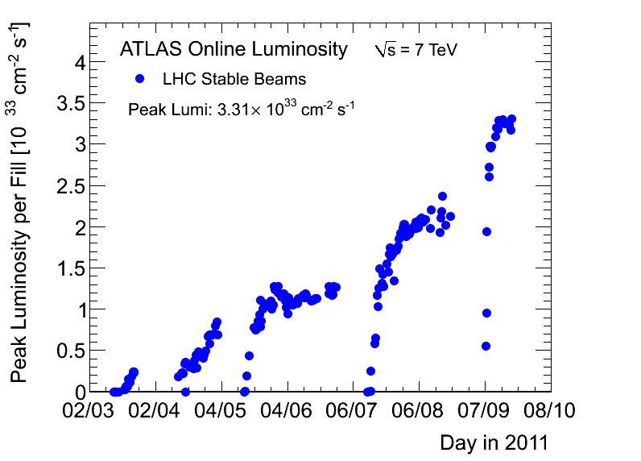
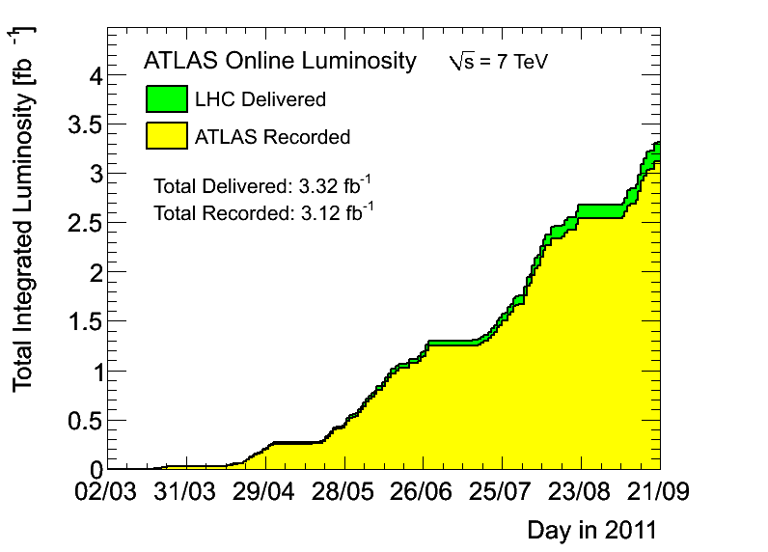
News! News! News!
Peak stable lumi 3.31x10³³cm⁻²s⁻¹
3.12fb⁻¹ with stable beams collected so far
Peak pileup increased from around 12 to 21; new average around 15 events/crossing

Slide 3
Issues…
Hadronic calibration workshop just started
Many issues to be discussed this week – will summarize in next week’s meeting
Local hadronic calibration (rel.17) should benefit our di-jet mass resolution
Agenda at: https://indico.cern.ch/conferenceOtherViews.py?view=standard&confId=132005
Just came back online and only starting to read email, so are there any urgent issues?

