Slide 1
H->bb Weekly Meeting: Introduction
Ricardo Gonçalo (RHUL)
HSG5 H->bb weekly meeting, 19 July 2011

Slide 2
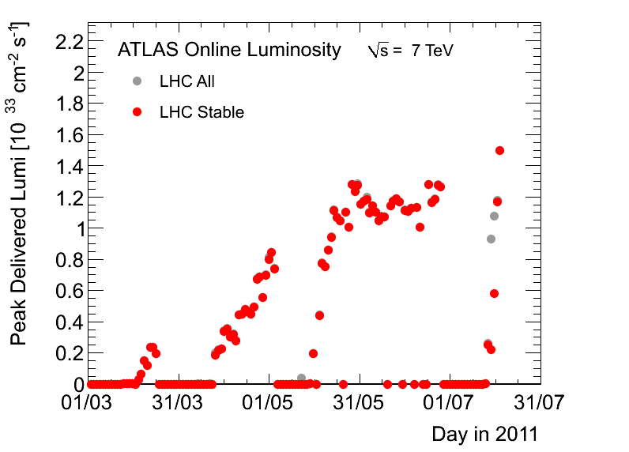
News! News! News!
Re-started operation after the technical stop
Total of 1.3 fb⁻¹ so far
Peak stable lumi of 1.5x10³³cm⁻²s⁻¹
Running with 50ns bunch crossing and 1380 filled bunches

Slide 3
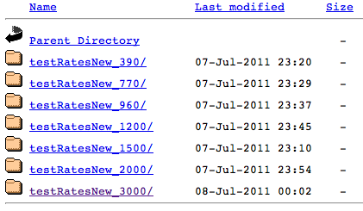
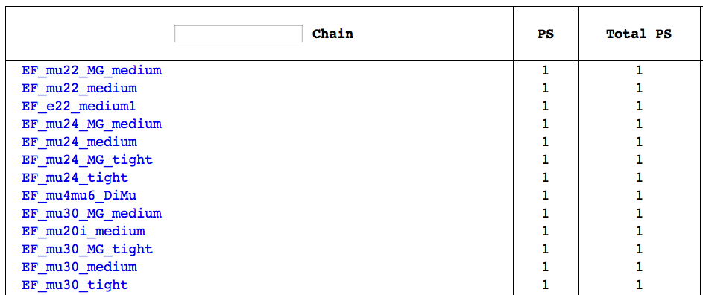
Trigger News
Indico page to collate information on trigger in Higgs channels https://indico.cern.ch:443/conferenceDisplay.py?confId=142271
Menus for after technical stop: http://olya.home.cern.ch/olya/menu2/more/
Menu for 3x10³³ attached to meeting agenda; see also “EPS menu”

Slide 4
WH/ZH, H->bb Note
WH/ZH note approved at open meeting yesterday! https://indico.cern.ch/conferenceDisplay.py?confId=146543
Very close to completion:
Need final signoff by Ed.Board and by Phys.Coord.
Last draft available for Ed.Board
Results included in ATLAS SM Higgs combination
Many thanks everyone for all the work! This is a great first step… and there will be more to follow!

Slide 5
Next Steps…
WH/ZH:
Room for improvements:
Multivariate analysis?
Reduce b-tagging uncertainty? – O(20%) systematic uncertainty
improve b-jet energy scale to improve m_{bb}?
Exploit correlations: e.g. combined fit to JES, top background and W+jets background
Is ZH->ννbb (inclusive) feasible?
“New” channels:
Boosted VH:
WH->lνbb, ZH->llbb, ZH->ννbb
First result with data in note
Build up effort on these channels! UCL and Edinburgh at present and much to do
ttH: needs to be in next batch of results!
MSSM H->bb? In principle one interested group so far. More?

Slide 6
Guessing the Tevatron sensitivity
Probably close to excluding (or not) the Higgs at low mass
At ≈ 4x SM with ZH->ννbb last year and new channel added in Moriond: ZH->ννbb
Several factors of 2 wrt now:
2 experiments
adding lepton channels
increased luminosity
H->bb may become un-interesting or very interesting indeed!! More news after EPS!
ZH->ννbb; March 2011
March 2011
July 2010
http://tevnphwg.fnal.gov/
http://tevnphwg.fnal.gov/

Slide 7
AOB…
Koloina can’t make it to Lepton Photon to present our poster.
Any candidates?
Holidays & next meetings?
H->bb NEEDS

Slide 8
Backup

