Slide 1
Introduction
Ricardo Gonçalo
HSG5 weekly meeting – 19 January 2012

Slide 2
News! News! News!
MC plans – from phys. coord. & etc
Expected timeline for finishing mc11 (last week):
Expect to finish digi+reco of all priority 0+1 digi+recon around 1st Feb
Includes redoing 50% of the priority 0 samples with PY6 pileup (better ETmiss modelling)
Finish simulation+digi+reco of all priority 2 samples around 20th Feb
Could advance this by ~2 weeks if we could reach 40M digi+reco per day
By mid February, need to start devoting resources to mc12, >50% from March
Estimate need at least 500M mc12 full simulation events for first collisions
In the meantime:
Tuning of grid parameters made production ramp up to 51M events (digi+reco)/day (peak 70M/day)
This is from existing HITS only, and at the cost of some D3PD production
The new default configuration is MC11c : identical to MC11b but uses Pythia6 pileup files

Slide 3
News! News! News!
HSG5 News:
ZH->ννbb:
Moved to two meetings/week up to Moriond
New e-group : atlas-phys-higgs-hsg5zh2nunubb@cern.ch
https://e-groups.cern.ch/e-groups/Egroup.do?egroupName=atlas-phys-higgs-hsg5zh2nunubb
Questions from muon contact person (Rosy):
Are we using MCP recommendations?
Are there any open issues concerning muons?
HSG5 MC samples:
Our request of 15M AFII Z->νν+h.f. was accepted in priority 1
Inclusive Pythia di-boson samples exist: WW, WZ, ZZ – around 20fb⁻¹
Our list of MC samples is now attached to the D3PD/MC wiki: https://twiki.cern.ch/twiki/bin/view/AtlasProtected/HSG5Higgs2bbFinalStateD3PD#List_of_available_MC_samples

Slide 4
Publication Plans
From PC/subconveners meeting:
Latest circulation date to ATLAS is 17th February
Higgs approval to be arranged with Ed.Board
In practice:
This means 2nd February Higgs approval for paper – very little margin
Plan is more clear for WH and ZH->llbb: need good 1st paper draft
Status is not as good for ννbb yet: work towards including in paper
Boosted VH in a parallel path for now: considering a note for Moriond
To gain a few days (if needed):
ZH->ννbb will be submitted as support documentation to be included in paper
This means that we can turn it into CONF note if not in schedule for paper
Now thinking about editors for note
Maybe wrong time to mention this but…
Looking into the future, aim to have combined WH analysis for ICHEP including boosted analysis
Or before… mention ICHEP to mean up to…
ttH can aim to have published results in same timescale

Slide 5
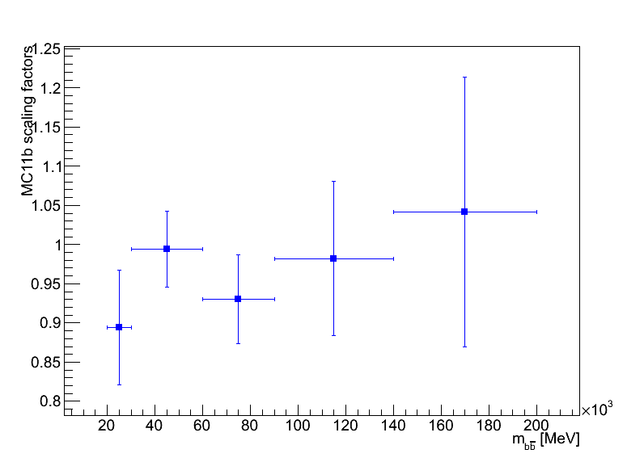
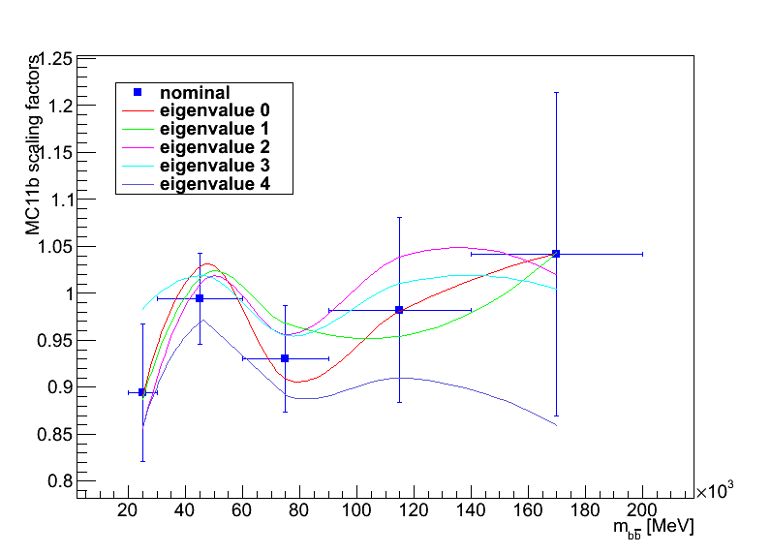
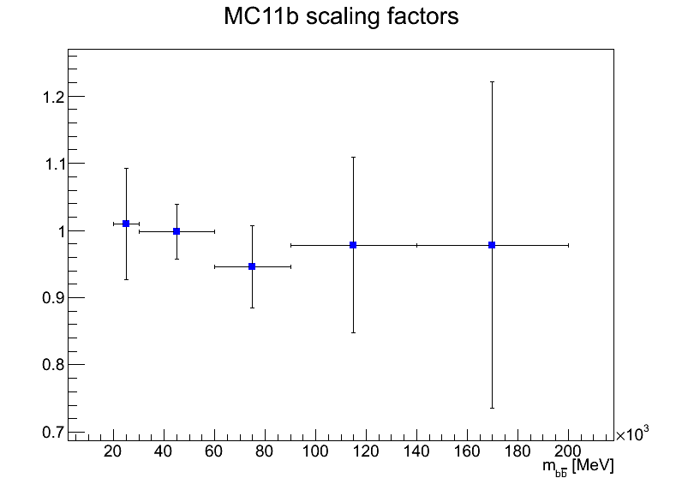
New b-tagging scale factors
MV1 factors
Fresh from the H.F. group:
Preliminary!
pTrel method only for now
May still get updated factors in early February
We moved to MV1
Larger pT dependence now
What do we do with our recipe to apply SFs and estimate uncertainties?
pT [MeV]
MC11a scaling factors
pT [MeV]

Slide 6
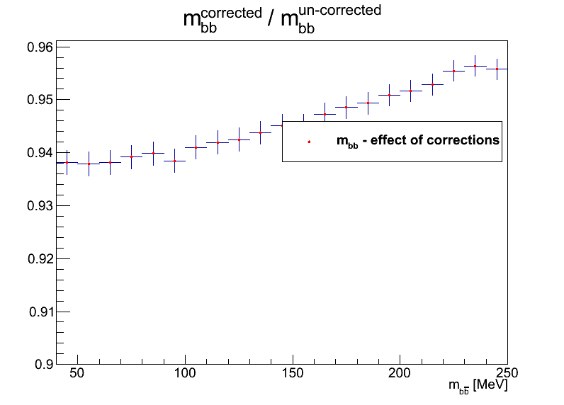
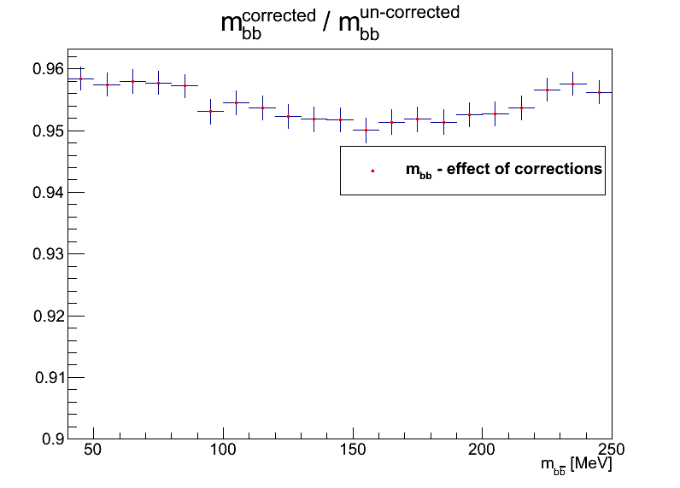
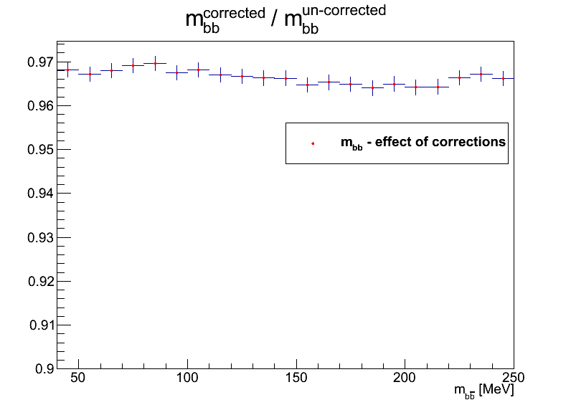
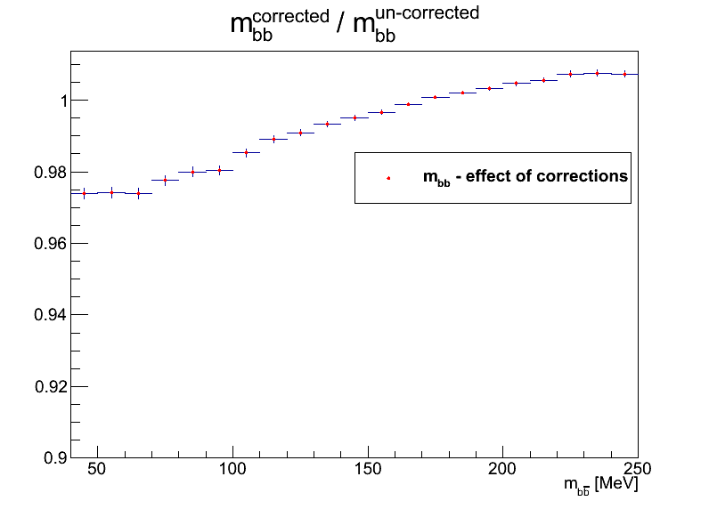
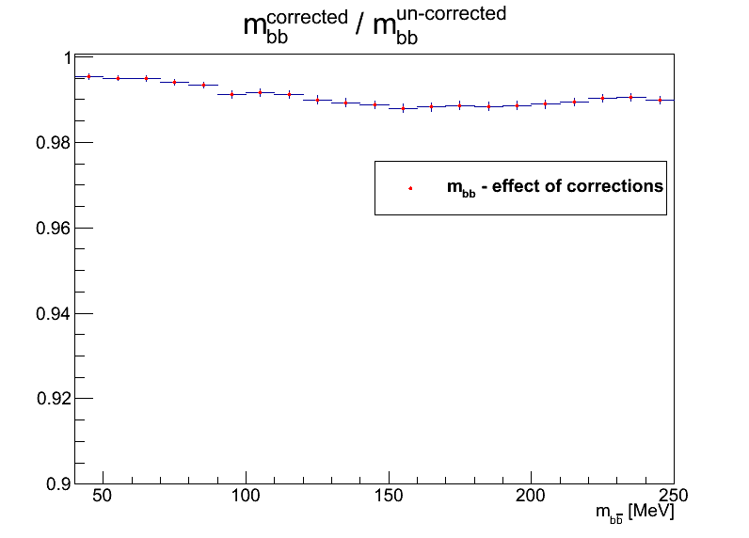
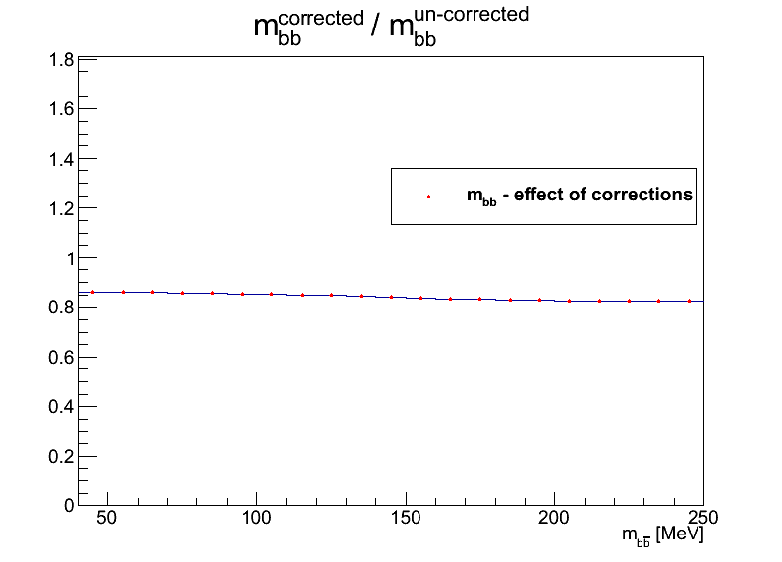
Effect of new b-tagging scale factors
Nominal
Variation eigenvalue 0
Variation eigenvalue 1
Variation eigenvalue 2
Variation eigenvalue 3
Variation eigenvalue 4

Slide 7
To do list
For ZH->ννbb need to decide on:
Use of MET significance cut
pT cut on leading jet
Final analysis binning
QCD estimation method comparison and systematic uncertainty
For all inclusive VH channels discuss:
Theory uncertainties
Limit setting and channel combination
Nvtx rescaling in MC11c
Today:
Decide on the above – especially ννbb
Focus on inclusive VH analyses since they are urgent
Discuss other issues if we can (apologies if we need to postpone)

Slide 8
Backup slides

