Slide 1
Introduction
Ricardo Gonçalo (RHUL)
Higgs Weekly Meeting – 19 April 2012

Slide 2
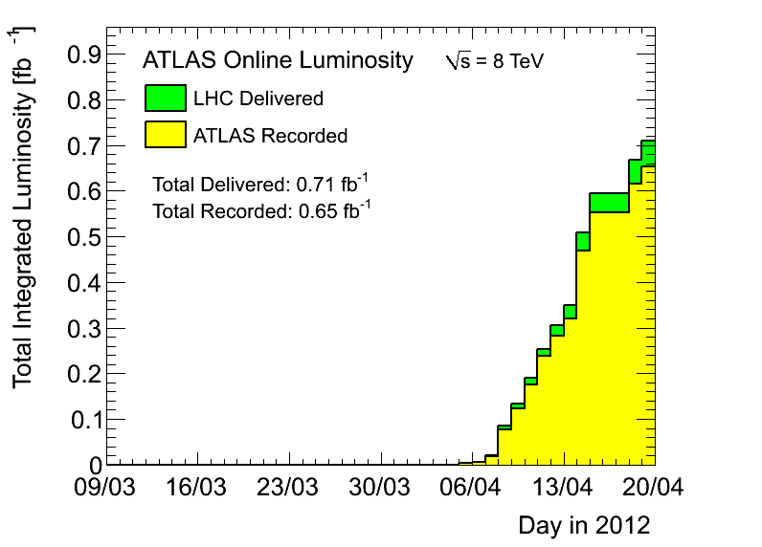
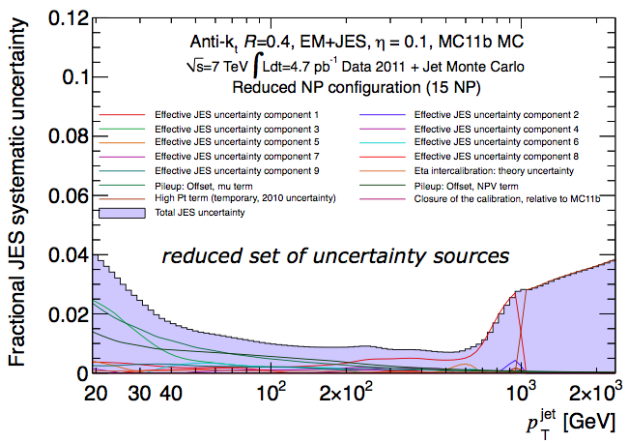
News! News! News!
LHC 2012 8TeV run going well
Running with 1092 bunches
Will get to 1380 soon
Peak <evts>/bunch crossing 20 – 25
Peak stable lumi 5.06x10³³cm⁻²s⁻¹
Lumi with stable beams 0.65fb⁻¹
≈ 0.41fb⁻¹ collected since last week
UFOs (not the little green men) again becoming a problem
Good Run List:
AllGood may become the default
Excludes all intolerable defects in ID, Calo, MS
AllGoodTight excludes also tolerable – bigger losses
For us this seems fine since we use ≈everything
Losses of 1 – 5% seen, depending on channels
New Jet calibration:
Very nice improvement! And very important for us!
Discussion in jet group to find practical way of using calibration – many nuisance parameters
https://indico.cern.ch/conferenceDisplay.py?confId=161254
https://indico.cern.ch/conferenceDisplay.py?confId=161253

Slide 3
Planning for 2012 analyses
No rest for the weary!…
Next issue for the whole group is an internal note on plans for 2012 analyses
The plan is not completely clear to me yet (e.g. which MC to use)
But main goal is to make unbiased decisions:
Decide on cuts and strategy before looking at new data
Should take this as an opportunity to think ahead:
Boosted VH analyses and how to merge with inclusive
ttH, VBF, BSM analyses (see e.g. Javier and Merlin’s talk today)
Use of MVAs (see e.g. Jan’s talk today)
Study trigger constraints and where we can gain signal (ongoing)
Needs from MC: generators, where MC improvements can help most – e.g. W+jets background, N_{jets} and p_{T}^{W} description, where can theory help?
CP performance gains needed: b-tagging, bJES, MET (see e.g. Jike’s and David’s talk)
Remember WH/ZH analyses are now systematics limited!
How to optimize analyses to prepare for 125GeV Higgs property measurements?

Slide 4
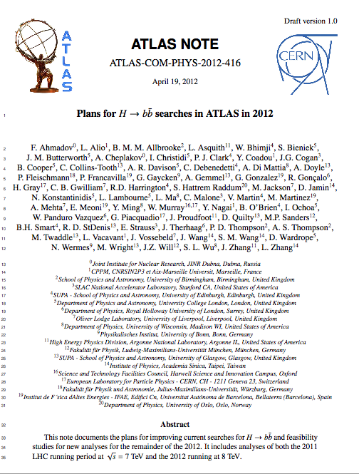
Internal note with 2012 plans - I
Need to detail analysis selection and optimization for 2012 for all analyses to be published this year
WH/ZH
Boosted VH
ttH
MWT? VBF? MSSM bH?
Prepared skeleton note
ATL-COM-PHYS-2012-416
One chapter for each of WH/ZH, ttH and VBF (?)
Tentative index in next pages

Slide 5
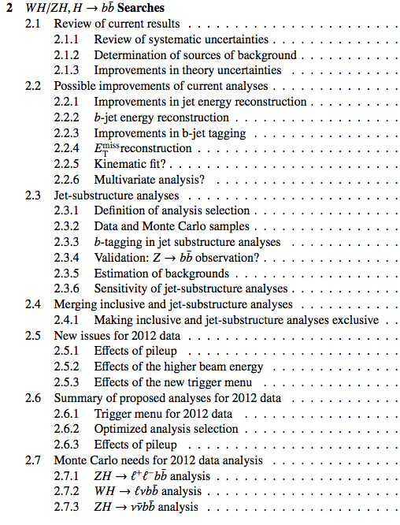
Internal note with 2012 plans - II
WH/ZH
Two parts: inclusive and boosted
Plus a section on combining analyses
Concentrate on possible improvements
List optimized analysis
Think about how to merge boosted analysis
Think about MC needs

Slide 6
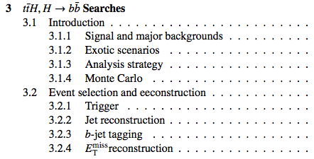
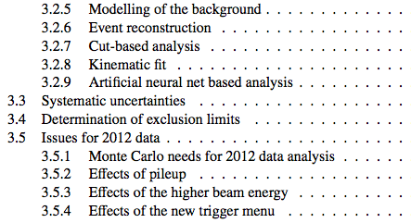
Internal note with 2012 plans - III
ttH:
Parallel to note in preparation

Slide 7
Monte Carlo
For now need to use existing 7TeV MC
Sample being generated for beginning of May:

Slide 8
Boosted VH and ttH
Need to press on… time running short
Boosted VH:
Propose to make weekly working meeting
Can use existing slot of Edinburgh+UCL?
ttH:
Same thing… time runs short

Slide 9
Bonus slides

Slide 10
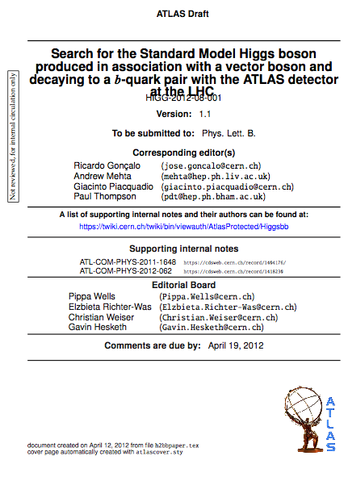
News! News! News!
H->bb analysis approved by Higgs group
Circulated today (1/2h ago)! https://cdsweb.cern.ch/record/1440266
Congratulations everyone! ☺
What next:
One week of comments
First reading
Second period of comments by collaboration and management
Second reading
Send to journal
More comments…
Publication!

