Slide 1
Introduction
Ricardo Goncalo
HSG5 H->bb weekly meeting, 15 November 2011

Slide 2
December Note(?)
Monte Carlo is starting to appear…
Priority 0 MC11b background samples are done
Only a few WH and ZH->llbb samples have finished
Large sample of Wbb (Powheg+Pythia, >50fb⁻¹) simulated in Atlfast-II being produced
This was possible thanks to the validation studies shown last week!
Full MC11b plans here: https://twiki.cern.ch/twiki/bin/view/AtlasProtected/AtlasProductionGroupMC11b
Editors:
Giacinto Piacquadio, Paul Thompson and Andy Mehta
RooStats workspaces for ATLAS combination:
Lianliang Ma and Silje Raddum
Editorial board:
Pippa Wells, Elzbieta Richter-Was, Christian Weiser
Timeline:
Higgs approval:
Other Higgs approvals on Monday 21 next week
We should aim for 23, and not later than 25
Circulation to ATLAS for 1 week for comments (up to 2 Dec. at latest)
Can be reduced to 3 days if we find a nice peak at 115 GeV, confirmed by H->γγ ☺
Public presentation plus 1 week for last comments (9 Dec. at latest)
CERN Council meeting starts 12 December… not much margin!

Slide 3
the SVN directory for the inputs has been created and can be found at the following location.https://svnweb.cern.ch/trac/atlasgrp/browser/Physics/Higgs/combined/Workspaces/Council2011
For those inputs which are ready (llqq, llvv, lvqq) please copy them in the HSG2 and HSG3 subdirectories. For the other channels we are still aiming at gathering preliminary inputs before the end of the week and if possible by thursday. For those of you who have never used the RooStats investigation tools, please do so at your earliest convenience. The tools are also available on SVN at the following location.https://svnweb.cern.ch/trac/atlasgrp/browser/Physics/StatForum/RooStatsTools

Slide 4
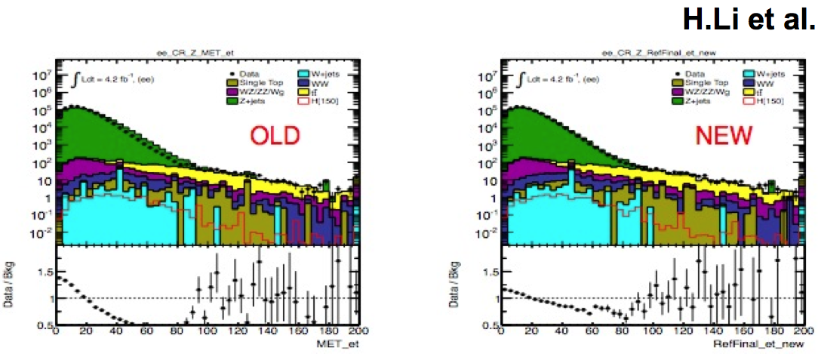
MET problem
Disagreement between data and MC11b found in HSG3
See presentation by Bruce Mellado: https://indico.cern.ch/getFile.py/access?contribId=7&resId=1&materialId=slides&confId=162605
Seems to come from modelling of soft contributions to MET (CellOut/SoftJets)

Slide 5
Quick solution proposed by HSG3 is to scale down soft contributions
Doesn’t address the source of the problem and doesn’t solve it – so only for the short term
Under discussion with Jet/Etmiss group
In parallel, thread about Pythia8 tune, MC description of diffractive vs non-diffractive components etc

Slide 6
ZH->ννbb
Monte Carlo:
Need to get enough dedicated background MC (most Atlas EW samples don’t have νν final state)
Trying to use: SUSY Alpgen Zbb->ννbb samples - Jike investigating generator-level cut to see if we can use them
Paul looking into requesting Sherpa samples – potential problem will be production priority
Mario looking into di-boson samples – potential problem with production priority
Ongoing:
Cut-flow comparisons between Ac.Sinica, Liverpool and IFAE
QCD data-driven methods being explored
Lei investigating NN-based correction to b-jet energy
David investigating triggers
Plans:
Cuts optimization in three MET bins: [120GeV, 160GeV], [160GeV, 200GeV], >200GeV
Not contemplating jet substructure analysis for now
Volunteers for investigating this are welcome!
Include the WH and Z(ll)H into the signal directly

Slide 7
Moriond timescale
Moriond is not far away…
Need to plan to have initial results in December, in parallel with CERN Council activity
One month from beginning of January 2012 until Higgs approval
E.g. HSG6 Moriond plans:
Dec 20: Complete drafts - supporting notes
In parallel: Paper draft ready– plots/numbers to be added
Dec 13:Data-driven background estimates ready (at least the fall-back ones)
Systematics ready (whereever possible)
Dec 06:Data vs MC comparisons complete
mc11b D3PDs should be arriving
Nov 29:First iteration of data-driven bkg estimates ready
Nov 22:First data vs MC comparisons: 5/fb
Acceptance challenges
Nov 15:Most D3PDs available (ttbar, signal MC++)
Selection frozen (few more days if decisions need these D3PDs: e.g. tauID)
Now:Analysis code ready for release 17

Slide 8
Backup

Slide 9
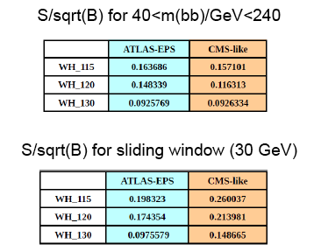
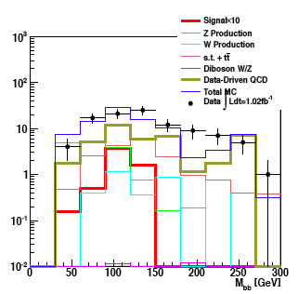
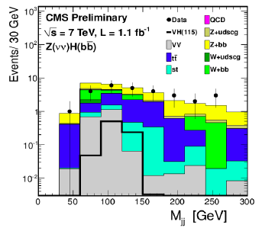
ATLAS-CMS comparisons
Jonas and Jike have emulated CMS’s cuts in WH->lνbb and ZH->ννbb
Differences not yet clear – need to continue to pursue this
Similar significances in WH ->lνbb when applying mass window cut
But very different event numbers – by factor 10-100 depending on channel
CMS seems to get a lower QCD background than us in ZH->ννbb
WH->lνbb

Slide 10
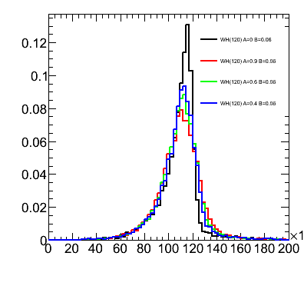
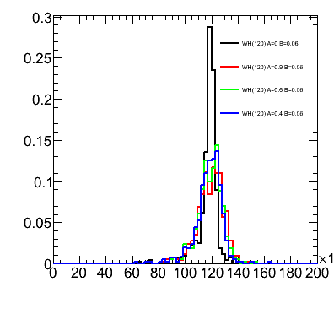
Performance studies
Main systematics are jet and b-tagging related
Current tasks listed in Wiki
More questions than answers at the moment, but pursuing several threads:
Jet resolution:
We seem to be affected by out-of-cone losses
Will try different jets
B-tagging:
Find how much improvement needed to reduce syst
Improve MC statistics term of b-tagging uncertainty with AFII – requesting some AFII validation samples
Differences between hadronic and semileptonic b-jets

Slide 11
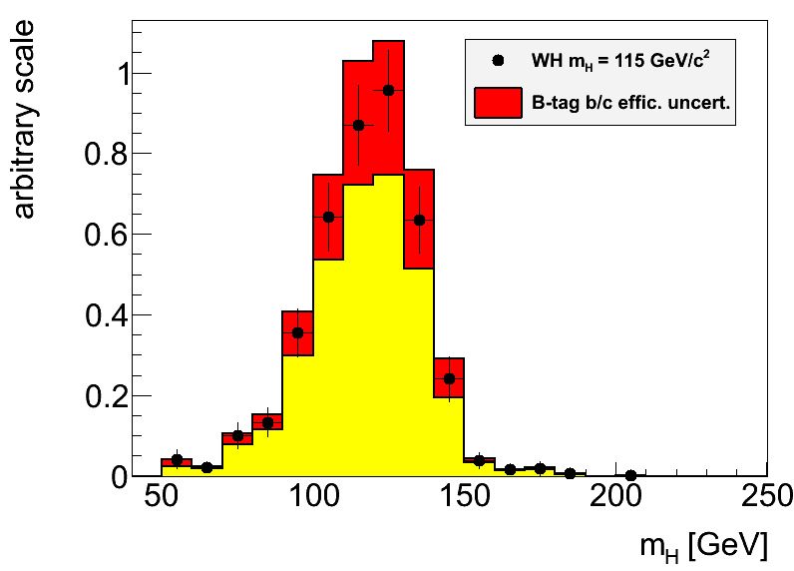
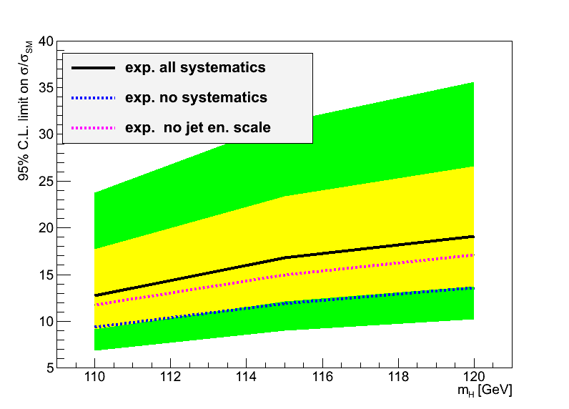
Hgbb – Reconstruction Performance
Main limitations from jet reconstruction and b-tagging uncertainties
Try to improve b-tagging efficiency/fake rate uncertainty:
Dominant uncertainty on signal yield in EPS analyses
Try to optimize di-jet mass resolution:
A sharper peak improves analysis sensitivity (10% width reduction ≈4% limit improvement)
Try to reduce jet energy scale uncertainty:
Large effect in limit through changes in m_{bb} shape

Slide 12
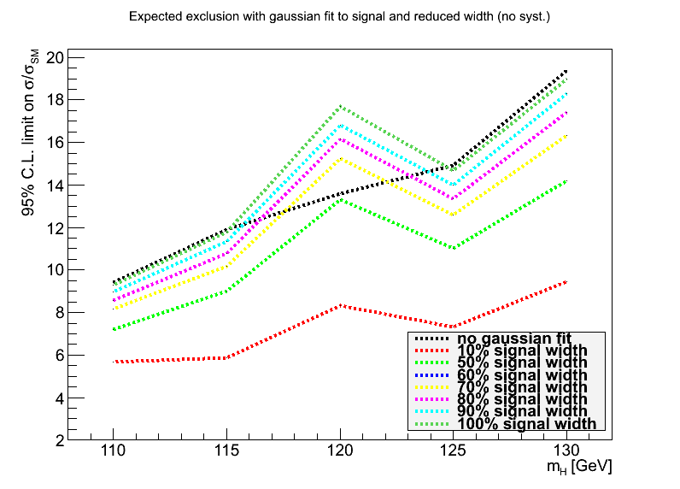
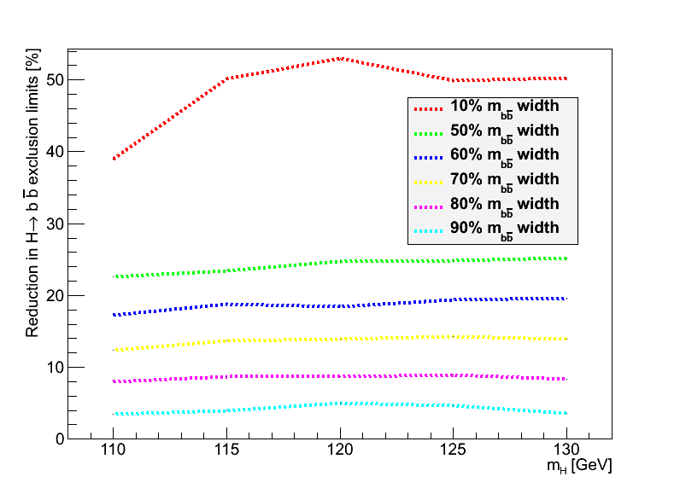
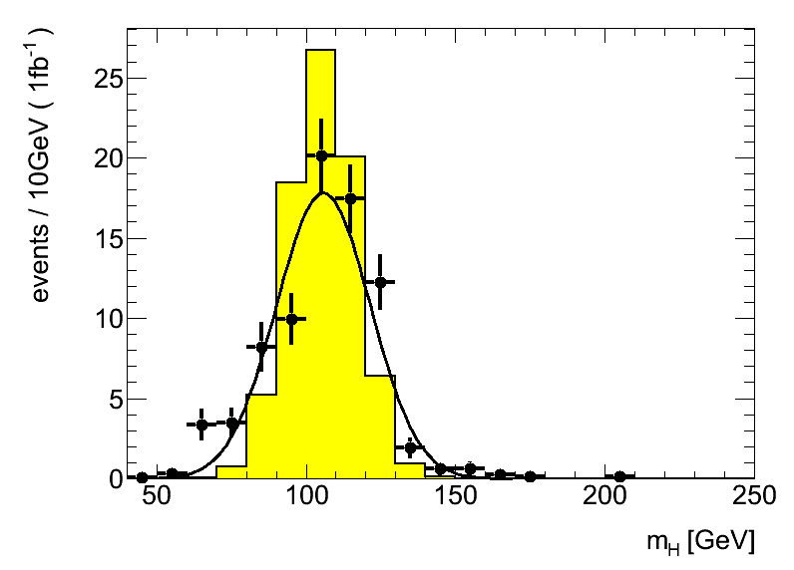
Backup
Replaced signal with fitted Gaussian to manipulate signal width
Estimated improvement in limits (1fb⁻¹) with reduced signal width
Reduction to 80% gives 8% improved limits (magenta line, bottom left)

Slide 13
1. Di-jet mass resolution:
Truth-level study, using partons (a similar study using truth jets would also be interesting). To be done for either WH or ZH channels, signal only would be enough.The idea is: 1. apply kinematic cuts to leptons and quarks similar to the analysis cuts - to look at a similar region of phase space 2. calculate the invariant mass of the two b quarks coming from the Higgs boson decay 3. determine the bb mass resolution 4. smear the parton transverse energies by some amount and go back to 2. The aim is to find by the (b-jet) energy scale uncertainty corresponding to a given value of the bb mass uncertainty. To define some numbers: the m(bb) uncertainty is around 20GeV. It would be interesting to know how much the jet energy resolution would need to decrease to make this 5%, 10%, 20% and 30% better.It would also be interesting to smear the quark directions. This should be a second-order effect for the un-boosted case but should be relevant for the boosted case.

Slide 14
2. B-tagging efficiency uncertainty:
Analysis-level study. Find how much the b-tagging efficiency uncertainty should be, to make the systematic uncertainty comparable to other systematic uncertainties.In the EPS analysis, the systematic uncertainty in the number of selected events, arising from the b-tagging (b/c efficiency & light fake rate), was 17% for WH and 16 for ZH. This was the dominant systematic uncertainty in both cases and the sub-leading systematic was 3% and 9%, respectively for WH and ZH.The idea is to run the analysis a few times with different values of the b/c efficiency uncertainty and the light fake rates (say, 80%, 60%, 40% of the official values to make it simple) and find what the corresponding systematic uncertainty would be on the signal yield.

Slide 15
3. Validate Atlfast II description of pTrel for b-tagging improvements
The b-tagging uncertainty is the one of the dominant uncertainties affecting the H->bb analyses. The estimated uncertainty itself is affected by several systematic uncertainties, and crucially by the MC statistics in the mu+jet samples used to determine the b-tagging scale factors. A solution for this would be to use fast simulation (Atlfast II) to get enough statistics. But this simulation needs to be verified against full simulation.So, this task aims to: compare the description of important quantities in AFII files against the same variable in full simulation files. The most important variable is "pTrel" for muons found inside a jet cone. This is the relative transverse momentum of muons with respect to the jet they belong to. of the The files to use are Jx samples filtered with a muon filter ("Jx*mufixed", with a filter selecting muons with pT>3GeV). Equivalent files need to be requested with AFII (to be done soon by Ricardo).

Slide 16
4. Differences between hadronic and semileptonic B decays
This is another of the important uncertainties affecting the b-tagging efficiency determination (as the study above). A term of the b-tagging efficiency uncertainty accounts for differences between jets arising from hadronic and semileptonic B decays. But this area remains under studied. It would be important to identify variables which show marked differences between these two types of jets, and could lead to differences in b-tagging efficiency. And to quantify the differences. Examples of possible variables to examine are the number of tracks, leading track pT fraction, Sum(pTtrack)/ET, etc.This task is not very well defined. Please get in touch with Ricardo

Slide 17
MC requests
Inclusive and boosted H->bb samples for MC11b:
Herwig++ in Powheg
Mass points: M_{H} = 110, 115, 120, 125, 130, 135, 140, 145, 150 GeV
WH->lνbb, ZH->llbb, ZH->ννbb
Both boosted and inclusive for each mass
Approved for production – still in waiting list for MC11b production (delays in MC11a)
Other samples:
Wbb, Zbb
ZH, WZ, WW -> lljj and llbb final states
Gluon-fusion H->bb
See Junichi’s page: https://twiki.cern.ch/twiki/bin/view/AtlasProtected/HSG5Higgs2bbFinalState#H_bb_MC_samples

