Slide 1
H->bb Weekly Meeting
Ricardo Gonçalo (RHUL)
HSG5 H->bb Weekly Meeting, 15 March 2011

Slide 2
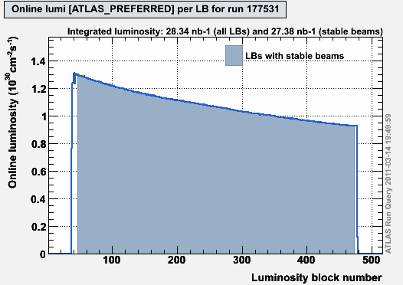
News! News! News!
First colliding stable beams run in 2011 on Sunday
Entire run: 28.34 nb⁻¹
Stable beams: 27.38 nb⁻¹
Peak lumi: 1.3x10³⁰ cm⁻²s⁻¹
Approx. lifetime: 21 h
3 colliding bunches
1.8x10¹¹ protons/bunch
Will progressively increase intensity over next 2 weeks:
Should get 32 bunches later today!
Technical stop early April for 2 weeks of scrubbing – should improve lifetime

Slide 3
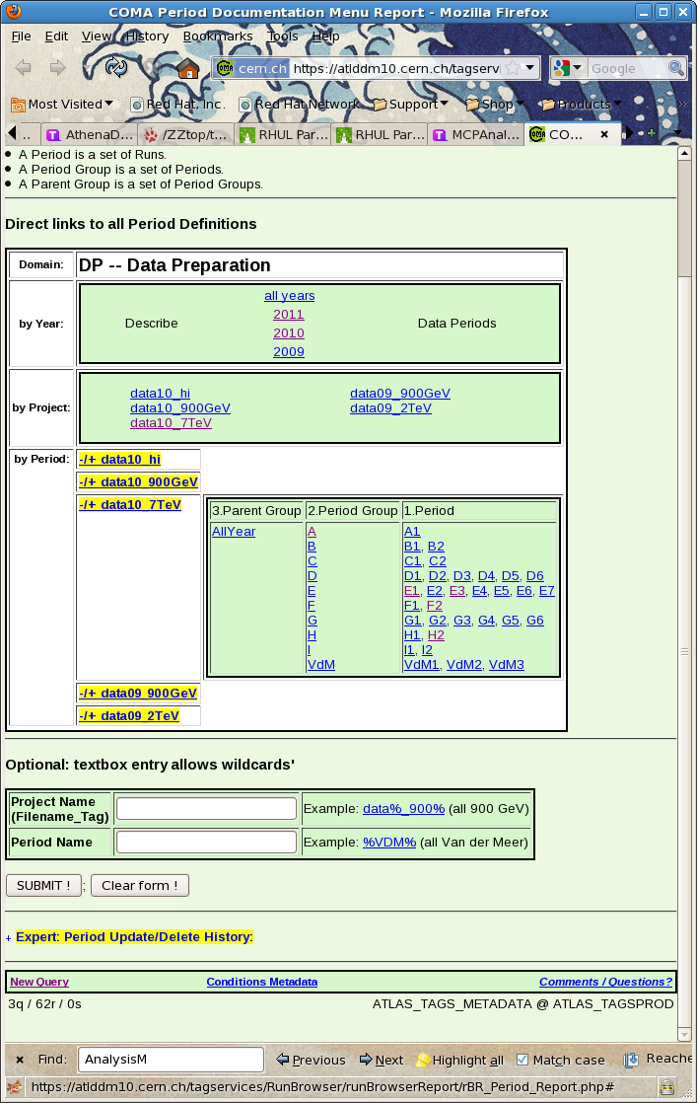
News! News! News!
New database interface to access data period information:https://atlas-tagservices.cern.ch/RBR/rBR_Period_Report.php
Feedback requested to hn-atlas-physicsMetadata@cern.ch.
This replaces data prep wiki:https://twiki.cern.ch/twiki/bin/view/AtlasProtected/DataPeriods

Slide 4
HSG5 Validation
Arnaud asks how to update the Trigger menu in the HSG5 validation package
Triggers currently being monitored:
L1 Triggers: L1_MU10, L1_MU15, L1_MU20_XE30, L1_EM10, L1_EM14, L1_EM18_XE30, L1_TAU9I_3J5_2J20, L1_TAU9_XE15, L1_XE40
L2 Triggers: L2_mu10, L2_mu15, L2_mu20_xe30, L2_e10_medium, L2_e15_medium, L2_e20_loose, L2_e20_loose_xe30, L2_tau16i_loose_3j30, L2_tau16_loose_xe20, L2_xe40
Event Filter Triggers: EF_mu10, EF_mu15, EF_mu20_xe30, EF_e10_medium, EF_e15_medium, EF_e20_loose, EF_e20_loose_xe30, EF_tau16i_loose_3j30, EF_tau16_loose_xe20, EF_xe40
Several of these are already obsolete…
Please check what your triggers will be for 2011 (until Summer) and let us know

Slide 5
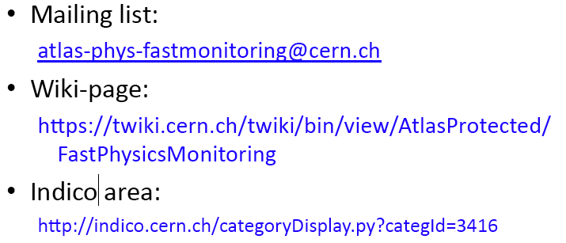
Fast Monitoring
Meeting on Wednesday last week: http://indico.cern.ch/conferenceDisplay.py?confId=130616
Use Athena ManagedMonToolBase, which is also used in normal monitoring
Not something really urgent for us, just something to keep an eye on

Slide 6
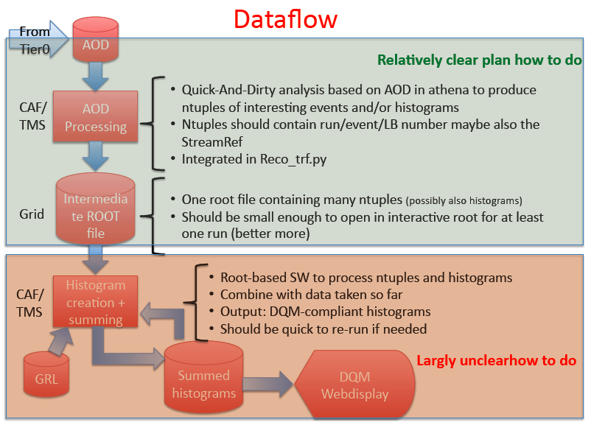

Slide 8
Proposed Roadmap for WH Analysis
After the effort on cut flows, we’re ready to start producing results!
Concentrating on un-boosted results here only because it’s still unclear what would be feasible in boosted analysis until Dubna – commissioning work ongoing
BUT: work on boosted VH is starting in parallel – see e.g. Wahid’s talk today
Intended results:
Cut-based analysis focusing on WH -> e/μ ν b b
I think there should be at least 2 analyses, for cross checking results
Ideally using 2 different data formats (AOD vs D3PD)
Multivariate analysis in parallel, to improve on cut-based analysis
Timeline:
Analyses should be semi-frozen by Dubna (17 – 19 May)
This leaves around 7 weeks
Results in the form of:
Histogram with # events vs m_{H}
Table of # events expected for each value of m_{H} and background type – including statistical and systematic uncertainties
Exclusion plot vs m_{H} (95% C.L. limit on σ/σ_{SM})
…plus control plots etc

Slide 9
Questions to be answered
Cut-based analysis focusing on WH -> e/μ ν b b
Establish analysis selection: why is each cut applied and why at each particular value? Are we convinced this is the right thing to do?
Establish set of systematic uncertainties: start from combined performance group recommendations. What are the most important? Are there any hidden pitfalls for us?
What b-taggers and why? What calibrations do we expect to be ready in time? What is the corresponding systematic uncertainty?
What sort of exclusion limits can we expect for 0.5, 1, 2 fb⁻¹ ?
Multivariate analysis in parallel, to improve on cut-based analysis
What event preselection should be used and why?
Use for signal-background separation only or target particular backgrounds?
What are the possible bias? Where can it go wrong?
What improvement can be expected wrt cut-based analysis for 0.5, 1, 2 fb⁻¹ ?
Exclusion plot vs m_{H} (95% C.L. limit on σ/σ_{SM})
Need someone to implement RooStats workspace

Slide 10
Date | Milestones wish list
17 May | Dubna workshop – analysis frozen After this: add data to un-boosted analysis and prepare for result approval Concentrate more effort on boosted VH with a view to obtaining results quickly
10 May | Review results with 2011 data from cut-based and multivariate analyses
3 May | Margin for dealing with unforeseen problems
26 April | Start looking at 2011 data if enough is available. Any surprises? How does the MC describe the new data? By now we should have a reasonable idea of results from the multivariate analysis
19 April | End of 2 weeks of beam scrubbing. (I’m away for Easter)
12 April | By now we should have a reasonable idea of the exclusion of the cut-based analysis First report on MVA preliminary results – establish plan for getting results by Dubna
5 April | Identify the worst systematics and discuss any possible improvements: Any changes needed in analysis cuts? Any study necessary for corrections to some systematic effect? Multivariate analysis: iterate on preselection cuts, methods, questions Assign tasks – divide the work to achieve better results!
29 March | Establish analysis cuts: If possible as result of optimization Use 2010 data to develop cuts and show that data is well described by background MC Start evaluating systematics
22 March | Iterate on analysis cuts – why is each cut applied at each particular value? Start iteration on multivariate methods to improve analysis

Slide 11
Backup

Slide 12
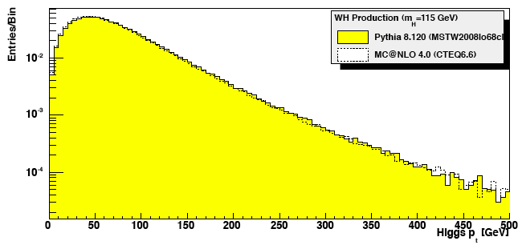
To boost or not to boost…
We expect a sizeable luminosity this year:
0.6 fb⁻¹ for PLHC in June; 1 fb⁻¹ for EPS in July; 2 fb⁻¹ for Lepton-Photon in August
Need to get boosted VH analyses going again!
Work is currently ongoing within the SM group – mainly on commissioning the jet substructure reconstruction
Looking at a H spectrum in WH (by eye!):
≈0.5 of the cross section above p_{T}^{H} = 100 GeV
≈7.5% above p_{T}^{H} = 200 GeV
√s = 7 TeV | p_{T}^{H} > 0 GeV | p_{T}^{H} > 100 GeV | p_{T}^{H} > 200 GeV
Channels | σ x BR(e/μ) (fb) OR # events per fb⁻¹ | σ x BR(e/μ) (fb) OR # events per fb⁻¹ | σ x BR(e/μ) OR # events per fb⁻¹
WH->lνbb | 150 | 75 | 11
ZH->llbb | 29 | 14 | 2.2

Slide 13
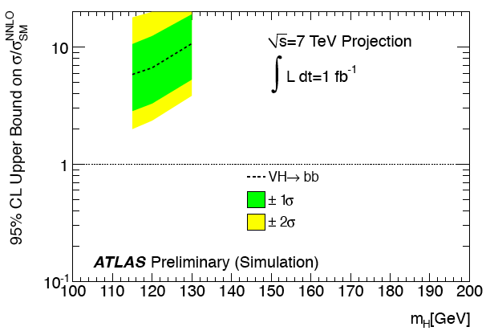
To boost or not to boost…
Un-boosted channel sensitivity:
Boosted channel sensitivity:
All we currently have at √s = 7 TeV are Lianliang’s numbers from the 15/12/2010 H->bb meeting: http://indico.cern.ch/conferenceDisplay.py?confId=115169
WH (e and μ channels) gives 56 x SM exclusion with 35 pb⁻¹ at m_{H} = 120 GeV
Includes 10% systematic uncertainty on signal and background and 11% on luminosity
Assumes IP3D+SV1 will be usable for this analysis
For 1 fb⁻¹ this translates roughly as a factor 5 improvement, i.e. exclude ≈ 10 x SM
Exclude 6.7 x SM at m_{H} = 120 GeV with 1 fb⁻¹ - see ATL_PHYS_PUB-2010-015
Obtained by scaling 14 TeV numbers – room for optimization at √s = 7 TeV
Analysis selects p_{T}^{H} > 200 GeV
WH(W->lν) most promising, followed by ZH(Z->νν)

Slide 14
To boost or not to boost…
Boosted VH Status and Plans:
Work ongoing in SM group on commissioning jet substructure technique
See Adam’s presentation in last week’s SM plenary: http://indico.cern.ch/getFile.py/access?contribId=0&resId=0&materialId=slides&confId=127720
Jet substructure note should be ready in 1-2 months
Work ongoing in parallel to provide b-tagging algorithm tuned for fat jet environment
Given infinite time, the plan would be to follow with measurements of g->bb and W/Z+bb with the substructure technique, and then VH(H->bb)
But we don’t have infinite time! – need to put effort into optimizing the boosted VH analysis for 7 TeV
Edinburgh group has started on this – presentation next week – but more effort will be needed

Slide 15
To boost or not to boost…
My view:
We need to have results for Summer conferences:
To improve the ATLAS sensitivity at low mass – follow the Tevatron mantra which says that “every channel counts”
Develop experience in the group on b tagging, WH reconstruction, setting limits and combining results – pave the way for later
Put H->bb on the map of useful channels
The un-boosted channels seem to be in a better position for this – remember only 2-3 months left, analysis should be ≈ frozen end of May
At the same time boosted VH has better sensitivity and must be our real goal for physics results in associated VH production this year
What could be shown from this channel in Summer?
How do we organize ourselves to achieve both goals?
My proposal:
Split the work so that some people concentrate on un-boosted analysis and some on optimizing boosted analysis and on helping to commission jet substructure method
Get results out for Summer and move on fully to boosted analysis

Slide 16
Reconstruction issues
Muon CP group recommendations for release 16:
Reconstruction efficiency and isolation efficiency scale factors, momentum smearing functions
https://twiki.cern.ch/twiki/bin/view/AtlasProtected/MCPAnalysisGuidelinesRel16
Jet/Etmiss recommendations for jet cleaning in release 16:
Medium jet cleaning should give similar rejection to rel 15 cleaning but with better efficiency
Tight jet cleaning should not be used – still under discussion
https://twiki.cern.ch/twiki/bin/view/AtlasProtected/HowToCleanJets#Bad_jets_rel16_data
New!: Final b-tagging calibrations for release 16 based on full 2010 data:
https://twiki.cern.ch/twiki/bin/view/AtlasProtected/Analysis16
e/gamma recommendations for energy scale and resolution in release 16:
https://twiki.cern.ch/twiki/bin/view/AtlasProtected/EnergyScaleResolutionRecommendations
And rescaler tool: https://twiki.cern.ch/twiki/bin/view/AtlasProtected/EnergyRescaler
Standard Model W/Z group baseline selection for release 16 (next 4 slides):
See discussion in W/Z group Sharepoint
Also, finer points (and perhaps the not so fine) still being discussed

Slide 20
Future changes in W/Z baseline selection

