Slide 1
H->bb Weekly Meeting
Ricardo Gonçalo (RHUL)
HSG5 H->bb Weekly Meeting, 15 February 2011

Slide 2
News! News! News!
e/gamma recommendations released last week
See S.Heim’s talk in Weekly meeting: http://indico.cern.ch/conferenceDisplay.py?confId=119624
Scale factors were determined from W and Z to correct MC efficiency
Note e.g. that the new recommendation is to smear the electron energy to obtain the central value
Energy rescaler tool – simple c++ class – can be used in both ROOT and Athena: https://twiki.cern.ch/twiki/bin/view/AtlasProtected/EnergyRescaler
Other:
HSG5 Workshop in Dubna
Final dates: 17th – 19th May 2011
Visas have to be thought about soon! Expect email with instructions for registration etc
Will be the last check point for Summer CONF notes before approval process – aim to have solid results

Slide 3
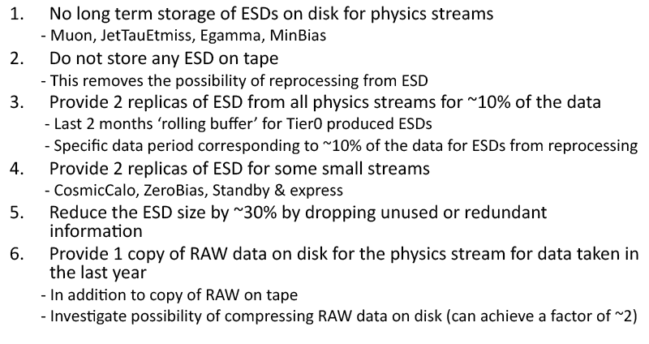
Proposal for Life without the ESD:
ESD stored on disk on the grid only for 2 months (and NOT on tape)
One copy of RAW will be made available on disk (i.e. with grid access) for 1 year
See J.Boyd’s talk in the weekly: http://indico.cern.ch/conferenceDisplay.py?confId=119624

Slide 4
Good Run List (GRL):
Information meeting yesterday:http://indico.cern.ch/conferenceDisplay.py?confId=126036
Donny Quilty will give summary at the next HSG5 meeting
GRLs will be centrally produced based on the Data Quality flags for each run
New way to classify problems: colour system replaced by defects database
See e.g. Fabien Tarrade’s talk – Fabien is the overall contact for GRLs
Each analysis should have one contact person to:
Copy/post/send the GRLs to SVN/AFS/Wikipage/email
Compute the integrated luminosity for dedicated trigger
Investigate losses of integrated luminosity (CSC,Tile problems)

Slide 7
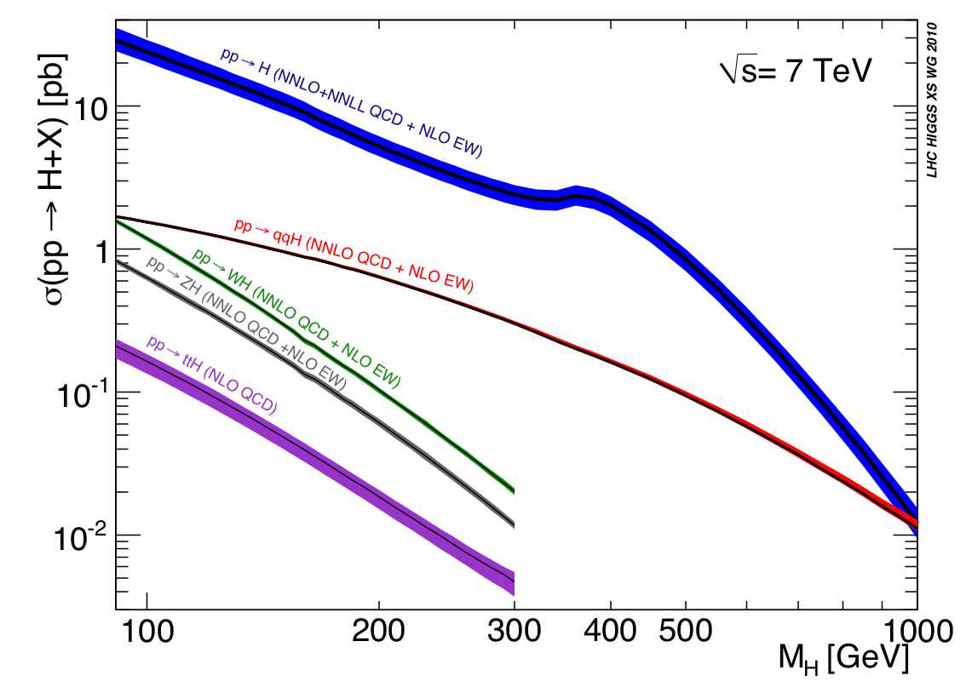
LHC Higgs Cross Section Working Group
LHC Higgs Cross Section Group: https://twiki.cern.ch/twiki/bin/view/LHCPhysics/CrossSections
Yellow report with inclusive cross sections:
Yellow report recently released: http://arxiv.org/abs/1101.0593
Higgs WG requested to use numbers from the LHC xsec wiki: https://twiki.cern.ch/twiki/bin/view/LHCPhysics/CERNYellowReportPageAt7TeV
Second phase of work starting now: exclusive Higgs observables
Higgs Signal: cross sections with cuts, differential K-factors, effect of jet-veto or b-tag jet on differential K-factors, comparison between NLO MC and NNLO codes
SM Backgrounds: define control regions, estimate theoretical errors, use the most advanced NLO MC (POWHEG, MC@NLO, new Sherpa), signal/background interference
Theory Uncertainties: for exclusive observables, for both SM and MSSM Higgs, QCD scale and PDF error correlations among different Higgs production channels and among
First results expected for BNL workshop in May; plan for 2 publications this year
H→bb meeting on 17 February 2011:
Survey of the codes (for both VH→Vbb and ttH), loose (i.e. non-boosted) VH analysis
Will start with validation on Wbb calculations
Volunteers welcome!

Slide 8
Common code?
Should we move to a common analysis code?
What? When?
No decision today – but discussion needs to start
This is connected to other issues:
Common monitoring code:
Run analysis for all data after reconstruction
How far should we take the cut-flow comparison in rel.16?
Next steps: once we’re happy with the rel.16 results
Evaluate systematics
Improve on main systematics
etc

