Slide 1
H->bb Note Plans for Summer
Ricardo Gonçalo (RHUL) on behalf of the HSG5 H->bb group
Higgs Working Group Meeting, 9 June 2011

Slide 2
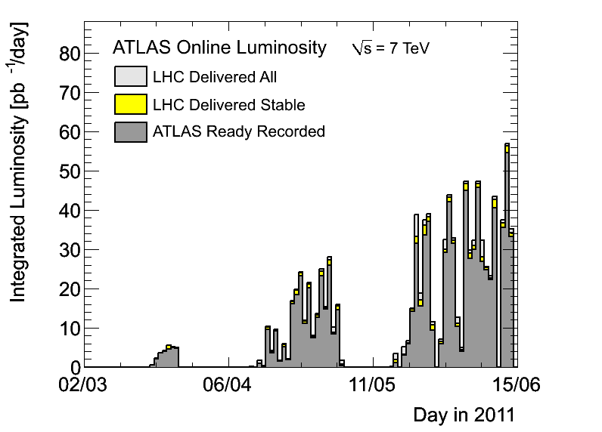
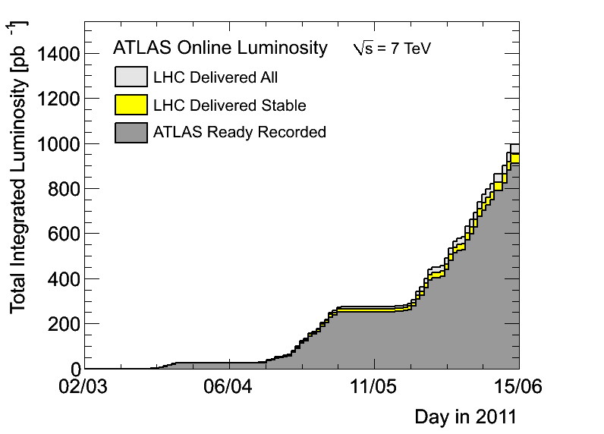
News! News! News!
About 0.9 fb⁻¹ collected with stable beams so far (0.95 delivered)
1042 bunches colliding in ATLAS
Peak lumi around 1.2x10³³cm⁻²s⁻¹
30 – 50pb⁻¹ per day

Slide 3
Trigger News
Evolution for 2 – 5x10³³ cm⁻²s⁻¹ being planned – final sign off tomorrow at Trigger General Meeting
Strawman plan with detailed prescales can be found here:https://aagaard.web.cern.ch/aagaard/Rates/Evolution50nsVeryTight5e33/
At 5x10³³ cm⁻²s⁻¹ :
mu20(_MG) disabled – new primary will be mu22
e20_medium1 disabled – new primary will be e22_medium1
EF_2b10_medium_4L1J10 disabled – should have EF_b10_medium_4j30_a4tc_EFFS or EF_2b15_medium_L1_2J10J50
Our feedback was that we will use EF_e22_medium1 and EF_mu22
An alternative would be e20i, but this has L1 isolation and would prevent us from using isolation cut for background estimation

Slide 4
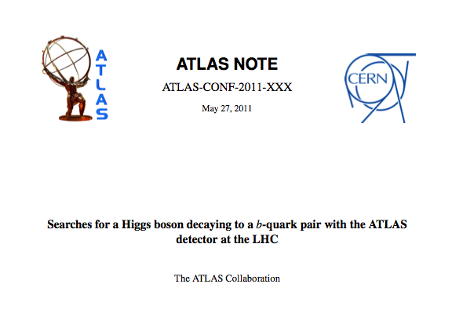
H->bb WH/ZH CONF note plans
ATL-COM-PHYS-2010-929
CONF note for EPS
First H->bb results from ATLAS with real data
WH and ZH un-boosted channels only, for now
Expect exclusion limits for WH and ZH in low Higgs mass range
If all goes well…
Introduction
Data and MC samples
Object selection
Event selection
WH analysis
ZH analysis
Systematic uncertainties
Results
Summary
Editors:
Patricia Conde Muino
Andrew Mehta
Paul Thompson

Slide 5
WH/ZH Note: Missing Ingredients
MC10b:
Can move to this essentially now
b tagging:
Need advanced tagger for increased background rejection
Efficiency scale factors almost done
Calibration & fake rate: preliminary on week of 20th June - will re-do analysis with final numbers
IP3D+SV1, 60% efficiency working point
Jet Vertex Fraction:
Fix exists but applicable only to AOD-based analyses – i.e. only one analysis in our group
Would like to re-run D3PD production
Editorial board: Done
Richard Bateley (chair)
Niels van Eldik
Alex Read
Emmanuel Lemonier
QCD background (incl. bb, cc):
Almost there, but not quite – remaining features at 10% level
Systematics:
First estimates done – dominated by b-tagging uncertainty (around 30%)
Jet energy scale uncertainty still missing – expected of same order
SM Higgs combination:
Need to produce inputs for SM Higgs combination

Slide 6
WH/ZH Note: Outlook
Skeleton draft of INT note should be available now…
Then a couple of weeks to finish details of QCD BG determination and interact with Editorial Board
Expect some changes to cuts etc during this
Dataset frozen on 22 June (I think)
Preliminary b-tagging calibrations around same time
Aim for Higgs approval at end of June
Last iteration with final b-tagging calibrations on…
Circulate note to ATLAS for CONF approval in early July for approval in time for EPS

Slide 7
WH/ZH in SM Higgs Combination
Hello,
A number of Higgs mass points have been for the ATLAS+CMS SM Higgs combination. The suggestion is that all analyses going into the overall Higgs combination should provide their results at these chosen mass points, within their range of sensitivity. See this:
https://indico.cern.ch/getFile.py/access?contribId=2&resId=0&materialId=0&confId=135328
There are 3 things:
1) The step size of the mass points
The choice of mass points for the combination is driven by the H -> gamma gamma and
H -> ZZ -> 4l analyses looking for a narrow peak over a continuum background. The
probe masses in the SM Higgs search should not be much farther apart than the
observable width of the Higgs peak. It is important to note that all analyses going
into the overall Higgs search combination should provide their results for all the
points in their corresponding explored range, without any skips, even if they do
not have the mass resolution as fine as the specified steps.
A total of 173 mass points are proposed between 110-600 GeV, as shown in the
aforementioned document.
2) The cross sections (XS) and branching ratios (BR) at each mass point
Full tables for the Higss XS and BR (with interpolation for missing points) are
being prepared within the LHC Higgs cross section group (Rei Tanaka et al).
3) Dealing with mass points for which we have no simulation
A few options are proposed in the aforementioned document.
This should be discussed in the Higgs (sub)group(s), in particular item 3).
Regards, Ketevi.

Slide 8
Backup

Slide 9
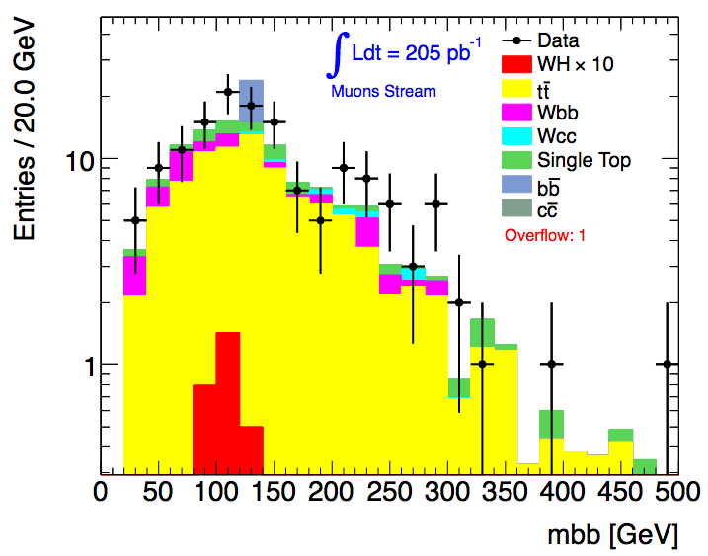
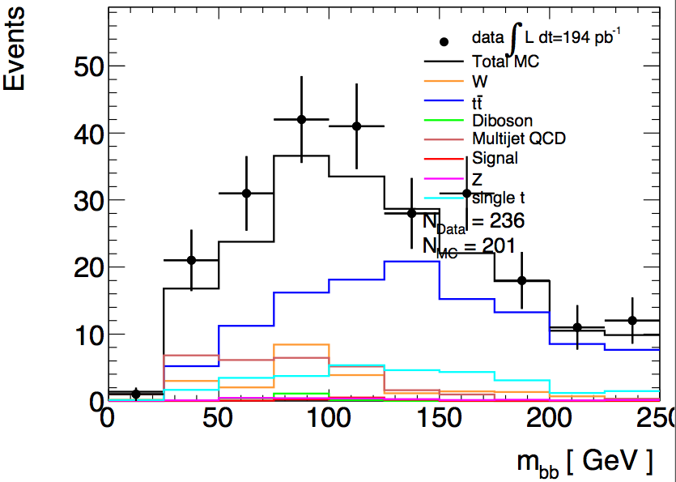
Do we need a JVF cut?
In principle yes!…
Need to use cut N_{jets} = 2 to suppress tt background; use N_{jets} = 3 as tt control region
So must suppress spurious jets from pileup…
Njets < 4
All backgrounds from Monte Carlo
bb and cc MC clearly not enough
Njets = 2
QCD background from data
Before last scale factor (1-b sideband)
Lianliang Ma
Paul Thompson

Slide 10
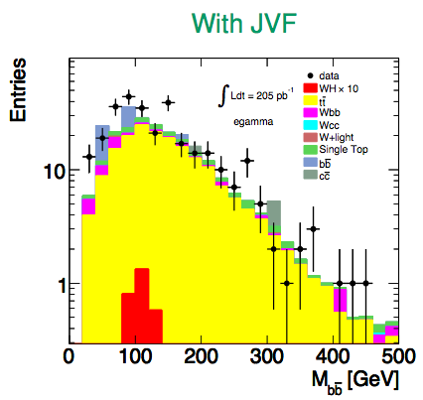
Do we need a JVF cut?
In fact, not using the Jet Vertex Fraction seems to have a significant effect on Njets
But a small effect after all cuts…
 | data | tt MC
No JVF cut | 303 | 200
JVF > 0.75 | 300 | 185
Haifeng Li
Haifeng Li

Slide 11
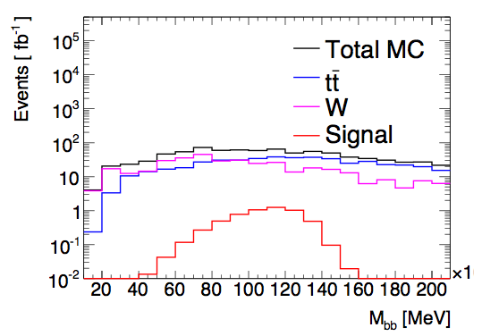
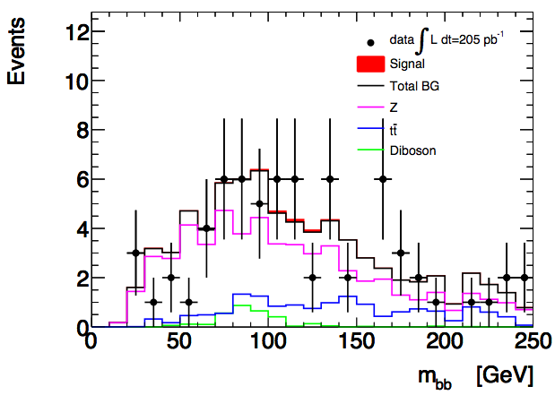
Results so far
Before systematic uncertainties…
WH: reject around 7x the SM at 95% CL with 1 fb⁻¹
ZH: reject 12x the SM with 1 fb⁻¹ / 3.5x for 10fb⁻¹
Note: these are just preliminary numbers, shown in the Dubna workshop, and likely to change significantly after systematics
WH
ZH

