Slide 1
Introduction
Ricardo Goncalo
HSG5 H->bb weekly meeting, 6 December 2011

Slide 2
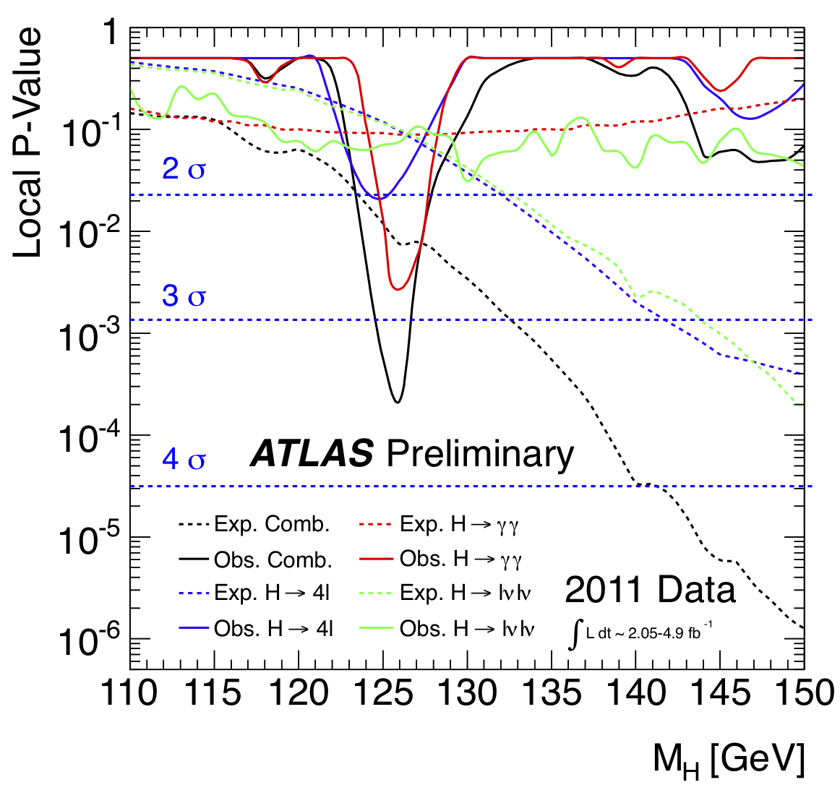
LHC Higgs Seminar Today!
Main auditorium at 14:00

Slide 3
WH->lνbb/ZH->llbb paper
No update today:
Tried anti-k_{T} with R=0.6 and found strange features (probably related to pileup problem from Pythia 8)
Would take too long to understand, so reverting to anti-k_{T} with R=0.4
Editors:
Andy Mehta, Giacinto Piacquadio and Paul Thompson
Editorial Board:
Pippa Wells, Elzbieta Richter-Was, Christian Weiser, Gavin Hesketh
Timeline:
Higgs pre-approval on Thursday
Final selections and limit code demonstration
Documentation to the EdBoards before Christmas break
Higgs approval at the very latest 9th Jan
Papers circulating by the 10th Jan
Open Presentation: Jan 18
Public Reading: Jan 25
Submission to journal: Jan 30
Links:
COM note (ATL-COM-PHYS-2011-1648): https://cdsweb.cern.ch/record/1404176?
SVN area for note: https://svnweb.cern.ch/trac/atlasgrp/browser/Physics/Higgs/HSG5/data_7TeV/ATL_COM_PHYS_2011_1648

Slide 4
Time of the HSG5 weekly meeting
Doodle poll: http://doodle.com/xkzn2zcgx6s3h38i
Meeting will move to Thursday 2pm

