Slide 1
Effect of b-tagging Scale Factors on M_{bb} invariant mass distribution
Ricardo Gonçalo

Slide 2
The problem
B-tagging scale factors enter the analysis as a weight for each b-jet, and depends on the jet pT
The event weight is taken as the product of the two weights (there are 2 b-jets per event)
This introduces a distortion in the jet pT distribution, where some pT regions become enhanced
Since m(bb) depends on jet pT this potentially introduces a distortion on the shape of the selected sample
This may be important since we are looking for a small excess in the form of a wide peak in the m(bb) distribution
We have a proposed way to deal with this effect by averaging the b-tagging scaling factors and propagating the factor uncertainties, which are used as systematic uncertainties
This small toy-Monte Carlo study tries to evaluate the size of this distortion

Slide 3
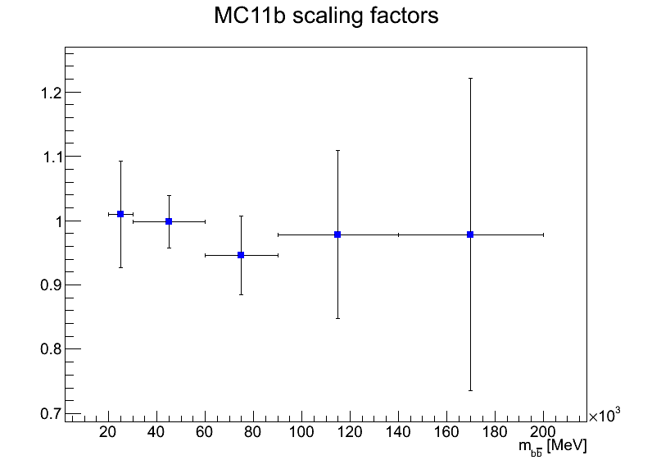
B-tagging scaling factors
The MC11b scaling factors at present show little evidence of a p_{T} dependence
But such a dependence would clearly be possible
New factors to be released also as a function of η

Slide 4
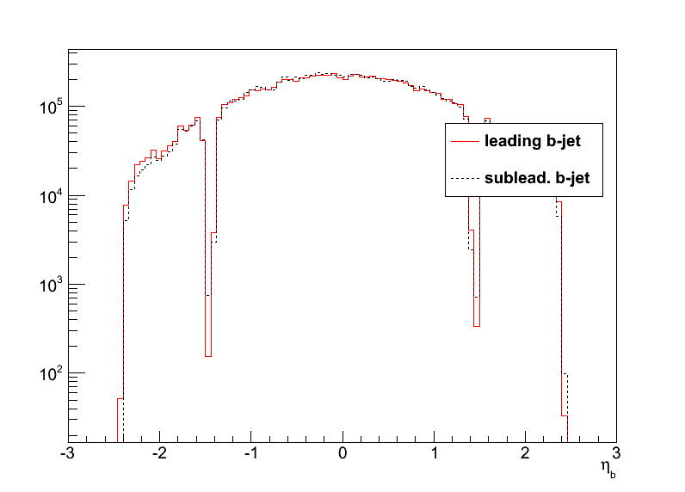
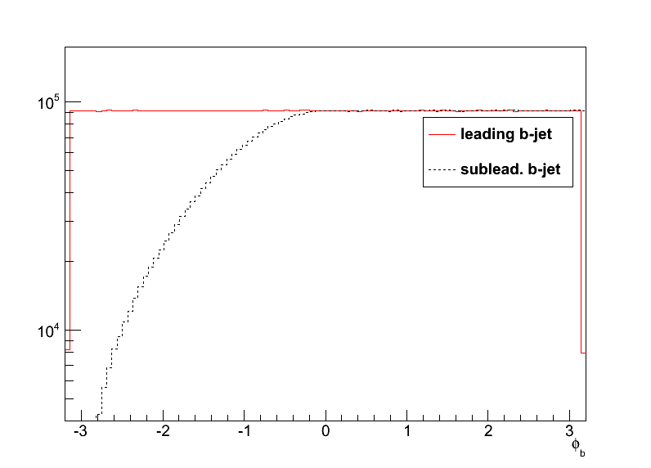
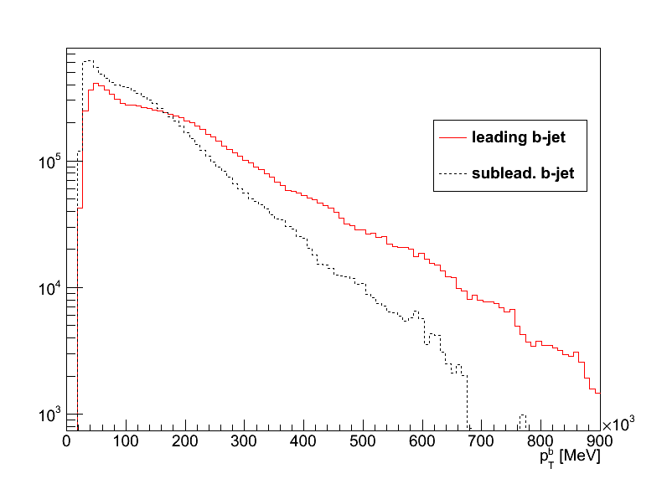
Toy Monte Carlo Study
Toy MC to study the effect of b-tag scale factors
Caveat: first study done with di-photon MC kinematics – a look at bb background later
Sample p_{T} and η of leading and subleading b-jets
Generate flat φ_{lead b-jet} and flat mass distribution
Calculate φ_{sublead b-jet} to be consistent with generated mass (and reject unphysical solutions

Slide 5
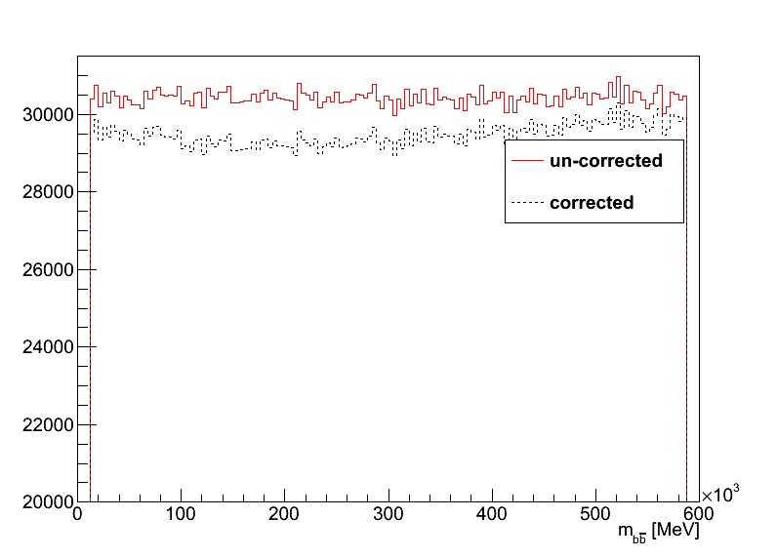
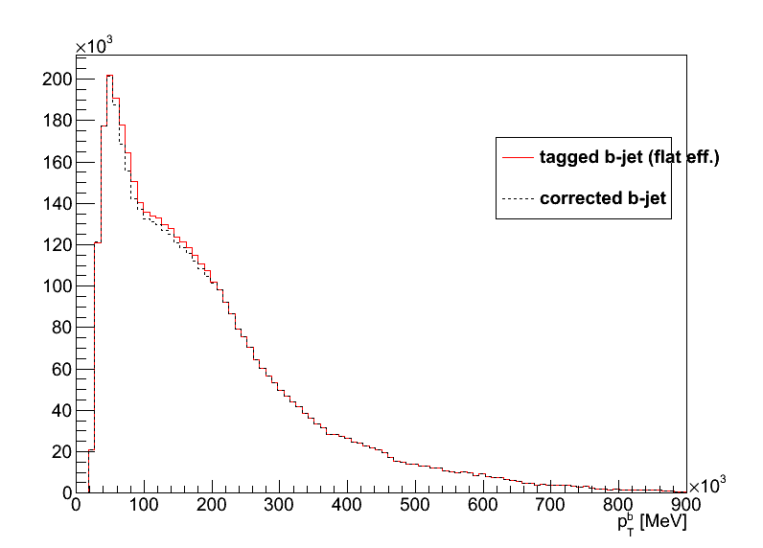
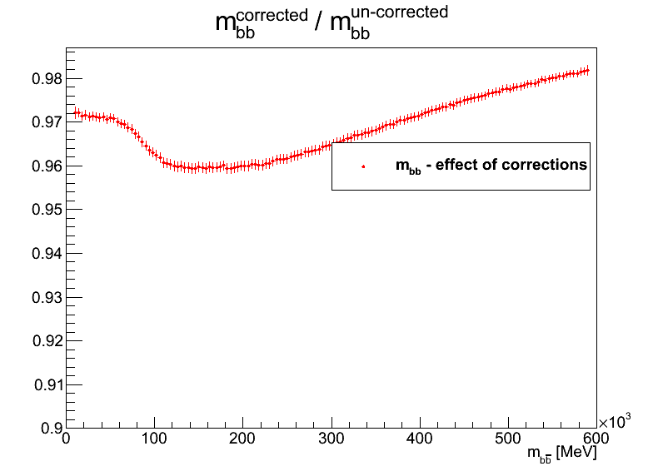
Effect of MC11b scaling factors
Scaling factors applied as a statistical weight for each b-jet W_{b1} and W_{b2} (W_{b}=1 for p_{T}^{b}>200GeV)
Event weight is product W_{b1} x W_{b2}
The reweighting causes a distortion in the flat invariant mass distribution (plus constant term)
The distortion is small, but then so is our signal compared to the background
May be more serious if width comparable to m_{bb} resolution, as in our case (σ_{m(bb)}≈20GeV)

Slide 6
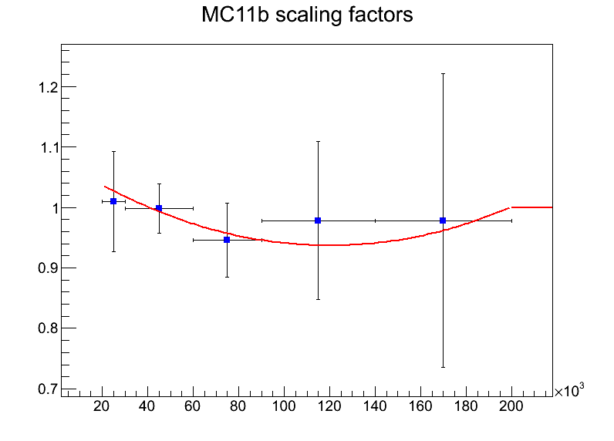
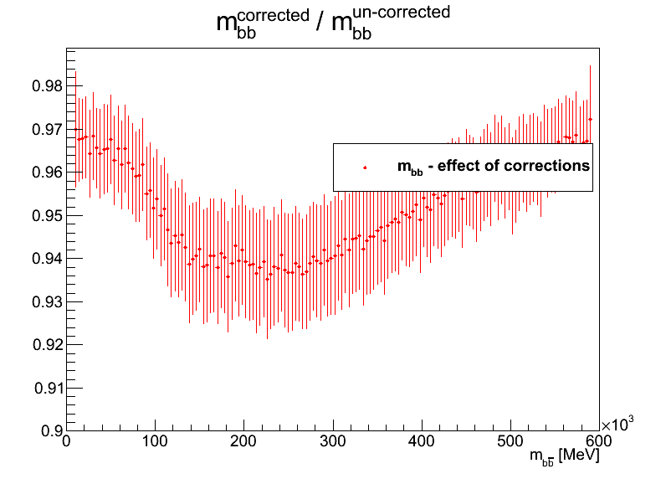
Binning effect?
To see whether this is an effect of the binning, fitted scaling factors (SF) with a parabola (and W_{b}=1 for p_{T}^{b}>200GeV)
Still get similar distortion => not (only) binning effect (notice lower statistics)

Slide 7
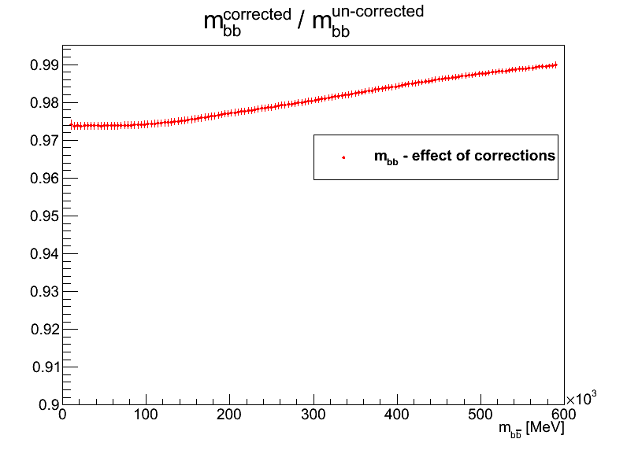
Effect of our averaging procedure
We use the average of the scale factors (0.9865) and propagate the errors taking into account bin-to-bin correlations
Small effect still visible (bottom right) looking at wide mass range
But very smooth compared to the horizontal with of our signal peak

Slide 8
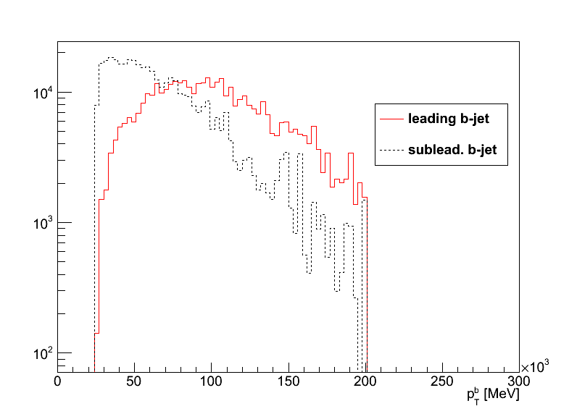
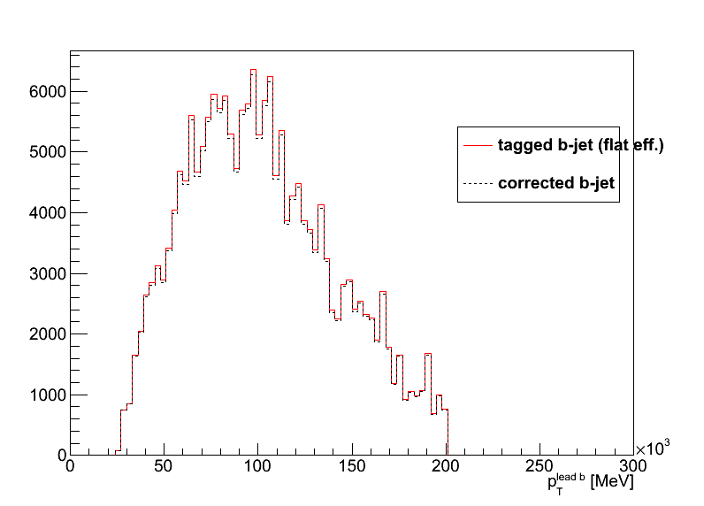
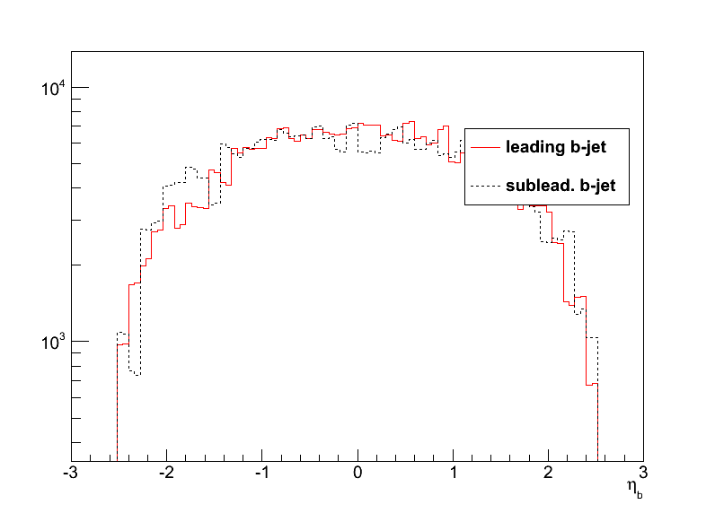
Using different input kinematics
Re-did some plots with b-tagged jets from W+bb and top backgrounds
Jet pT cutoff at 200GeV

Slide 9
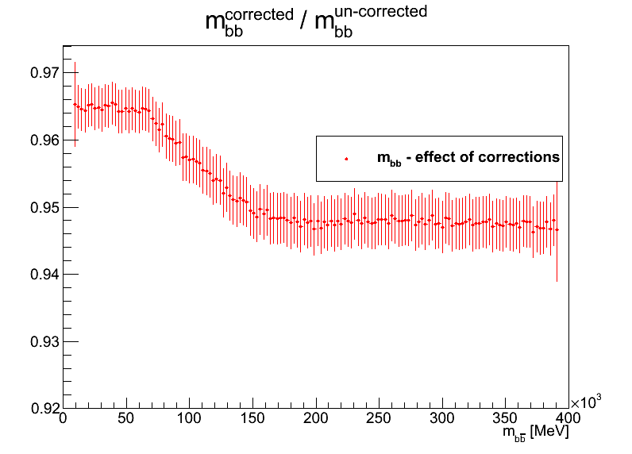
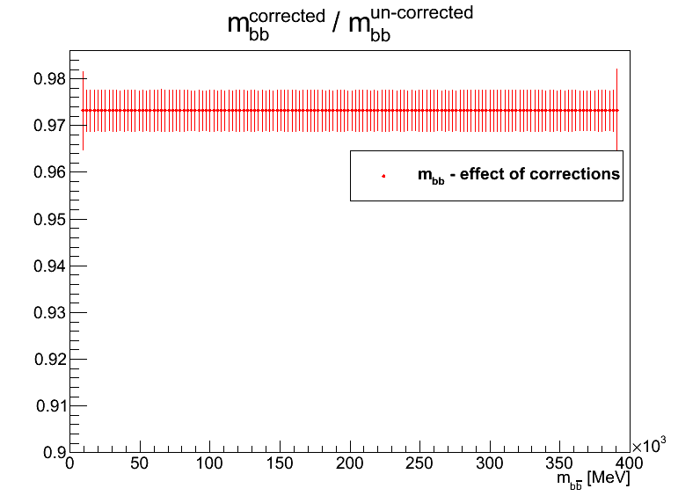
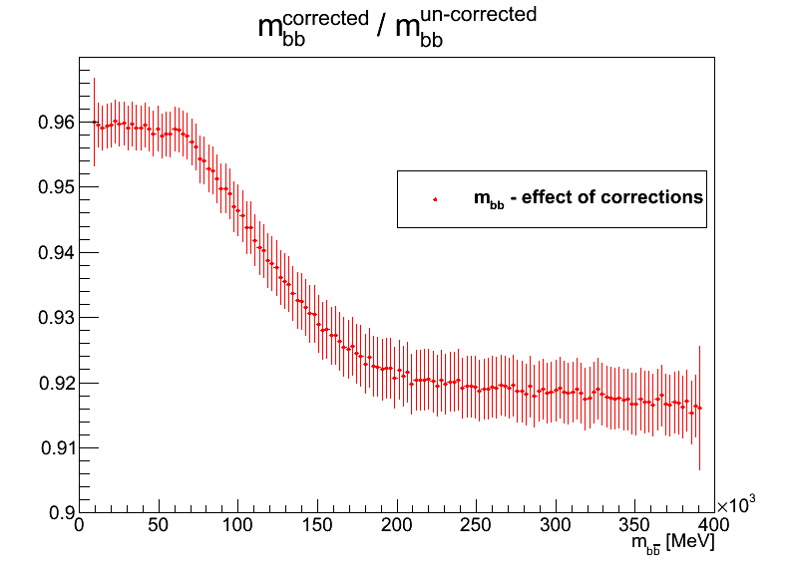
Results using background kinematics
Basically same conclusion:
MC11b scaling factors distort mass distribution (top right)
Even if a parametrization is used (bottom right)
Our averaging procedure removes shape distortion (bottom left) – note zero distortion in this case only due to jet pT cutoff at 200 GeV!

Slide 10
Backup slides

Slide 11
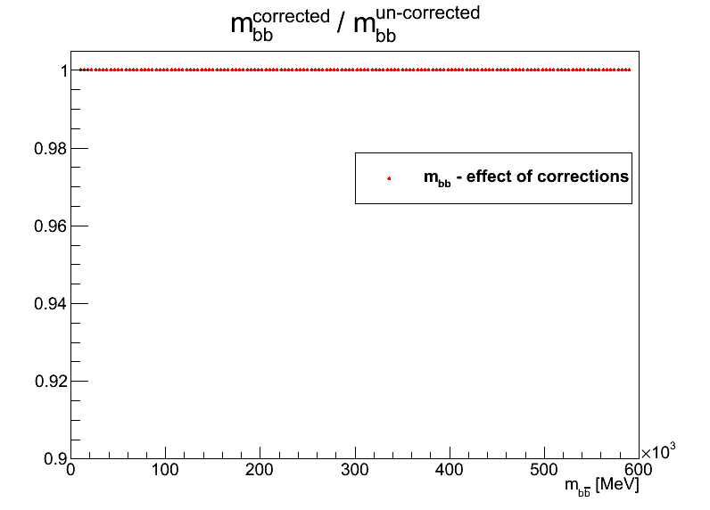
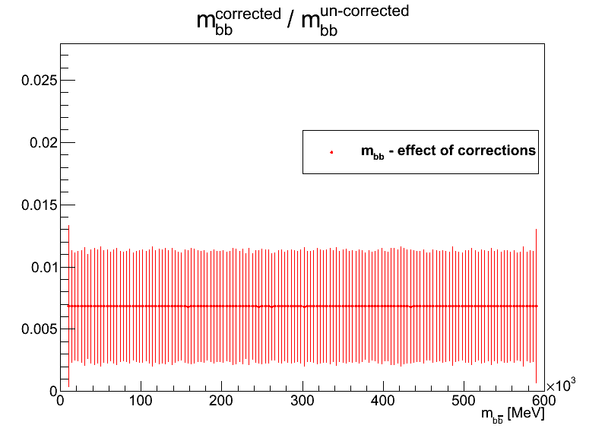
Cross checks
If all b-tagging scale factors are set to 1 there is no effect on the mass distribution, as expected (top right)
If they are all set to the average (0.9865) including for jets with p_{T}^{b}>200GeV, effect on mass is flat, also as expected (bottom right)

Slide 12
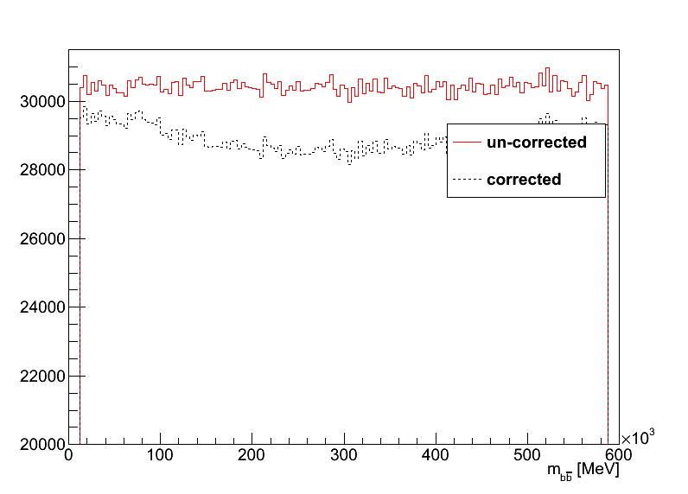
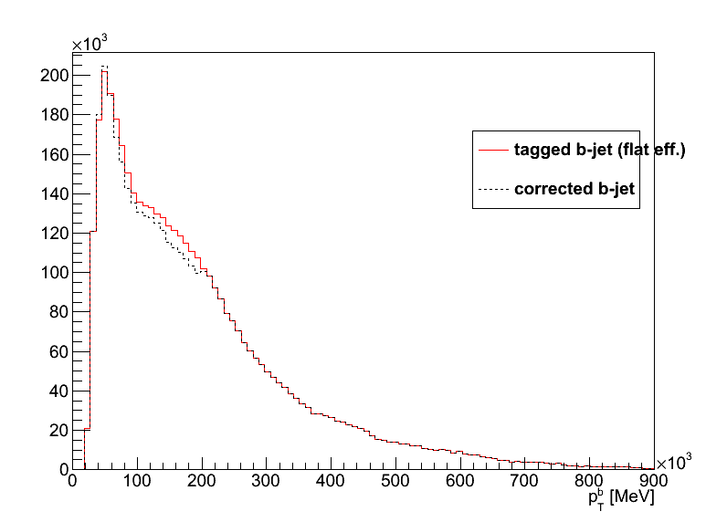
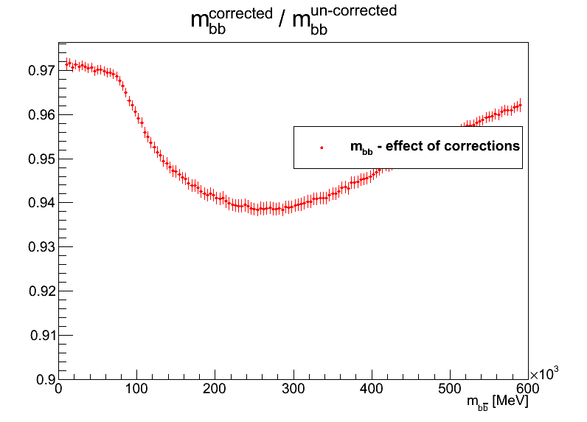
Other scaling factors
Using preliminary scaling factors from MC11a (December 2011) get even larger effect

