Slide 1
Introduction
Ricardo Gonçalo (RHUL)
Higgs Weekly Meeting – 12 April 2012

Slide 2
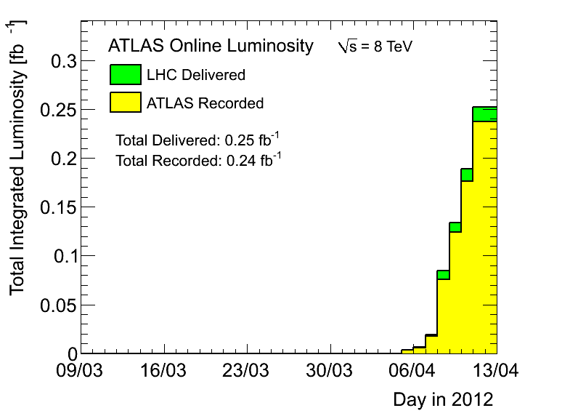
News! News! News!
LHC 2012 8TeV run has started!
Peak <events>/bunch crossing 27 (37 seen!!)
Peak stable lumi 2.5x10³³cm⁻²s⁻¹
From Lumi talk at Open EB:
Final lumi scale error for 2011 likely to be close to 2%. Small change to central value possible
And also… for initial 2012 running:
New CMS lumi scale implies significant luminosity imbalance between points 1 and 5 (6-8%)

Slide 3
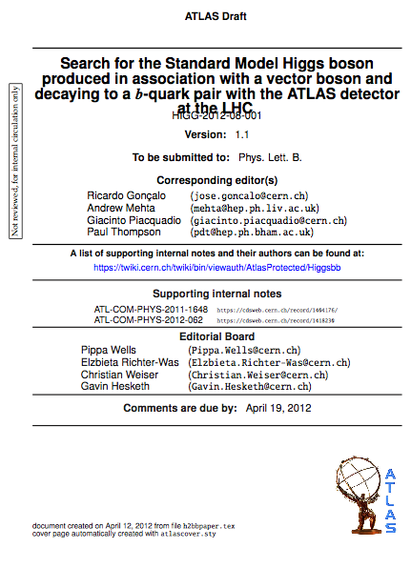
News! News! News!
H->bb analysis approved by Higgs group
Circulated today (1/2h ago)! https://cdsweb.cern.ch/record/1440266
Congratulations everyone! ☺
What next:
One week of comments
First reading
Second period of comments by collaboration and management
Second reading
Send to journal
More comments…
Publication!

Slide 4
Planning for 2012 analyses
No rest for the weary!…
Next issue for the whole group is an internal note on plans for 2012 analyses
The plan is not completely clear to me yet (e.g. which MC to use)
But main goal is to make unbiased decisions:
Decide on cuts and strategy before looking at new data
Should take this as an opportunity to think ahead:
Boosted VH analyses and how to merge with inclusive
ttH, VBF, BSM analyses (see e.g. Javier and Merlin’s talk today)
Use of MVAs (see e.g. Jan’s talk today)
Study trigger constraints and where we can gain signal (ongoing)
Needs from MC: generators, where MC improvements can help most – e.g. W+jets background, N_{jets} and p_{T}^{W} description, where can theory help?
CP performance gains needed: b-tagging, bJES, MET (see e.g. Jike’s and David’s talk)
Remember WH/ZH analyses are now systematics limited!
How to optimize analyses to prepare for 125GeV Higgs property measurements?

Slide 5
Minimal walking technicolor analysis
Proposed by Georges Azuelos, Koji Terashi and Else Lytken
Idea is to do combined work between HSG5 and Exotics diboson group
Should be very readily applicable to the ZH->llbb analysis, and other possibilities exist
See Merlin’s talk

Slide 6
Bonus slides

