Slide 1
H->bb Weekly Meeting
Ricardo Gonçalo (RHUL)
HSG5 H->bb weekly meeting, 11 October 2011

Slide 2
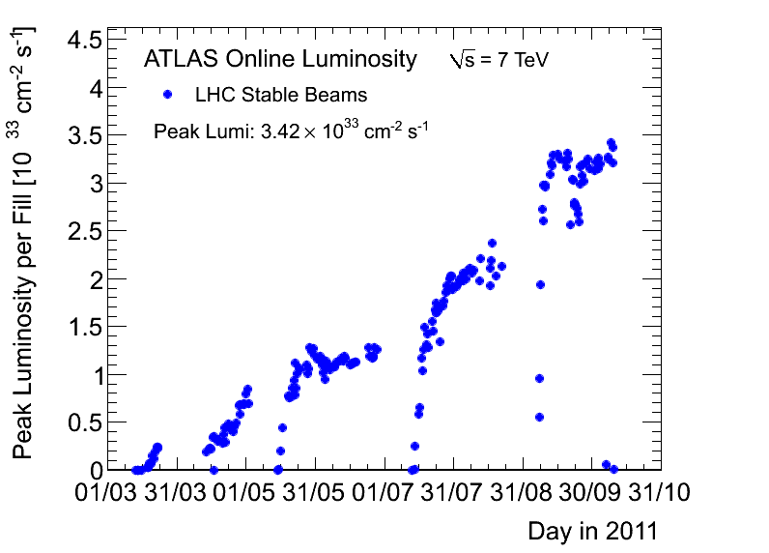
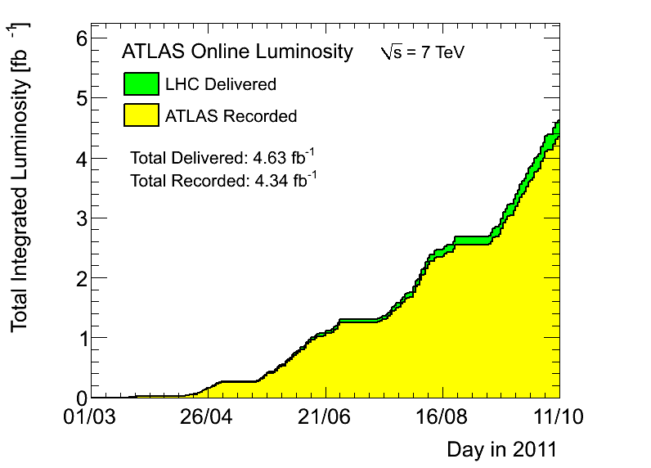
News! News! News!
Peak stable lumi 3.31x10³³cm⁻²s⁻¹
4.3 fb⁻¹ with stable beams collected so far – 4.6 fb⁻¹ delivered
≈350pb⁻¹ collected last week
Pileup peak around 21
25ns run taken on 7th Oct. with 288 bunches – more on Thursday this week

Slide 3
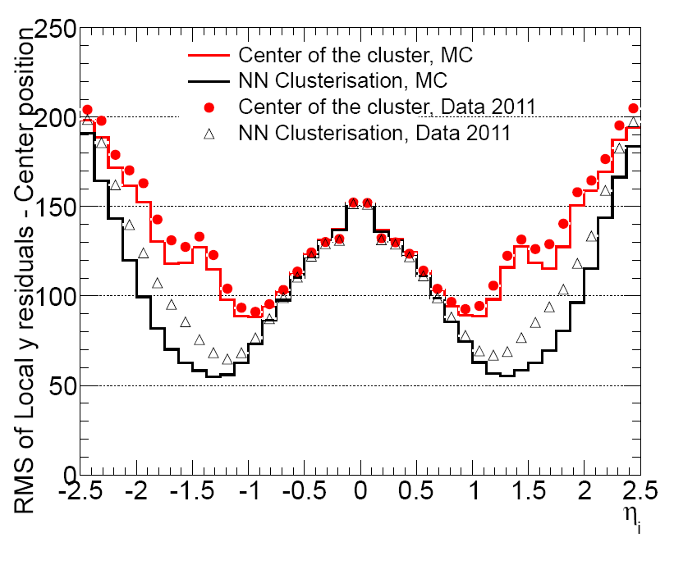
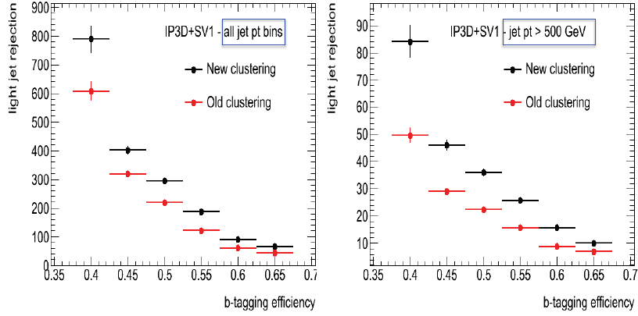
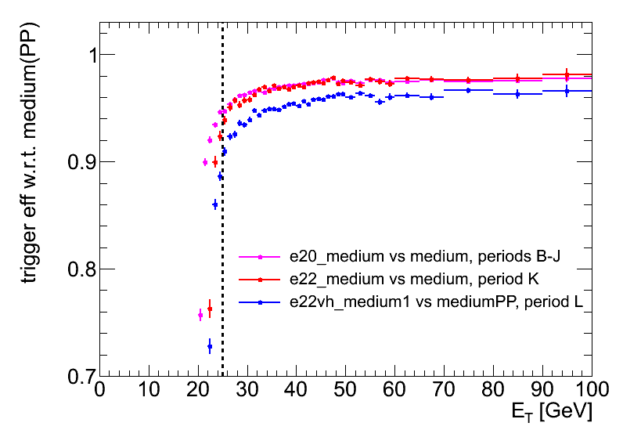
News from ATLAS Week
Pixel cluster residuals much reduced for |η|>1
New pixel clustering improves b tagging
New single electron trigger since period L: e22vh_medium1
Other useful triggers (for ZH):
2e12Tvh_medium
e15vh_loose1_e12Tvh_loose1_Zee
Glossary:
V = L1 threshold variable in η
H = hadronic core leakage < 1 GeV
T = thin “gap” between L1 and HLT thresholds
Medium1 corresponds to offline “medium++”

Slide 4
HSG5 D3PD Status
New stream for gamma+bb:
Selection modified to loosen cuts for gamma+bb
Z->bb:
Some changes to HighPtTracks mplemented by Ilektra:
Lowered pT cut, stored more track info
Not yet validated
Adding b-tagging info and more changes to D3PD, will privately produce small validation samples for tests
WH->lnubb: Validated by Edinburgh
WH stream ready to go to DPD train!
Means getting your D3PDs for new data with no effort…
ZH analyses need to check Skim selections before adding this to DPD train!
Output Skim | #events | Size
HSG5WH | 5.5 M | 340 GB
HSG5ZHLL | 5.5 M | 340 GB
HSG5ZHMET | 4.8 M | 240 GB
HSG5ZBB | 8 M | 480 GB
Total | 24 M | 1.4 TB
Input Stream | Period | #events | Size
JetTauEtmiss | E | 8,588,376 | 1.27 TB
Muons | E | 6,182,165 | 0.89 TB
Egamma | E | 8,157,991 | 1.01 TB
JetTauEtmiss | H | 37,748,640 | 5.51 TB
Muons | H | 28,367,693 | 3.99 TB
Egamma | H | 29,506,835 | 3.56 TB
Total | E+H | 118,551,700 | 16.2 TB

Slide 5
MC requests
Inclusive and boosted H->bb samples for MC11b:
Herwig++ in Powheg
Mass points: M_{H} = 110, 115, 120, 125, 130, 135, 140, 145, 150 GeV
WH->lνbb, ZH->llbb, ZH->ννbb
Both boosted and inclusive for each mass
Approved for production – still in waiting list for MC11b production (delays in MC11a)
Other samples:
Wbb, Zbb
ZH, WZ, WW -> lljj and llbb final states
Gluon-fusion H->bb
See Junichi’s page: https://twiki.cern.ch/twiki/bin/view/AtlasProtected/HSG5Higgs2bbFinalState#H_bb_MC_samples

