Slide 1
Introduction
Ricardo Gonçalo (RHUL)
Higgs Weekly Meeting – 11 May 2012

Slide 2
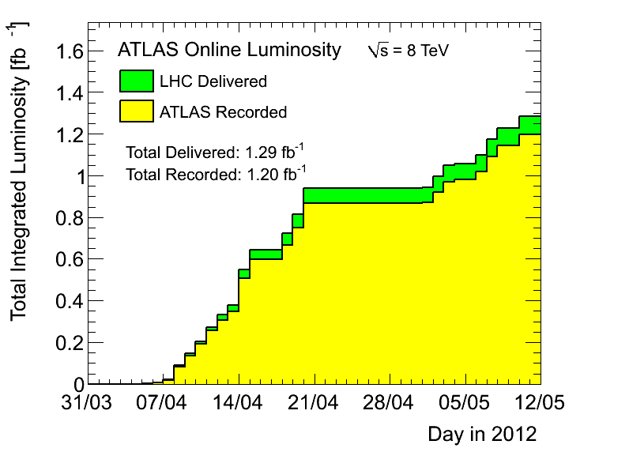
News! News! News!
Peak <evts>/bunch crossing: 20 – 26
Peak stable lumi: 5x10³³cm⁻²s⁻¹
Lumi with stable beams: 1.2fb⁻¹
≈ 0.27 fb⁻¹ collected last week

Slide 3
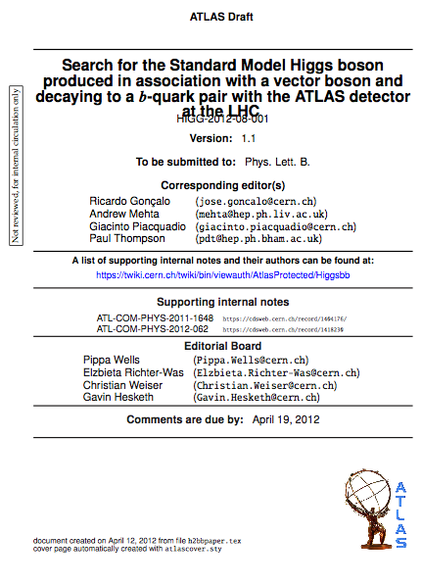
News! News! News!
H->bb paper almost ready for second circulation
https://cdsweb.cern.ch/record/1440266
Current version in CDS for last comments by EB
https://cdsweb.cern.ch/record/1439564?ln=en
Due to SVN problems, moved to:
atlasusr/jgoncalo/ATL_COM_PHYS_2011_1648
Would be good to answer all comments today
What next:
Second circulation
1 week of comments by collaboration and management
Second reading
Send to journal
More comments…
Publication!

Slide 4
News! News! News!
HSG5 Contact people with the Jets group of the LHC Higgs XS WG:
Paolo Francavilla and David Lopez Mateos
Identified issues to discuss at meeting on Monday:
Uncertainty from jet counting/binning/veto
Existing methods by Frank Tackmann and Gavin Salam
Impact of PS tune on this uncertainty
MC description of low-ΔR(jj) region
Impact of PS on jet substructure
See Ben Cooper’s slides in today's SM meeting: https://indico.cern.ch/conferenceDisplay.py?confId=153420
Top+Njets: ttjj and ttbb are main ttH backgrounds
Interference between Wb and single top
Modelling of Higgs hadronic decay
Giacinto Piacquadio will be involved from the WH/ZH theory side
Chris Potter contact person for ttH theory contact

Slide 5
Workshop?
Doodle sent around today
Mon-Tue or Thu-Fri
Dates in June – beginning of July at CERN
Dates in late July in Edinburgh (thanks!)
http://doodle.com/bwg3akk5bxehf867

Slide 6
Bonus slides

