Slide 1
H->bb Weekly Meeting
Ricardo Gonçalo (RHUL)
HSG5 H->bb Weekly Meeting, 10 May 2011

Slide 2
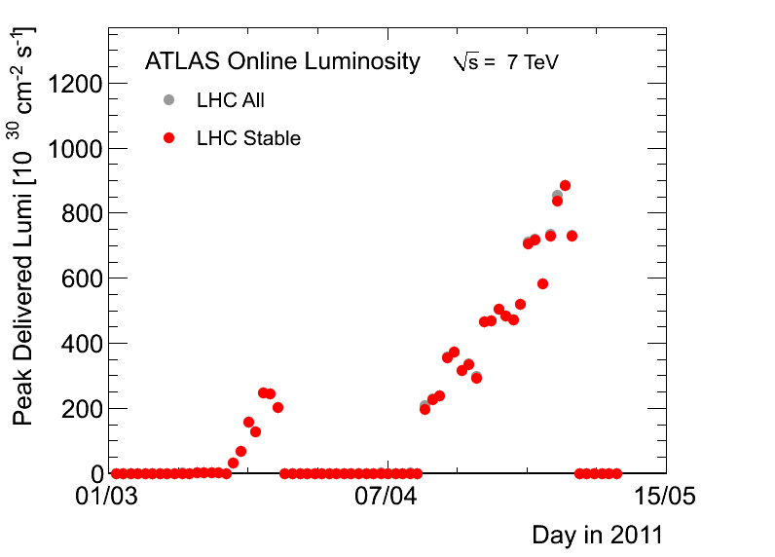
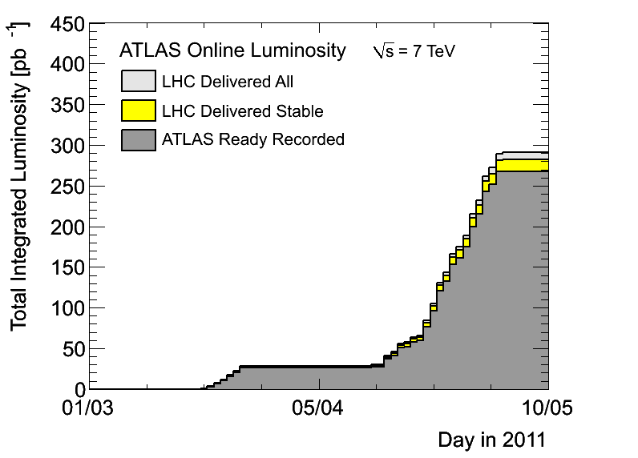
News! News! News!
Currently in technical stop – no changes since last week
About 0.27 fb⁻¹ collected with stable beams so far
50ns bunch spacing
768 colliding bunches
700 bunches in ATLAS
Inst Lumi up to ≈9x10³²cm⁻²s⁻¹
From increased nr of bunches, so peak pileup stays ≈ 10 - 14 collisions per bunch crossing

Slide 3
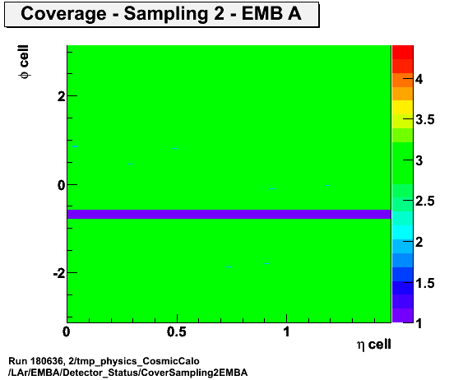
News! News! News!
Open Discussion of the first draft on the combination of Higgs searches https://indico.cern.ch/conferenceDisplay.py?confId=137883
New calibration of the 2011 luminosity now available:https://atlas-datasummary.cern.ch/lumicalc/
For all 2011 data (periods A to E)
Lost LAr Front End Boards (FEBs)
Φ = [-0.64,-0.74] & η = [0,1.4]
Lost after power glitch on 30 April
Possibly only recoverable during Christmas
LAr cleaning and object quality: https://twiki.cern.ch/twiki/bin/view/AtlasProtected/LArCleaningAndObjectQuality
To allow filtering out of:
LAr noise bursts and data integrity errors
Bad quality clusters through the Object Quality Flag
Dealing with LAr hardware problems in Monte Carlo.

Slide 4
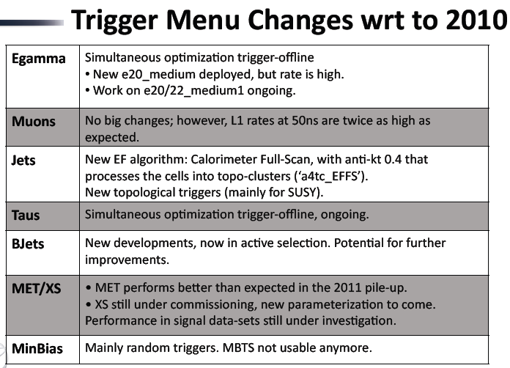
Trigger menus in 2011: from Anna Sfyrla’s talk at the last Weekly:https://indico.cern.ch/getFile.py/access?contribId=2&resId=0&materialId=slides&confId=119636
At 2x10³³cm⁻²s⁻¹ (not so far away) e20_medium and mu18 disabled
On e.g. e/gamma trigger optimization see A.Tricoli’s talk in today’s weekly
We need someone to follow the menu/trigger performance evolution for our group!

Slide 5
News! News! News!
Jet calibration task force meeting today dedicated to fat jets: https://indico.cern.ch/conferenceDisplay.py?confId=138439
Jet substructure note: http://cdsweb.cern.ch/record/1347794
And backup note: http://cdsweb.cern.ch/record/1344082/
From Sandra’s intro talk to Higgs WG meeting last week: https://indico.cern.ch/getFile.py/access?contribId=0&resId=0&materialId=slides&confId=136406
Ongoing work on jet performance:
JES uncertainties, especially due to pile-up.
Expect recommendations for central jets, |η|<2.1 on PLHC time scale
Call for manpower to join studies – work needed especially on JVF and effect of pileup on MET (MET recommendation based on 2010 studies)
b-tagging – operating points to be calibrated for PLHC:
SV0 50% (w>5.85)
JetProb 50%, 70%, 80%, 90% (-log10(w) > 3.25, 2.05, 1.40, 0.60)
Plan to update uncertainties related to pile-up and run conditions.
Run calib with two JVF settings (to check stability): no JVF cut, JVF>0.8

Slide 6
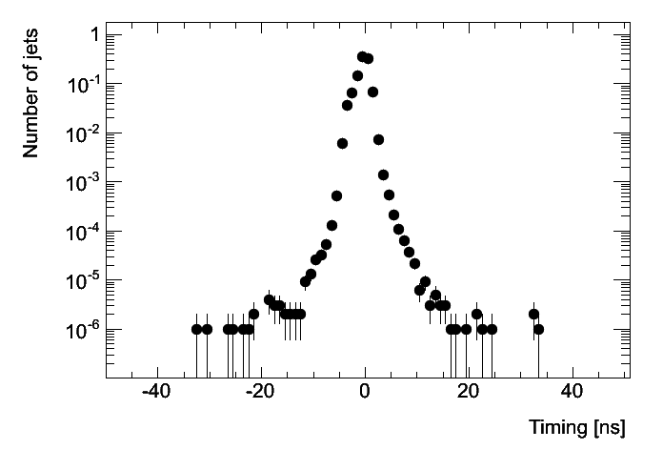
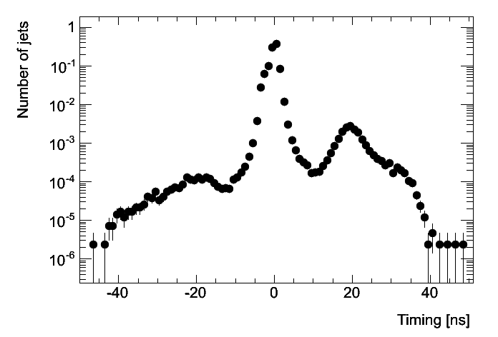
Jet timing problem
Found last week:
Peak at Δt ≈ 20ns in jet timing distribution https://indico.cern.ch/getFile.py/access?contribId=10&sessionId=0&resId=2&materialId=slides&confId=135825
Appeared in 50ns running, not apparent in 75ns running
Problem understood:
Effect from HLT jets seeded by random triggers (not L1 jets) active in empty bunches between colliding bunches
EF_j20_a4tc_EFFS, EF_j10_a4tc_EFFS, EF_j15_a4tc_EFFS affected (full-scan EF jets)
Problem became evident after changes in jet trigger coincidental with 50ns running
75ns
50ns

Slide 7
Monte Carlo
From Jianming’s talk on Higgs reweighting to NLO at Higgs WH meeting:
Large differences between NLO generators in jet distributions
Watch this space…

Slide 8
Conferences:
for EPS-HEP, focus on papers instead of notes
Higgs approvals for EPS-HEP: 20th – 25th July
https://indico.cern.ch/getFile.py/access?contribId=0&resId=0&materialId=slides&confId=136406

Slide 9
From Chris C-T’s talk in Higgs meeting: https://indico.cern.ch/getFile.py/access?contribId=8&resId=0&materialId=slides&confId=136406

Slide 10
Poster abstract for EPS-HEP
H->bb searches with the ATLAS detector at the LHC
The H -> bb channel is extremely important for the observation of a Higgs boson signal at the LHC. In the Standard Model, this channel would provide a significant contribution to the Higgs boson search in the low mass region, where this decay mode constitutes the dominant Higgs decay channel. Due to the enormous jet production cross-section at the LHC, the search must target channels where the Higgs boson is produced in association with a weak boson, a pair of top quarks, or jets separated by a rapidity gap. It also requires complex techniques to reconstruct the signal and separate it from an overwhelmingly large background. We present the status of Higgs searches in the H->bb channel currently being performed within ATLAS.
In case it’s accepted we’ll need a candidate to present it at EPS
Please let me know by email before Friday if you would like to do this
Will randomly choose a presenter from candidates

Slide 11
Backup

Slide 12
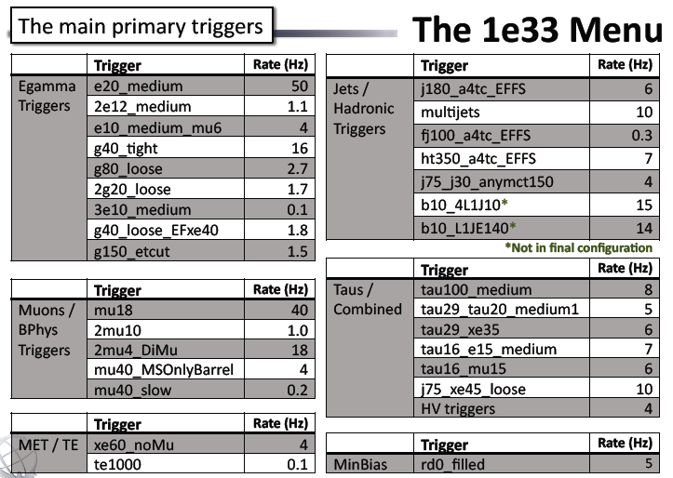

Slide 13
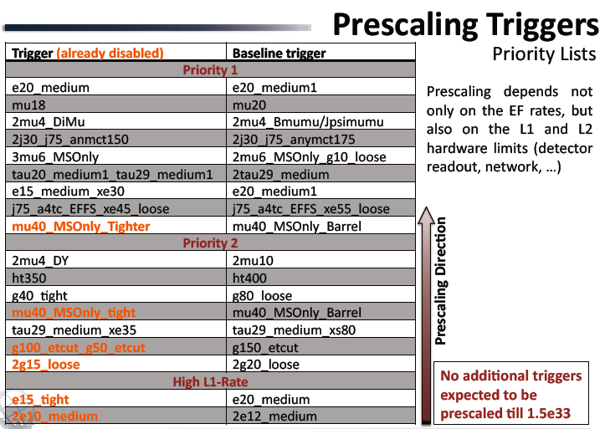

Slide 14
Discussion on Summer conferences
Dubna (in 2 weeks) should be time to freeze our plans
Reminder of Summer conferences:
Data estimates from February seem to be on track!
PLHC 2011: 6 June (http://www.pg.infn.it/plhc2011/) L ≈ 0.6 fb⁻¹
EPS-HEP 2011: 21 July (http://eps-hep2011.eu/) L ≈ 1 fb⁻¹
Dataset frozen ≈ 1 month before; expect GRL, Lumi etc to be refined then
We aim to have CONF note for EPS – HEP 2011
PLHC too soon for us – would need a draft ready today…
Note on WH:
Lots of work has been building up to this, mostly on un-boosted channel
Let work evolve (task list) up to Dubna and start to write up – see Jike’s talk today
Expect at bb mass plot plus control plots and data-driven background determination
Anything to include on boosted channel? Define in Dubna…
What else? ttH? ZH?... Again, define in Dubna and then stick to the plan
Would like to send abstract for poster on H->bb (see next slide)

Slide 15
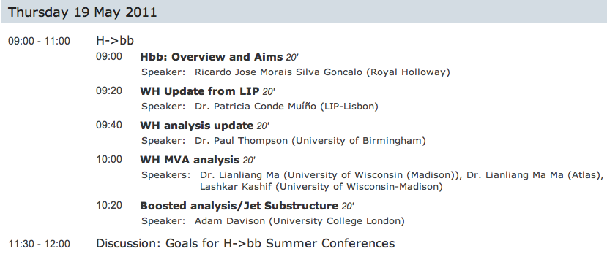
Dubna Workshop
Focus of H->bb agenda is WH
Should define final strategy for Summer conferences
https://indico.cern.ch/conferenceDisplay.py?confId=124954

Slide 16
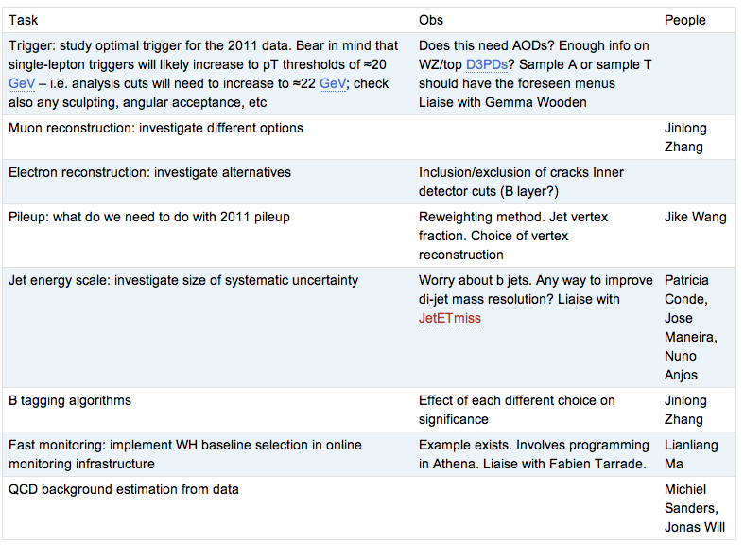
WH Task List
https://twiki.cern.ch/twiki/bin/view/AtlasProtected/WHNoteSummer2011#Analysis_Tasks

Slide 18
Date | Milestones wish list
17 May | Dubna workshop – analysis frozen After this: add data to un-boosted analysis and prepare for result approval Concentrate more effort on boosted VH with a view to obtaining results quickly
10 May | Review results with 2011 data from cut-based and multivariate analyses
3 May | Margin for dealing with unforeseen problems
26 April | Start looking at 2011 data if enough is available. Any surprises? How does the MC describe the new data? By now we should have a reasonable idea of results from the multivariate analysis
19 April | End of 2 weeks of beam scrubbing. (I’m away for Easter)
12 April | By now we should have a reasonable idea of the exclusion of the cut-based analysis First report on MVA preliminary results – establish plan for getting results by Dubna
5 April | Identify the worst systematics and discuss any possible improvements: Any changes needed in analysis cuts? Any study necessary for corrections to some systematic effect? Multivariate analysis: iterate on preselection cuts, methods, questions Assign tasks – divide the work to achieve better results!
29 March | Establish analysis cuts: If possible as result of optimization Use 2010 data to develop cuts and show that data is well described by background MC Start evaluating systematics
22 March | Iterate on analysis cuts – why is each cut applied at each particular value? Start iteration on multivariate methods to improve analysis

Slide 19
Reconstruction issues
Muon CP group recommendations for release 16:
Reconstruction efficiency and isolation efficiency scale factors, momentum smearing functions
https://twiki.cern.ch/twiki/bin/view/AtlasProtected/MCPAnalysisGuidelinesRel16
Jet/Etmiss recommendations for jet cleaning in release 16:
Medium jet cleaning should give similar rejection to rel 15 cleaning but with better efficiency
Tight jet cleaning should not be used – still under discussion
https://twiki.cern.ch/twiki/bin/view/AtlasProtected/HowToCleanJets#Bad_jets_rel16_data
New!: Final b-tagging calibrations for release 16 based on full 2010 data:
https://twiki.cern.ch/twiki/bin/view/AtlasProtected/Analysis16
e/gamma recommendations for energy scale and resolution in release 16:
https://twiki.cern.ch/twiki/bin/view/AtlasProtected/EnergyScaleResolutionRecommendations
And rescaler tool: https://twiki.cern.ch/twiki/bin/view/AtlasProtected/EnergyRescaler
Standard Model W/Z group baseline selection for release 16 (next 4 slides):
See discussion in W/Z group Sharepoint
Also, finer points (and perhaps the not so fine) still being discussed

