Slide 1
H->bb Weekly Meeting
Ricardo Gonçalo (RHUL)
HSG5 H->bb Weekly Meeting, 9 March 2011

Slide 2
News! News! News!
Bad samples:
MC10 Pythia-CTEQ66 QCD samples (IDs: 115216-115221 ) have been mistakenly run with the MC09c tune (i.e. LO* PDF) due to a bug – will be re-run
Mainly for Eric…
New VBFNLO version will be out in next 2 months: http://www-itp.particle.uni-karlsruhe.de/~vbfnloweb/
KinFitter – those considering a kinematic fit may be interested in this package:
Wiki: https://twiki.cern.ch/twiki/bin/viewauth/Atlas/KinFitter
ATLAS Note in CDS (ATL-COM-SOFT-2009-014): http://cdsweb.cern.ch/record/1206849?ln=en
Next meeting of the LHC Higgs Cross Section H->bb subgroup booked for 17 March, 15:00 CET – see email from Chris Potter
More participants welcome, especially experimentalists

Slide 3
News! News! News!
Muon CP group recommendations for release 16:
Reconstruction efficiency and isolation efficiency scale factors, momentum smearing functions
https://twiki.cern.ch/twiki/bin/view/AtlasProtected/MCPAnalysisGuidelinesRel16
Jet/Etmiss recommendations for jet cleaning in release 16:
Medium jet cleaning should give similar rejection to rel 15 cleaning but with better efficiency
Tight jet cleaning should not be used – still under discussion
https://twiki.cern.ch/twiki/bin/view/AtlasProtected/HowToCleanJets#Bad_jets_rel16_data
New!: Final b-tagging calibrations for release 16 based on full 2010 data:
https://twiki.cern.ch/twiki/bin/view/AtlasProtected/Analysis16
e/gamma recommendations for energy scale and resolution in release 16:
https://twiki.cern.ch/twiki/bin/view/AtlasProtected/EnergyScaleResolutionRecommendations
And rescaler tool: https://twiki.cern.ch/twiki/bin/view/AtlasProtected/EnergyRescaler
Standard Model W/Z group baseline selection for release 16:
See discussion in W/Z group Sharepoint
Also, finer points (and perhaps the not so fine) still being discussed

Slide 4
Future changes in W/Z baseline selection

Slide 5
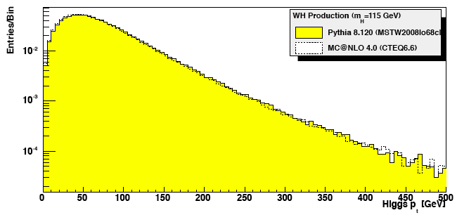
To boost or not to boost…
We expect a sizeable luminosity this year:
0.6 fb⁻¹ for PLHC in June; 1 fb⁻¹ for EPS in July; 2 fb⁻¹ for Lepton-Photon in August
Need to get boosted VH analyses going again!
Work is currently ongoing within the SM group – mainly on commissioning the jet substructure reconstruction
Looking at a H spectrum in WH (by eye!):
≈0.5 of the cross section above p_{T}^{H} = 100 GeV
≈7.5% above p_{T}^{H} = 200 GeV
√s = 7 TeV | p_{T}^{H} > 0 GeV | p_{T}^{H} > 100 GeV | p_{T}^{H} > 200 GeV
Channels | σ x BR(e/μ) (fb) OR # events per fb⁻¹ | σ x BR(e/μ) (fb) OR # events per fb⁻¹ | σ x BR(e/μ) OR # events per fb⁻¹
WH->lνbb | 150 | 75 | 11
ZH->llbb | 29 | 14 | 2.2

Slide 6
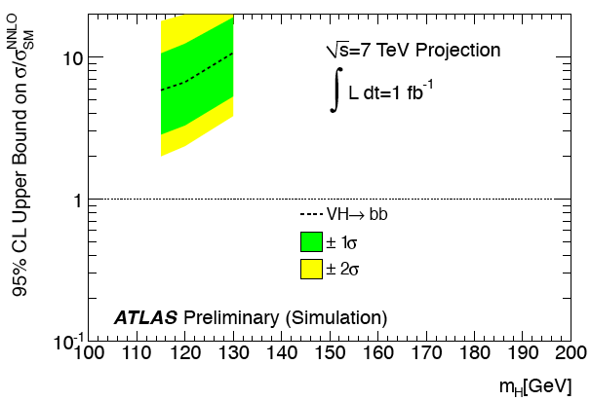
To boost or not to boost…
Un-boosted channel sensitivity:
Boosted channel sensitivity:
All we currently have at √s = 7 TeV are Lianliang’s numbers from the 15/12/2010 H->bb meeting: http://indico.cern.ch/conferenceDisplay.py?confId=115169
WH (e and μ channels) gives 56 x SM exclusion with 35 pb⁻¹ at m_{H} = 120 GeV
Includes 10% systematic uncertainty on signal and background and 11% on luminosity
Assumes IP3D+SV1 will be usable for this analysis
For 1 fb⁻¹ this translates roughly as a factor 5 improvement, i.e. exclude ≈ 10 x SM
Exclude 6.7 x SM at m_{H} = 120 GeV with 1 fb⁻¹ - see ATL_PHYS_PUB-2010-015
Obtained by scaling 14 TeV numbers – room for optimization at √s = 7 TeV
Analysis selects p_{T}^{H} > 200 GeV
WH(W->lν) most promising, followed by ZH(Z->νν)

Slide 7
To boost or not to boost…
Boosted VH Status and Plans:
Work ongoing in SM group on commissioning jet substructure technique
See Adam’s presentation in last week’s SM plenary: http://indico.cern.ch/getFile.py/access?contribId=0&resId=0&materialId=slides&confId=127720
Jet substructure note should be ready in 1-2 months
Work ongoing in parallel to provide b-tagging algorithm tuned for fat jet environment
Given infinite time, the plan would be to follow with measurements of g->bb and W/Z+bb with the substructure technique, and then VH(H->bb)
But we don’t have infinite time! – need to put effort into optimizing the boosted VH analysis for 7 TeV
Edinburgh group has started on this – presentation next week – but more effort will be needed

Slide 8
To boost or not to boost…
My view:
We need to have results for Summer conferences:
To improve the ATLAS sensitivity at low mass – follow the Tevatron mantra which says that “every channel counts”
Develop experience in the group on b tagging, WH reconstruction, setting limits and combining results – pave the way for later
Put H->bb on the map of useful channels
The un-boosted channels seem to be in a better position for this – remember only 2-3 months left, analysis should be ≈ frozen end of May
At the same time boosted VH has better sensitivity and must be our real goal for physics results in associated VH production this year
What could be shown from this channel in Summer?
How do we organize ourselves to achieve both goals?
My proposal:
Split the work so that some people concentrate on un-boosted analysis and some on optimizing boosted analysis and on helping to commission jet substructure method
Get results out for Summer and move on fully to boosted analysis

Slide 9
Un-boosted WH Analysis – Next Steps
After the effort with comparing cut flows, we’re ready to start producing results!
The roadmap is clear:
Study optimal event selection
Proposal: start from W/Z group’s baseline selection
Mostly the same as used in cut flow comparison with some differences:
STACO instead of Muid muons and some differences in jet cleaning
Evaluate sources of systematic uncertainty
Improve analyses
Find ways to reduce most important systematics
Multivariate methods?
Accumulate statistics, write note, get results approved
After this: merge efforts into boosted analysis for another set of public results before the end of the year

Slide 10
Other ongoing issues
Fast monitoring
We are not a priority channel for this…
But should be ready to produce code for running in Tier0 once the analysis cuts are well defined and stable
The monitoring analysis cuts will be set in stone
ttH:
Ongoing – see talk by Alistair today
Barcelona group ramping up on this channel
VBF H->bb:
Ongoing – see talk by Eric today
Eric reassessing channel potential and working together with jet trigger to find good strategy
Anything else?

Slide 11
Backup

Slide 12
Fast Monitoring
Idea is to receive early warning when there is something interesting in the data
…better than getting a late warning from the other side of the ring ☺
Not to make plots of control regions – we have the regular monitoring for that
Not to do the analysis in real time – no final corrections, systematic uncertainties etc
Note that not seeing a signal does not mean it is not there, and vice versa!...
Implications are that it should be stable and robust selection focusing on signal region
Several open technical/organizational questions at the moment:
Where to run: Tier0, CAF or CERN Tier1
Other Tier1/2/3 would require too much bandwidth for AOD/D3PD/DAOD transfer
What data format:
D3PD:
Serious complications from D3PD versioning and stability - D3PDs not stable until long after data collection
D3PD size also a problem – would need to be produced from recent AODs as they are produced
Which D3PD – many different varieties and would require different analysis applications starting from different inputs
AOD:
Would need to implement analysis selection in Athena! (IWithin monitoring framework?)
Less versioning complications – could use stable Tier0 cache used for production
Could produce DAOD for selected events – would allow easy subsequent analysis, producing event displays etc
When plans are more clear will need someone to implement/coordinate this for our group

