Slide 1
Introduction
Ricardo Gonçalo
HSG5 weekly meeting – 9 February 2012

Slide 2
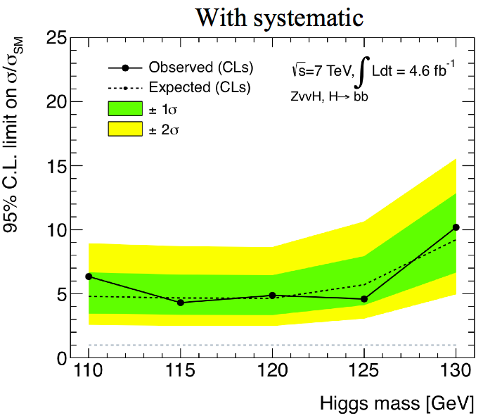
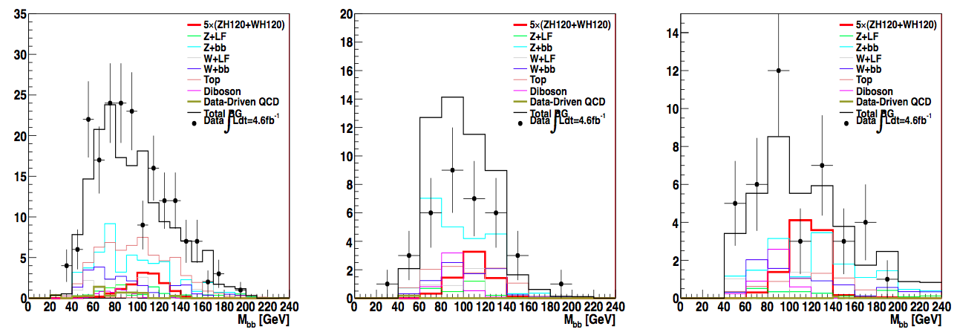
News! News! News!
Status report on H->ννbb yesterday https://indico.cern.ch/conferenceDisplay.py?confId=176385
Analysis well received
List of things to do but no show stoppers
Important dependence on llbb/lνbb for scale factors etc
Slight worry about 2nd bin
Looking good for adding to llbb/lνbb

Slide 3
WH->lνbb
p_{T}>45GeV
ΔR(b,b) > 0.7
No Cuts

Slide 4
The p_{T}>45GeV affair…
p_{T}>45GeV
No Cuts
Questions about the p_{T}(lead jet)>45GeV cut in the WH analysis
Meeting with editorial board today to discuss this
Note drafts in CDS and being updated:
WH->νlbb and ZH->llbb: https://cdsweb.cern.ch/record/1404176/
ZH->ννbb: https://cdsweb.cern.ch/record/1418230?ln=en

Slide 5
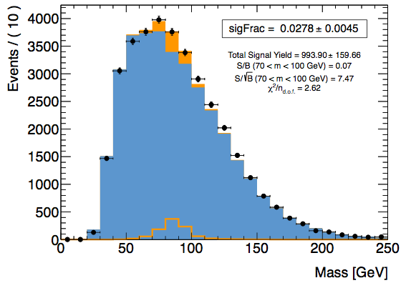
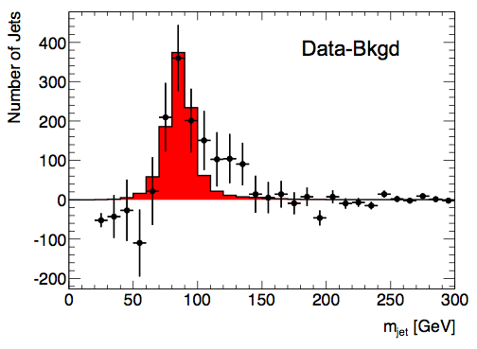
Today…
D3PD news
Latest news on Z peak (and shoulder…)

Slide 6
Backup slides

Slide 7
Publication Plans
From PC/subconveners meeting:
Latest circulation date to ATLAS is 17th February
Higgs approval to be arranged with Ed.Board
In practice:
This means 2nd February Higgs approval for paper – very little margin
Plan is more clear for WH and ZH->llbb: need good 1st paper draft
Status is not as good for ννbb yet: work towards including in paper
Boosted VH in a parallel path for now: considering a note for Moriond
To gain a few days (if needed):
ZH->ννbb will be submitted as support documentation to be included in paper
This means that we can turn it into CONF note if not in schedule for paper
Now thinking about editors for note
Maybe wrong time to mention this but…
Looking into the future, aim to have combined WH analysis for ICHEP including boosted analysis
Or before… mention ICHEP to mean up to…
ttH can aim to have published results in same timescale

