Slide 1
Introduction
Ricardo Goncalo
HSG5 H->bb weekly meeting, 8 November 2011

Slide 2
For the Higgs meeting on Thursday
Higgs Working Group meeting on November 10th.
Need to show summary of:
Progress of all analyses based on 5 fb⁻¹ of data
Current results
To-do list for the Council week, bottlenecks etc.
Progress of the CP work
General time scale for CP recommendations – from Higgs-CP liaison people
Progress of Higgs contributions to CP etc
Please let me know the status of your CP work today

Slide 3
The Monte Carlo Saga
Production status (Borut’s talk in yesterday’s PhysCoor): https://indico.cern.ch/conferenceDisplay.py?confId=160828
Geant4 production for priority 0 samples almost done
MC11b’ (old trigger menu etc) H->4l almost done
Full plans for MC11b (except SM and exotics) here: https://twiki.cern.ch/twiki/bin/view/AtlasProtected/AtlasProductionGroupMC11b
MC11b production:
Final validation of 17.0.5.1 tomorrow
Priority 0 should start this week
Priority ≥1 should start in ≈1 week
Our spreadsheets attached to today’s agenda

Slide 4
Summary of MC11b plans for H->bb
Summary:
Zbb looks ok: 25 – 50fb-1 with Alpgen and some more with Sherpa
A few samples have ≈10fb-1 with full sim and ≈10fb-1 with AtlfastII
Z+jets, Wcc, Wc, and W+jets
But generally same truth events were used, so samples are correlated
W+light looks too small:
W+Np0: 0.5fb-1
W+Np1: 2fb-1
tt is fine: >50fb-1 for fullsim and same with Atlfast II
single top: >25fb-1 for fullsim and same with Atlfast II
QCD background (bb, cc): 1% of 5fb-1
Requesting boosted W+h.f and Z+h.f

Slide 5
The importance of W+jets…
Some numbers from Jonas (thanks!)
EPS-like WH->lνbb analysis
After all cuts (for 1.5fb-1 – matching period J):
W+"light" (107680 ... 107705): 334.40 ± 47.69
W+bb (107280 ... 107283):292.15 +/- 12.49
W+cc (117284 ... 117287):104.01 +/- 5.92
W+c (117288 ... 117292):180.54 +/- 20.56
Not same cuts as we have now, but most likely similar conclusions
So, main contribution with EPS cuts was W+ light jets :
Np0: 170.20 ± 41.69
Np1: 45.80 ± 21.86
Np2: 94.32 ± 6.83
Np3: 20.04 ± 3.05
Np4: 3.50 ± 1.33
Np5: 0.55 ± 0.55
NpX is number of additional partons in Alpgen
I.e.:
Most events from Np0, where we have the least MC
Np1 MC statistics has the largest relative error
In the MC11b production plans we have:
0.5fb⁻¹ of W + Np0
2fb⁻¹ of W + Np1
Would be good to understand:
If we have similar numbers with the new selection
What are these events like – e.g. are additional jets from parton showers or pileup?

Slide 6
D3PDs and mixed trigger menus
Problem mentioned last week with D3PD makes and mixed trigger configurations
Problem is each AOD file may have more than one active trigger menu
Fine for AOD analysis based on TrigDecisionTool
But D3PD maker got trigger configuration in event 1 so had problems with mixed menus
Solution from Scott Snyder now being tested by Attila Krasnahorkay – looks promising
But be aware that access to trigger info in D3PDs may be more complicated – details will surface soon
Important to have our own D3PDs validated for when the MC becomes ready

Slide 7
Backup

Slide 8
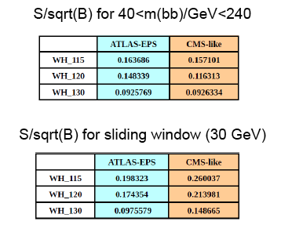
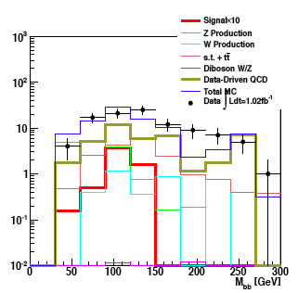
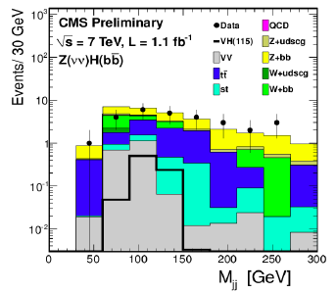
ATLAS-CMS comparisons
Jonas and Jike have emulated CMS’s cuts in WH->lνbb and ZH->ννbb
Differences not yet clear – need to continue to pursue this
Similar significances in WH ->lνbb when applying mass window cut
But very different event numbers – by factor 10-100 depending on channel
CMS seems to get a lower QCD background than us in ZH->ννbb
WH->lνbb

Slide 9
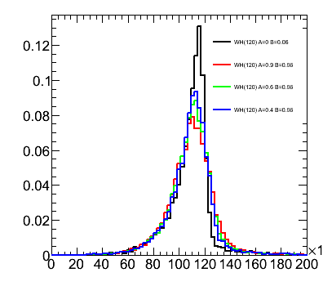
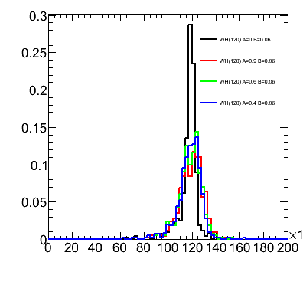
Performance studies
Main systematics are jet and b-tagging related
Current tasks listed in Wiki
More questions than answers at the moment, but pursuing several threads:
Jet resolution:
We seem to be affected by out-of-cone losses
Will try different jets
B-tagging:
Find how much improvement needed to reduce syst
Improve MC statistics term of b-tagging uncertainty with AFII – requesting some AFII validation samples
Differences between hadronic and semileptonic b-jets

Slide 10
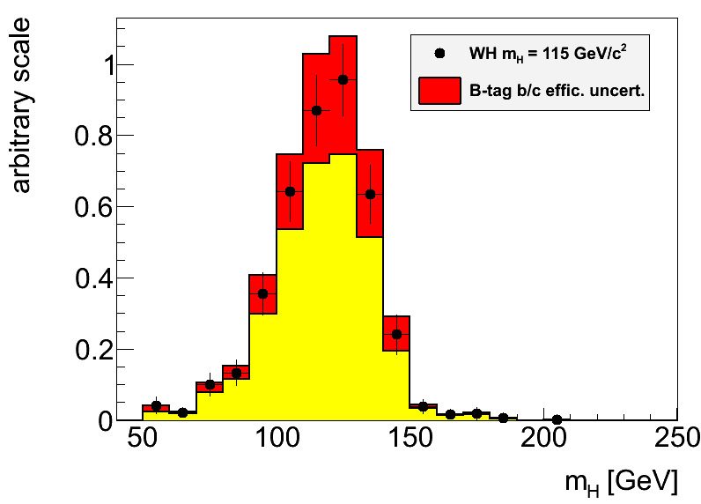
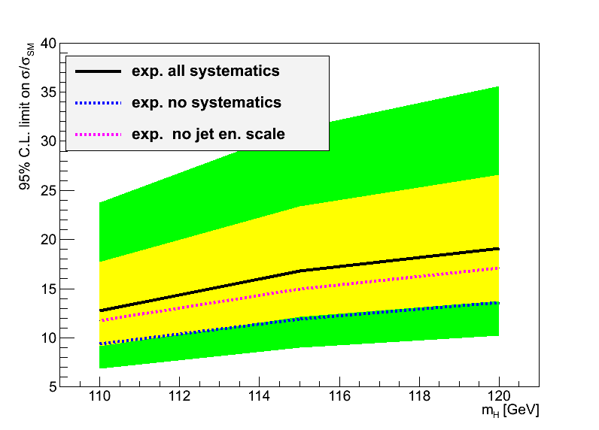
Hgbb – Reconstruction Performance
Main limitations from jet reconstruction and b-tagging uncertainties
Try to improve b-tagging efficiency/fake rate uncertainty:
Dominant uncertainty on signal yield in EPS analyses
Try to optimize di-jet mass resolution:
A sharper peak improves analysis sensitivity (10% width reduction ≈4% limit improvement)
Try to reduce jet energy scale uncertainty:
Large effect in limit through changes in m_{bb} shape

Slide 11
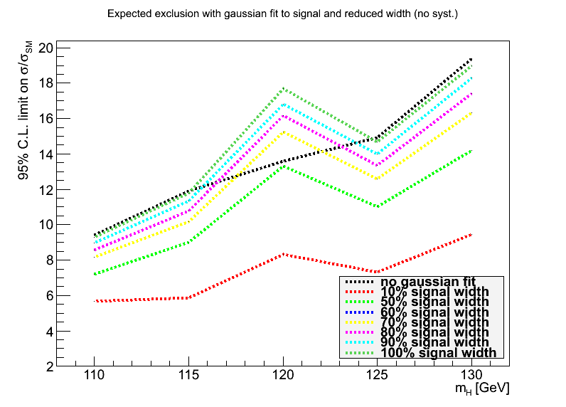
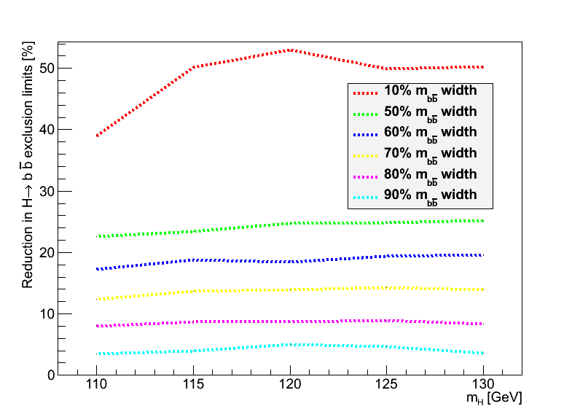
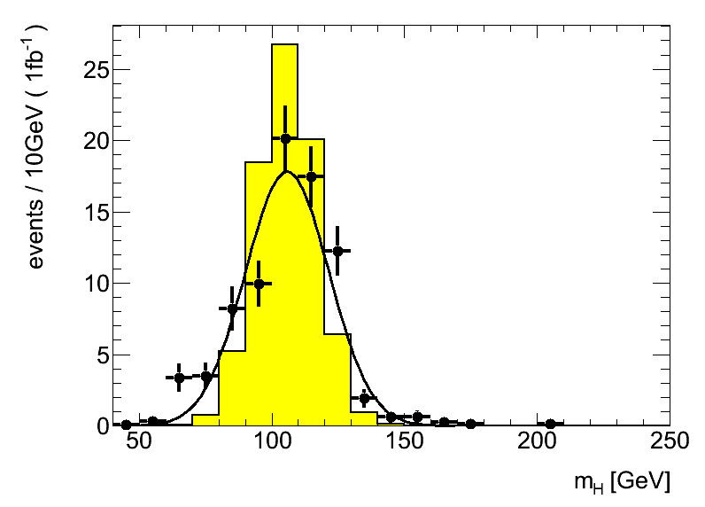
Backup
Replaced signal with fitted Gaussian to manipulate signal width
Estimated improvement in limits (1fb⁻¹) with reduced signal width
Reduction to 80% gives 8% improved limits (magenta line, bottom left)

Slide 12
1. Di-jet mass resolution:
Truth-level study, using partons (a similar study using truth jets would also be interesting). To be done for either WH or ZH channels, signal only would be enough.The idea is: 1. apply kinematic cuts to leptons and quarks similar to the analysis cuts - to look at a similar region of phase space 2. calculate the invariant mass of the two b quarks coming from the Higgs boson decay 3. determine the bb mass resolution 4. smear the parton transverse energies by some amount and go back to 2. The aim is to find by the (b-jet) energy scale uncertainty corresponding to a given value of the bb mass uncertainty. To define some numbers: the m(bb) uncertainty is around 20GeV. It would be interesting to know how much the jet energy resolution would need to decrease to make this 5%, 10%, 20% and 30% better.It would also be interesting to smear the quark directions. This should be a second-order effect for the un-boosted case but should be relevant for the boosted case.

Slide 13
2. B-tagging efficiency uncertainty:
Analysis-level study. Find how much the b-tagging efficiency uncertainty should be, to make the systematic uncertainty comparable to other systematic uncertainties.In the EPS analysis, the systematic uncertainty in the number of selected events, arising from the b-tagging (b/c efficiency & light fake rate), was 17% for WH and 16 for ZH. This was the dominant systematic uncertainty in both cases and the sub-leading systematic was 3% and 9%, respectively for WH and ZH.The idea is to run the analysis a few times with different values of the b/c efficiency uncertainty and the light fake rates (say, 80%, 60%, 40% of the official values to make it simple) and find what the corresponding systematic uncertainty would be on the signal yield.

Slide 14
3. Validate Atlfast II description of pTrel for b-tagging improvements
The b-tagging uncertainty is the one of the dominant uncertainties affecting the H->bb analyses. The estimated uncertainty itself is affected by several systematic uncertainties, and crucially by the MC statistics in the mu+jet samples used to determine the b-tagging scale factors. A solution for this would be to use fast simulation (Atlfast II) to get enough statistics. But this simulation needs to be verified against full simulation.So, this task aims to: compare the description of important quantities in AFII files against the same variable in full simulation files. The most important variable is "pTrel" for muons found inside a jet cone. This is the relative transverse momentum of muons with respect to the jet they belong to. of the The files to use are Jx samples filtered with a muon filter ("Jx*mufixed", with a filter selecting muons with pT>3GeV). Equivalent files need to be requested with AFII (to be done soon by Ricardo).

Slide 15
4. Differences between hadronic and semileptonic B decays
This is another of the important uncertainties affecting the b-tagging efficiency determination (as the study above). A term of the b-tagging efficiency uncertainty accounts for differences between jets arising from hadronic and semileptonic B decays. But this area remains under studied. It would be important to identify variables which show marked differences between these two types of jets, and could lead to differences in b-tagging efficiency. And to quantify the differences. Examples of possible variables to examine are the number of tracks, leading track pT fraction, Sum(pTtrack)/ET, etc.This task is not very well defined. Please get in touch with Ricardo

Slide 16
MC requests
Inclusive and boosted H->bb samples for MC11b:
Herwig++ in Powheg
Mass points: M_{H} = 110, 115, 120, 125, 130, 135, 140, 145, 150 GeV
WH->lνbb, ZH->llbb, ZH->ννbb
Both boosted and inclusive for each mass
Approved for production – still in waiting list for MC11b production (delays in MC11a)
Other samples:
Wbb, Zbb
ZH, WZ, WW -> lljj and llbb final states
Gluon-fusion H->bb
See Junichi’s page: https://twiki.cern.ch/twiki/bin/view/AtlasProtected/HSG5Higgs2bbFinalState#H_bb_MC_samples

