Slide 1
H->bb Weekly Meeting
Ricardo Gonçalo (RHUL)
HSG5 H->bb Weekly Meeting, 8 February 2011

Slide 2
News! News! News!
Busy Physics & Performance week last week
See M.Aleksa’s talk in Weekly meeting for details of Chamonix decisions: http://indico.cern.ch/conferenceDisplay.py?confId=119623
See D.Costanzo’s talk in physics plenary for status of MC vs data comparisons: http://indico.cern.ch/conferenceDisplay.py?confId=121506
B-tagging meeting last week: http://indico.cern.ch/conferenceDisplay.py?confId=124967
Trigger/Physics discussion of menu for 2011: http://indico.cern.ch/conferenceDisplay.py?confId=125322
Higgs WG meeting: http://indico.cern.ch/conferenceDisplay.py?confId=119789
Other:
HSG5 Workshop in Dubna
Final dates: 17th – 19th May 2011
Visas have to be thought about soon! Expect email with instructions for registration etc
Will be the last check point for Summer CONF notes before approval process – aim to have solid results

Slide 3
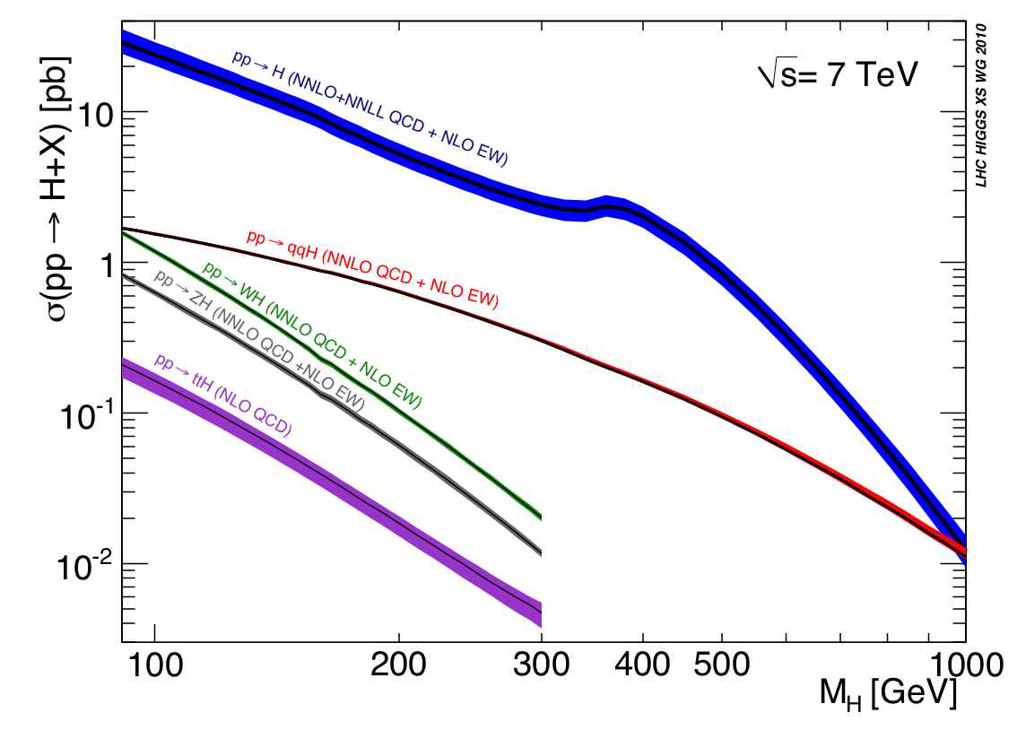
LHC Higgs Cross Section Working Group
LHC Higgs Cross Section Group: https://twiki.cern.ch/twiki/bin/view/LHCPhysics/CrossSections
Yellow report with inclusive cross sections:
Yellow report recently released: http://arxiv.org/abs/1101.0593
Higgs WG requested to use numbers from the LHC xsec wiki: https://twiki.cern.ch/twiki/bin/view/LHCPhysics/CERNYellowReportPageAt7TeV
Second phase of work starting now: exclusive Higgs observables
Higgs Signal: cross sections with cuts, differential K-factors, effect of jet-veto or b-tag jet on differential K-factors, comparison between NLO MC and NNLO codes
SM Backgrounds: define control regions, estimate theoretical errors, use the most advanced NLO MC (POWHEG, MC@NLO, new Sherpa), signal/background interference
Theory Uncertainties: for exclusive observables, for both SM and MSSM Higgs, QCD scale and PDF error correlations among different Higgs production channels and among
First results expected for BNL workshop in May; plan for 2 publications this year
H→bb meeting on 17 February 2011:
Survey of the codes (for both VH→Vbb and ttH), loose (i.e. non-boosted) VH analysis
Will start with validation on Wbb calculations
Volunteers welcome!

Slide 4
Trigger for VBF H->bb and hadronic ttH
Work actively ongoing in these areas
Eric (VBF H->bb) and Saverio (ttH) investigating possible triggers and their performance
In touch with jet and b-jet trigger people

Slide 5
B-tagging meeting
Removal of PU events that have been re-used too often:
Ntuple based: macro at: https://twiki.cern.ch/twiki/bin/view/AtlasProtected/Analysis162
Missing truth label for PU jets (especially relevant for 'soft' events, e.g. QCD J0):
MinBias PU interaction may be harder than 'main interaction’ and drive signal primary vertex determination (sum pt2)
Relevant when computing MC truth mistag rate in these samples
Tracking group proposes to raise track reconstruction pt threshold from 100 MEV to 400 MeV.
B-Tagging validation didn't show significant effects: http://indico.cern.ch/conferenceDisplay.py?confId=124040

Slide 6
From last week…
Wisconsin: larger data samples for WH NN/BDT training:
Lashkar looked at effect of lepton filter on WH->lnubb
Lepton cuts of p_{T} > 15 GeV and |η| < 2.8 give filter efficiency of 68%
New proposal is 100k events with the filter at each of m_{H} = 115, 120 and 130 GeV
EVGEN job options would be modification of sample 105872: W->eν and W->μν, but NO W->τν
CAVEAT: error on the simulation is large, so training an MVA to use details of the kinematics could be BAD. Will need detailed comparisons of data and MC
More thoughts?
LMU: SVN area for code
Created today (sorry for the delay)
atlasoff/PhysicsAnalysis/HiggsPhys/HSG5/Hbb/LMU_H2bbAnalysis
Will do the same for Lisbon analysis code

Slide 7
Any Other Business?

