Slide 1
Introduction
Ricardo Gonçalo (RHUL)
HSG5 H->bb weekly meeting, 7 June 2011

Slide 2
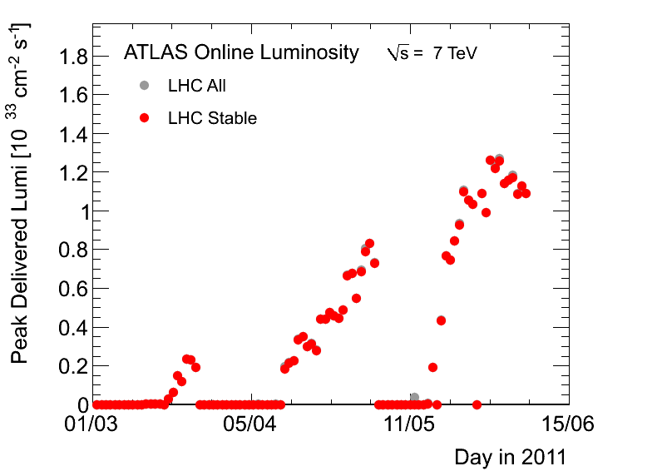
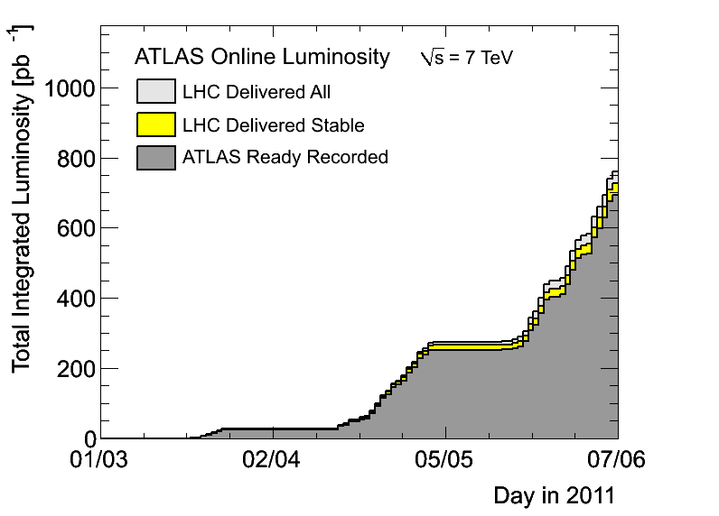
News! News! News!
About 0.7 fb⁻¹ collected with stable beams so far
Up to 1042 bunches colliding in ATLAS
Lumi around 1.2x10³³cm⁻²s⁻¹
Will keep number of bunches and bunch charge until we get ≈1fb⁻¹ in time for EPS

Slide 3
Trigger News
Evolution for 2 – 5x10³³ cm⁻²s⁻¹ being planned NOW
Strawman plan with detailed prescales can be found here:https://aagaard.web.cern.ch/aagaard/Rates/Evolution50nsVeryTight5e33/
mu20(_MG) disabled – new primaries will be mu22 and mu20i
e20_medium1 disabled – new primary will be e22_medium1
EF_2b10_medium_4L1J10 disabled – should have EF_b10_medium_4j30_a4tc_EFFS or EF_2b15_medium_L1_2J10J50
See slides by Eric and Chris today
E.g. muon trigger rates:
L=3E33: mu22_medium: 55Hz; mu22_MG_medium: 60Hz; mu20i_medium: 20Hz
L=5E33: mu24_medium: 61Hz; mu24_MG_medium: 67Hz; mu20i_medium: 33Hz
Use sample T for study:
r2400 has conditions which do NOT include the noise suppression.
r2434 has conditions which DO include the noise suppression.
Find samples with e.f.: dq2-ls "valid*r2434*”
Results being collected by Stefania to show at the Trigger General Meeting tomorrow: https://indico.cern.ch/conferenceDisplay.py?confId=142271
Slides on H+ from Liron and from Chris on ttH already in place but nothing from WH, ZH, VBF

Slide 4
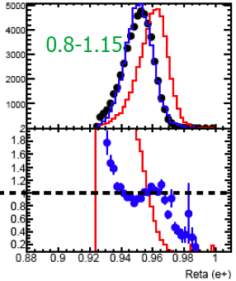
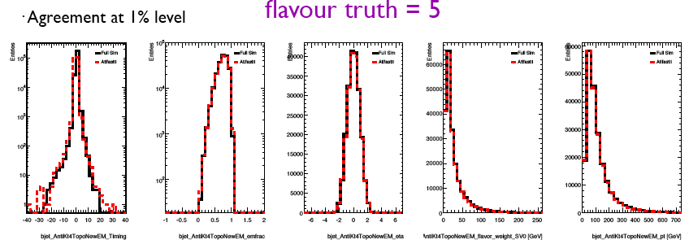
Atlfast – II
Rη in η bin:
Seems to be reaching maturity
Should provide factor 10-20x speed improvement
Shows good agreement with data
Can be tuned to data, unlike full-sim
SUSY group will pioneer using it for a publication
See e.g. simulation meeting today: https://indico.cern.ch/conferenceDisplay.py?confId=141119
FullSim
AFII
data
b jets: pT > 20 GeV; |η| < 2.8; jet_AntiKt4TopoNewEM_flavor_weight_SV0 > 5.85
FullSim
AFII

Slide 5
CONF note for EPS-HEP 2011
Tight time scale – but feasible!
First INT note draft should be ready on 10 June
Finished – Higgs approval – by the end of June at the latest
Data frozen for EPS on 22 June – expect final calibrations etc soon after
CONF note circulated early July to be approved before conference
Conference starts 21 July
Notes:
Re-using existing CDS number ATL-COM-PHYS-2010-929
Having a bit of difficulty finding willing and able editorial-board members
SVN area for notehttps://svn.cern.ch/reps/atlasgrp/Physics/Higgs/HSG5/data_7TeV/ATL_COM_PHYS_2010_929/trunk/

Slide 6
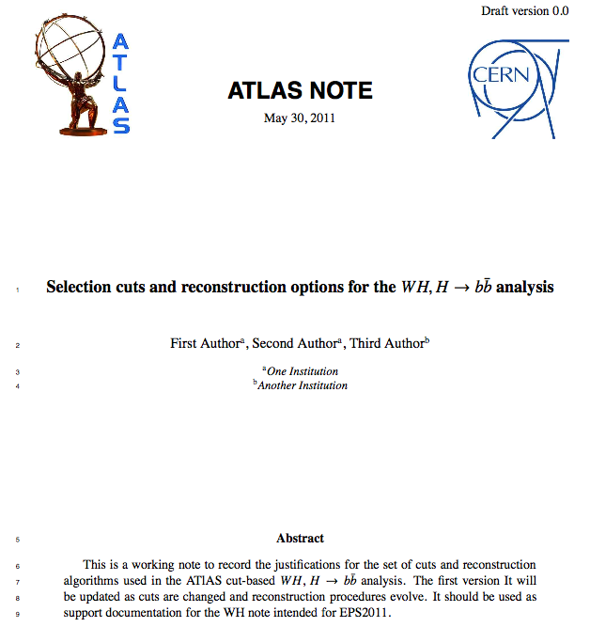
Documenting Cuts
Draft note to document our current thinking about cut values and corrections
Should give a frozen view of cuts used for summer note
So that we will later know why we did something (and sometimes to know we had no good reason)
For our own use – not even internal review
Will send 1st draft around for additions/corrections/comments/violent disagreement ☺

Slide 7
Backup

Slide 8
Poster abstract for EPS-HEP
H->bb searches with the ATLAS detector at the LHC
The H -> bb channel is extremely important for the observation of a Higgs boson signal at the LHC. In the Standard Model, this channel would provide a significant contribution to the Higgs boson search in the low mass region, where this decay mode constitutes the dominant Higgs decay channel. Due to the enormous jet production cross-section at the LHC, the search must target channels where the Higgs boson is produced in association with a weak boson, a pair of top quarks, or jets separated by a rapidity gap. It also requires complex techniques to reconstruct the signal and separate it from an overwhelmingly large background. We present the status of Higgs searches in the H->bb channel currently being performed within ATLAS.
In case it’s accepted we’ll need a candidate to present it at EPS
Please let me know by email before Friday if you would like to do this
Will randomly choose a presenter from candidates

Slide 9
Conferences:
for EPS-HEP, focus on papers instead of notes
Higgs approvals for EPS-HEP: 20th – 25th July
https://indico.cern.ch/getFile.py/access?contribId=0&resId=0&materialId=slides&confId=136406

Slide 10
M.Vincter

