Slide 1
H->bb Note Plans for Summer
Ricardo Gonçalo (RHUL)
HSG5 H->bb weekly meeting, 5 July 2011

Slide 2
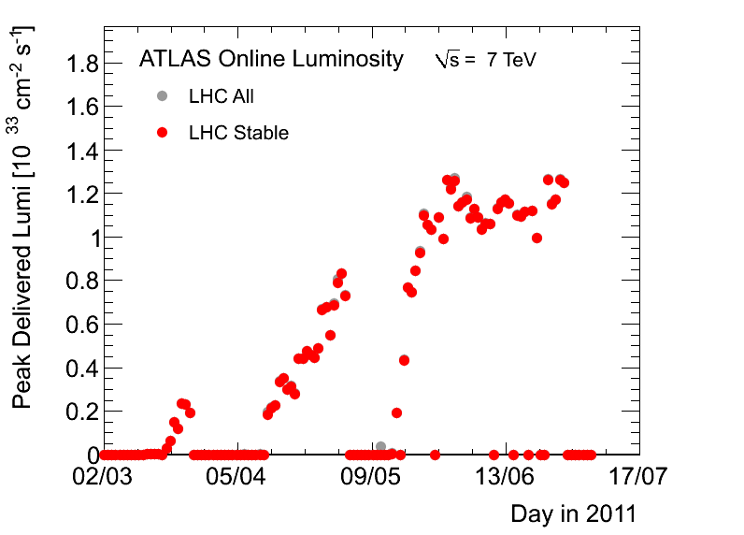
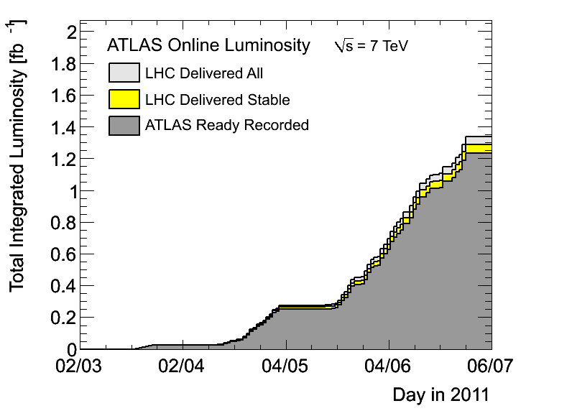
News! News! News!
Technical stop…
…but that’s fine because we have plenty of data...
…now we just need to publish it!

Slide 3
News! News! News!
Note approved as INT by the Editorial Board this morning!!
Still to be updated as we improve things, but can now concentrate on CONF
Congratulations to everyone involved!!
See note in CDS: http://cdsweb.cern.ch/record/1307560?ln=en

Slide 4
WH/ZH Note
Third meeting with the editorial board this morning:https://indico.cern.ch/conferenceDisplay.py?confId=145790
Very full to-do list for the next few days!
Improve text
Tidy up plots
Add more data
Improve and check exclusion plots
Final sign-off meeting scheduled for Thursday 5:30pm!
Also need to worry about SM Higgs Combination
Meeting tomorrow: https://indico.cern.ch/conferenceDisplay.py?confId=146014
If all goes well, show at EPS and later!
Both one talk and one poster on H->bb: Patricia and me asked to show this

Slide 5
Backup

Slide 6
Last call for EPS
Leandro (ATLAS Week)
June 23rd: final “analysis update”
Assumes ~ 7-10 days to run full analysis
Data taken up to June 18th available with GRL (recorded L=1 fb⁻¹);
Jul 5th: Drafts submitted to EdBoard
Early drafts should be circulated to the EdBoard earlier; very similar to PLHC
Final drafts on Jul 8th to PC;
Jul 9th: last circulation of Papers/Notes
Run again the full analysis to include the data after June 26th , at least for benchmark analyses? (technical stop on June 29th^{th}, for ~10 days)
Jul 15th: last approval meetings
Present the circulated results and the ones obtained updating the analysis
Jul 18th: conclude sign-offs of Papers/CONF Notes
Assumes 1 week for EdBoard and two sign-offs from PC/PubComm/Mngt
18→20: 3 days contingency
Jul 21st: EPS Conference
This particular schedule can be adopted only for a few Papers and/or Notes (searches or more in general luminosity sensitive)
Expect a “hot period” during next two weeks fully dominated by CONF/Paper approval meetings

Slide 7
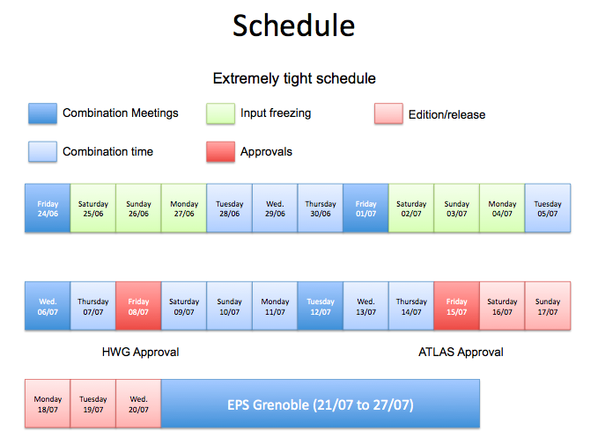
Schedule for Setting Limits
Combination meeting: https://indico.cern.ch/conferenceDisplay.py?confId=144353
Inputs need to be:
Available today (28th June) – to have limits for INT note approval by Ed.board and Higgs WG on 30th
On 30th June – approval and final decision on whether to include in SM Higgs combination
Frozen by 4th July for Higgs approval on the 8th July
Interpolated inputs ready right after Higgs WH approval for input to ATLAS SM Higgs combination
ATLAS approval on 15th July

