Slide 1
Introduction
Ricardo Goncalo
HSG5 H->bb weekly meeting, 5 January 2012

Slide 2
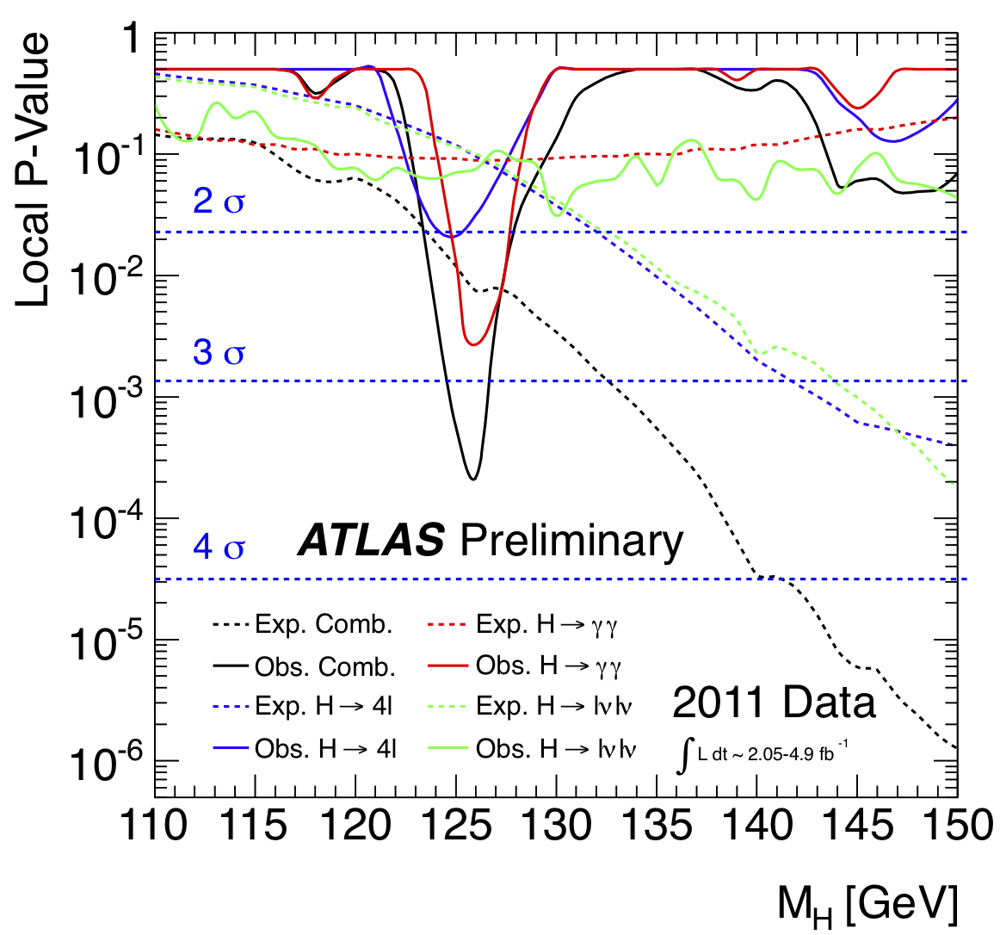
Happy New Year!
Very interesting year ahead!
Lots to do!
Analyze 2011 data before new data:
H->bb paper for Moriond
Boosted VH analyses
ZH->ννbb analysis
ttH analysis (news today)
VBF analysis
Help answer the 126GeV/c² question!
Use new data optimally:
Can freeze “2011” analyses we will have at the time and run on new data
And at the same time build improved analyses – time for multivariate methods

Slide 3
Moriond…
We have a few weeks to get analyses ready - Higgs approval on the 1st week of February
WH/ZH->llbb unboosted analyses not far away, but some features remain to be understood
ZH->ννbb and boosted analyses are likely candidates – but a lot to do!
Current plan is to aim for a H->bb paper collating these analyses
Turn a paper draft into CONF note if needed
Remaining analyses keep working and aim for notes after Moriond – 5fb⁻¹ analysis will become less interesting as we get close to 10fb⁻¹ around Summer

