Slide 1
H->bb Weekly Meeting
Ricardo Gonçalo (RHUL)
HSG5 H->bb Weekly Meeting, 5 April 2011

Slide 2
News! News! News!
Forthcoming meetings:
Simulation workshop tomorrow aimed at the physics needs for 2011-2012 data analysis: https://indico.cern.ch/conferenceDisplay.py?confId=133590
New meeting on procedures for statistical interpretation of ATLAS results on April 15: https://indico.cern.ch/conferenceDisplay.py?confId=132499
Workshop on combined performance for 2011, on 14 April: https://indico.cern.ch/conferenceDisplay.py?confId=132123

Slide 3
News! News! News!
Two very interesting combined performance talks in last Higgs WG meeting
May points I took: we’ll need segment-tagged muons and we’ll need to pay close attention to jets group activities:
Two main jet calibration schemes will be available for 2011/2012 data analysis:
A simple-robust scheme based on EM+JES that is presently recommended for physics analysis supplemented with the GSC schemes (exploiting jet properties to improve the resolution without changing the mean energy). Here, cluster and tower jet will be supported.
The LC calibration scheme using LC-calibrated clusters as jet inputs using numerical inversion to set the final JES.I would like to point out that we seek help to work-out pile-upcorrections and uncertainties for the LC-scheme for the early analysis the new data.Regards,
The slides of the discussion int he last jet/etmiss meeting can be found here.https://indico.cern.ch/getFile.py/access?contribId=6&resId=0&materialId=slides&confId=131195

Slide 4
Monte Carlo Samples
Need to review what we have and what we need for the coming year:
Several ongoing strands:
Giacinto looking into Wbb in Powheg
Michiel looking into MC@NLO for VH signal
Michiel/Chris C-T, Aurelio: discussion of ttbb ME production in Alpgen
Mass points:
ZH(Zll), WH(Wlnu), ttH, VBF(Hbb) analyses have mass points: 115, 120, 125, 130 GeV/c2
Any more WH/ZH (boosted/non-boosted) samples needed?
Additional backgrounds?

Slide 5
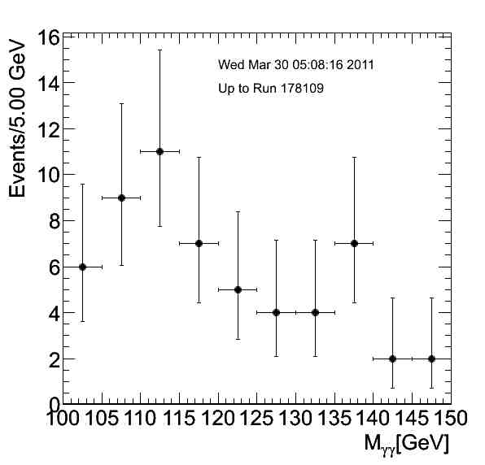
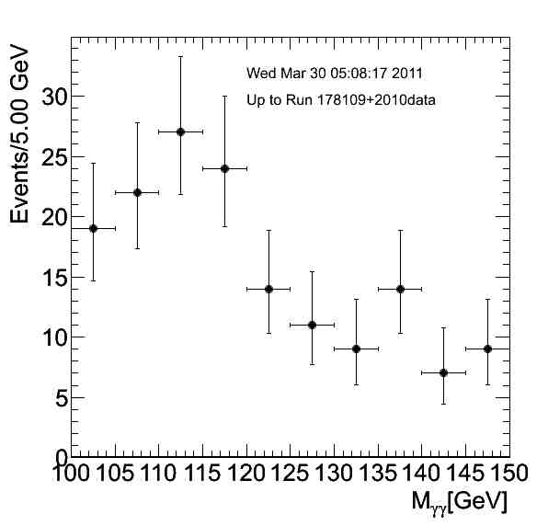
Fast Monitoring
H->gamma gamma: http://www-wisconsin.cern.ch/~fang/MonitoringHtoGamGam_d3pd/

Slide 6
WH Baseline Selection
See discussion in Sharepoint: https://espace.cern.ch/atlas-project-HSG5-H2bb/default.aspx

Slide 8
Next…
Need to assign tasks:
Triggers for 2011 data
Choice of muon algorithms
Choice of electron PID and fiducial cuts
Jet calibration and JES systematic uncertainties
B-tagging
…
Comments?

Slide 9
Backup

Slide 10
Proposed Roadmap for WH Analysis
After the effort on cut flows, we’re ready to start producing results!
Concentrating on un-boosted results here only because it’s still unclear what would be feasible in boosted analysis until Dubna – commissioning work ongoing
BUT: work on boosted VH is starting in parallel – see e.g. Wahid’s talk today
Intended results:
Cut-based analysis focusing on WH -> e/μ ν b b
I think there should be at least 2 analyses, for cross checking results
Ideally using 2 different data formats (AOD vs D3PD)
Multivariate analysis in parallel, to improve on cut-based analysis
Timeline:
Analyses should be semi-frozen by Dubna (17 – 19 May)
This leaves around 7 weeks
Results in the form of:
Histogram with # events vs m_{H}
Table of # events expected for each value of m_{H} and background type – including statistical and systematic uncertainties
Exclusion plot vs m_{H} (95% C.L. limit on σ/σ_{SM})
…plus control plots etc

Slide 11
Questions to be answered
Cut-based analysis focusing on WH -> e/μ ν b b
Establish analysis selection: why is each cut applied and why at each particular value? Are we convinced this is the right thing to do?
Establish set of systematic uncertainties: start from combined performance group recommendations. What are the most important? Are there any hidden pitfalls for us?
What b-taggers and why? What calibrations do we expect to be ready in time? What is the corresponding systematic uncertainty?
What sort of exclusion limits can we expect for 0.5, 1, 2 fb⁻¹ ?
Multivariate analysis in parallel, to improve on cut-based analysis
What event preselection should be used and why?
Use for signal-background separation only or target particular backgrounds?
What are the possible bias? Where can it go wrong?
What improvement can be expected wrt cut-based analysis for 0.5, 1, 2 fb⁻¹ ?
Exclusion plot vs m_{H} (95% C.L. limit on σ/σ_{SM})
Need someone to implement RooStats workspace

Slide 12
Date | Milestones wish list
17 May | Dubna workshop – analysis frozen After this: add data to un-boosted analysis and prepare for result approval Concentrate more effort on boosted VH with a view to obtaining results quickly
10 May | Review results with 2011 data from cut-based and multivariate analyses
3 May | Margin for dealing with unforeseen problems
26 April | Start looking at 2011 data if enough is available. Any surprises? How does the MC describe the new data? By now we should have a reasonable idea of results from the multivariate analysis
19 April | End of 2 weeks of beam scrubbing. (I’m away for Easter)
12 April | By now we should have a reasonable idea of the exclusion of the cut-based analysis First report on MVA preliminary results – establish plan for getting results by Dubna
5 April | Identify the worst systematics and discuss any possible improvements: Any changes needed in analysis cuts? Any study necessary for corrections to some systematic effect? Multivariate analysis: iterate on preselection cuts, methods, questions Assign tasks – divide the work to achieve better results!
29 March | Establish analysis cuts: If possible as result of optimization Use 2010 data to develop cuts and show that data is well described by background MC Start evaluating systematics
22 March | Iterate on analysis cuts – why is each cut applied at each particular value? Start iteration on multivariate methods to improve analysis

Slide 13
Reconstruction issues
Muon CP group recommendations for release 16:
Reconstruction efficiency and isolation efficiency scale factors, momentum smearing functions
https://twiki.cern.ch/twiki/bin/view/AtlasProtected/MCPAnalysisGuidelinesRel16
Jet/Etmiss recommendations for jet cleaning in release 16:
Medium jet cleaning should give similar rejection to rel 15 cleaning but with better efficiency
Tight jet cleaning should not be used – still under discussion
https://twiki.cern.ch/twiki/bin/view/AtlasProtected/HowToCleanJets#Bad_jets_rel16_data
New!: Final b-tagging calibrations for release 16 based on full 2010 data:
https://twiki.cern.ch/twiki/bin/view/AtlasProtected/Analysis16
e/gamma recommendations for energy scale and resolution in release 16:
https://twiki.cern.ch/twiki/bin/view/AtlasProtected/EnergyScaleResolutionRecommendations
And rescaler tool: https://twiki.cern.ch/twiki/bin/view/AtlasProtected/EnergyRescaler
Standard Model W/Z group baseline selection for release 16 (next 4 slides):
See discussion in W/Z group Sharepoint
Also, finer points (and perhaps the not so fine) still being discussed

