Slide 1
H->bb Weekly Meeting
Ricardo Gonçalo (RHUL)
HSG5 H->bb weekly meeting, 4 October 2011

Slide 2
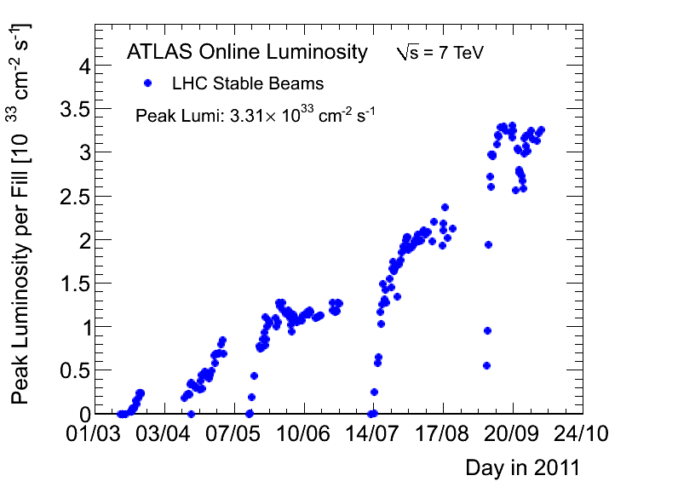
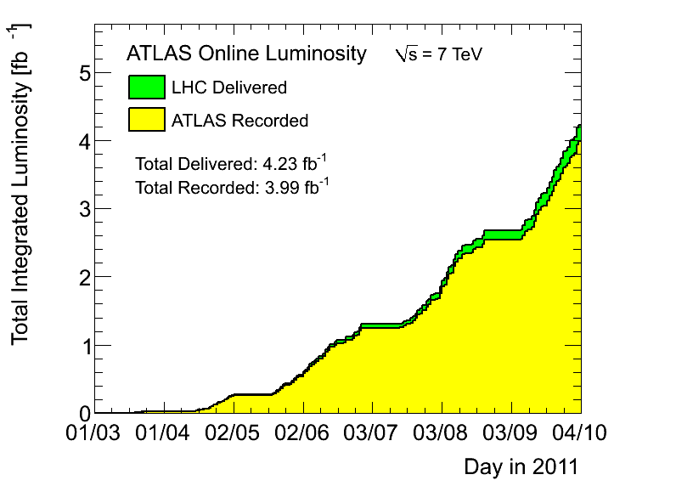
News! News! News!
Peak stable lumi 3.31x10³³cm⁻²s⁻¹
3.99 fb⁻¹ with stable beams collected so far – 320 pb⁻¹ during the last week – 4.23 fb⁻¹ delivered
Pileup at <μ> ≈ 15.5, peak around 19 – 21 (!)
May go to 25ns running this week!

Slide 3
MC requests
Inclusive and boosted H->bb samples for MC11b:
Herwig++ in Powheg
Mass points: M_{H} = 110, 115, 120, 125, 130, 135, 140, 145, 150 GeV
WH->lνbb, ZH->llbb, ZH->ννbb
Both boosted and inclusive for each mass
Approved for production – in waiting list for MC11b production (delays in MC11a)
Next: need to discuss W+jets/Z+jets
Sherpa samples vs Alpgen vs Powheg
Fast simulation:
Being validated/used by SUSY and top groups
Would be very useful for us (and several others) to produce large background samples

Slide 5
Backup

Slide 6
Jet energy scale
Paul Thompson
Top:
mjj for W->jj in top events
Cuts used: pTjet > 25 GeV, η < 2.5
The JES uncertainty seems overestimated
Bottom:
Effect of JES uncertainty on WH->lνbb analysis expected limit (1fb⁻¹)
Note CMS quote 1% rather than our ≈7%
B-tag efficiency systematic is still dominant (≈16%) – can we improve on it?
Ricardo G

Slide 7
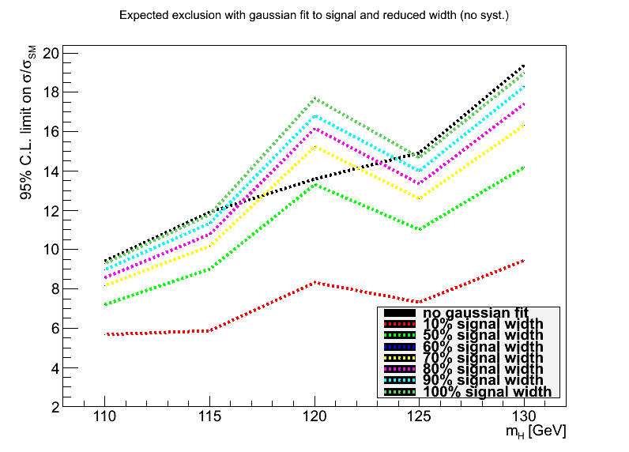
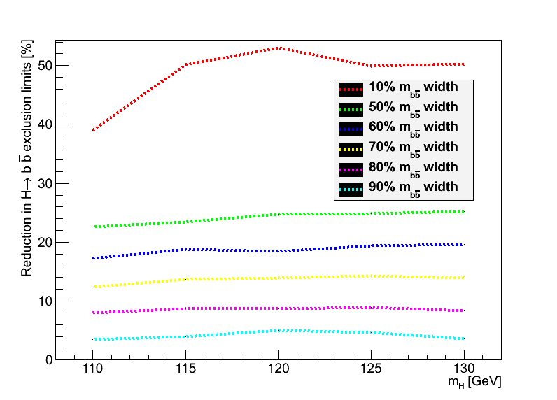
Di-jet mass resolution and limits
Fitted signal by a gaussian and re-did fits (modified code from Lianliang) after thinning signal m_{bb} histo by several factors
Plot shows effect of improved di-jet mass:
Basically linear in range of interest
10% improvement in m(bb) gives 4% improvement in limit across all masses

