Slide 1
Introduction
Ricardo Gonçalo (RHUL)
Higgs Weekly Meeting – 3 May 2012

Slide 2
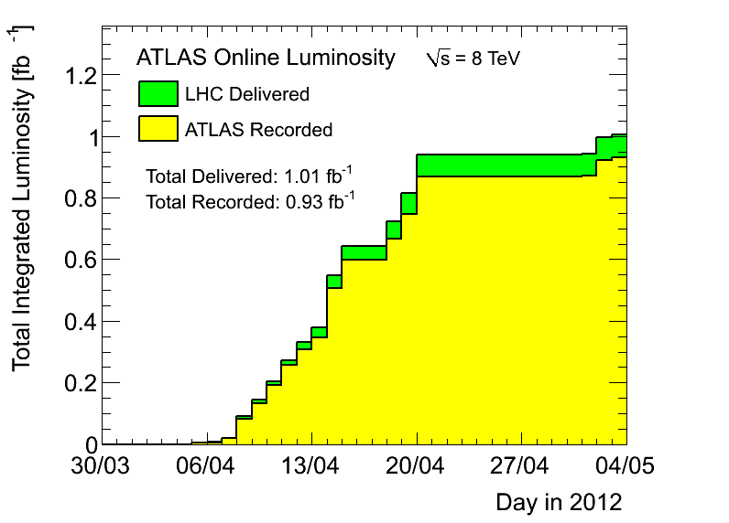
News! News! News!
Peak <evts>/bunch crossing 20 – 29
Peak stable lumi 5x10³³cm⁻²s⁻¹
Lumi with stable beams 0.93fb⁻¹
≈ 0.13fb⁻¹ collected since technical stop
(Emanuel) After cuts adjusted high rate in b-tag triggers

Slide 3
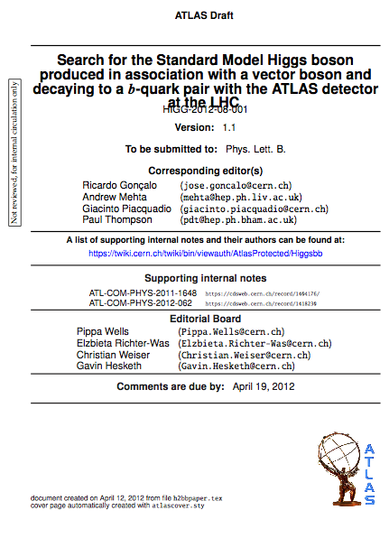
News! News! News!
H->bb analysis approved by to go for second circulation
https://cdsweb.cern.ch/record/1440266
Current version in CDS for last updates and reading by EB
https://cdsweb.cern.ch/record/1439564?ln=en
Due to SVN problems, moved to:
atlasusr/jgoncalo/ATL_COM_PHYS_2011_1648
Should go for 2nd circulation soon
Updated version next few days
What next:
Second circulation
1 week of comments by collaboration and management
Second reading
Send to journal
More comments…
Publication!

Slide 4
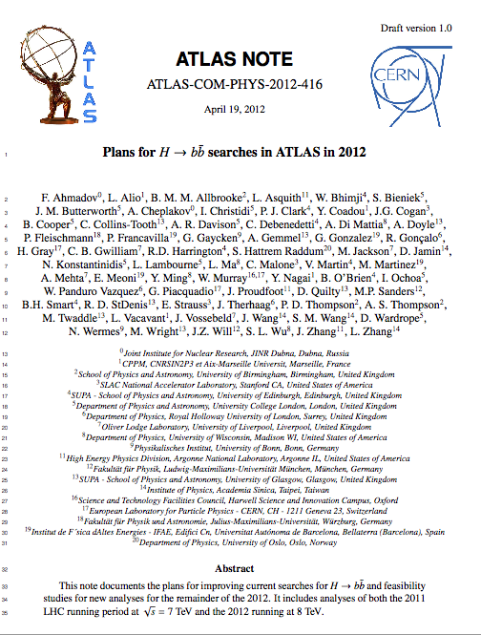
Internal note with 2012 plans - I
Not much progress… but need to put something on paper before 10th (in 1 week)
Cannot make fully detailed note
Not have enough information to predict 2012 changes
Argument was taken into account
Should still make “declaration of intentions” for 2012 analyses
Useful to prepare roadmap but no legal bound to detailed cuts (impossible)
To be ready for 10th May
Content:
WH/ZH
Boosted VH
ttH
MSSM bH/A->bbb
MWT? VBF?
Due to SVN problems, moved to:
atlasusr/jgoncalo/ATL_COM_PHYS_2012_416
CDS record (skeleton only):ATL-COM-PHYS-2012-416

Slide 5
Higgs Subconveners Meeting
Combination:
Will use new asymptotic bands only in the combination paper, won't change ongoing papers
Background modelling workshop on Wednesday
MC
New problem found in Py8 H->WW->tautau->llvvvv: polarization of Ws now ok, but tau polarization still wrong; will also affect H->ZZ->4tau
In Pow+Py6, some Z in H->ZZ have negative mass
MC@NLO WW had problems (now fixed and being re-launched)
Py8 inclusive dibosons (inclusive, all decay modes incl. hadronic and vv) ready for validation

Slide 6
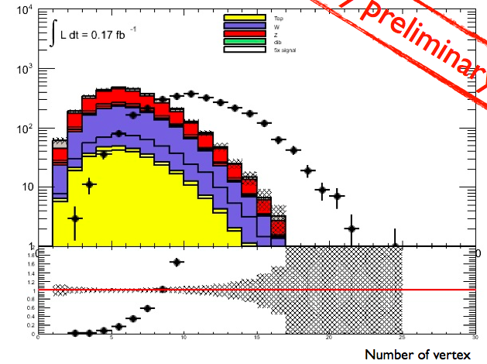
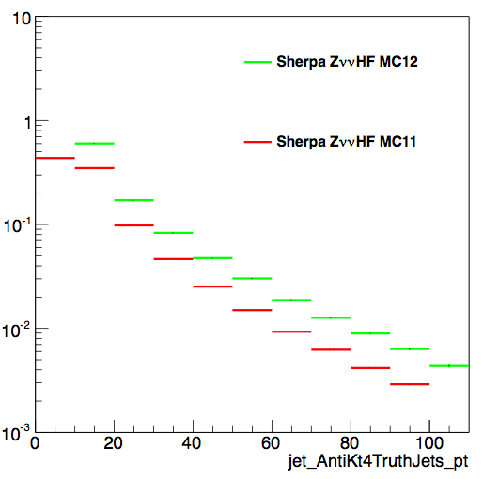
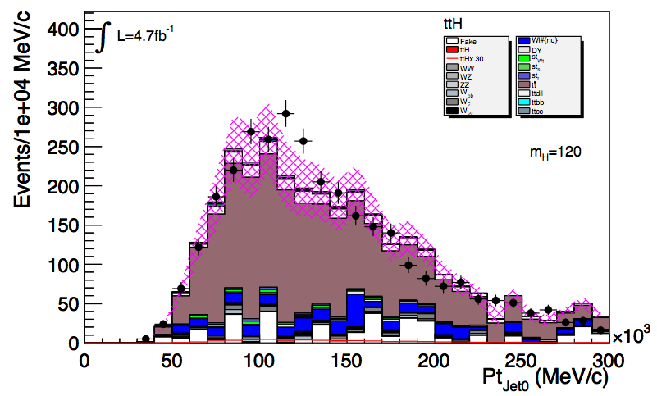
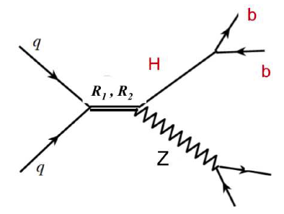
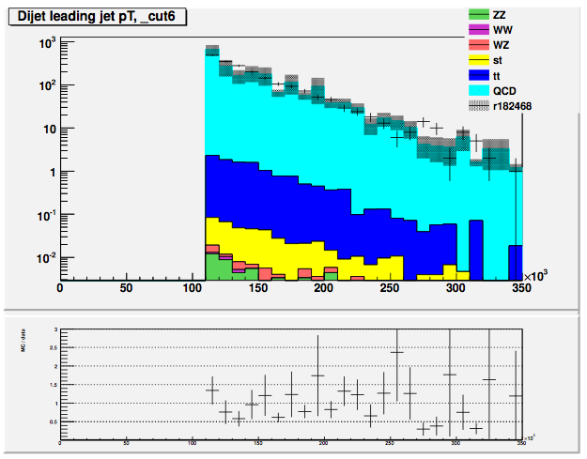
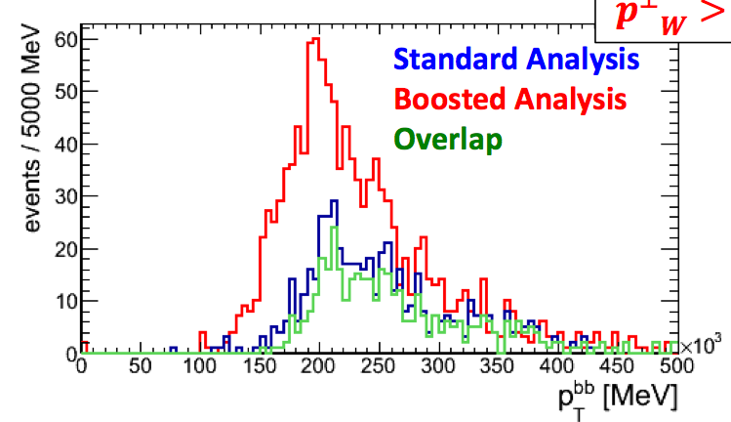
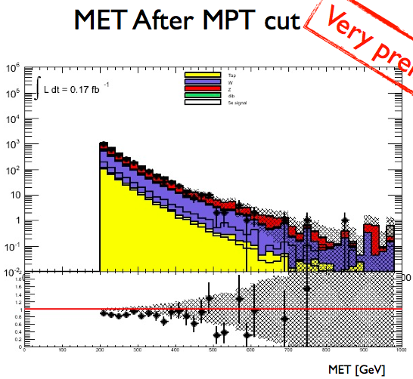
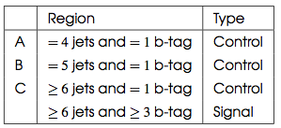
News & activity
MC requests:
W/Z+h.f. – asking for large AFII Sherpa samples
Possible problem: looks like a p_{T}^{jet}>20GeV truth-level cut
A few other ongoing requests
Other channels:
Boosted H->bb – aim for results in Summer
Improvement on inclusive sensitivity clear
Ongoing: progress in cut-flow comparison
ttH working for 2011 analysis in mid May
Ongoing: control region checks, estimating model uncertainties; detailed systematics with rel.16 (b-tagging is dominant)
From 1-b control region: scale top down by 25%
Walking technicolor analysis with Exo group:
Preliminary results shown some sensitivity with ≈zero effort:
https://indico.cern.ch/conferenceDisplay.py?confId=187283
Waiting for MC for 1 model point to see if we have exclusion: all channels
WZ->lνbb: use as a calibration for H->bb mass peak
Simple mods from existing analysis
Expect preliminary results today
First look at 2012 data – exploratory
Using PDF reweighting
Needed to scale down MC by 20% (lumi? Pileup? JES?)
Other:
bA/H->bbb: ongoing – MC requests
VBF H->bb: ongoing
Lead jet p_{T}
bA/H->bbb
p_{T}^{W}>200GeV

Slide 7
Workshop?
End of June seems best option (just before ICHEP)
Proposals? CERN?

Slide 8
Bonus slides

Slide 9
Planning for 2012 analyses
No rest for the weary!…
Next issue for the whole group is an internal note on plans for 2012 analyses
The plan is not completely clear to me yet (e.g. which MC to use)
But main goal is to make unbiased decisions:
Decide on cuts and strategy before looking at new data
Should take this as an opportunity to think ahead:
Boosted VH analyses and how to merge with inclusive
ttH, VBF, BSM analyses (see e.g. Javier and Merlin’s talk today)
Use of MVAs (see e.g. Jan’s talk today)
Study trigger constraints and where we can gain signal (ongoing)
Needs from MC: generators, where MC improvements can help most – e.g. W+jets background, N_{jets} and p_{T}^{W} description, where can theory help?
CP performance gains needed: b-tagging, bJES, MET (see e.g. Jike’s and David’s talk)
Remember WH/ZH analyses are now systematics limited!
How to optimize analyses to prepare for 125GeV Higgs property measurements?

Slide 10
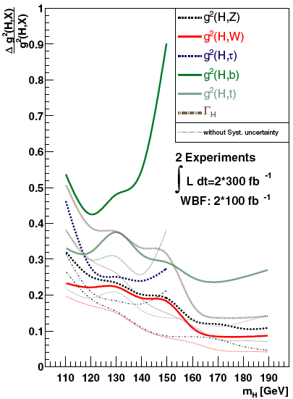
Higgs couplings
Fit Higgs couplings using all available final states and injecting some theory assumption, i.e. Γ_{V} ≤ Γ_{V}SM (V=W,Z)
Δg²_{VV}/g²_{VV} can be determined with an uncertainty of ~ 20% (2x300/fb)
Δg²_{bb}/g²_{bb} can be determined with an uncertainty of ~ 40% (2x300/fb)
Find the optimal point in the luminosity-pileup plane to perform the best measurements in particular for H→bb and H→ττ?
M. Duhrssen PHYSICAL REVIEW D 70, 113009 (2004)

Slide 11
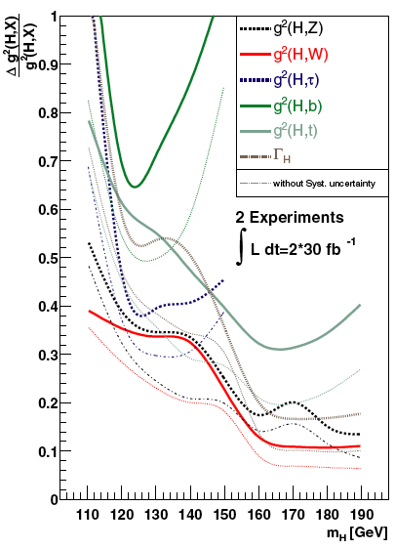
Higgs couplings with up to 2012 data
Fit Higgs couplings using all available possible final states and injecting some theory assumption, i.e. Γ_{V} ≤ Γ_{V}SM (V=W,Z)
Δg²_{VV}/g²_{VV} can be determined with an uncertainty of ~ 35% (2x30/fb)
Δg²_{bb}/g²_{bb} can be determined with an uncertainty of ~ 65% (2x30/fb)

Slide 12
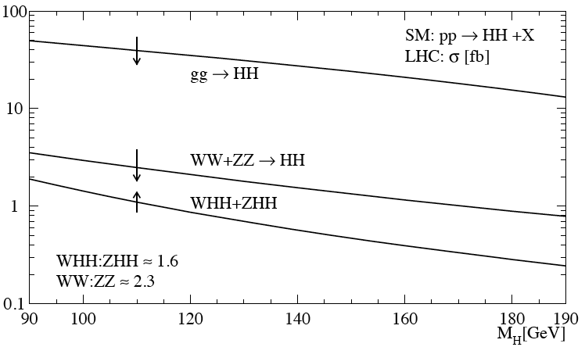
Higgs self-couplings
A complete verification of the Standard Model prediction requires the measurements of the Higgs self-couplings.
Trilinear and quartic interactions
Direct trilinear interaction: H*→HH
SM: g = 3m²_{H}/v
Processes of interest: gg → HH, VBF qq→qqHH, associated production (ttH,VH)
Most interesting final state so far studied: HH→WWWW→lνjj lνjj
http://arxiv.org/abs/hep-ph/9904287v1
ggF cross section: ~30/fb
Quartic interactions: very likely not feasable at the LHC/HL-LHC, but it is worth to review this process as well
SM: g = 3m²_{H}/v²
Recent internal studies done in ATLAS by A. Dahlhoff and M. Duhrssen (based on fast simulation).

