Slide 1
H->bb Weekly Meeting
Ricardo Gonçalo (RHUL)
HSG5 H->bb Weekly Meeting, 3 May 2011

Slide 2
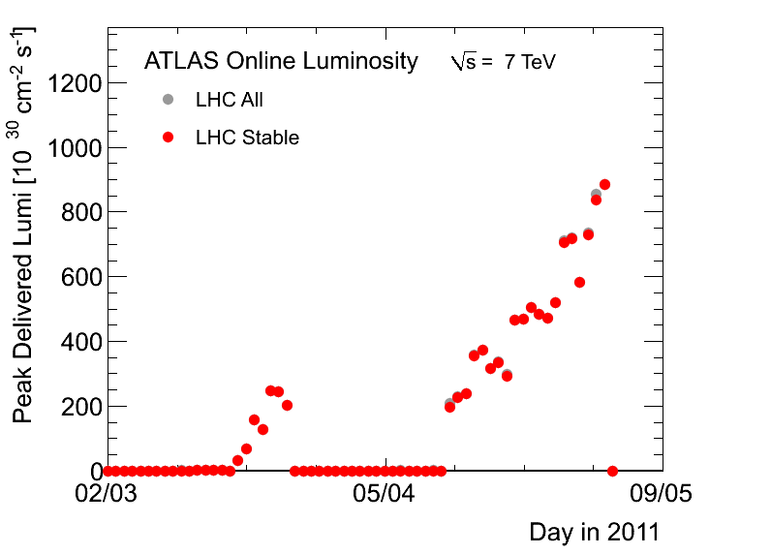
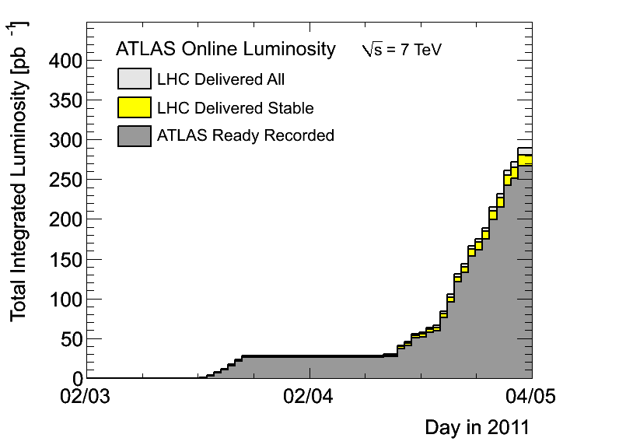
News! News! News!
About 0.27 fb⁻¹ collected with stable beams so far
50ns bunch spacing
768 colliding bunches
700 bunches in ATLAS
Inst Lumi up to ≈9x10³²cm⁻²s⁻¹
From increased nr of bunches, so peak pileup stays ≈ 10 - 14 collisions per bunch crossing

Slide 3
News! News! News!
Data preparation for PLHC:
Last run will be taken on Wednesday, May 4th
Data processing should finish by May 8th
GRL available by May 10th for all 2011 data
Luminosity currently overestimated by 4-8%
Lumi uncertainty of a few % larger than 2010 (available by May 10th)
Muon CP recommendations for PLHC:
https://twiki.cern.ch/twiki/bin/view/AtlasProtected/MCPAnalysisGuidelinesPLHC2011
Same selection as for 2010 data. Muon efficiency scale factors and the muon momentum smearing code based on ≈30 pb⁻¹ (2011 data)
To be updated with ≈200 pb⁻¹ of data within two weeks
First draft of Higgs combination paper:
http://cdsweb.cern.ch/record/1348030
H->γγ, H->ZZ->llll/llνν/llqq, H->WW->lνlν/lνqq, 2010 data
LHC Higgs Cross Section Group workshop in BNL tomorrow: http://www.bnl.gov/hcs/
Status report at Higgs WG meeting on Thursday – I will prepare some slides for Chris C-T to show

Slide 4
Discussion on Summer conferences
Dubna (in 2 weeks) should be time to freeze our plans
Reminder of Summer conferences:
Data estimates from February seem to be on track!
PLHC 2011: 6 June (http://www.pg.infn.it/plhc2011/) L ≈ 0.6 fb⁻¹
EPS-HEP 2011: 21 July (http://eps-hep2011.eu/) L ≈ 1 fb⁻¹
Dataset frozen ≈ 1 month before; expect GRL, Lumi etc to be refined then
We aim to have CONF note for EPS – HEP 2011
PLHC too soon for us – would need a draft ready today…
Note on WH:
Lots of work has been building up to this, mostly on un-boosted channel
Let work evolve (task list) up to Dubna and start to write up – see Jike’s talk today
Expect at bb mass plot plus control plots and data-driven background determination
Anything to include on boosted channel? Define in Dubna…
What else? ttH? ZH?... Again, define in Dubna and then stick to the plan
Would like to send abstract for poster on H->bb (see next slide)

Slide 5
Poster abstract for EPS-HEP?
H->bb searches with the ATLAS detector at the LHC
The H -> bb channel is extremely important for the observation of a Higgs boson signal at the LHC. In the Standard Model, this channel would provide a significant contribution to the Higgs boson search in the low mass region, where this decay mode constitutes the dominant Higgs decay channel. Due to the enormous jet production cross-section at the LHC, the search must target channels where the Higgs boson is produced in association with a weak boson, a pair of top quarks, or jets separated by a rapidity gap. It also requires complex techniques to reconstruct the signal and separate it from an overwhelmingly large background. We present the status of Higgs searches in the H->bb channel currently being performed within ATLAS.

Slide 6
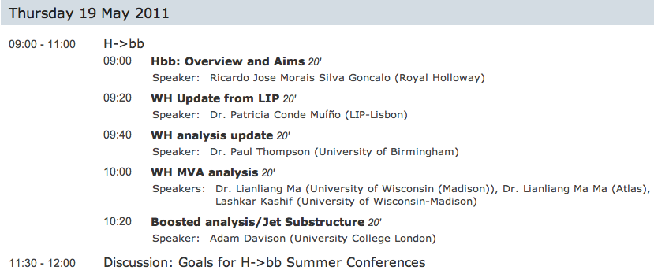
Dubna Workshop
Focus of H->bb agenda is WH
Should define final strategy for Summer conferences
https://indico.cern.ch/conferenceDisplay.py?confId=124954

Slide 7
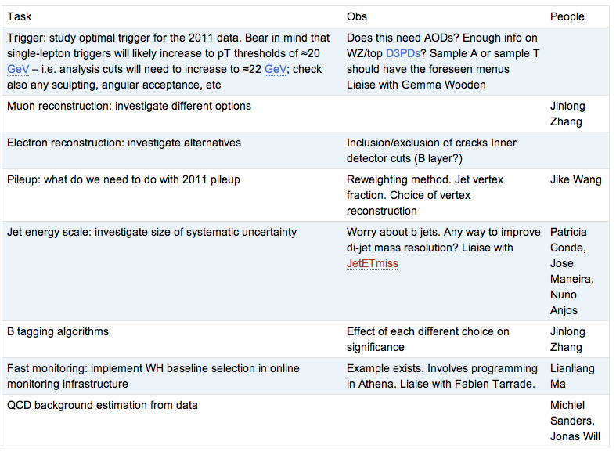
WH Task List
https://twiki.cern.ch/twiki/bin/view/AtlasProtected/WHNoteSummer2011#Analysis_Tasks

Slide 8
Backup

Slide 10
Date | Milestones wish list
17 May | Dubna workshop – analysis frozen After this: add data to un-boosted analysis and prepare for result approval Concentrate more effort on boosted VH with a view to obtaining results quickly
10 May | Review results with 2011 data from cut-based and multivariate analyses
3 May | Margin for dealing with unforeseen problems
26 April | Start looking at 2011 data if enough is available. Any surprises? How does the MC describe the new data? By now we should have a reasonable idea of results from the multivariate analysis
19 April | End of 2 weeks of beam scrubbing. (I’m away for Easter)
12 April | By now we should have a reasonable idea of the exclusion of the cut-based analysis First report on MVA preliminary results – establish plan for getting results by Dubna
5 April | Identify the worst systematics and discuss any possible improvements: Any changes needed in analysis cuts? Any study necessary for corrections to some systematic effect? Multivariate analysis: iterate on preselection cuts, methods, questions Assign tasks – divide the work to achieve better results!
29 March | Establish analysis cuts: If possible as result of optimization Use 2010 data to develop cuts and show that data is well described by background MC Start evaluating systematics
22 March | Iterate on analysis cuts – why is each cut applied at each particular value? Start iteration on multivariate methods to improve analysis

Slide 11
Reconstruction issues
Muon CP group recommendations for release 16:
Reconstruction efficiency and isolation efficiency scale factors, momentum smearing functions
https://twiki.cern.ch/twiki/bin/view/AtlasProtected/MCPAnalysisGuidelinesRel16
Jet/Etmiss recommendations for jet cleaning in release 16:
Medium jet cleaning should give similar rejection to rel 15 cleaning but with better efficiency
Tight jet cleaning should not be used – still under discussion
https://twiki.cern.ch/twiki/bin/view/AtlasProtected/HowToCleanJets#Bad_jets_rel16_data
New!: Final b-tagging calibrations for release 16 based on full 2010 data:
https://twiki.cern.ch/twiki/bin/view/AtlasProtected/Analysis16
e/gamma recommendations for energy scale and resolution in release 16:
https://twiki.cern.ch/twiki/bin/view/AtlasProtected/EnergyScaleResolutionRecommendations
And rescaler tool: https://twiki.cern.ch/twiki/bin/view/AtlasProtected/EnergyRescaler
Standard Model W/Z group baseline selection for release 16 (next 4 slides):
See discussion in W/Z group Sharepoint
Also, finer points (and perhaps the not so fine) still being discussed

