Slide 1
Introduction
Ricardo Gonçalo
HSG5 weekly meeting – 3 February 2012

Slide 2
News! News! News!
WH->νlbb and ZH->llbb support note in CDS:
https://cdsweb.cern.ch/record/1404176/
ZH->ννbb in CDS (early iteration!):
https://cdsweb.cern.ch/record/1418230?ln=en
Many thanks to everyone involved!!!
That means YOU!
Please check them… maybe still a bit raw
Also please check the authors list and let me know if I missed someone

Slide 3
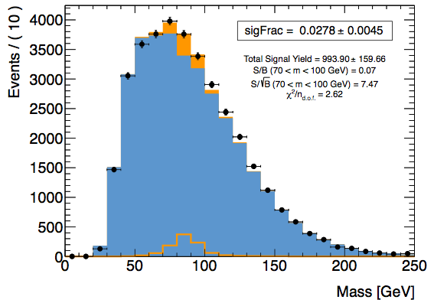
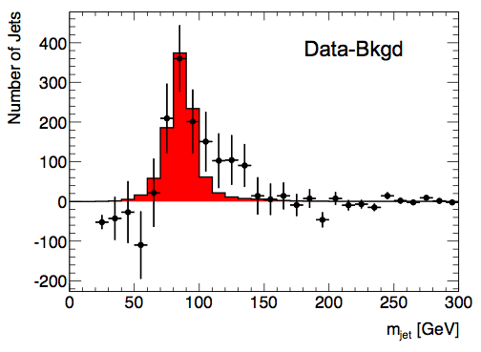
Today…
Latest news on H->bb limits etc
Latest news on Z peak (and shoulder…)

Slide 4
Backup slides

Slide 5
Publication Plans
From PC/subconveners meeting:
Latest circulation date to ATLAS is 17th February
Higgs approval to be arranged with Ed.Board
In practice:
This means 2nd February Higgs approval for paper – very little margin
Plan is more clear for WH and ZH->llbb: need good 1st paper draft
Status is not as good for ννbb yet: work towards including in paper
Boosted VH in a parallel path for now: considering a note for Moriond
To gain a few days (if needed):
ZH->ννbb will be submitted as support documentation to be included in paper
This means that we can turn it into CONF note if not in schedule for paper
Now thinking about editors for note
Maybe wrong time to mention this but…
Looking into the future, aim to have combined WH analysis for ICHEP including boosted analysis
Or before… mention ICHEP to mean up to…
ttH can aim to have published results in same timescale

