Slide 1
Introduction
Ricardo Gonçalo (RHUL)
Higgs Weekly Meeting – 2 March 2012

Slide 2
Outlook
Inclusive analyses:
Analysis results and status of paper draft
Boosted Z->bb status
Analysis plans up to Summer

Slide 3
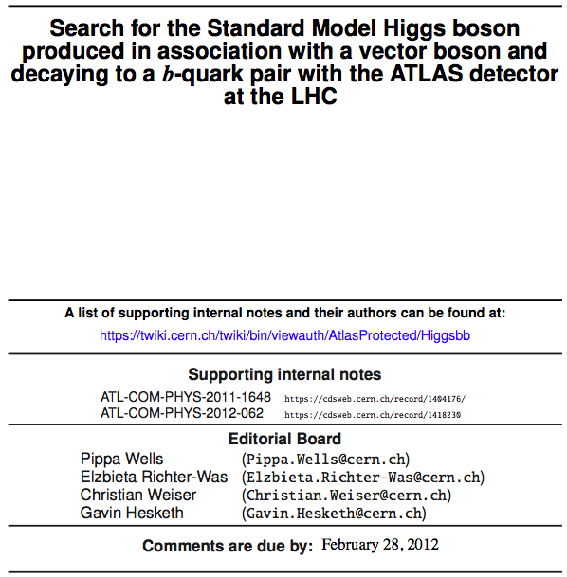
Editorial board signed off yesterday – last changes being made today after Phys.Coord. comments
Editorial board:
Chair:
Pippa Wells
Members:
Elzbieta Richter-Was Christian Weiser
Gavin Hesketh
Editors:
Ricardo Gonçalo Andrew Mehta Giacinto Piacquadio Paul Thompson
Editors of ZH->ννbb note:
Bill Murray
Song-Ming Wang
Paper CDS record: https://cdsweb.cern.ch/record/1425880
Draft 1 under approval as CONF note: https://cdsweb.cern.ch/record/1428142
Support material:
ZH➝llb & WH➝lνbb: https://cdsweb.cern.ch/record/1404176/
ZH➝ννbb: https://cdsweb.cern.ch/record/1418230
Thanks!!! ☺

Slide 4
The state of the art…
Previous results – EPS2011: 15 – 20 x SM (expected)
ZH➝llbb and WH➝lνbb (1.04 fb⁻¹)
Since last Summer:
Cuts changed mainly to suppress top background
Lumi increased by 4.5x and included ZH➝ννbb
Latest results – under approval: 2.6 – 5.1 x SM (expected)
ZH➝llbb and WH➝lνbb (4.7 fb⁻¹) and ZH➝ννbb (4.6 fb⁻¹)

Slide 5
Plans up to Summer - I
H->bb paper:
The CONF note for Moriond is the first draft
Must finish paper soon to contribute to combination(s)
Expect other analyses to converge, e.g.:
Z->bb work will continue to evolve
Boosted H->bb analysis very lively:
Aim to converge for Summer results
Try to merge with inclusive analyses at the highest pT(W/Z) bin
First results point at significant improvement – see talk by Ines Ochoa at the last HSG5 meeting: https://indico.cern.ch/conferenceDisplay.py?confId=167398
ttH has shown first baseline results:
Stat-only limits of ≈15xSM with 1fb-1
=> expect ≈7xSM with full 2011 data (stats only) – See Donnachda Quilty’s talk here: https://indico.cern.ch/conferenceDisplay.py?confId=167391
ttH cross section may help a lot for √s = 8TeV (≈2x?)
… and much more! -> VBF H->bb, b(b)H, MV methods, cut flow, etc

Slide 6
Plans up to Summer - II
Continue to work on the existing channels:
ZH➝ννbb had first iteration, but has space to evolve
MV methods not yet explored enough
Essential to get the best of our data:
More interaction with CP groups:
Main points and open questions in current analyses are on jets, MET and b-tagging
Would benefit (a lot!!) from better understanding of jet energy scale, MET, di-jet mass resolution
Trigger – e.g. MET trigger, trigger for VBF H->bb, b(b)H, etc
See Yoshikazu’s talk today on ννbb trigger; also work in b(b)H and on boosted Z->bb trigger
Preparing list of MC samples needed for MC12
Crucial to get enough MC (and of the right kind) – Paolo’s talk today on PowHeg validation
Produce new results for ICHEP2012 with 2012 data
…maybe shortly after… see the Higgs in H->bb ☺

Slide 7
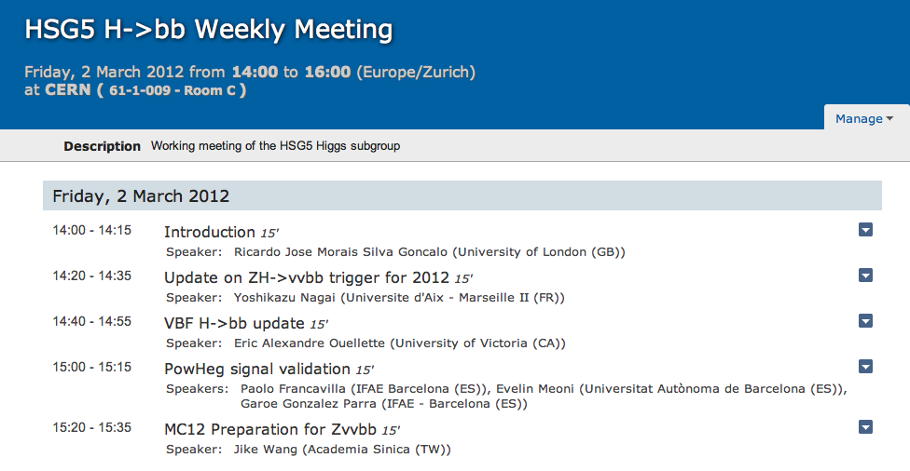
Today’s agenda

Slide 8
Backup slides

Slide 9
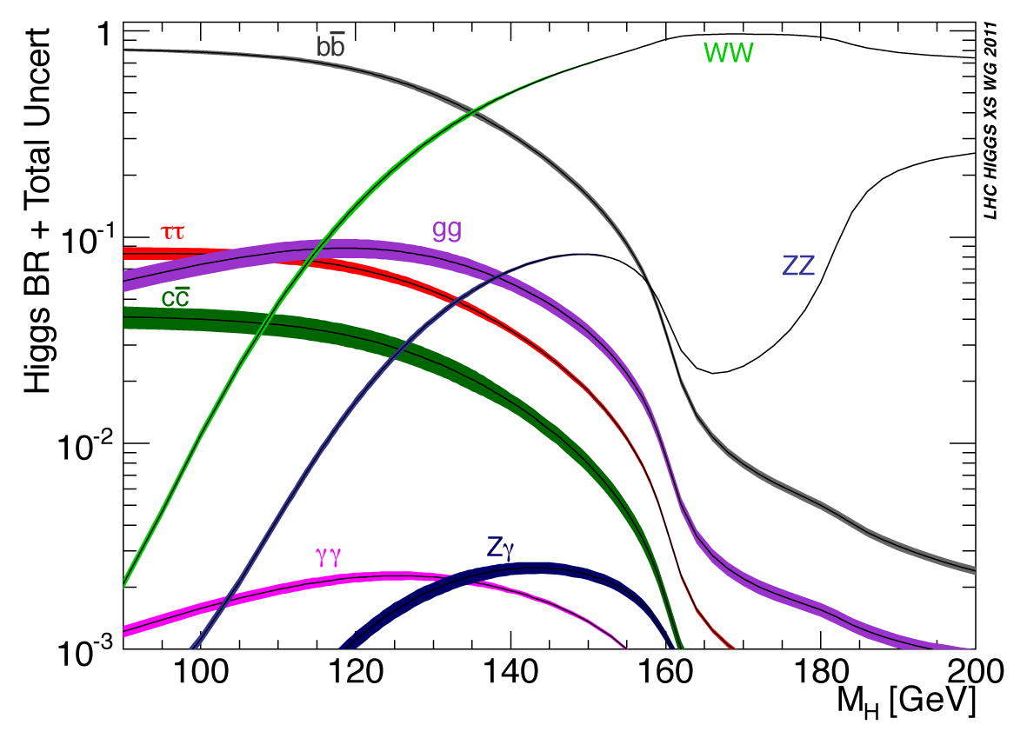
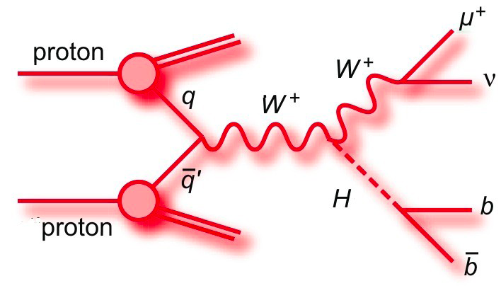
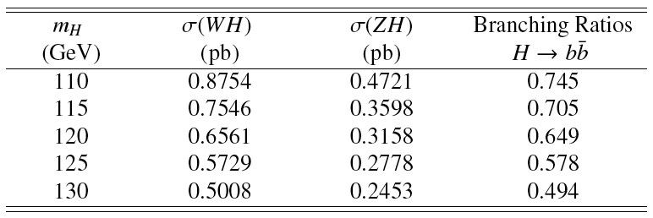
This paper:
ZH➝llb, WH➝lνbb and ZH➝ννbb
4.6 – 4.7 fb⁻¹ analyzed
H->bb dominant at low mass
WH cross section factor ≈2x higher than ZH, but important top background
Cut-based analyses:
Select Z or W or large E_{T}^{miss} and search for 2 additional b jets
Search Higgs in m_{bb} spectrum

Slide 10
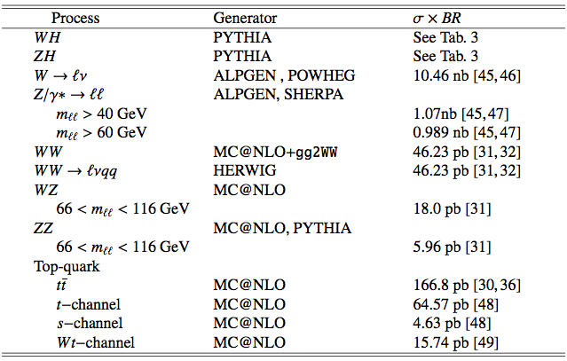
Monte Carlo samples

Slide 11
Datasets
Full 2011 data from periods B-M
4.7 fb⁻¹ e/μ streams (ZH➝llb, WH➝lνbb)/4.6 fb⁻¹ JetTauETmiss (ZH➝ννbb)
Signal (MC11c)
ZH➝llbb, WH➝lνbb, ZH➝ννbb simulated in Pythia
Normalized to NLO (EW) + NNLO (QCD) from LHC Higgs cross section WG (Yellow Report I)
m_{H} = 110 − 130 GeV in steps of 5 GeV
Background (MC11c)
Z/W+jets: ALPGEN to model l (l and c jets) for Z(W)
High statistics Zcc/Zbb(Wbb) using SHERPA(POWHEG)
Top: ttbar + single top from MC@NLO
Diboson: ZZ/WZ/WW from MC@NLO
QCD background
ZH➝llbb multi-jet electron from loose-loose no medium data scaled
WH➝lνbb electron and muon from anti-isolation data scaled
ZH➝ννbb from data (ABCD method) – negligible

Slide 12
Lepton Selection: WH➝llb, WH➝lνbb
Electrons
medium++ (tight++) with pT > 20(25) GeV and |η| < 2.47 for Z(W)
Include crack region
Trackisolation: Ptracks /pT < 0.1 within R = 0.2
For WH: Calo isolation: Pcalo /ET < 0.14 within R = 0.3
For WH: Impact parameter cut d0 < 0.1 mm
Latest recommended smearing and efficiency corrections
Veto in WH: use central loose++ with pT > 10 GeV and forward loose
with pT > 20 GeV(|η| < 4.5). Require trk/calo isolation (except forward)
Muons
STACO(Muid) tight with pT > 20(25) GeV and |η| < 2.5 for Z(W)
Track isolation (as for electrons); For WH calo isolation
Impact paramter cuts d0 < 1(0.1) mm for Z(W)
Impact parameter cut against cosmics z0 < 10 mm
Latest recommended smearing and efficiency corrections
For veto in WH extend to Loose/standalone, pT > 10 GeV and
|η| < 2.7. Require track isolation (except standalone)

Slide 13
Jet/E_{t}^{miss} selection
Jets – not updated to last week’s recommendations
Anti-kT 4 with pT > 25 GeV and |η| < 2.5 ”AntiKt4TopoEMJets”
For jet veto in WH pT > 20 GeV and |η| < 4.5
Remove events with jets pointing to the bad FEB region
Pile-up: reject jets with |JVF| < 0.75 for jets with |η| < 2.5
Current JES/JER uncertainty including pile-up, close by and b JES
b-tagging – not updated to last week’s version
MV1 with w > 0.602 ( 70% efficiency)
Applying corrections and uncertainties derived by b-tagging group.
MET – not updated to last week’s version
MET RefFinal out-of-the-box
Apply pile-up reweighting for each MC run period
Additional μ scaling reweighting: scale <μ> by 1.03±0.03

Slide 14
Lepton and jet veto: ZH➝ννbb, WH➝lνbb
Veto leptons:
Electron : medium , pT>10 GeV, |η|<2.47, pTcone20/pT<0.1
Muon : Combined & segmented-tagged STACO, pT>10 GeV, |η|<2.4, pTcone20/pT<0.1
Veto on any event having an object with:
pT > 20 GeV. Veto lepton has wider range than trigger electron
(standalone muons, forward electrons).
Remove any event with:
1 extra lepton with pT > 20 GeV
1 extra opposite sign lepton with pT < 20 GeV
> 1 extra leptons
Remove any event with ≥ 3 jets (veto jet: pT > 20 GeV and |η| < 4.5)
In ZH➝llbb, WH➝lνbb: remove overlaps between electrons, muons, jets

Slide 15
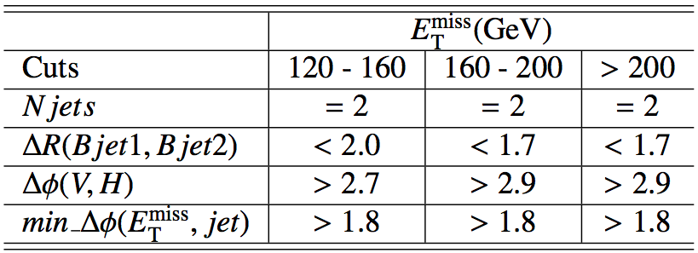
Event selection
Common selection
Using WZ+jets GRL (incl. b-tagging)
Primary vertex containing at least 3 tracks
ZH➝llb
Triggers: single and dilepton triggers
Exactly 2 leptons with 83 < mll < 99 GeV
Opposite charge required for muons
ET^{miss} < 50 GeV
At least 2 jets (1 jet with p_{T} >45 GeV), exactly 2 b tagged
WH➝lνbb
Triggers: single lepton trigger
1 lepton and MT > 40 GeV
Emiss
T > 25 GeV
Exactly 2 jets(1 jet with pT >45 GeV) and both b tagged
ZH➝ννbb
Trigger: EF_xe70_noMu
No lepton (e or μ)
Etmiss > 120 GeV
Ptmiss > 30 GeV (remove events with fake high Etmiss)
2 or 3 jets, exactly 2 b-tagged jets
Leading jet Pt>45 GeV (new)
B-tagged jets separated by dR(b1,b2)>0.7 (for 120<Etmiss<200 GeV)
Δφ(Etmiss, Ptmiss) < π/2 (new)
Plus optimized angular cuts (table)

Slide 16
Other aspects of the analysis
Selected sample is divided into pT(W/Z) categories to increase significance
Some cuts are optimized for each bin in ZH➝ννbb analysis
Heavily data-driven estimation of backgrounds
Normalization of main backgrounds transferred from
ZH➝llbb/WH➝lνbb analysis to ZH➝ννbb analysis
More info in support material:
ZH➝llb & WH➝lνbb: https://cdsweb.cern.ch/record/1404176/
ZH➝ννbb: https://cdsweb.cern.ch/record/1418230

Slide 17
Plots for approval – Fig.1

Slide 18
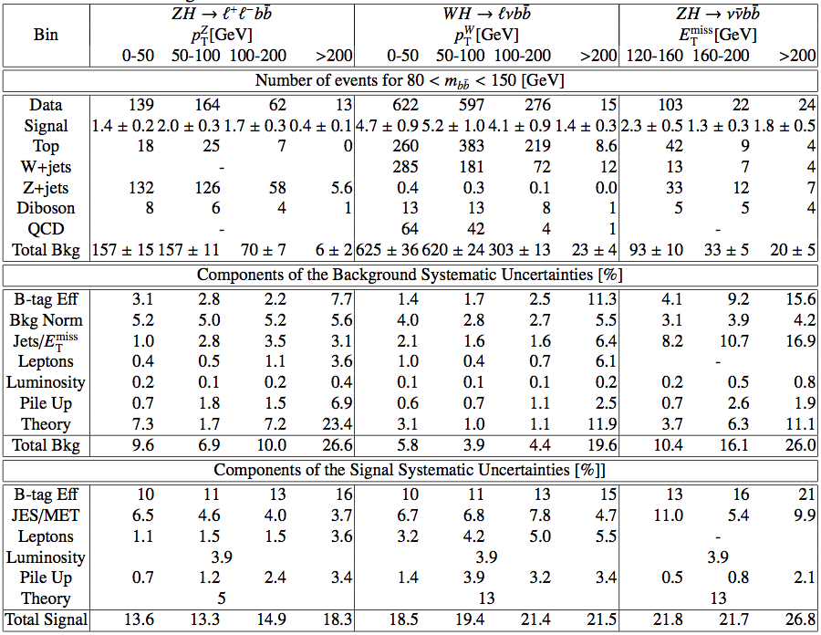

Slide 19
Inclusive analyses
Cut-based analyses
ZH➝llbb and WH➝lνbb and ZH➝ννbb
Select Z or W or large E_{T}^{miss} and search for 2 additional b jets
Search Higgs in m_{bb} spectrum
Determine main backgrounds from data (sidebands & control regions)
Both ZH and WH (≈20%) contribute to ZH➝ννbb
Internal
ZH➝llb
Internal
ZH➝ννbb
WH➝lνbb

Slide 20
Plots for approval – Fig.2 (ZH➝llbb)

Slide 21
Plots for approval – Fig.3 (WH➝lνbb)

Slide 22
Plots for approval – Fig.4 (WH➝lνbb)

Slide 23
Limits plots for approval

Slide 24
Last public results:
First H➝bb search from the LHC shown at EPS – July 2011
ZH➝llb, WH➝lνbb only
1fb⁻¹ @ 7 TeV
Combined sensitivity: ≈10-20xSM
Ref.: ATLAS-CONF-2011-103

Slide 25
Un-tagged m(j,j) plots
Added to WH/ZH support note (appendix O.7): https://cdsweb.cern.ch/record/1404176/
Also in control regions of ZH->ννbb support note: https://cdsweb.cern.ch/record/1418230
ZH->llbb
ZH->vvbb
WH->lvbb

Slide 26
Table 2 – Exclusion Limits

Slide 27
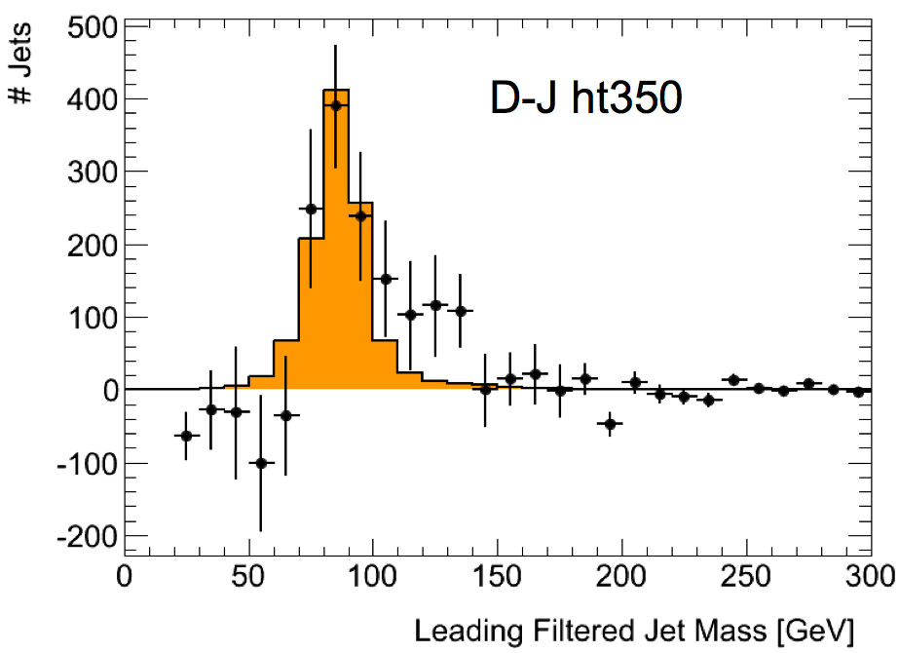
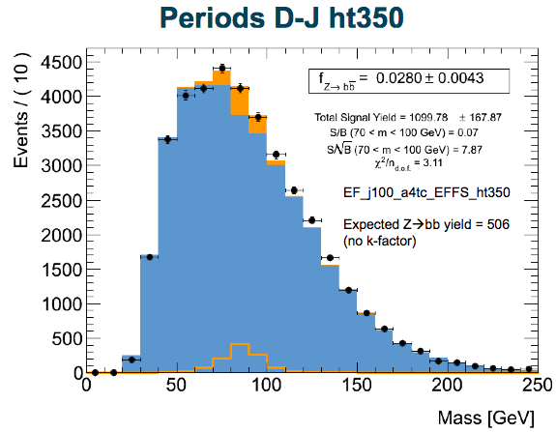
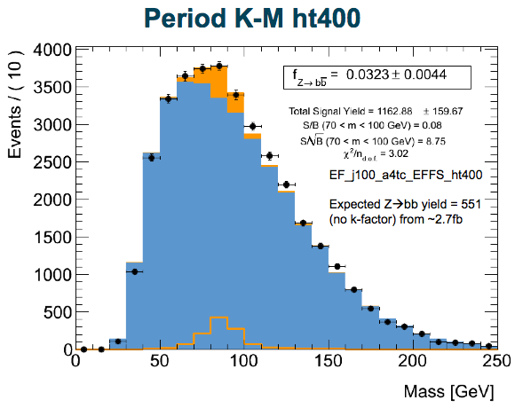
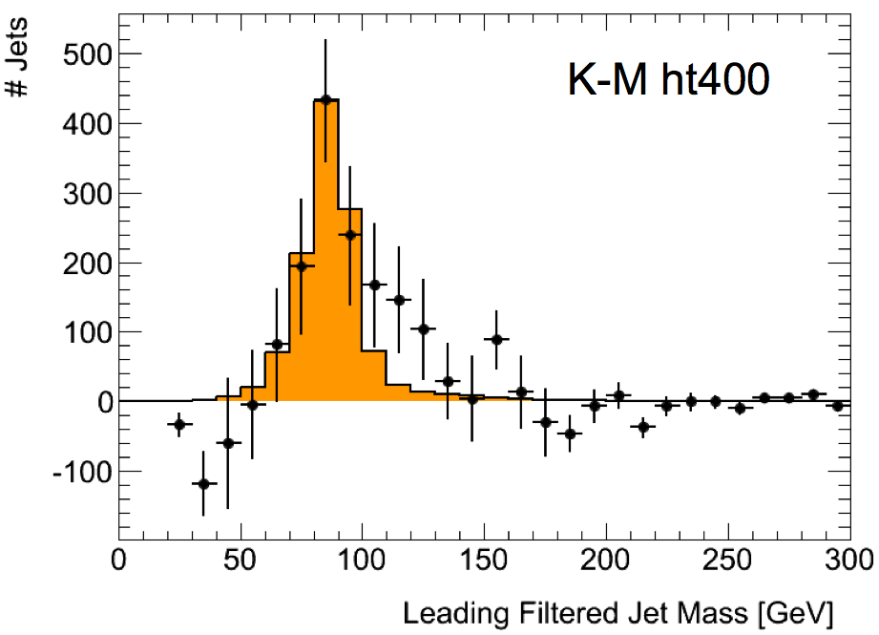
Boosted Z->bb
Z->bb analysis with jet substructure in HSG5
Perfect calibration for boosted H->bb!
An exciting Z->bb peak can be seen after background subtraction
And (perhaps even more exciting?!) there is a shoulder just above the Z mass… at around 126GeV ☺
Caveat: get excited, but don’t get too excited!
A lot of work has been going on to test the results
Much progress made so far
But many questions remain and must be answered
Observing the Z->bb in this analysis would be fantastic!
Current status:
Now looking at full simulation MC
Observations in D-J is still there in periods K-M!
D – J with trigger EF_j100_a4tc_EFFS_ht350
K – M with trigger EF_j100_a4tc_EFFS_ht400
See Luke Lambourne’s talk at HSG5 meeting: https://indico.cern.ch/conferenceDisplay.py?confId=167396

