Slide 1
H->bb Weekly Meeting
Ricardo Gonçalo (RHUL)
HSG5 H->bb weekly meeting, 2 August 2011

Slide 2
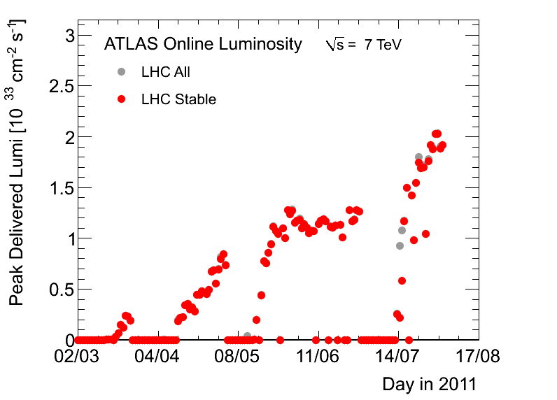
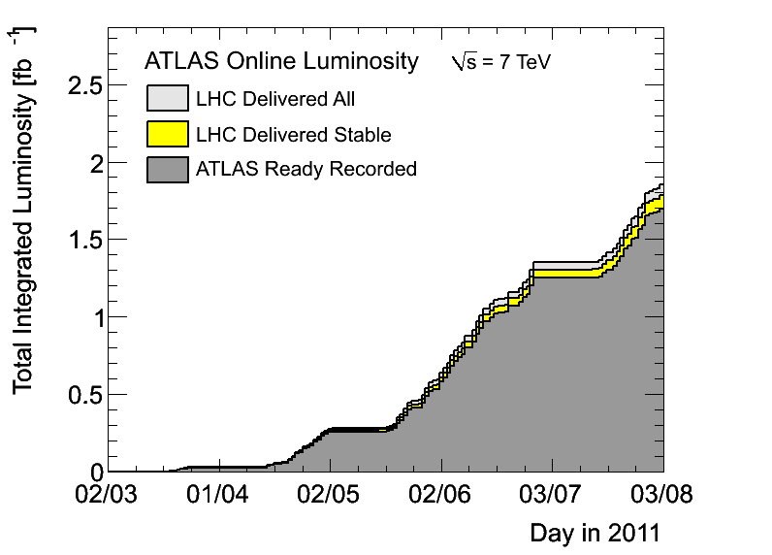
News! News! News!
Peak stable lumi up to 2x10³³cm⁻²s⁻¹
1.7fb⁻¹ with stable beams collected so far
Peak pileup around 11
1380 bunches in the machine – maximum for 50ns

Slide 3
H->bb Posters
Patricia won best poster prize at EPS! Congratulations!
Koloina could not make it to Lepton-Photon, but Dilip Jana will present our poster at the conference. Many thanks!

Slide 4
Boosted VH Data Format
Had a phone meeting on Friday last week to discuss a common D3PD format for boosted VH analyses
Will use “official” Jet/ETmiss D3PD maker code by Bertrand Capleau to produce SM W/Z D3PDs including jet substructure variables
https://twiki.cern.ch/twiki/bin/view/AtlasProtected/GroomedJetsD3PD
Filtered Cambridge-Aachen jets and their constituent jets etc
Need to run b-tagging on sub-jets
Edinburgh (Robert H.) working on this with help from UCL
Then the idea is to make data skims to ease running on new data

Slide 5
Data skims for H->bb
We need to have data skims to avoid pain of running over too much data – both for inclusive and boosted analyses (ZH inclusive already using HSG2 skims)
Plan to join the DPD train:
The code to produce DAODs or D3PDs should be in AtlasPhysics cache and fully tested
The production needs to be done with a single Reco_trf.py instruction (fully tested standalone)
Write the data to Higgs group space
DPD production done in Tier1 from AODs
Skims should be small enough for this to make sense
Once code is running, need to get the ok from the Higgs conveners and production manager
Should test asap on rel.16 AODs to be ready for production after reprocessing

Slide 6
Data reprocessing and MC11
Tier0 will move to rel.17 soon – possibly 24th August to allow for rel.16 data for LP2011
After that, all 2011 data will be reprocessed with rel.17
We should move to rel.17 and MC11 asap

Slide 7
Rumours…
Word on the street is that CMS may send H->bb results to LP2011 which are very competitive with ours
Means we need to keep working hard to improve existing analyses and add more channels

Slide 8
No meeting next week…
I’ll be on holidays with no internet
Hold the fort until I’m back and keep up the good work!

Slide 9
Backup Slides

Slide 10
General Impressions
Very good that we presented these results for several reasons:
We showed it can be done!... (first time for the LHC) And now we have baseline to build on
It was nicely done in several ways – data-driven estimates of worst backgrounds etc
We showed that boosted VH is within reach – boosted VH plot got lots of attention! Now we need to deliver on the promise
Important to have a cross check for H->γγ
Results included in ATLAS SM Higgs combination
What is missing:
Real sensitivity – we’re only at 10-15 times the SM
The way forward:
Space for improvement in WH/ZH
Include other channels
Try to move higher in mass reach (but cannot do much)
See next slides…
Concerns
Current results: small screw-up in limits (obs vs exp) needs to be understood
Near future: not much time! Waiting to see how much low mass excluded by Tevatron
Sociological: need to keep focused on this – need to get activity going again after EPS madness

Slide 11
Post-mortem of WH/ZH results
M_{bb} resolution is extremely poor
Should try to get a peak, but this needs work on jet (and b-jet) energy scale
Try to think about this together with jet/E_{T}^{miss} people
Could we improve other things in jet reco to improve m_{bb}?
In ZH->llbb could try to use ll vs bb p_{T} balance to do in-situ calibration?
B-tagging systematic uncertainty dominates by far
16% vs 7-9% for JES and ≈1-2% others
Should be possible to improve this, since the error is dominated by the statistics used in b-tagging studies
Would improve limits by up to 25-30%
Think about this with b-tagging people
Limits: must get help from roostats experts to understand the difference between expected and observed
WH cuts on exactly 2 jets
A lot of signal is lost there – can it be improved?
WH backgrounds:
Top and W+jets background estimate using simultaneous template fit to m_{bb} sidebands (<80GeV and 140-250GeV)
Probably should try to also constrain jet energy scale from this fit
JES changes m_{bb} distribution and could affect normalization of backgrounds
In light of H->WW results, should move upper sideband to e.g. 160-250GeV – at m_{H}=150GeV, σ*BR already 1/10 of value at 115GeV, but H->WW and H->bb resolution is very broad
Can top background be reduced further?
ZH background from Z+bb seems irreducible – can it be improved?

Slide 12
WH/ZH analysis plans
We can still try to improve cut based analysis:
Get a m_{bb} peak, improve b-tagging systematics, constrain JES in WH, etc…
Reduce top background in WH:
Try using looser leptons or extending lepton id to forward region to veto tt->lvlvbb
Loosen jet η cut (at |η|<2.5 now) and maybe p_{T} cut to veto tt->lvjjbb/jjjjjbb
But… must keep pileup and JVF in mind
Reduce Z+bb background in ZH? Would probably need a clever new variable like cos*θ
Then clearly we should include multivariate methods
Used intensively by Tevatron
e.g. use NN to target top background – may allow to relax 2-jet cut in WH
NN may also help in rejecting Z+bb background in ZH?
See if MV method can improve existing b-tagging
Add more channels!
Can something be done with ZH->ννbb? Very good channel in Tevatron, but complex and mature analysis
Academia Sinica group plans to work on this But trigger is the crucial part
Boosted VH is clearly the next thing to push! WH->lνbb and ZH->llbb, but also ZH->ννbb
UCL and Edinburgh working on this – should be enough manpower now, but need to get results soon
ttH has been slowly building up in Glasgow – will push for this to happen together with Chris

Slide 13
Technical issues
ZH benefitted from HSG2 DAOD skims, but WH suffered from painful running on data
Need to push for WH skims – will follow up with Kostas & Co.
In contrast to other groups we don't have an error due to LO/NLO on the signal. Need to get NLO signal MC
Also need to re-do WH samples at 110 and 140 since the current ones were done with a lepton filter by mistake
Should also other mass points:
Get 135 for WH and ZH since we have 130 and 140
Should we try to extend to 150 GeV in light of H->WW results? Almost no sensitivity, but could prove useful later

