Slide 1
First H->bb Weekly Meeting
Ricardo Gonçalo (RHUL)
HSG5 H->bb Weekly Meeting, 1 February 2011

Slide 2
News! News! News!
News:
Mini acceptance challenge in HSG5:
Compare everyone’s results given the same cuts and the same data sample: tt di-lepton MC or possibly data from given period – very useful to debug analysis machinery
HSG5 Workshop in Dubna
Likely dates have changed to 17th – 19th May 2011
Visas have to be thought about soon! Expect email with instructions for registration etc
Will be the last check point for Summer CONF notes before approval process – aim to have solid results

Slide 3
Chamonix!
Chamonix workshop last week: http://indico.cern.ch/conferenceOtherViews.py?view=standard&confId=103957
We are going to run in 2012
Beam energy: 3.5 TeV in 2011 – think again in 2012
Initial parameters:
beta* =1.5 m
bunch intensity 1.2x10¹¹ p/bunch
bunch spacing 75 ns
Increase number of bunches until ≈300
Then clean with beam scrubbing and decide on 50/75 ns spacing
May reach an instantaneous luminosity of ≈10³³ cm⁻²s⁻¹ by mid May
More details in today’s Weekly meeting: http://indico.cern.ch/conferenceDisplay.py?confId=119623

Slide 4
B-tagging
For the winter conferences (Moriond EW and later)
Flavour Tag group we will provide calibrations for SV0 and JetProb
Operating points:
SV0:
w > 5.85 (50% b-tagging efficiency on ttbar MC)
JetProb:
-log₁₀(w) > 3.25 (50% b-tagging efficiency on ttbar MC)
-log10(w) > 2.05 (70% b-tagging efficiency on ttbar MC)
Approval of calibration analyses and release of preliminary calibrations tomorrow (agenda in preparation): http://indico.cern.ch/conferenceDisplay.py?confId=110409#6
Work ongoing advanced tag calibrations
More info in b-tagging TWiki:https://twiki.cern.ch/twiki/bin/view/AtlasProtected/Analysis16

Slide 5
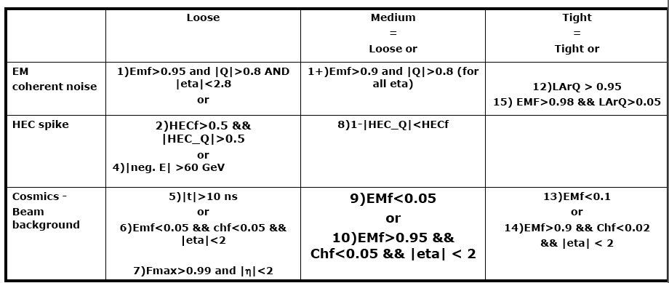
Jet cleaning cuts for release 16
Jet cleaning discussion this morning – possible proposal below
Proposal to be shown in Jet/Etmiss meeting tomorrow: http://indico.cern.ch/conferenceDisplay.py?confId=117497

Slide 6
From last week…
Issues:
Wisconsin: larger data samples for WH NN training:
Currently 50k events for 3 mass points
Private production: 150k for each mass point
Preselection leaves too few events for training
Would like 300k events for each mass point
Alternatives? Use truth-level? Filters?
LMU: SVN area for code
Only need to know desired name, to request this (sorry for late request, mea culpa)

