Slide 1
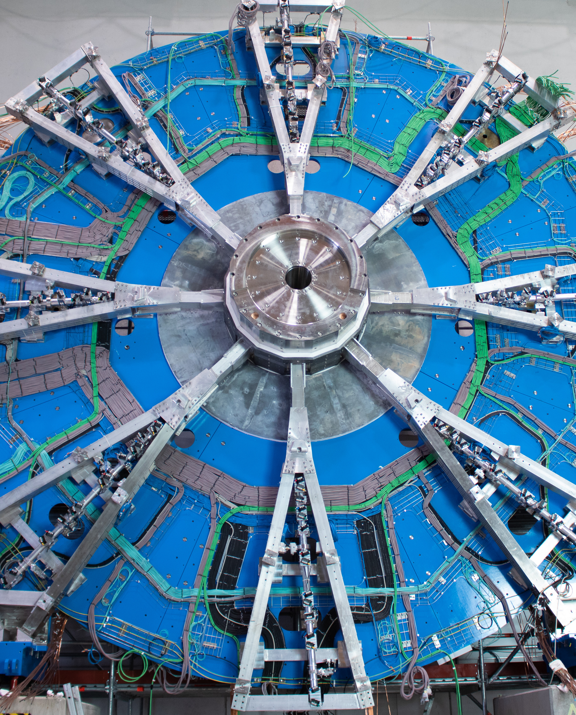
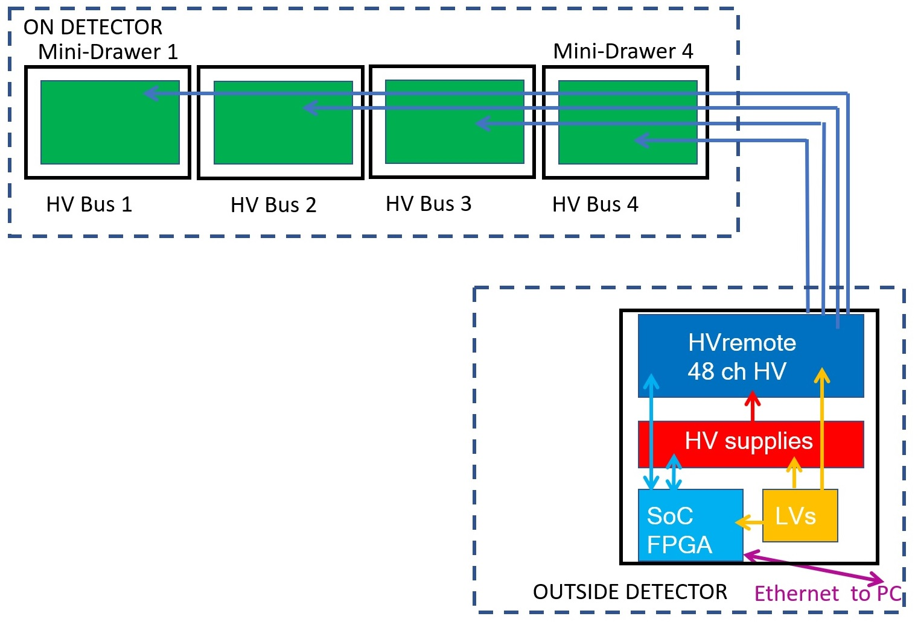
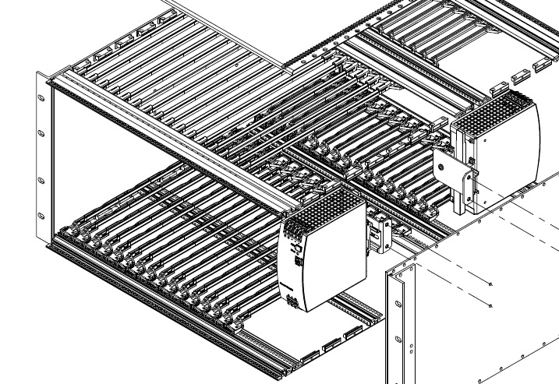
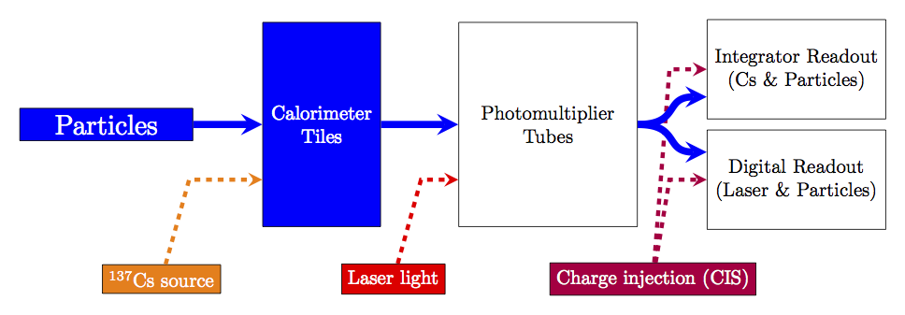
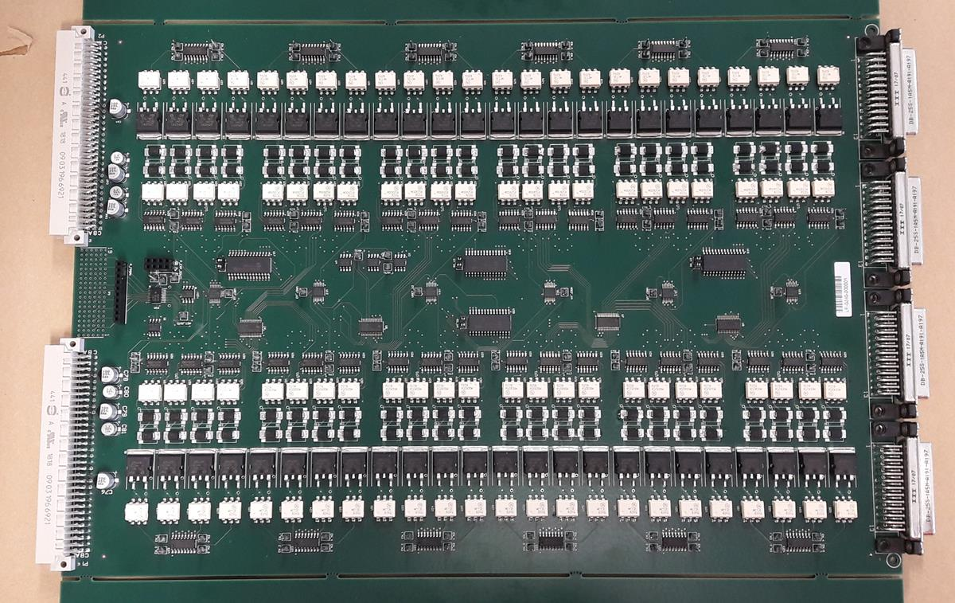
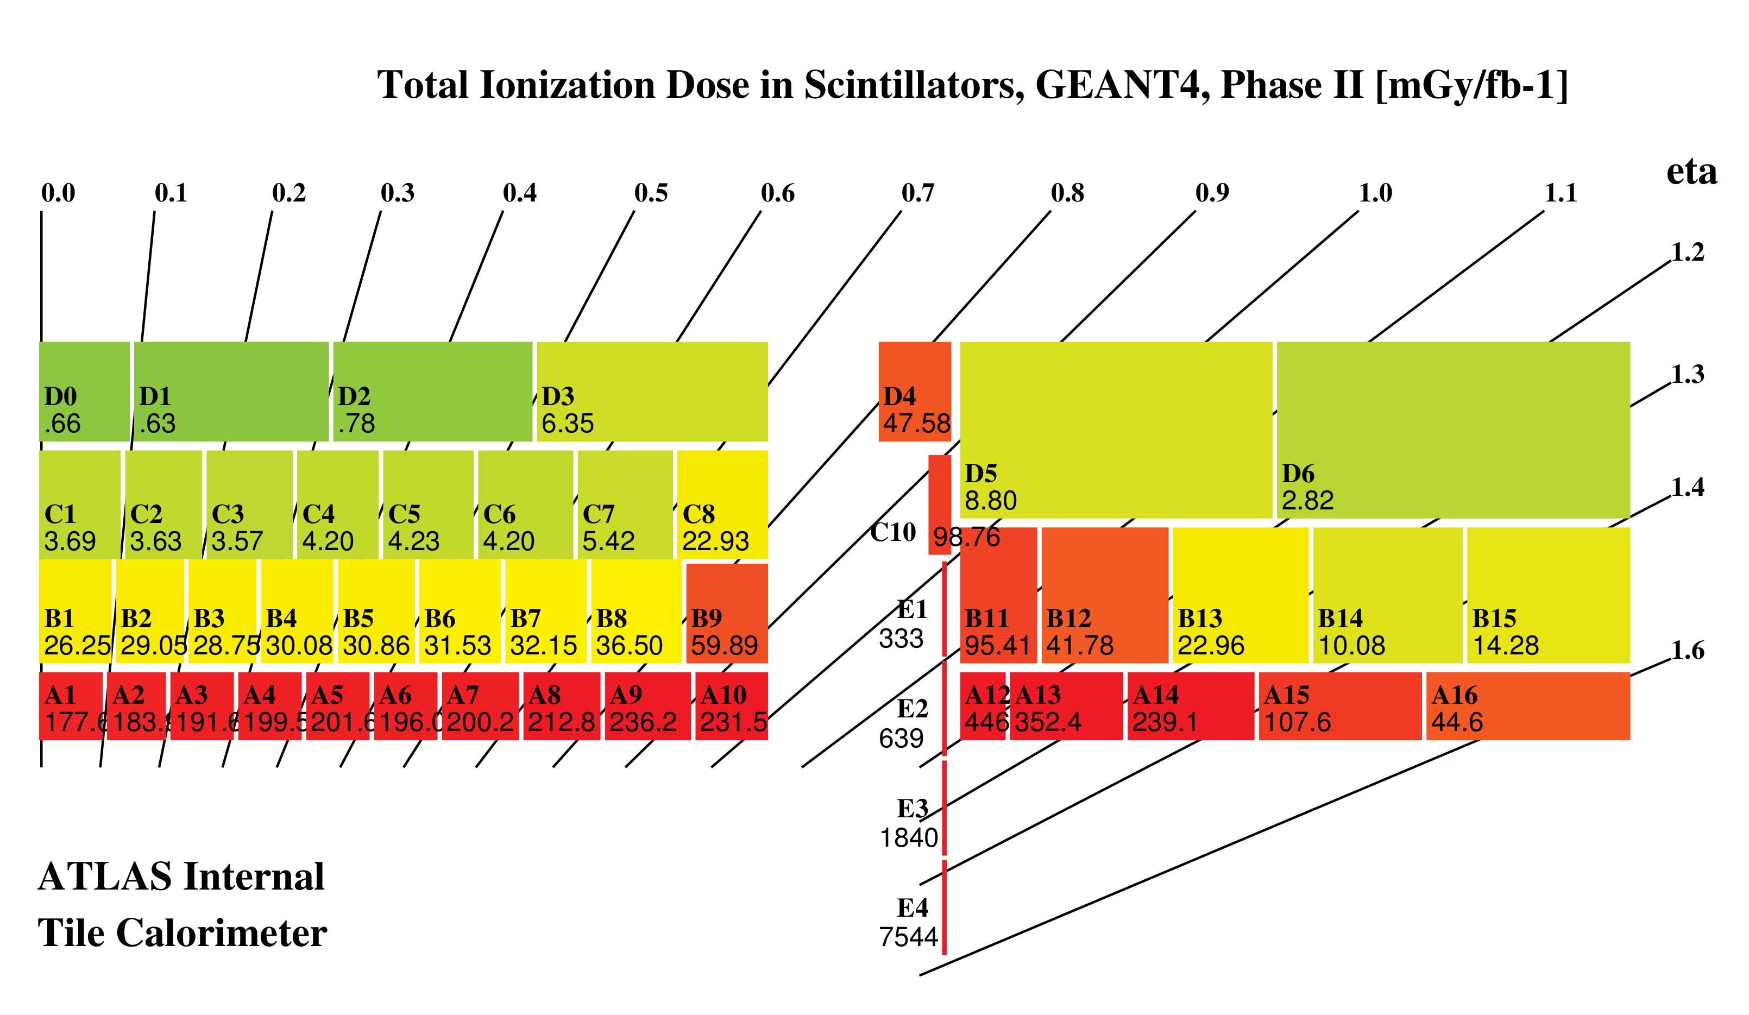
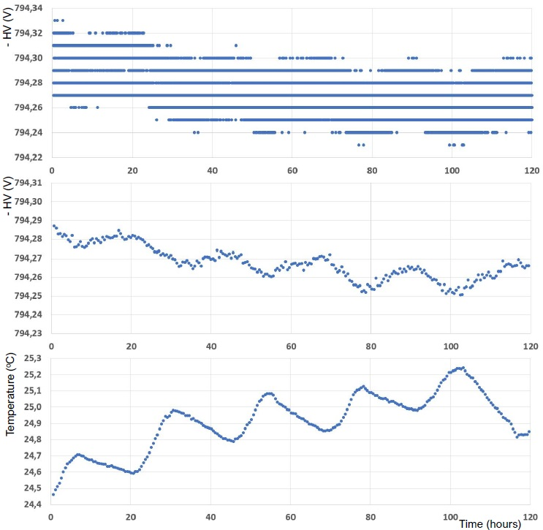

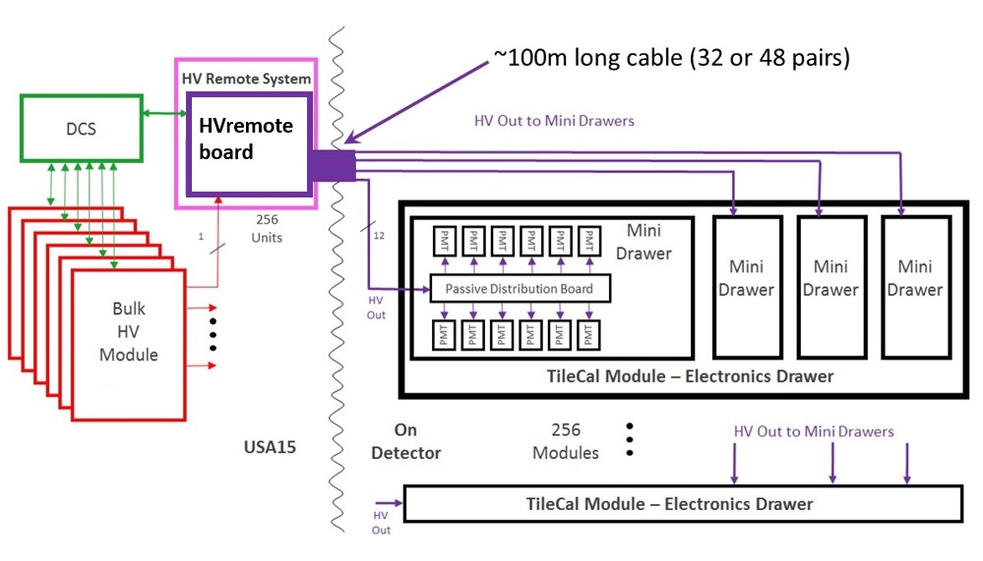
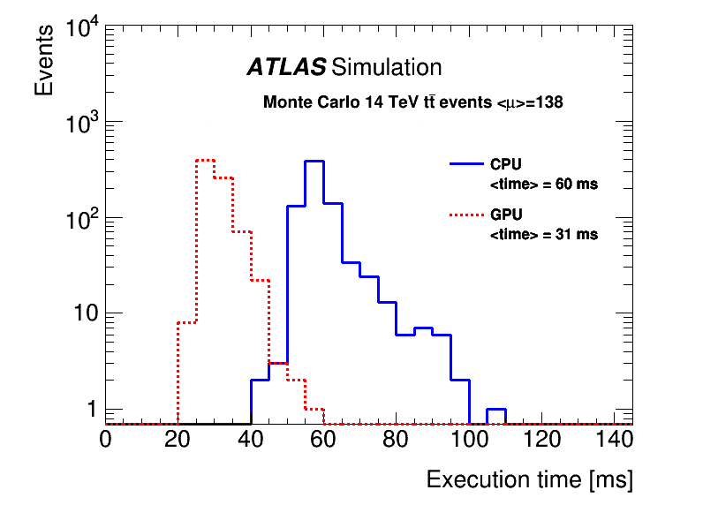
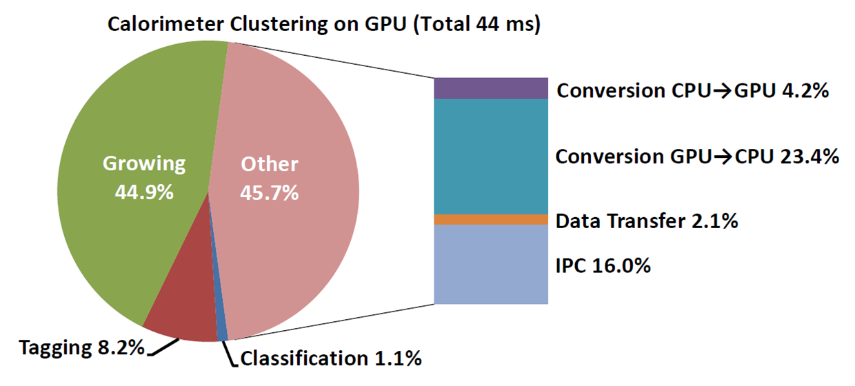
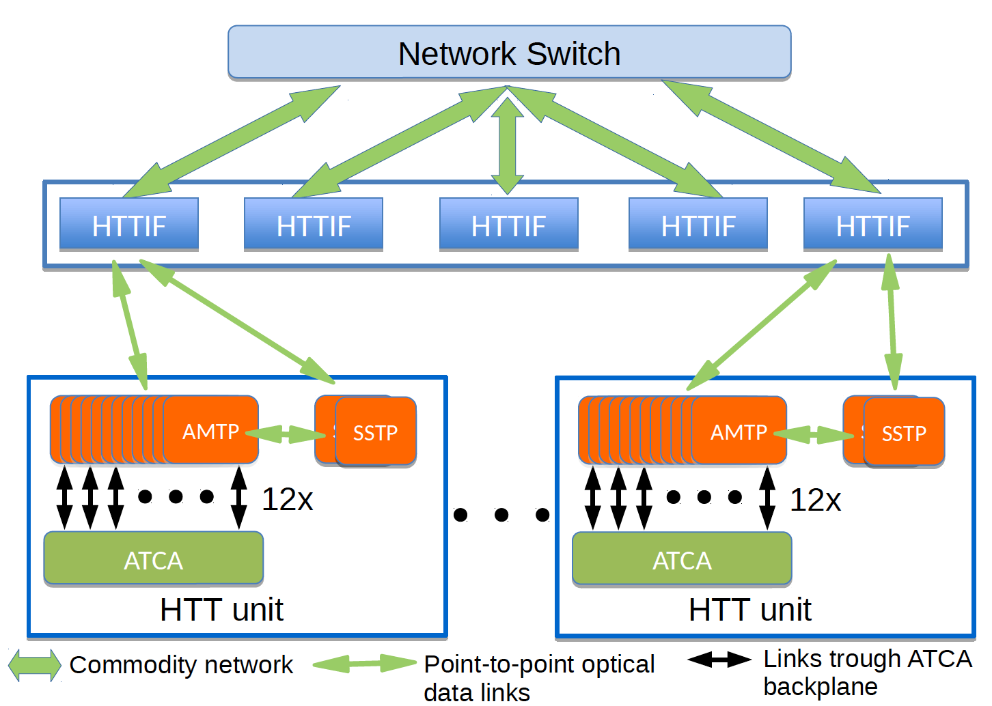
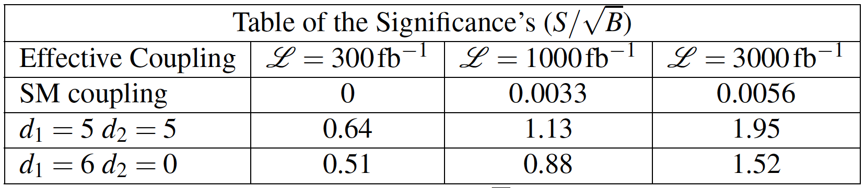
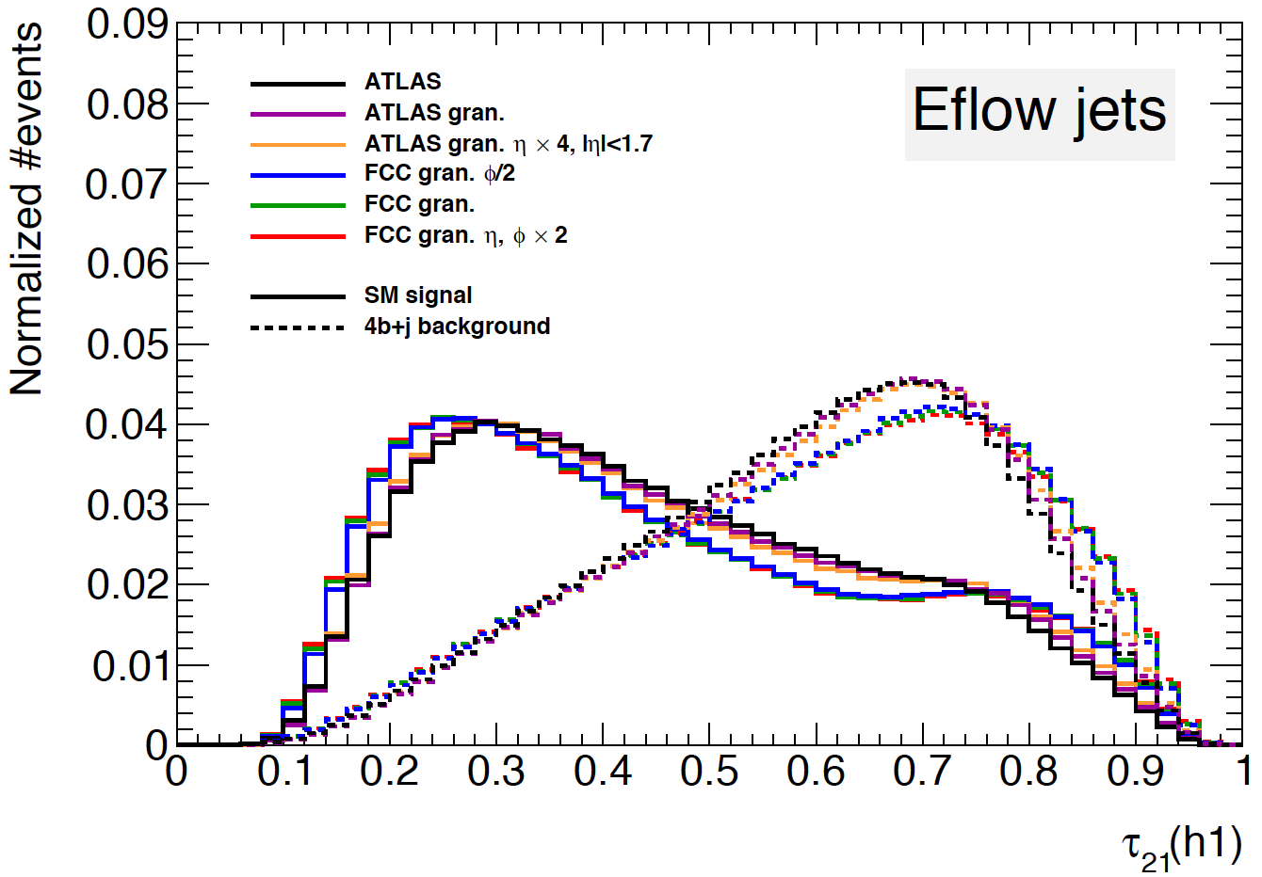
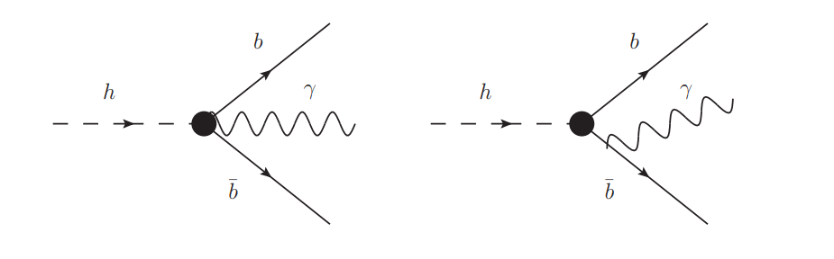

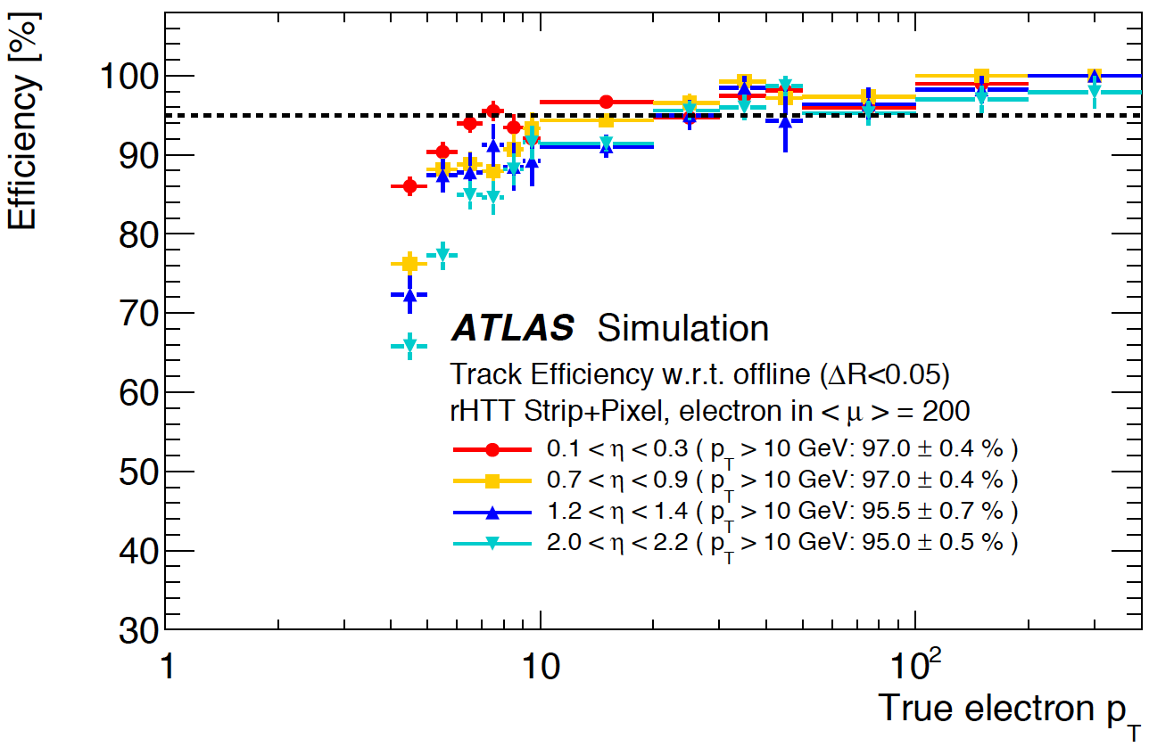








ATLAS Experiment Upgrade
CERN/FIS-PAR/0033/2019
Miguel Alves, José Augusto, Ana Carvalho, Patricia Conde, Filipe Cuim, Guiomar Evans, Ricardo Faria,
Rui Fernandez, Agostinho Gomes, Ricardo Gonçalo, António Gonçalves, Luís Gurriana, Amélia Maio, Filipe Martins, António Pina, Bruno Rodrigues, José Rufino, João Saraiva, Susana Sério, André Wemans
Tilecal High Voltage System Upgrade
Radiation ageing and obsolescence of components requires a new Tilecal HV distribution system for operation at the HL-LHC
Profit from change to move HV regulation to USA15, far from detector: improve reliability and ease accessibility and maintenance
Provide 10 000 voltages of [-470,-830] or [-590,-950] V
Ageing of Tilecal optics
Future LHC running will lead to increased radiation damage to TileCal scintillators and fibres – crucial to study light yield vs dose
We’re developing a combined analysis with inputs from all Tilecal calibration systems to isolate light loss from optics degradation
Separate effects from scintillators, WLS fibres, PMTs, electronics
Will model performance vs ionising dose to extrapolate to HL-LHC
Complement and cross check analysis with measurements at the LOMaC laboratory in LIP
100m long cables with 12, 32 or 48 pairs of wires
Reviews:
HVbus,HVremote and cables PDRs passed in June with recommendations
HVsupplies PDR expected January 2020
crate developed with Heitec, Germany
main part of HV regulation loop
Challenges and status
Certification of long cables from Portuguese industry: fire, noise and connectors breakdown
Achieve needed control&monitoring performance
Development of the FPGA adaptation board
Testing new 48-channel HVremote prototype
Next: vertical slice test with all HV components in April-June 2020
5-day stability test
raw data (every 10 seconds)
average per 30 minutes
Use of GPUs in trigger processing
Contributing to new trigger and offline GPU efforts
Port the old TAC (Topo-Automaton Clustering) to the new Athena offline framework
TAC performance studies in the new framework
Identify current bottlenecks and develop new solutions
Study alternative machine learning clustering algorithms
Specs and parameters:
High Voltage < 950 V
Average applied HV so far ≈750 V
Individual channel current < 400 μA
HV stability < 0.5 V rms
Setting/reading precision 0.25 V
Hardware Tracking for the Trigger (HTT)
Hardware tracking co-processor for the trigger based on custom Associative Memory ASIC: matches hit groups to predefined patterns
Crucial to: reject low-p_{T} leptons, identify vertex, jet and MET resolution
Portugal responsible for production of RTM communications module
Will contribute to:
  Prototyping and testing of boards – ATCA testing station will be purchased and installed at LIP and person power allocated
  Development of HTT DCS – profiting from Tilecal and AFP experience
  Development of HTT fast simulation and performance estimates
Prospective Physics Studies
The purpose of this task is to reserve time and resources for the reason we’re building the HL-LHC: the physics – we want to prepare the future by developing new analysis ideas and techniques
Higgs: EFT studies of anomalous H→bbγ coupling and HH→bbbb
Top: contributing to development within LHCTopWG of global combination of top-quark related observables; preparing HL-LHC search for new physics in top quark sector in trilepton final states
Developing use of machine learning techniques to maximize sensitivity and generality of future HL-LHC analyses
Status and schedule
PDRs for initial prototypes in June 2019
System Specification Review passed July
Demonstrators & slice testing 2020/21
Prototypes & pre-production 2022/23
HTT Specs and Numbers
Regional tracking:
  1 MHz, 10% of ITk, p_{T} > 4 GeV, |η|< 4
Global tracking:
  100 kHz, 100% of ITk, p_{T} > 1 GeV, |η|< 4
58 ATCA shelves
727 Tracking Processor boards
1245 Pattern Recognition Mezzanines
A.Kelly, MSc Thesis, U.Amsterdam & LIP, 2018
A.Carvalho, MSc Thesis, IST &LIP 2018
Outreach: senior team members keep a regular outreach activity including CERN masterclasses, lectures, summer students, etc. Involvement of PhD students in outreach will be strongly encouraged.
Acknowledgements:

