Slide 1
H->bb: Goals for Summer 2011
Ricardo Gonçalo (RHUL)
HSG5 Workshop at JINR, Dubna, 10 May 2011

Slide 2
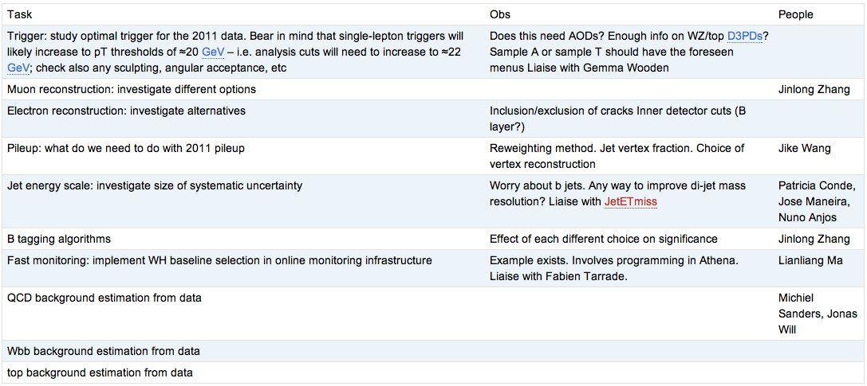
Un-boosted WH analysis
Cut-flow comparison between various groups
First done in rel.15, re-done to check migration to rel.16
Analysis cuts established and almost final (see below)
Several ongoing studies to finalize analysis selection:

Slide 3
CONF note for EPS-HEP 2011
Editors: Paul Thompson, Andrew Mehta, Patricia Conde-Muiño
Title: “Searches for a Higgs boson decaying to a b-quark pair with the ATLAS detector at the LHC”
Tight time scale – but feasible!
First INT note draft should be ready on 10 June
To be finished by the end of the month
Data frozen for EPS on 22 June – expect final calibrations etc
CONF note circulated early July to be approved before conference
Conference starts 21 July
Notes:
Need this material for H->bb poster accepted at EPS-HEP
Could re-use the existing CDS number (ATL-COM-PHYS-2010-929)
Contacted members of old Winter “background” note ed.board to check availability before moving forward
SVN area for notehttps://svn.cern.ch/reps/atlasgrp/Physics/Higgs/HSG5/data_7TeV/ATL_COM_PHYS_2010_929/trunk/

Slide 4
CONF Note
Contents:
Title is generic to make sure we can adapt contents to time available
Should aim for a short CONF note – possibly a longet INT note
Un-boosted WH is the obvious candidate
From Wahid’s talk, boosted WH does not seem a viable candidate in the available time (but I would be happy to be contradicted!)
Un-boosted ZH seems feasible and we should aim to include it
ttH clearly not for this note – but no reason to not expect it for end of the year
VBF H->bb may be in a longer timescale – let’s see
Analysis results:
Need m(b,b)
Systematic errors – including JES (can start with an old recipe?)
Xsection limits?
Control plots (for INT note?)

Slide 5
SM Higgs Combinations
Bill says we should contribute to the Atlas/CMS combination
… may be a bit soon – latest date for inputs is 19th June, I think
Alternatively there may be an Atlas-only combination later
Comments?

Slide 6
The Master Plan
Get CONF note out for EPS
This will set the basis for later work
Contribute to ATLAS or LHC Higgs combination asap?
Need to discuss this
Plan for a paper at end of this year or early 2012
This must include remaining channels and boosted Higgs techniques

Slide 7
Backup

Slide 8
H->bb poster for EPS-HEP
H->bb searches with the ATLAS detector at the LHC
The H -> bb channel is extremely important for the observation of a Higgs boson signal at the LHC. In the Standard Model, this channel would provide a significant contribution to the Higgs boson search in the low mass region, where this decay mode constitutes the dominant Higgs decay channel. Due to the enormous jet production cross-section at the LHC, the search must target channels where the Higgs boson is produced in association with a weak boson, a pair of top quarks, or jets separated by a rapidity gap. It also requires complex techniques to reconstruct the signal and separate it from an overwhelmingly large background. We present the status of Higgs searches in the H->bb channel currently being performed within ATLAS.
The poster abstract was accepted by the conference
Will be presented by Patricia (random selection among list of volunteers)

