Slide 1
H->bb Overview and Aims
Ricardo Gonçalo (RHUL)
HSG5 Workshop at JINR, Dubna, 10 May 2011

Slide 2
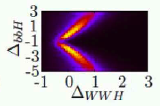
The story so far…
H->bb channel essential for Higgs searches
Essential to determine Higgs couplings: see Sven Heinemeyer’s talk
Probes important mass region just above LEP limit
“Bumps” in other channels will need confirmation
Last H->bb results from boosted VH Monte Carlo study at 14TeV
Every channel helps!…
H->bb activities for past few months:
Most effort has been into WH->lνbb analysis – aimed for Summer conferences
Both on un-boosted and boosted analyses
Other activities also important for now or for later: ZH, ttH, VBF H->bb
A few people in several groups involved:
Academia Sinica: WH, ZH, cut-based analysis, pileup studies
Argonne: WH, cut-based analysis, muon reconstruction
Edinburgh: boosted WH, W+jets backgrounds
Glasgow: ttH, cut-based analysis, multivariate analysis
LIP Lisbon: WH, cut-based analysis, jet studies
Liverpool/Birmingham: WH, ZH, cut-based & multivariate analysis, b tagging
LMU Munich: WH cut-based analysis, QCD background, NLO MC validation
UCL London: boosted WH/ZH
Victoria: VBF H->bb, trigger studies
Wisconsin: WH, cut-based & multivariate analysis
… and more…

Slide 3
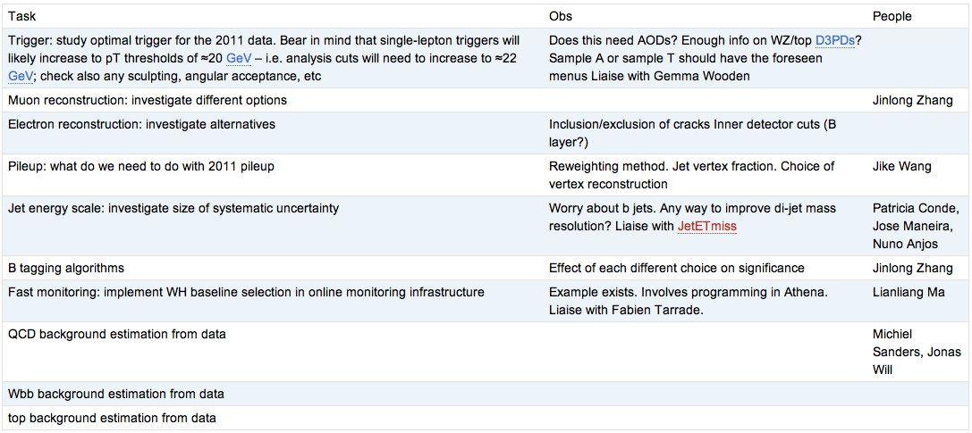
Un-boosted WH analysis
Cut-flow comparison between various groups
First done in rel.15, re-done to check migration to rel.16
Analysis cuts established and almost final (see below)
Several ongoing studies to finalize analysis selection:

Slide 4
WH analysis
Analysis cuts almost frozen
Additions & changes:
Number of jets/b-tagged jets:
Allowing >2 jets enhances tt background => cut at N_{jet}==2
Cut on Δϕ(H,W) > 2.5
Signal mostly back to back
B-tagger & working point:
Plan to use IPD3+SV1
Decide on working point
Interact with H.F.-tagging group
See talks by Andy and Paul later
To be discussed:
Background determination
Systematic uncertainties

Slide 5
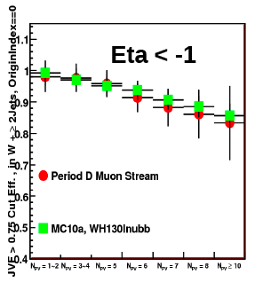
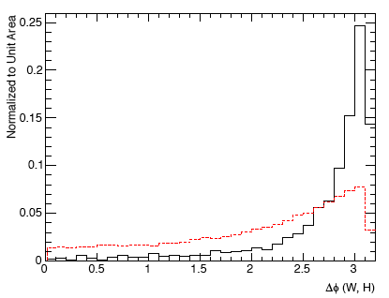
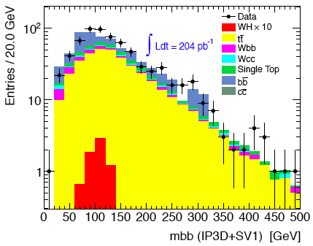
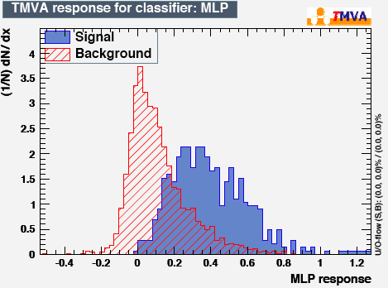
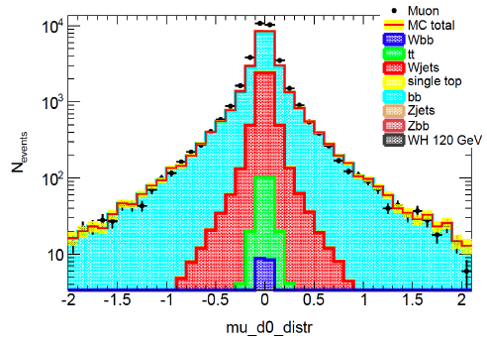
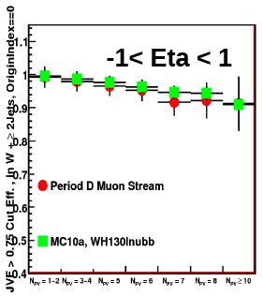
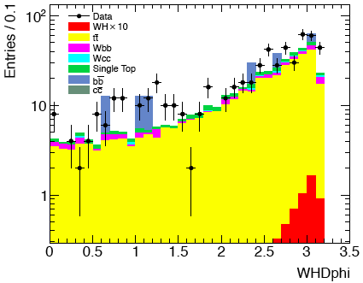
ttbar
WH
Some recent results:
Cut on Δϕ(H,W) > 2.5
Signal eff. 80%
tt eff. 42%
Effect of JVF well described by MC
Method being developed to determine QCD background
Improvements from use of multivariate analysis
2011 data (0.2fb⁻¹) reasonably well described by MC
But need to control bb background
Jike Wang
Lianliang Ma
Jonas Will
Paul Thompson
Lianliang

Slide 6
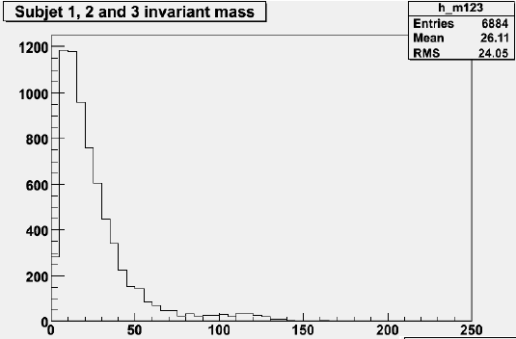
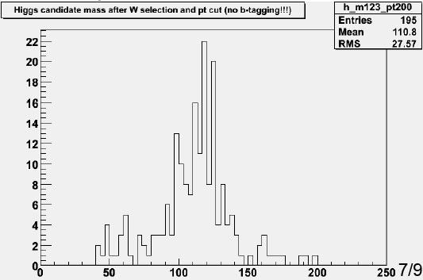
Boosted WH analysis
Higher sensivity than un-boosted
With 1fb-1 should be able to reject ≈6xSM for low-mass Higgs versus ≈10 – 12xSM for WH/ZH (stat. only)
But relies on difficult techniques now being commissioned
Essential to dominate technique and extract results this year!
Currently:
Optimizing cuts for 7TeV: 0.7% signal efficiency with 14 TeV cuts
Add b tagging to boosted jets
NLO WH->bb validation
Chiara Debenedetti

Slide 7
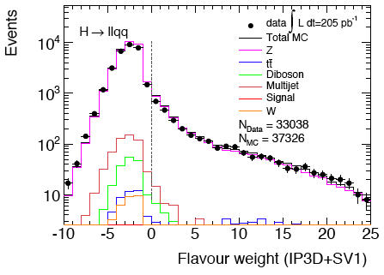
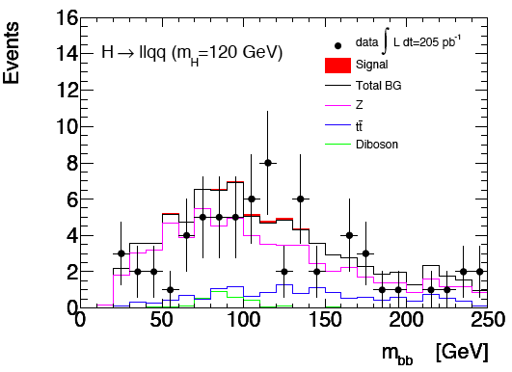
ZH analysis
Recently re-visited ZH analysis
Applied heavy-Higgs H->ZZ analysis to low mass and 2011 data
Reject 12xSM with 1fb⁻¹
Statistical errors only
May still be optimized
Will try to include in Summer note
Andrew Mehta

Slide 8
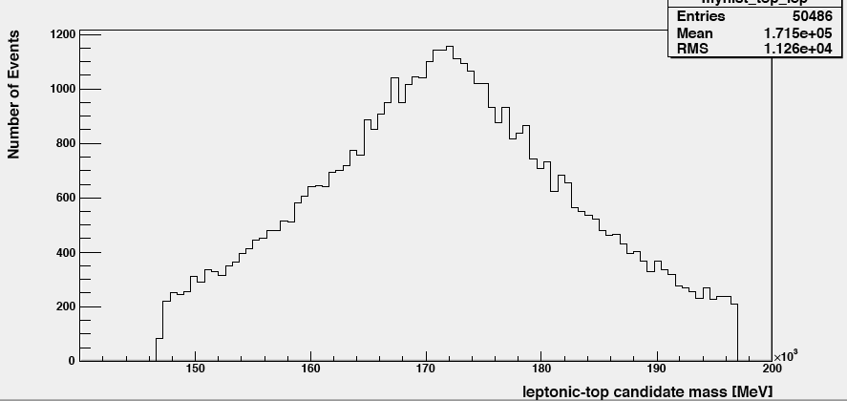
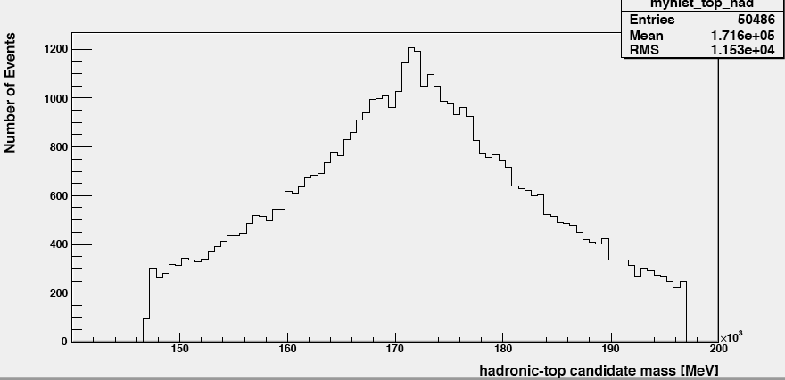
ttH analysis
Some recent progress on this channel
Cut-based and multivariate analyses ongoing
Expecting more progress soon!
Donny Quilty

Slide 9
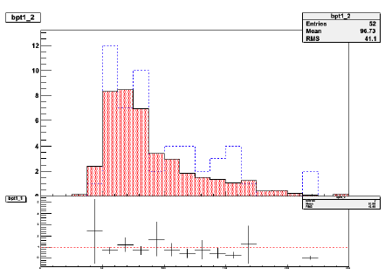
VBF H->bb analysis
Difficult channel
Challenging trigger
Working with jet trigger experts
Short- to medium-term solution found (up to ≈2E33)
HLT 2b + L1 jets
Rough estimation gives similar event numbers to all-hadronic VBF H->τ_{h}τ_{h}
Testing data-driven background determination method:
Get bb background from ratio of single- to double-b tagged events in control region

Slide 10
CONF note for EPS-HEP 2011
Editors: Paul Thompson, Andrew Mehta, Patricia Conde-Muiño
Title: “Searches for a Higgs boson decaying to a b-quark pair with the ATLAS detector at the LHC”
Tight time scale:
First INT note draft should be ready on 10 June
To be finished by the end of the month
Data frozen for EPS on 22 June – expect final calibrations etc
CONF note circulated early July to be approved before conference
Conference starts 21 July
Notes:
Need this material for H->bb poster accepted at EPS-HEP
Could re-use the existing CDS number (ATL-COM-PHYS-2010-929)
SVN area for notehttps://svn.cern.ch/reps/atlasgrp/Physics/Higgs/HSG5/data_7TeV/ATL_COM_PHYS_2010_929/trunk/

Slide 11
H->bb poster for EPS-HEP
H->bb searches with the ATLAS detector at the LHC
The H -> bb channel is extremely important for the observation of a Higgs boson signal at the LHC. In the Standard Model, this channel would provide a significant contribution to the Higgs boson search in the low mass region, where this decay mode constitutes the dominant Higgs decay channel. Due to the enormous jet production cross-section at the LHC, the search must target channels where the Higgs boson is produced in association with a weak boson, a pair of top quarks, or jets separated by a rapidity gap. It also requires complex techniques to reconstruct the signal and separate it from an overwhelmingly large background. We present the status of Higgs searches in the H->bb channel currently being performed within ATLAS.
The poster abstract was accepted by the conference
Will be presented by Patricia (random selection among list of volunteers)

Slide 12
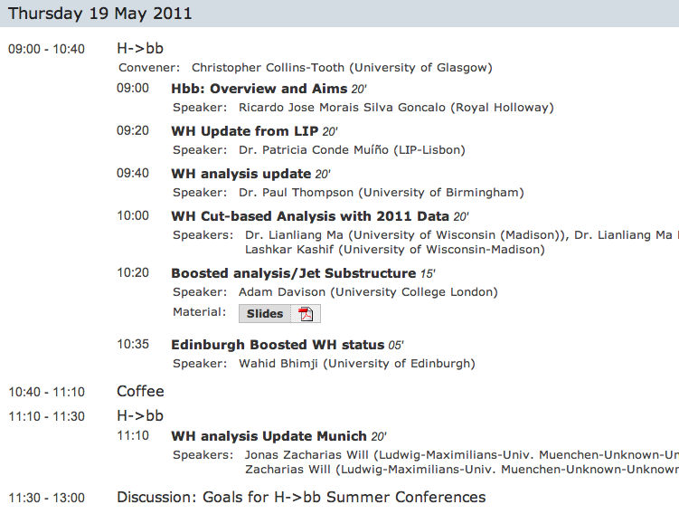
Today’s agenda

Slide 13
Backup

Slide 14
The Grand Plan
Get CONF note out for EPS
This will set the basis for later work
Contribute to ATLAS or LHC Higgs combination asap
Plan for a paper at end of this year or early 2012
This must include remaining channels and boosted Higgs techniques

