Slide 1
Single-beam chains

Slide 2
Single-beam chains
Being setup in TriggerMenuPython (Rasmus):
In SingleBeam_v1.py and SingleBeam_v2.py
First phase (SingleBeam_v1.py):
MBTS commissioning with 32 L1 items + MBTS_A/MBTS_C
HLT: taus more or less complete; rest incomplete
Second phase (SingleBeam_v2.py):
Only L1 so far
Would like to have L2 and EF algorithms with minimal changes:
No c++ changes if possible
Loose tunings (parameters) of FEX and hypos
So far:
Loose chains planned from each slice (slice contributions later)
Chains starting from MBTS/something else:
T2CaloEgamma:
Start from MBTS_A or MBTS_C and open wide ROIs
Add a Hypo algo after T2Calo with very loose cuts
TrigEgammaRec:
EF AllTeAlgo to do unseeded full-calorimeter reconstruction (Phillip)
Currently no tracking for either L2 or EF: to be added

Slide 4
T2CaloEgamma from MBTS
Tested online (Denis and Alex)
NAV_ERROR returned by algo when no TrigEMClusters produced
All events sent to debug stream
Needs minor fix to algo (would always be necessary)
Taken out of the menu; Alex working to re-integrate it
Points to necessity of testing new chains online asap

Slide 5
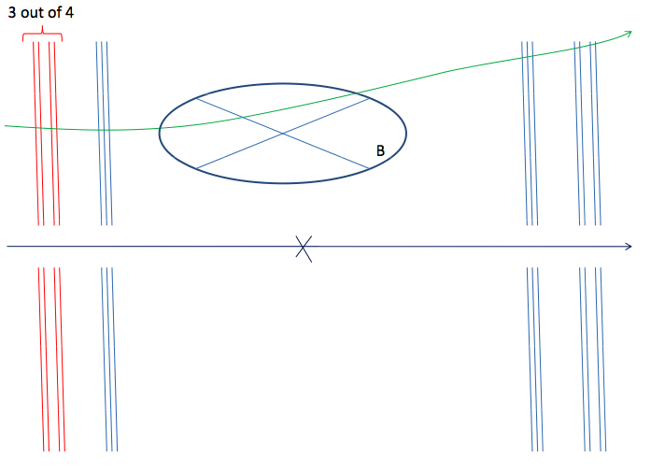
L2 muon full scan
A muon trigger from the endcap is possible (see talk by Masaya) in the last Core & Slices meeting http://indico.cern.ch/conferenceDisplay.py?confId=24854
Plan to use a chain modified from mu4_dimu_fs
Starts from L1_MU4
HLT chain counter 390
L2_MU4_DiMu_FS
EF_MU4_DiMu_FS
Uses TrigDiMuonFast at L2
Plan to use existing L2 setup in new chain

Slide 6
Plans
This week expect to have T2Calo running from MBTS
Add tracking (full scan)
Add full-scan muon chain from L1 endcap item
Anything else?

