Slide 1
CAF Brainstorming – Trigger
30 January 2009
Discussion on CAF activities for online/offline activities
Ricardo Gonçalo on behalf of the Trigger

Slide 2
Trigger Tasks in CAF
CAF was used in 2008 run for 3 main purposes:
Run High Level Trigger on Level 1-selected bytestream data
Test new Super Master Keys before online deployment
Classify High Level Trigger errors, crashes, etc
Run trigger offline monitoring on bytestream data from step 1
Produce ESDs with trigger information from step 1 bytestream data for analysis
Estimate trigger rates for new menus (occasional and lower priority)
Plans for the CAF in 2009:
Initial running will be pretty much the same as 2008 (running HLT on L1-only data, etc)
Plans for steady-state data taking :
Run error analysis/classification/recovery on all debug stream events
Run Data Quality monitoring jobs on some/all express stream data
Run online/offline trigger result comparison on some/all express stream data
Continue to test new menus and code offline in the CAF before deploying them

Slide 3
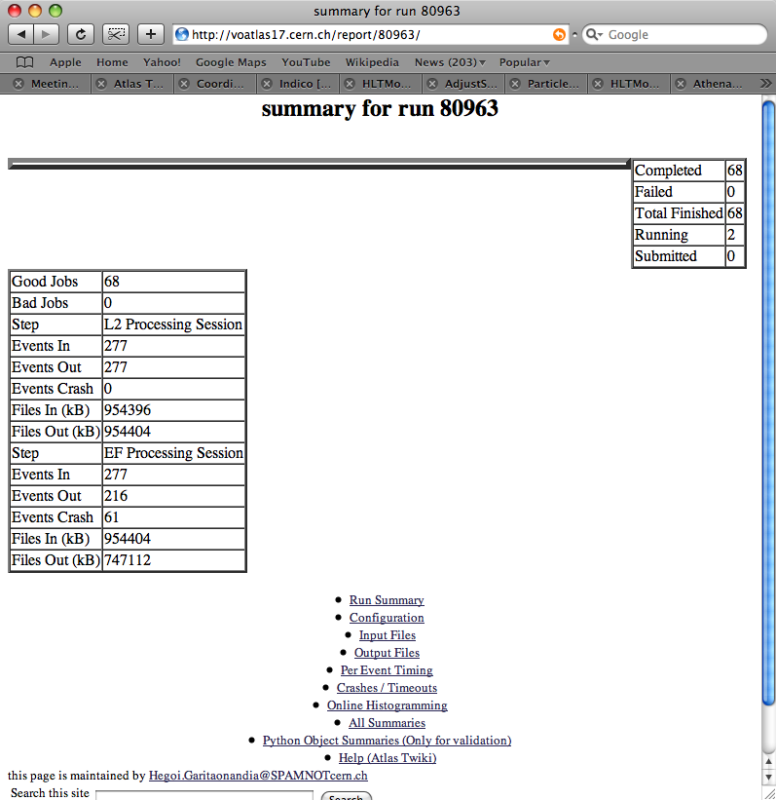
Task Management
Initial system written and developed for 2008 run: HDEBUG framework (Hegoi Garitaonandia)
Job submission for step 1 used HDEBUG, based on GANGA, and publishes results to web server
Monitoring jobs run trigger monitoring tools in TrigHLTMonitoring (Tier0) and TrigHLTOfflineMon (CAF) under AthenaMon
Monitoring and ESD (steps 2. and 3.) used simple queue submission scripts (bsub)
Small library of useful scripts for error classification, etc
Plans for 2009:
Automate job submission in HDEBUG framework – eliminate manual submission of jobs on debug and express stream
Complete merger of error classification scripts into HDEBUG
Ongoing development of analysis algorithms for online/offline comparison – to be managed by HDEBUG
Continue to use CAF for testing new SMKs before online deployment of menu
Simplify submission of test jobs and make it more robust

Slide 4
Centralizing task management?
Which of these tasks would benefit from a central system - and which would not?
This arrives a bit late… but it would be useful if it becomes the standard
Submission of jobs on DEBUG and EXPRESS streams could benefit from central facility – being done in HDEBUG
Initial data: run different menu and (possibly) release than was used online
Steady state: run same release and menu as used online
Would be useful to have system to automatically send jobs to all new data from these streams – under development in trigger, but perhaps useful elsewhere
Testing new menus: need to specify data set, menu, release (possibly nightly)
Need tool to un-stream data before running – avoid mixing streams after new HLT version runs on data
Other constraints:
DQ, debug stream and test jobs need to publish results in web-accessible way for remote DQ
Need to run this asynchronously from (before) offline reconstruction
For the DEBUG stream this means quasi-real time
Farm/queue load varies mostly depending on demand for testing new menus (time critical)

