Slide 1
H➝bb search and b-tagging
Ricardo Gonçalo
on behalf of the Higgs subgroup 5

Slide 2
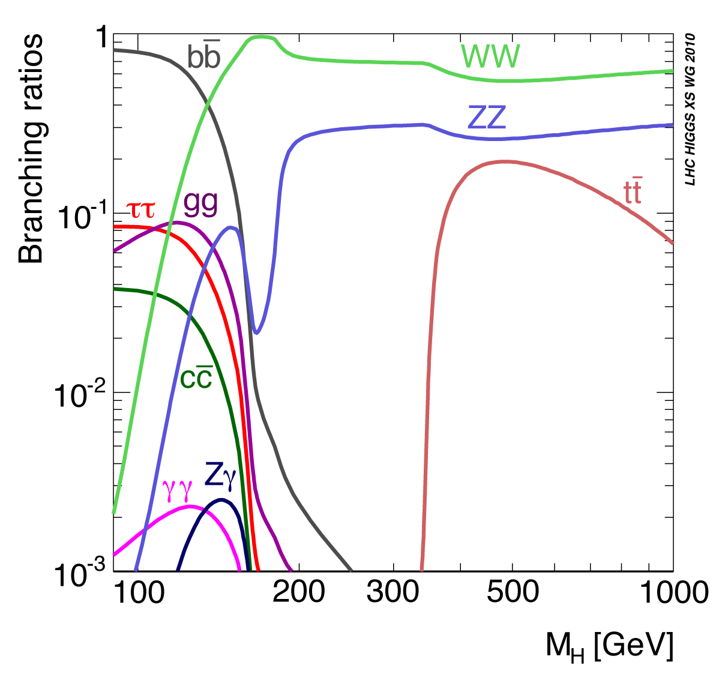
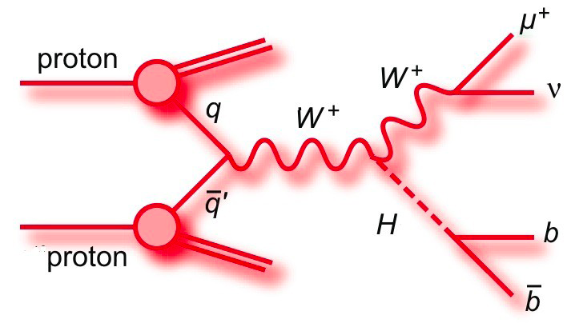
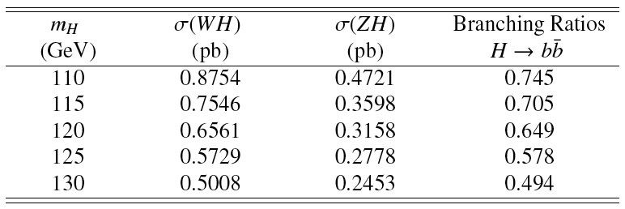
CERN-2011-002; arXiv:1101.0593
So far:
H->bb dominant at low mass
WH➝lνbb, ZH➝llbb
1 fb⁻¹ results shown in EPS2011
4.7 fb⁻¹ analyzed (preliminary)
WH σ≈2x higher than ZH
ZH➝ννbb and boosted VH
Coming soon - good things expected!
ttH – first data results since Christmas
Also: VBF, bbH – developing
Simple & robust analyses so far
Get background normalization from data as much as possible
Search Higgs in m_{bb} spectrum
Critically depend on b-tagging!

Slide 3
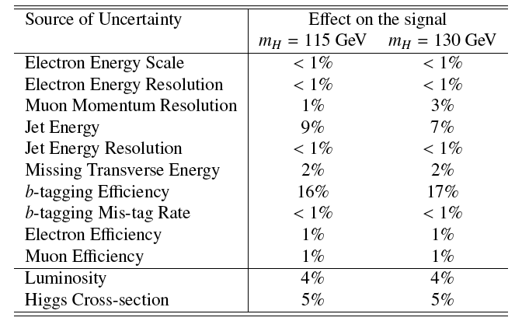
Systematic Uncertainties
Dominant systematic errors from b-tagging efficiency in both analyses
Followed by jet energy scale
Points at the next things things to improve!
(*) shown numbers for 1fb⁻¹
ZH➝llbb
WH➝lνbb

Slide 4
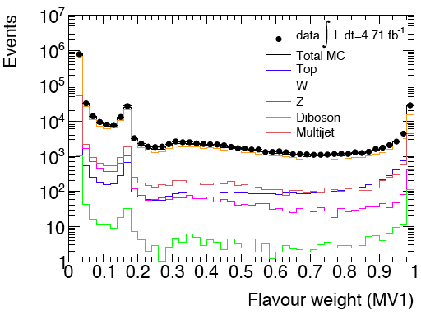
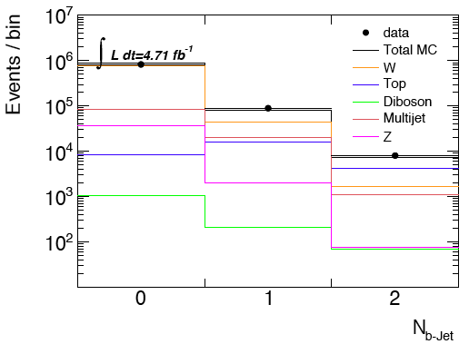
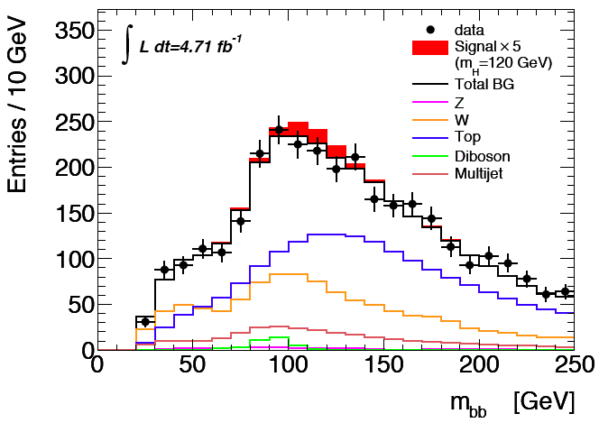
Current status
Expect exclusion of around 3.5-4 x SM for m(H)=120GeV
ZH/WH analyses just moved to MV1 and all looks ok so far
But lots still to do before Moriond…

Slide 5
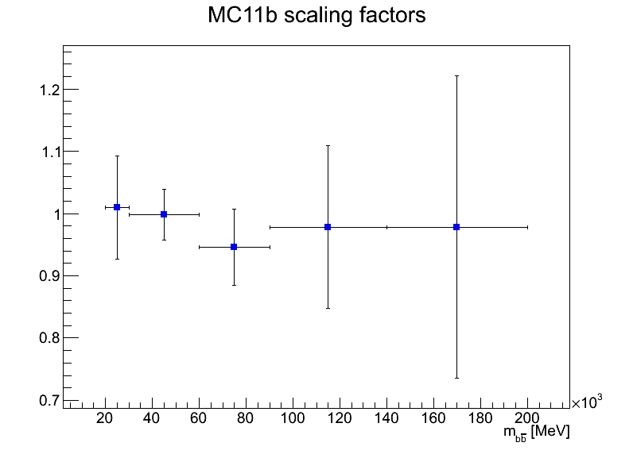
Effect of b-tagging Scale Factors on M_{bb} distribution
B-tagging scale factors enter the analysis as a weight for each b-jet, and depends on jet p_{T}
This introduces a distortion in the jet p_{T} distribution
…which potentially introduces a distortion on the shape of the invariant mass
May be important since we are looking for a small excess in the form of a wide peak in m(bb)
We propose to average scaling factors propagate SF uncertainties into systematic uncertainties
The MC11b scaling factors at present show little evidence of a p_{T} dependence
But such a dependence would clearly be possible

Slide 6
Giacinto P

Slide 7
Giacinto P

Slide 8
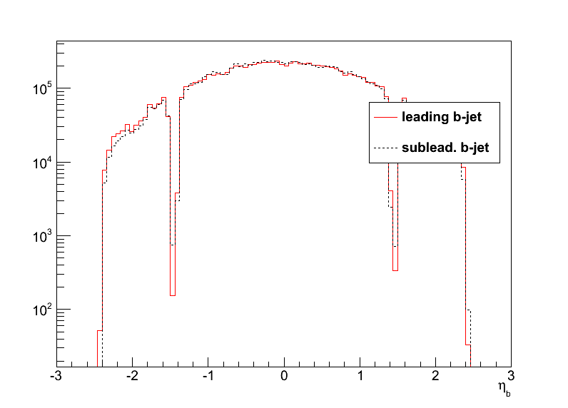
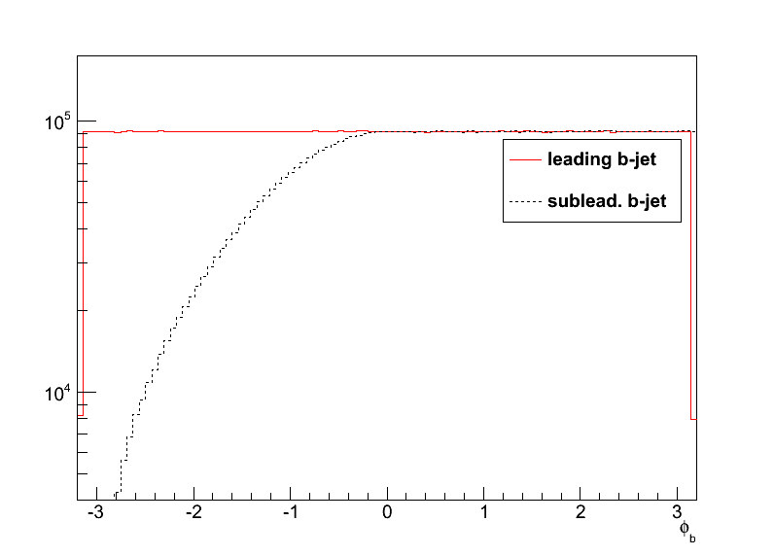
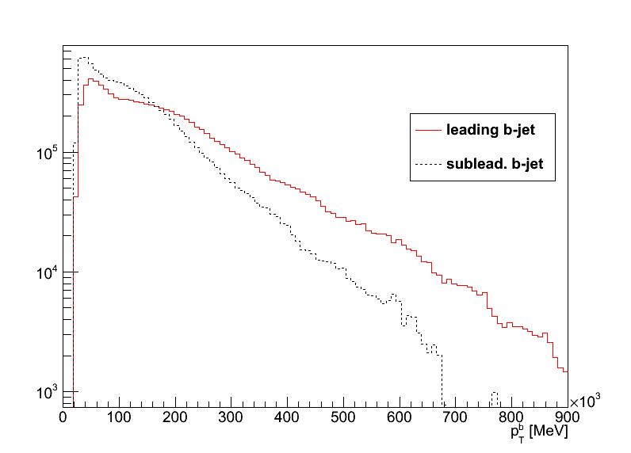
Toy Monte Carlo study of mass distortion
Toy MC to study the effect of b-tag scale factors
Caveat: first study done with di-photon MC kinematics – a look at bb background later
Sample p_{T} and η of leading and subleading b-jets
Generate flat φ_{lead b-jet} and flat mass distribution
Calculate φ_{sublead b-jet} to be consistent with generated mass (and reject unphysical solutions

Slide 9
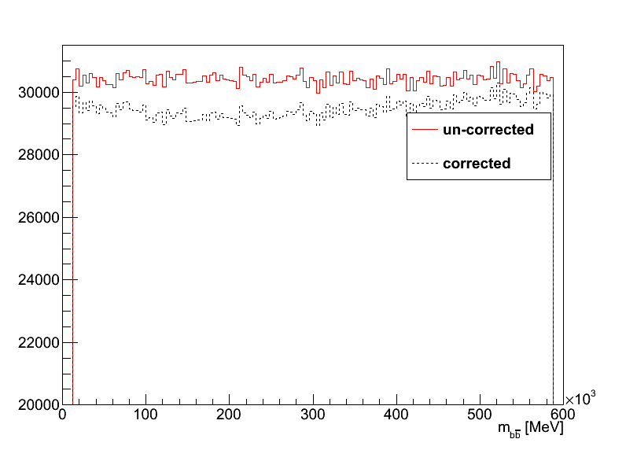
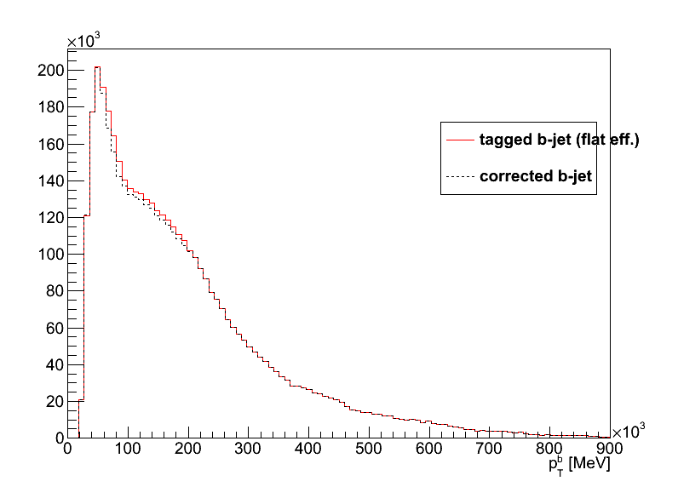
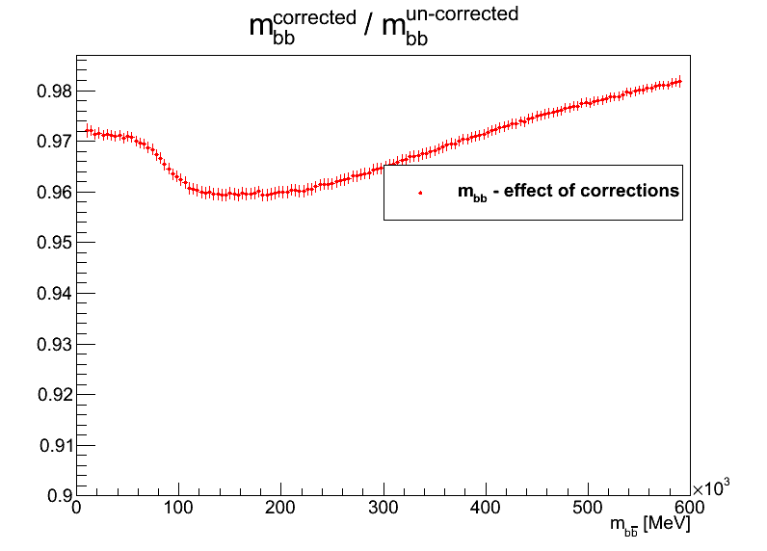
Effect of MC11b scaling factors
The reweighting causes a distortion in the flat invariant mass distribution (plus constant term)
The distortion is small, but then so is our signal compared to the background
May be more serious if width comparable to m_{bb} resolution, as in our case (σ_{m(bb)}≈20GeV)

Slide 10
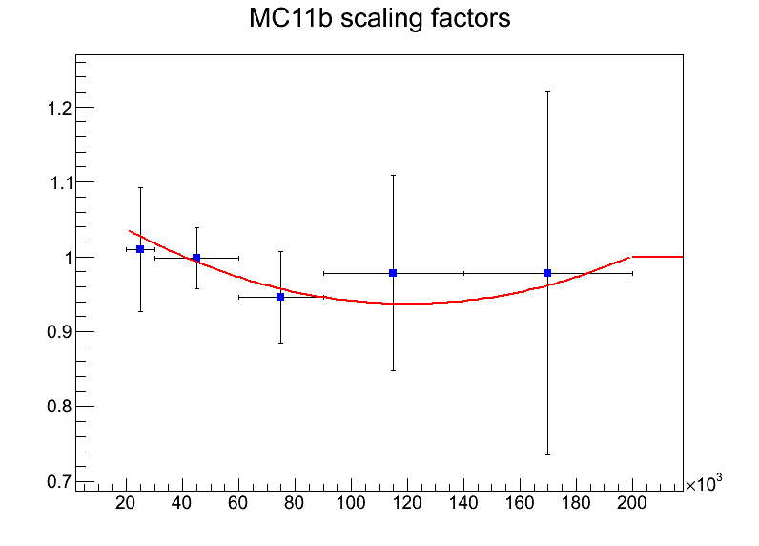
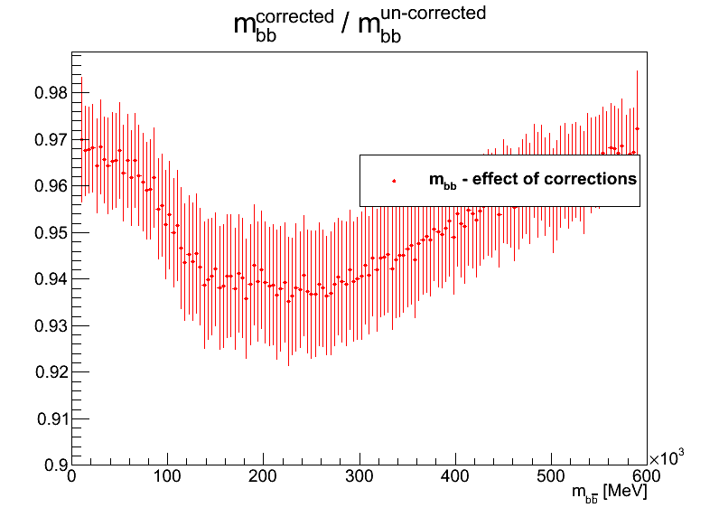
Binning effect?
To see whether this is an effect of the binning, fitted scaling factors (SF) with a parabola (and W_{b}=1 for p_{T}^{b}>200GeV)
Still get similar distortion => not (only) binning effect

Slide 11
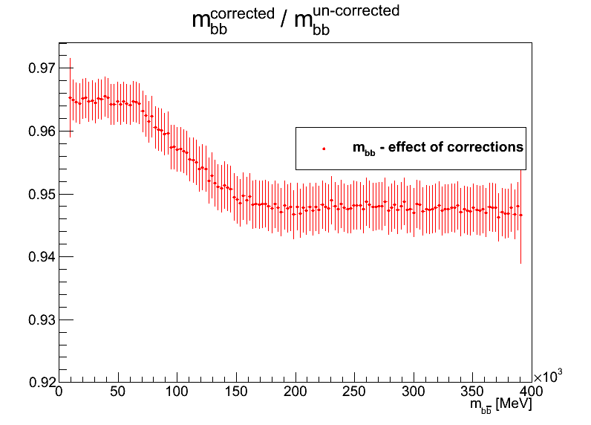
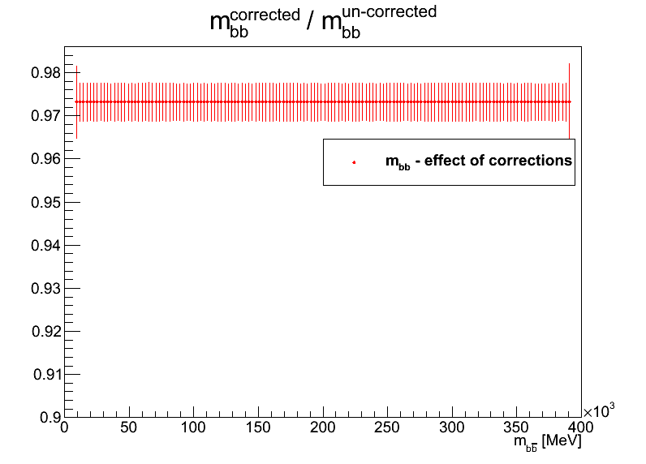
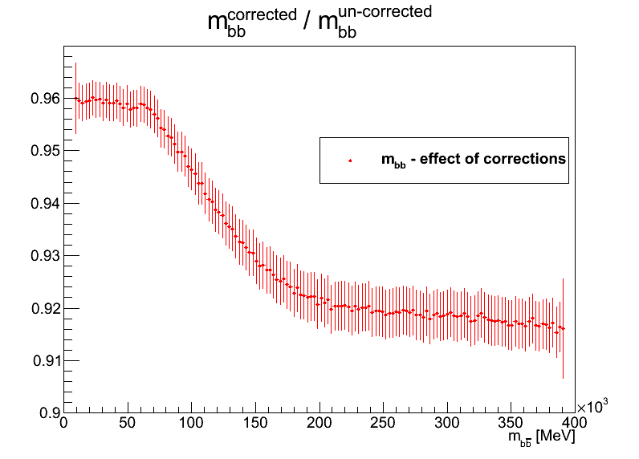
Results using background kinematics
Basically same conclusion:
MC11b scaling factors distort mass distribution (top right)
Even if a parametrization is used (bottom right)
Our averaging procedure removes shape distortion (bottom left) – note zero distortion in this case only due to jet pT cutoff at 200 GeV!

Slide 12
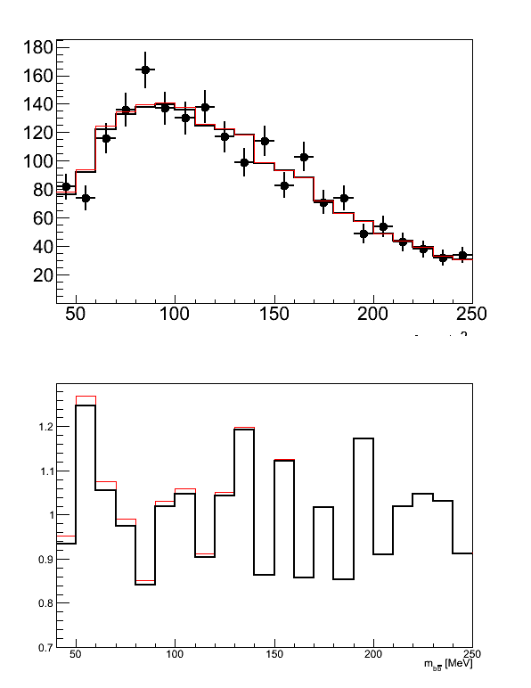
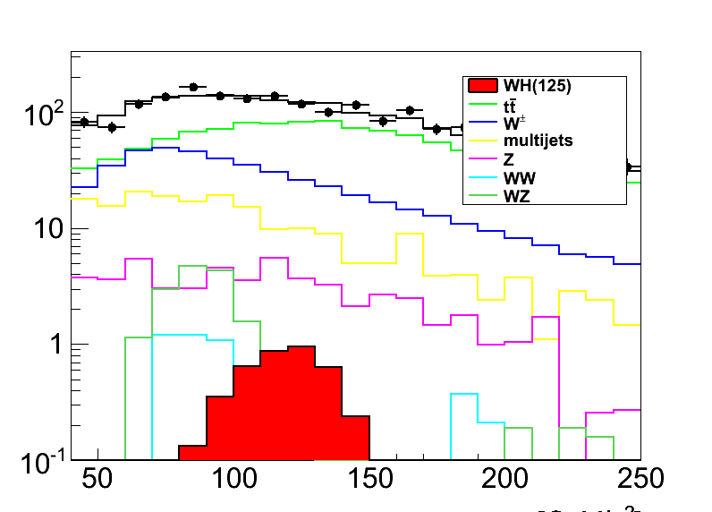
Effect on final distribution
Well… the effect is small, but is there
Tried applying distortion on 1fb⁻¹ mass distribution

Slide 13
Conclusions
These are interesting times for Higgs and H->bb!
We depend critically on the b-tagging performance (BIG THANKS everyone!!!)
Looked at distorting effects from p_{T} dependence of the b-tagging scale factors
A method for removing the mass distortion in JFC scale factors exists and works
May need to think again depending on what you find for MV1

Slide 14
Backup slides

Slide 19
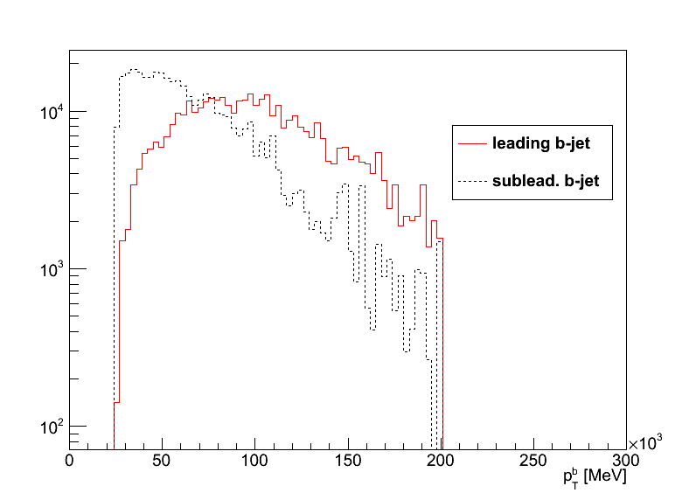
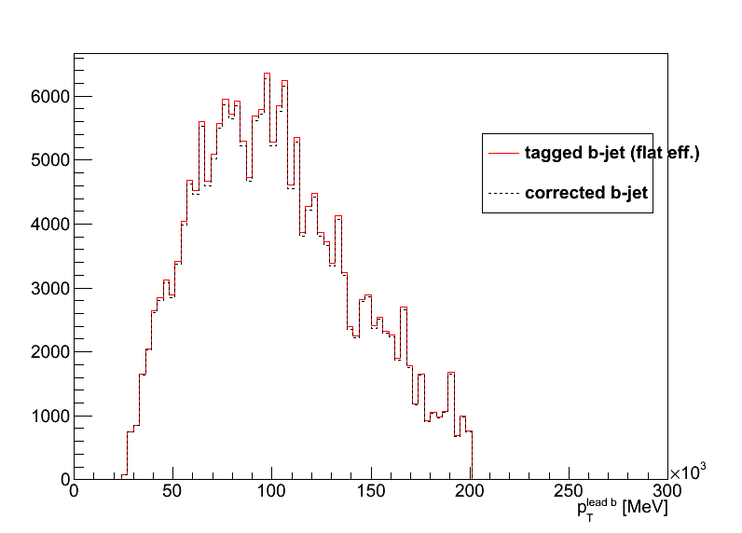
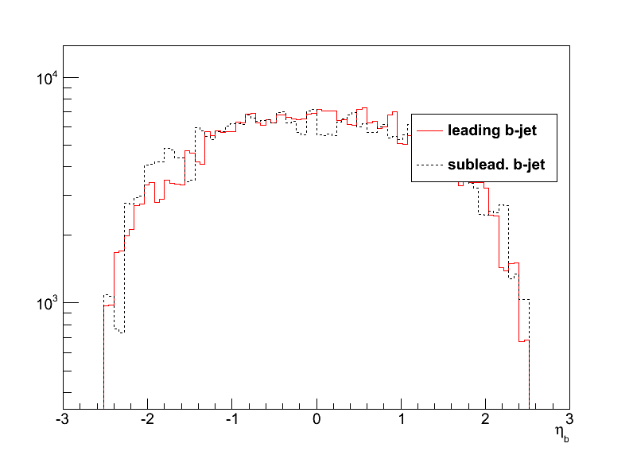
Using different input kinematics
Re-did some plots with b-tagged jets from W+bb and top backgrounds
Jet pT cutoff at 200GeV

Slide 20
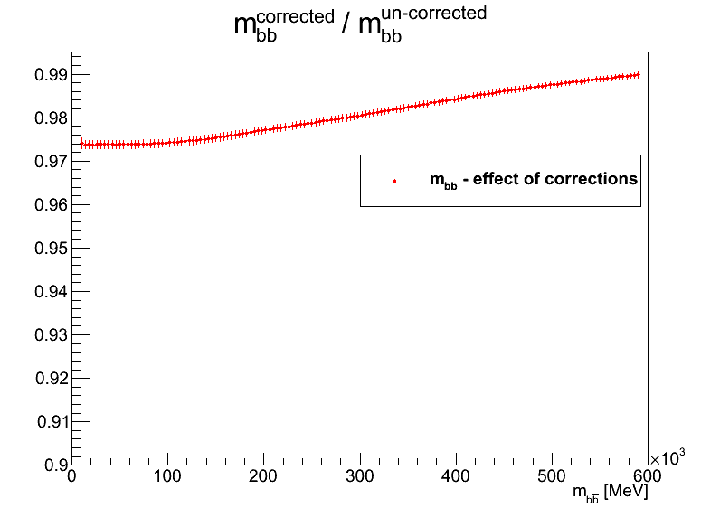
Effect of our averaging procedure
We use the average of the scale factors (0.9865) and propagate the errors taking into account bin-to-bin correlations
Small effect still visible (bottom right) looking at wide mass range
But very smooth compared to the horizontal with of our signal peak

Slide 21
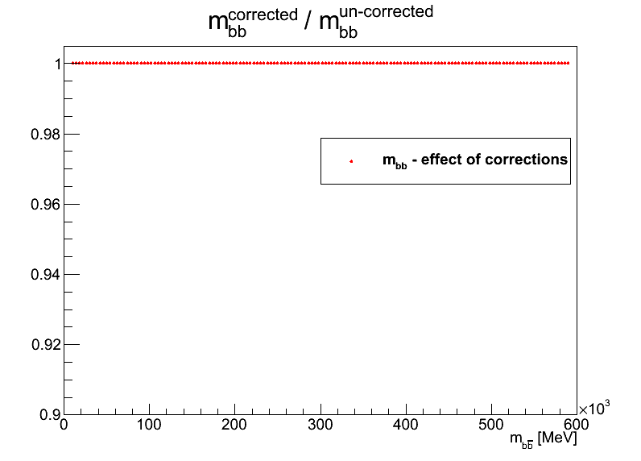
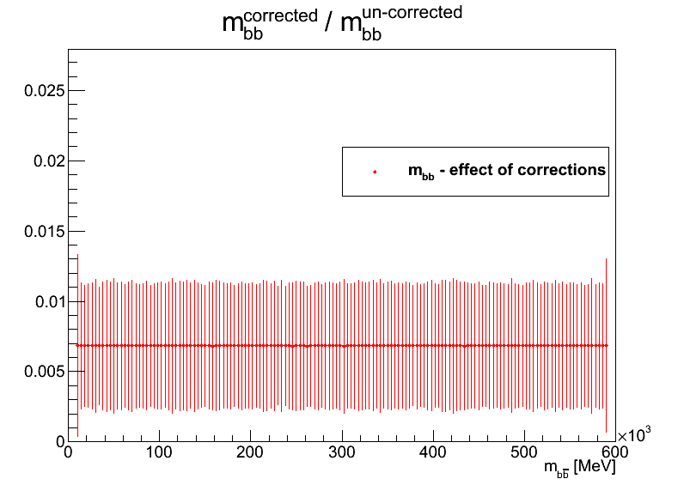
Cross checks
If all b-tagging scale factors are set to 1 there is no effect on the mass distribution, as expected (top right)
If they are all set to the average (0.9865) including for jets with p_{T}^{b}>200GeV, effect on mass is flat, also as expected (bottom right)

