Slide 1
Higgs & More Session – Overview
Sinead Farrington (Oxford), Ricardo Gonçalo (RHUL)

Slide 2
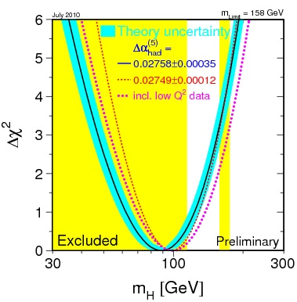
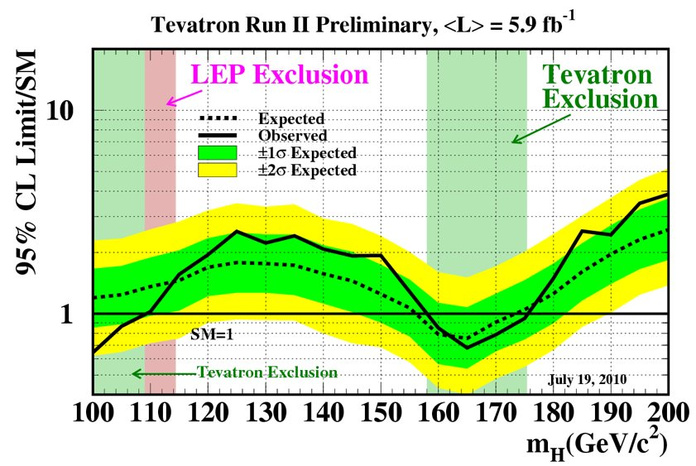
Higgs current limits
Current direct mass limits at 95% C.L. as of July 2010:
LEP excluded mass range below 114.4 GeV/c²
Tevatron excluded mass range of 158 – 175 GeV/c²
Indirect mass limits from precision fits to electroweak observables:
M_{H} = 89⁺³⁵₋₂₆ GeV/c² (from Δχ² = 1)
M_{H} < 158 GeV/c² (one-sided 95% C.L. not including LEP direct exclusion)
Including LEP: m_{H} < 185 GeV/c² (one-sided 95% C.L.)
http://lepewwg.web.cern.ch/LEPEWWG/
http://tevnphwg.fnal.gov/results/SM_Higgs_Winter_08hepex/

Slide 3
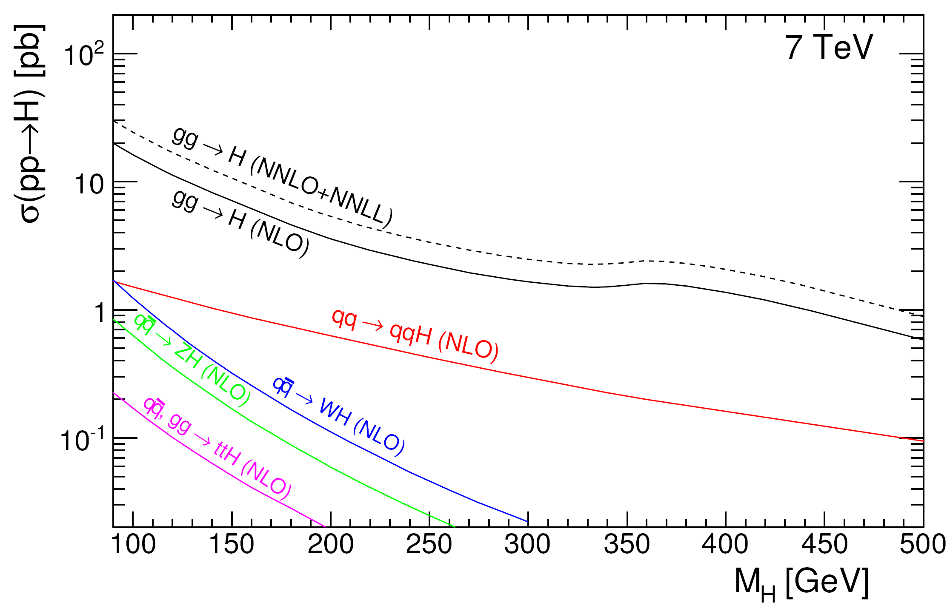
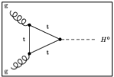
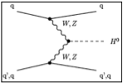
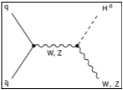
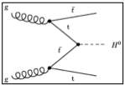
Disfavoured by EW precision fits
Excluded by LEP
Excluded by Tevatron
If σ = 10pb then 450 Higgs bosons were already produced!
Notes:
Main production channels: gluon fusion, Vector Boson Fusion, associated production with vector bosons, associated production with ttbar pair
Animation

Slide 4
Notes:
Main production channels: gluon fusion, Vector Boson Fusion, associated production with vector bosons, associated production with ttbar pair
Animation

Slide 5
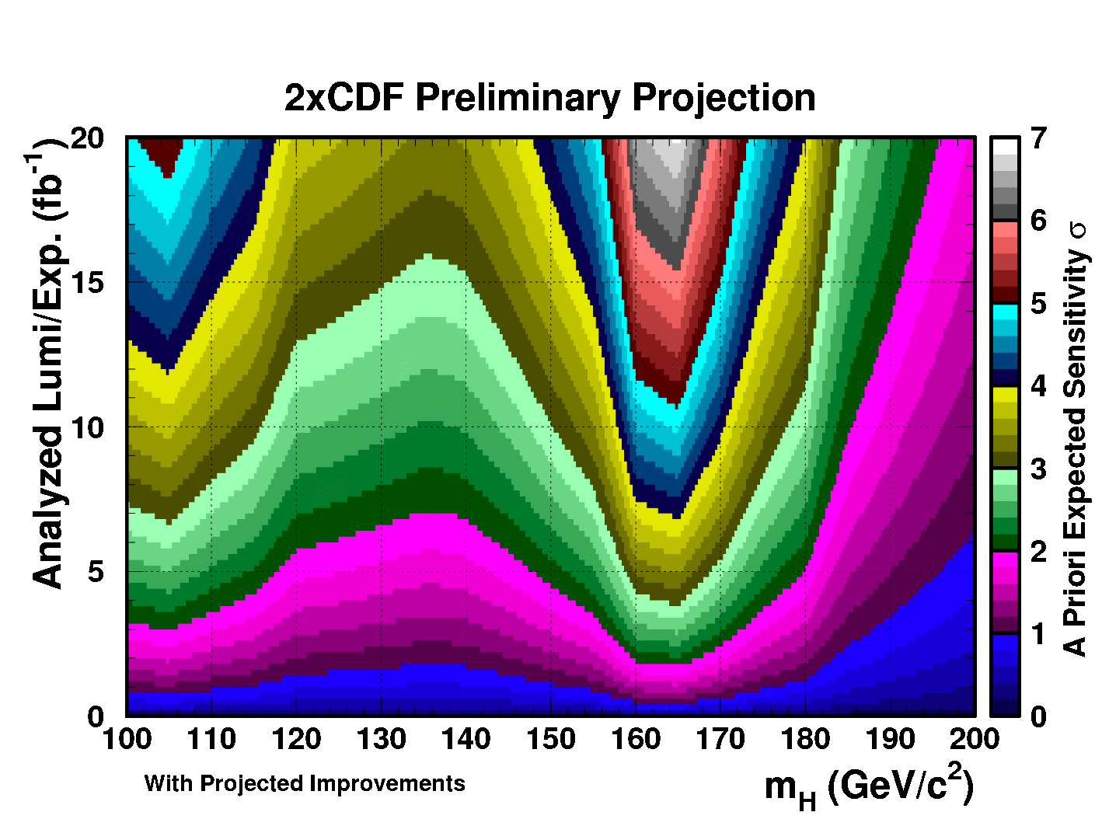
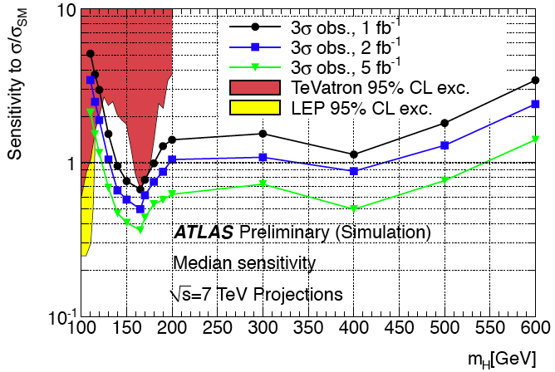
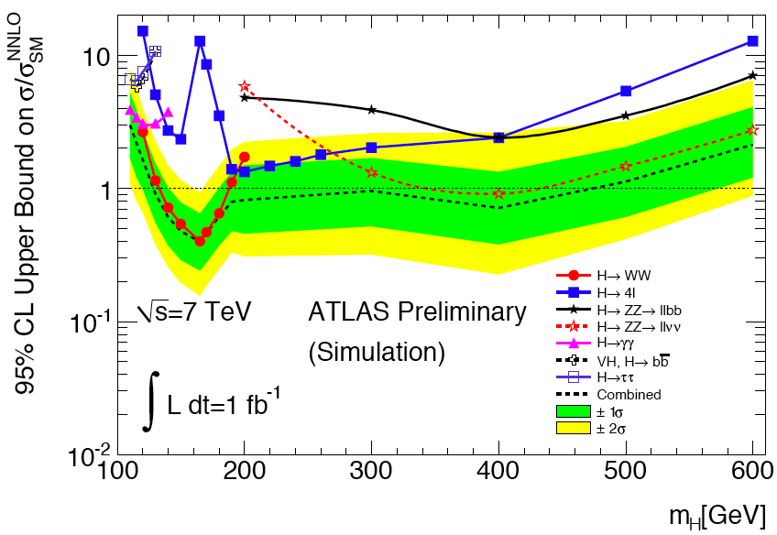
Projections
G.Bernardi, Higgs Hunting Workshop, Paris, July 2010
Tevatron expects:
12fb⁻¹ recorded per experiment by end of 2011
16 fb⁻¹ analyzed by end of 2014
Current LHC expectations:
Earlier plans were 1 fb⁻¹ @ 7 TeV by end of 2011
From Roger Bailey’s talk in November LHCC: 2 - 7 fb⁻¹ @ 8 TeV by end of 2011
More news after the LHC Chamonix workshop…
Excluded by LEP
Excluded by Tevatron

Slide 6
But perhaps Nature hides her secrets more subtly than
is written in the Standard Model …
In the MSSM, 2 Higgs doublets give 5 Higgs bosons
Three neutral: h, H (CP-even), A (CP-odd); two charged: H±
At tree level m_{h}<m_{Z} – after radiative corrections m_{h} < 135 GeV/c²
Important parameters: m_{A}, tan β = v₁/v₂
As tan β increases, Higgs decays to b quarks and tau leptons enhanced
BR(h)
BR(A)
BR(H±)
M.Spira, Higgs Hunting workshop, Orsay, July 2010

Slide 7
Higgs & Trigger Menu
Gemma Wooden
Good trigger menu outlook for Higgs physics at 10³³:
Expect peak luminosities between around 6x10³² and 2x10³³ (see Nov. LHCC)
mu20 and e20_medium_tight for H -> ZZ, WW, ττ; ZH; H⁺ -> csbar, τν
2e12_medium, 2mu10, e10_loose_mu6 for H -> ZZ, WW
2g20_loose for H -> γγ
e15_tight_xe30_noMu for H⁺ -> τν (fully leptonic)
2tau29_loose1, tau16_loose_e15_tight, tau16_medium_mu15, tau29_medium_xe35_noMu for H -> ττ, H⁺ -> τν(had)
je350, 4j50 for ttH (fully hadronic), VBF H -> bbbar
Difficult channels:
Fully hadronic ttH (UK effort) – missing 7 TeV MC, but should be able to use triggers for fully hadronic ttbar
H⁺ -> τν and a1 -> ττ-> eμ require very low thresholds – work ongoing
Schedule:
Plan to build MC_pp_v2 by 10th Jan
Physics_pp_v2 should be finalised by 1st Feb

Slide 8
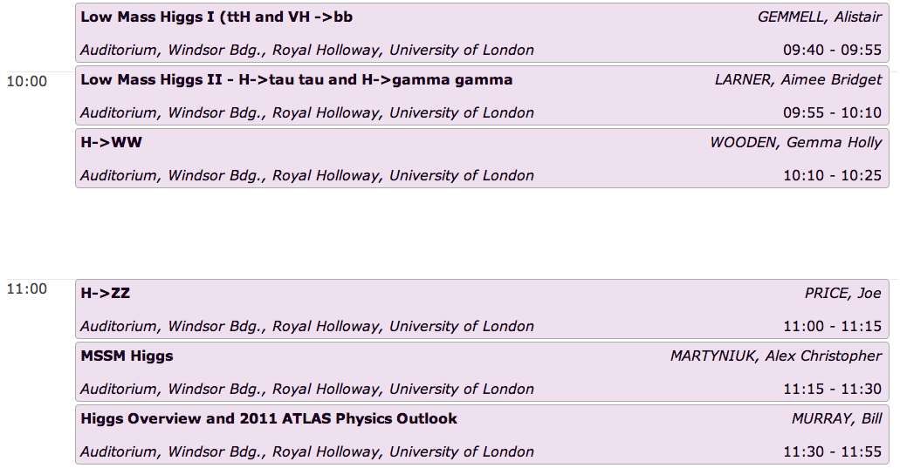

Slide 9
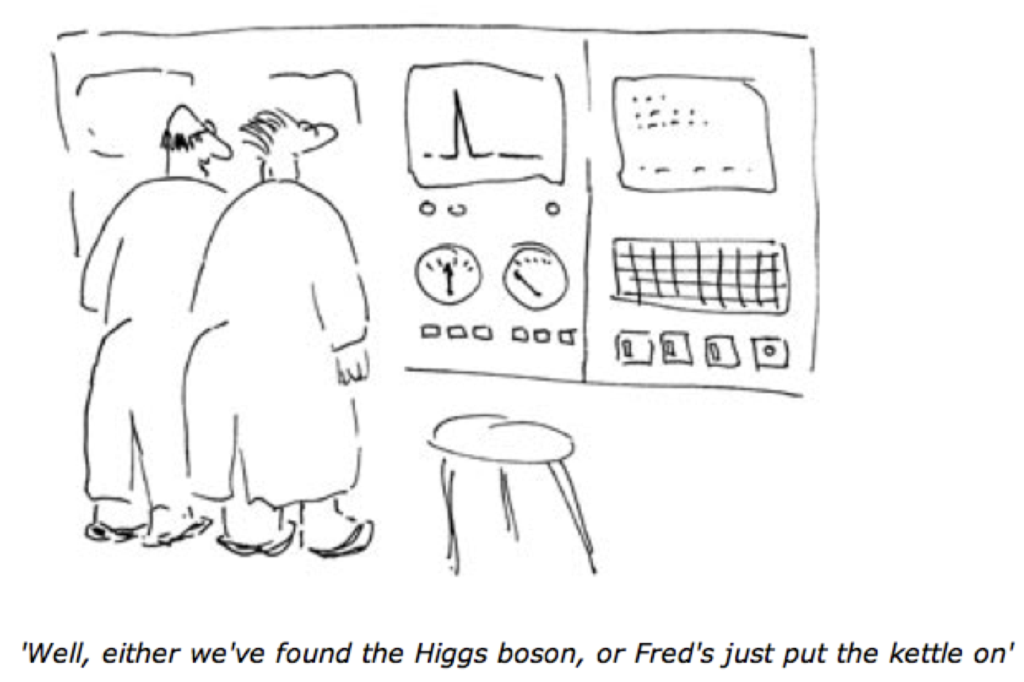
Conclusions
2011 will be extremely important for Higgs searches in ATLAS
The Higgs UK activity is in good health – see talks in this session!
But there is a lot to do! – plenty of opportunities…

Slide 10
Backup – LHC running in 2011
Two possible LHC scenarios for next year: expect 2 to 7 fb⁻¹ … and pileup!
http://indico.cern.ch/getFile.py/access?contribId=0&sessionId=0&resId=1&materialId=slides&confId=112439
4 TeV (to be discussed at Chamonix)
936 bunches (75 ns)
3 micron emittance
1.2 x 10¹¹ protons/bunch
β* = 2.5 m, nominal crossing angle
4 TeV
1400 bunches (50 ns)
2.5 micron emittance
1.5 x 10¹¹ protons/bunch
β* = 2.0 m, nominal crossing angle

