Slide 1
Introduction
Ricardo Goncalo
ATLAS-UK Higgs Meeting, 3 November 2011

Slide 2
The New HSG5 Group
The old Higgs Subgroup 5 was split into:
HSG5 dedicated to H->bb (SM and BSM)
HSG6 dedicated to H+
Two week old organisation, but lots of work already done and ongoing
CONF note from July, shown at EPS and later conferences
Several active channels:
Inclusive WH->lνbb and ZH->llbb
Boosted Higgs VH analyses (jet substructure techniques)
ZH->ννbb
ttH, H->bb
VBF H->bb (and even a gluon-fusion analysis)
MSSM b(b)H
Near-term goals:
Update WH/ZH results for December CERN Council Meeting
Several other analyses to converge for Moriond 2012
Publication (refereed paper) on this timescale

Slide 3
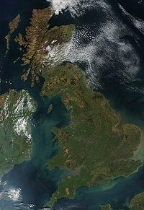
HSG5 Composition
Good and active UK participation:
Birmingham
Edinburgh
Glasgow
Liverpool
RHUL
UCL
Also work or interest from:
Canada: Victoria
France: CPPM Marseille
Germany: Bonn, LMU, Würzburg
Portugal: LIP Lisbon
Russia: JINR Dubna
Spain: IFAE
Taiwan: Academia Sinica
USA: Argonne, Harvard, Iowa, SLAC, Wisconsin

Slide 4
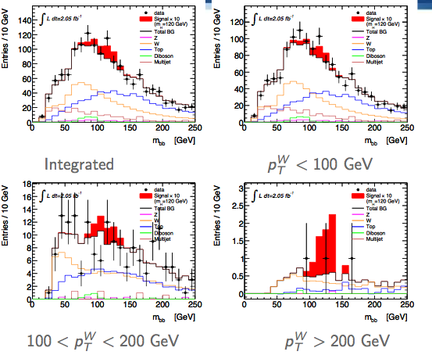
WH->lνbb and ZH->llbb
First attempt at this analysis with 1fb⁻¹
ATLAS-CONF-2011-103
Analysis optimized to reject main backgrounds and increase acceptance
Separated into p_{T}^{V} bins
Latest results (2fb⁻¹, rel.16) very promising!

Slide 5
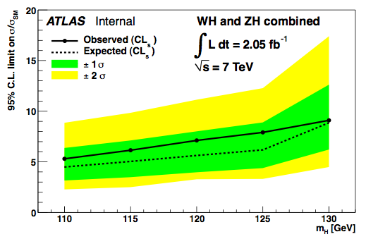
WH->lνbb and ZH->llbb
First attempt at this analysis with 1fb⁻¹
ATLAS-CONF-2011-103
Analysis optimized to reject main backgrounds and increase acceptance
Separated into p_{T}^{V} bins
Latest results (2fb⁻¹, rel.16) very promising!
More details on Benedict’s talk

Slide 6
Alternative to inclusive channels: search for high-pT Higgs to bb:
J. M. Butterworth, A. R. Davison, M. Rubin, and G. P. Salam, Phys. Rev. Lett. 100 (2008) 242001, arXiv:0802.2470 [hep-ph]
p_{T}^{H} > 200GeV ≈ 5% of inclusive cross section but improved significance
Select W➝lν events and search for a H➝bb jet
Search for high-p_{T} jet (Cambridge-Aachen algorithm, R=1.2)
Search jet clustering history in reverse and look for large mass drop
Re-cluster with small R parameter to find sub jets
Peak consistent with W➝jj in tt events
Proof of principle for future analysis
See talk by Wahid

Slide 7
The future
Main candidates for CERN Council meeting are WH->lνbb and ZH->llbb
Moriond is our real goal - aiming for results from:
WH->lνbb
ZH->llbb
ZH->ννbb
plus jet substructure VH analyses
ttH

Slide 8
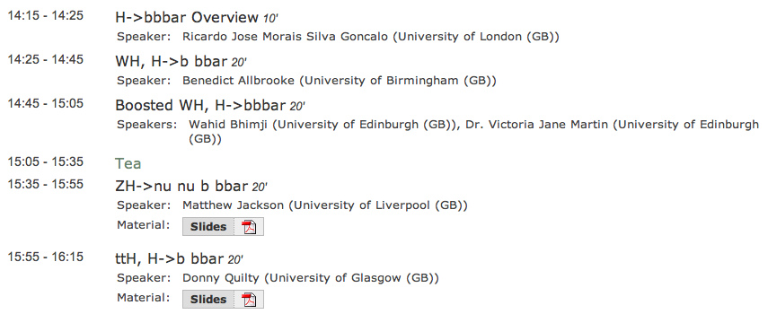
H->bb UK activity reflected in today’s agenda
New results shown today (and there’s more…)

Slide 9
BACKUP

Slide 10
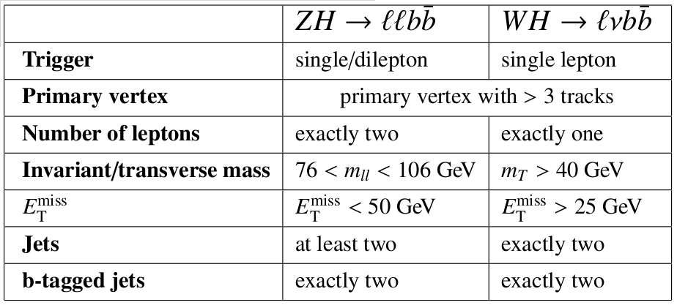
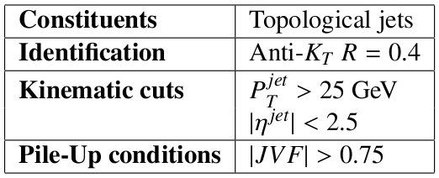
Common event selection:
Lepton Identification:
Jet reconstruction:

Slide 11
ZH➝llbb Selection
Trigger:
e (p_{T}^{e}>20GeV) or μ (p_{T}^{μ}>18GeV)
2e/2μ trigger (p_{T}>12GeV)
Exactly 2 leptons p_{T} > 20GeV
Opposite charge for μ
Z mass cut: 76 < m_{ll} < 106 GeV
E_{T}^{miss} < 50GeV
Two leading jets b tagged

Slide 12
WH➝lνbb Selection
Trigger: e (p_{T}^{e}>20GeV) or μ (p_{T}^{μ}>18GeV)
Exactly 1 lepton – p_{T} > 25GeV
M_{T} = √2p_{T}^{l}p_{T}^{ν}(1 - cos Δφ_{lν} ) > 40 GeV
E_{T}^{miss} > 25GeV
Exactly 2 jets (anti-k_{T} 0.4; E_{T} > 25GeV) to reduce top background
Both jets b tagged

Slide 13
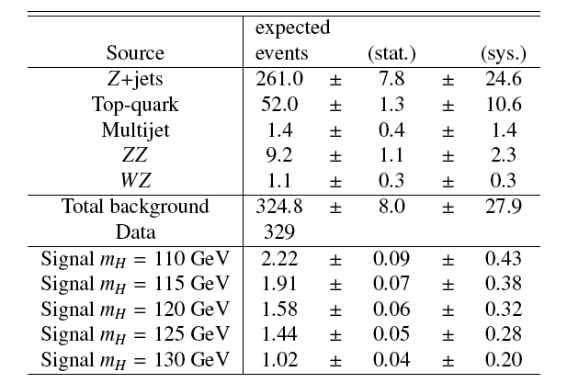
ZH➝llbb
Good description of the background
No excess observed
Single-channel exclusion of ≈20x Standard Model

Slide 14
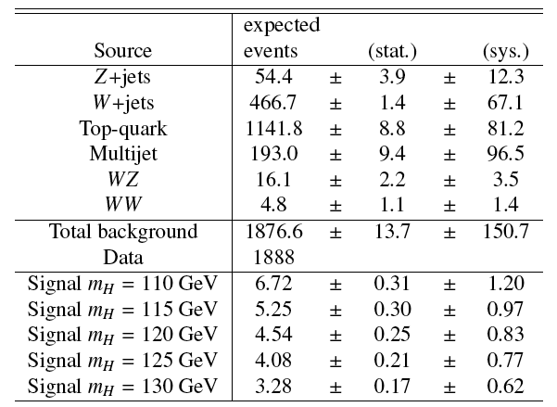
WH➝lνbb
Good description of the background
No excess observed
Single-channel exclusion of ≈20-30x Standard Model

Slide 15
First direct search for H➝bb at the LHC in WH and ZH channels
Combined sensitivity to ≈10-20x Standard Model
Room for improvement!
Reduce systematics
New channels to explore
Multivariate analyses
Lots of data expected!
Proof of principle for boosted Higgs analysis
Watch this space!
Ref.: ATLAS-CONF-2011-103

