Slide 1
Status of ttH, H➔bb in ATLAS
BANG
Ricardo Gonçalo, RHUL
For the ttH analysis group
UK involvement from Gaslgow & RHUL
Thanks to several people for several stolen slides!

Slide 2
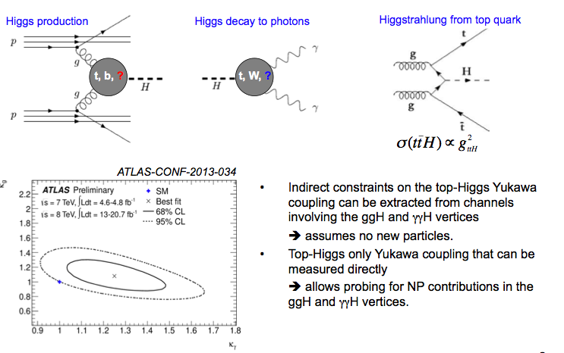
Motivation

Slide 3
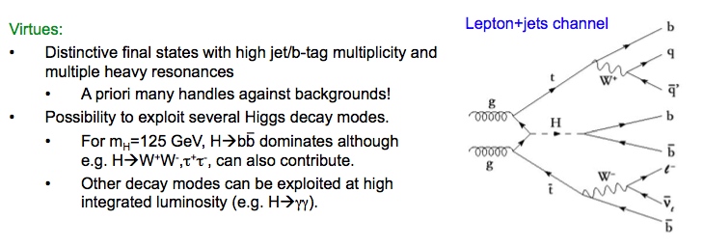
Direct ttH searches

Slide 4
Direct ttH searches

Slide 5
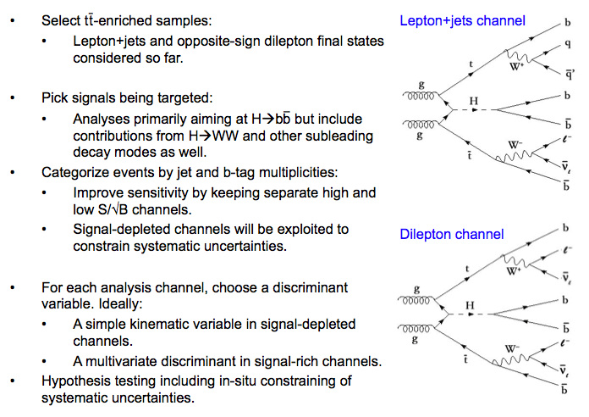
Analysis Strategy

Slide 6
7TeV ATLAS Analysis

Slide 7
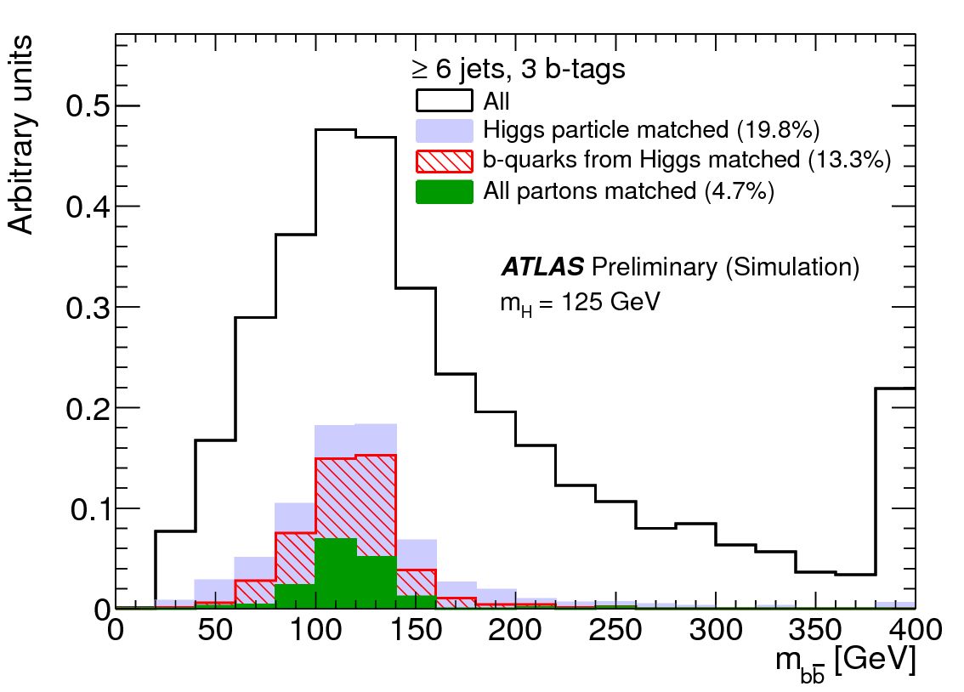
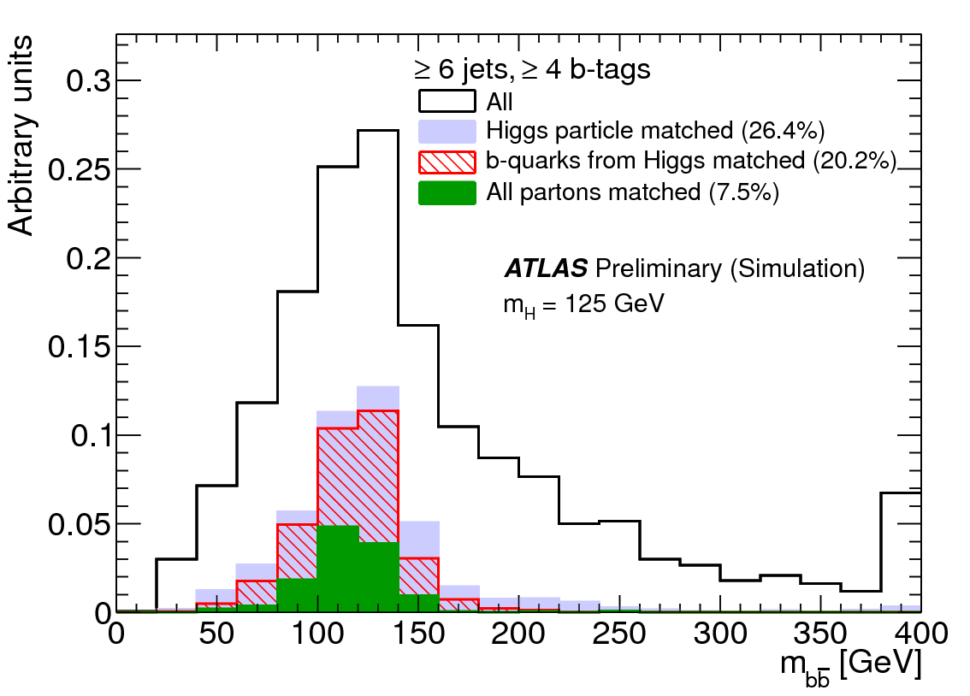
Kinematic Fit
Implemented in KLFitter – used by several top analyses
Analysis sensitivity hampered by combinatorial background
Reject bad combinations – e.g. where b-jet used in W reconstrucion – to reduce impact
Selection purity still rather low => reconstructed mass spectrum in signal very broad

Slide 8
Recent CMS results
Recently released an analysis of 8TeV data
CMS-PAS-HIG-13-019
ttH->bb in lepton+jets and dilepton
ttH, H->ττ
Results:
Observed 5.2 x σ_{SM} (expected 4.1 x σ_{SM}) 95% CL limits from 8TeV data
Observed 3.4 x σ_{SM} (expected 2.7 x σ_{SM}) when combining with other ttH results

Slide 9
Event Selection

Slide 10
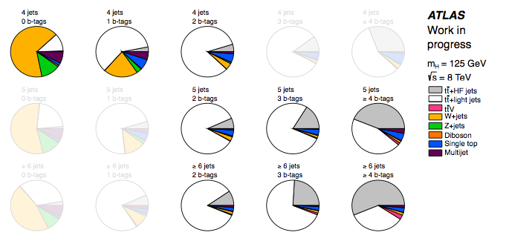
Constraining Uncertainties

Slide 11
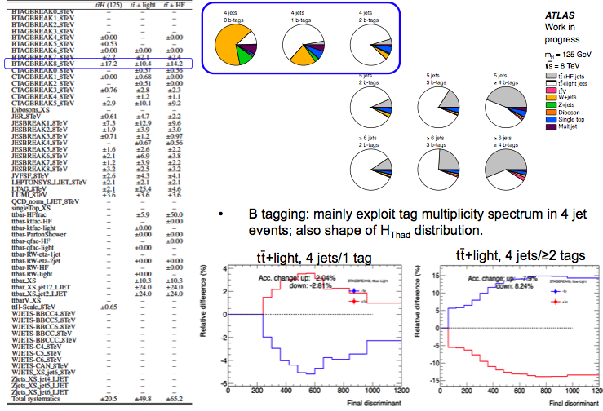

Slide 12
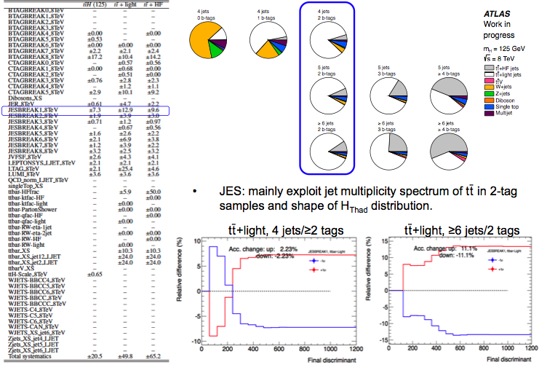

Slide 13
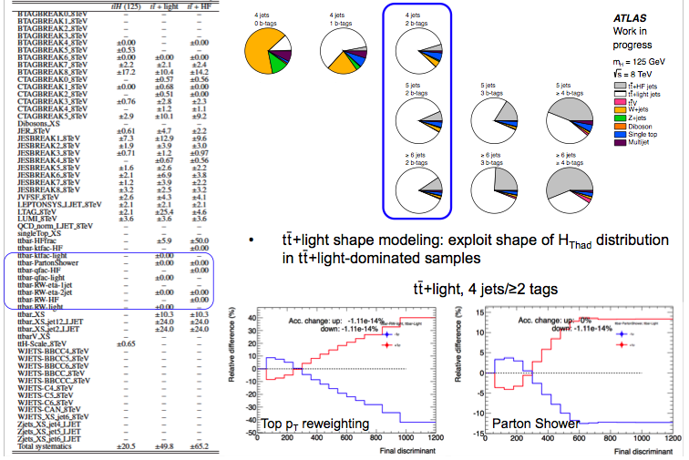

Slide 14
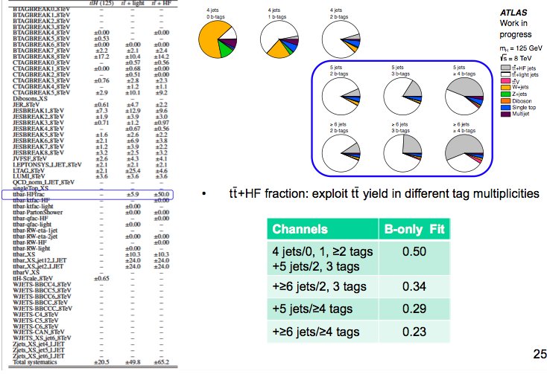

Slide 15
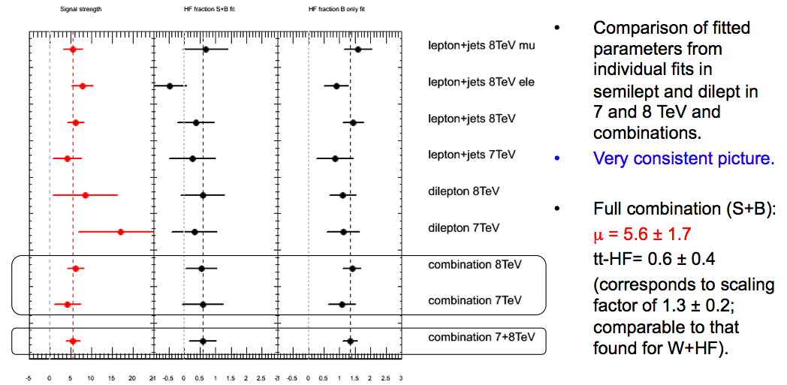
Initial Results
Signal Strength HF Fraction (S+B) HF Fraction (B only)

Slide 16
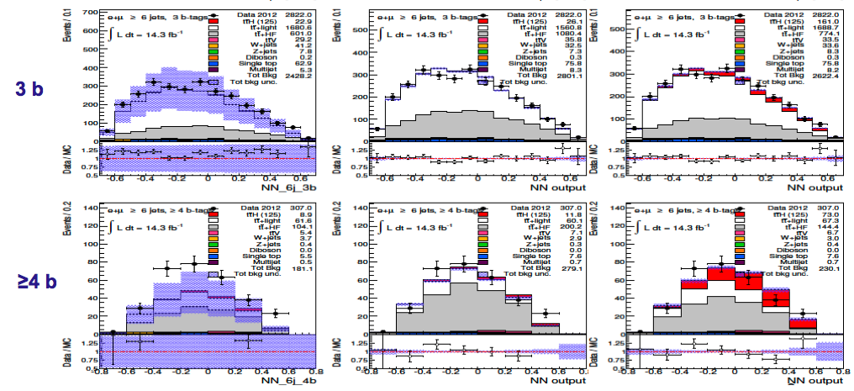
What’s Going On?
Pre-Fit
Background-only Fit
Signal+Background Fit

Slide 17
The Story So Far…
The high value of μ lead us to closely investigate several issues
The modeling of background has many unknowns:
tt+HF cross section easily changes by ≥x2 for different theory choices
Affects extrapolation from background-dominated regions into signal region
The use of HFOR to mix tt+light jets and tt+HF is being investigated
Different choice of hard scale:
Default: Q² = Sum(p_{T}² + m²) ; BDDP: Q² = m_{t} √(p_{T}^{b1} p_{T}^{b2});
Mass scale: Q² = m_{t} m_{bb} ; Mass/2: Q² = m_{t} m_{bb}/2
Different theory model in MadGraph
b-tagging calibration: we’ve been starting from pTrel-based calibration
Reviewing our fit model (important!)
Have been in close communication with theorists: workshop in Glasgow with people from IPPP, Edinburgh etc, and others

Slide 18
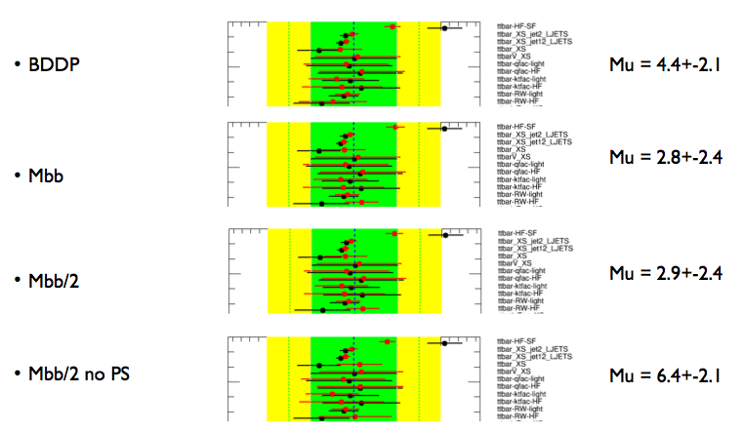
Example: default fit model

Slide 19
Conclusions
Very much “work in progress”!
Now moving to 20/fb 8TeV data
Hopefully first plots in Higgs plenary this week
Aiming at a CONF note in the Fall
Wish list:
Improved theory understanding of background (and NLO signal)
Improved fit model
Continuous b-tagging: very strong discriminant

Slide 20
Bonus slides

Slide 21
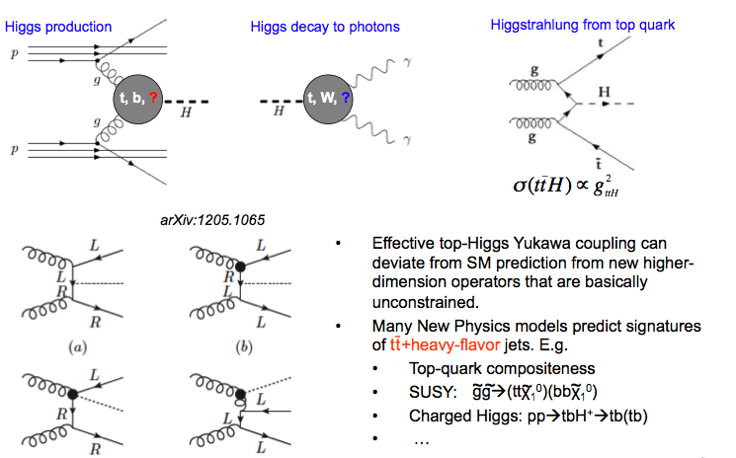
Motivation

Slide 22
