Slide 1


Trigger Commissioning and Menus
Ricardo Gonçalo – Royal Holloway
ATLAS UK Meeting – Cambridge, 6-8 January 2010

Slide 2
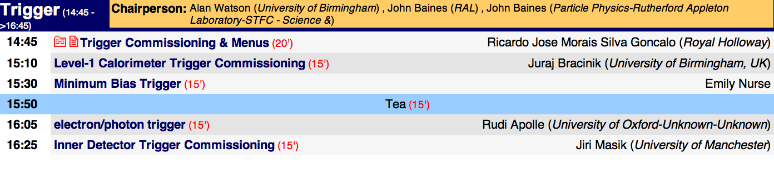
Introduction
This talk will try to give an overview of the 2009 LHC run period from 20th November to 16th December from the trigger perspective
Will only give an outline: more details in following talks
Note: will report on the work of many people; names mentioned occasionally, when author is clear. But ultimately the credits go to the whole ATLAS Collaboration!

Slide 3
LHC Milestones
Date | Day | Achieved
Nov 20 | 1 | Each beam circulating. Key beam instrumentation working.
Nov 23 | 4 | First collisions at 450 GeV. First ramp (reached 560 GeV).
Nov 26 | 7 | Magnetic cycling established (reproducibility).
Nov 27 | 8 | Energy matching.
Nov 29 | 10 | Ramp to 1.18 TeV.
Nov 30 | 11 | Experiment solenoids on.
Dec 04 | 15 | Aperture measurement campaign finished. LHCb and ALICE dipoles on.
Dec 05 | 16 | Machine protection (Injection, Beam dump, Collimators) ready for safe operation with pilots.
Dec 06 | 17 | First collisions with STABLE BEAMS, 4 on 4 pilots at 450 GeV, rates around 1Hz.
Dec 08 | 19 | Ramp colliding bunches to 1.18 TeV
Dec 11 | 22 | Collisions with STABLE BEAMS, 4 on 4 at 450 GeV, > 10¹⁰ per bunch, rates around 10Hz.
Dec 13 | 24 | Ramp 2 bunches per beam to 1.18 TeV. Collisions for 90mins.
Dec 14 | 25 | Collisions with STABLE BEAMS, 16 on 16 at 450 GeV, > 10¹⁰ per bunch, rates around 50Hz.
Dec 16 | 27 | Ramp 4 on 4 to 1.18 TeV. Squeeze to 7 m.
Friday night: splashes
Monday: first LHC collisions!
Much work, little sleep…
LHC breaks energy record!
Other news big and small
High-energy collisions!
S.Myers, 18/09

Slide 4
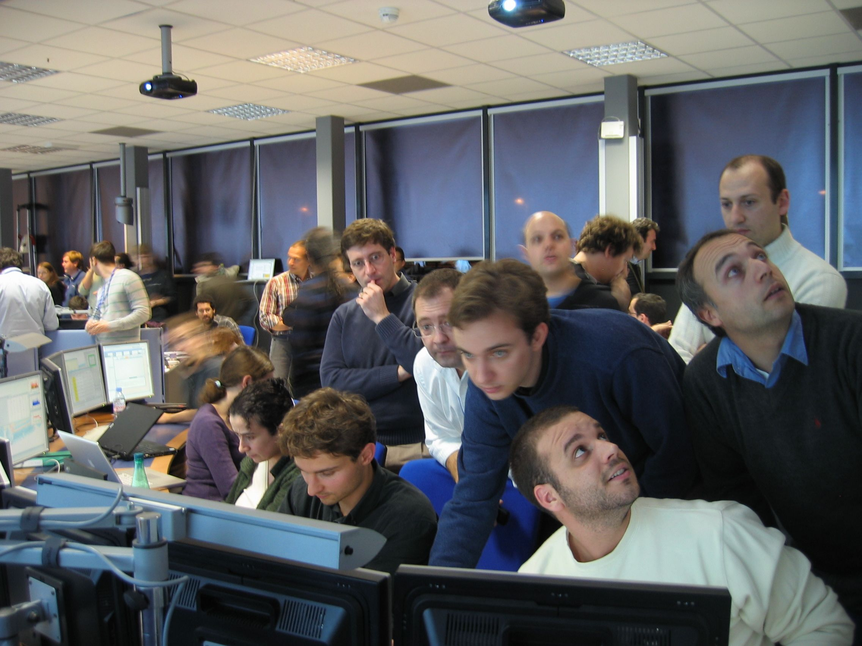
In the ATLAS Control Room…

Slide 5
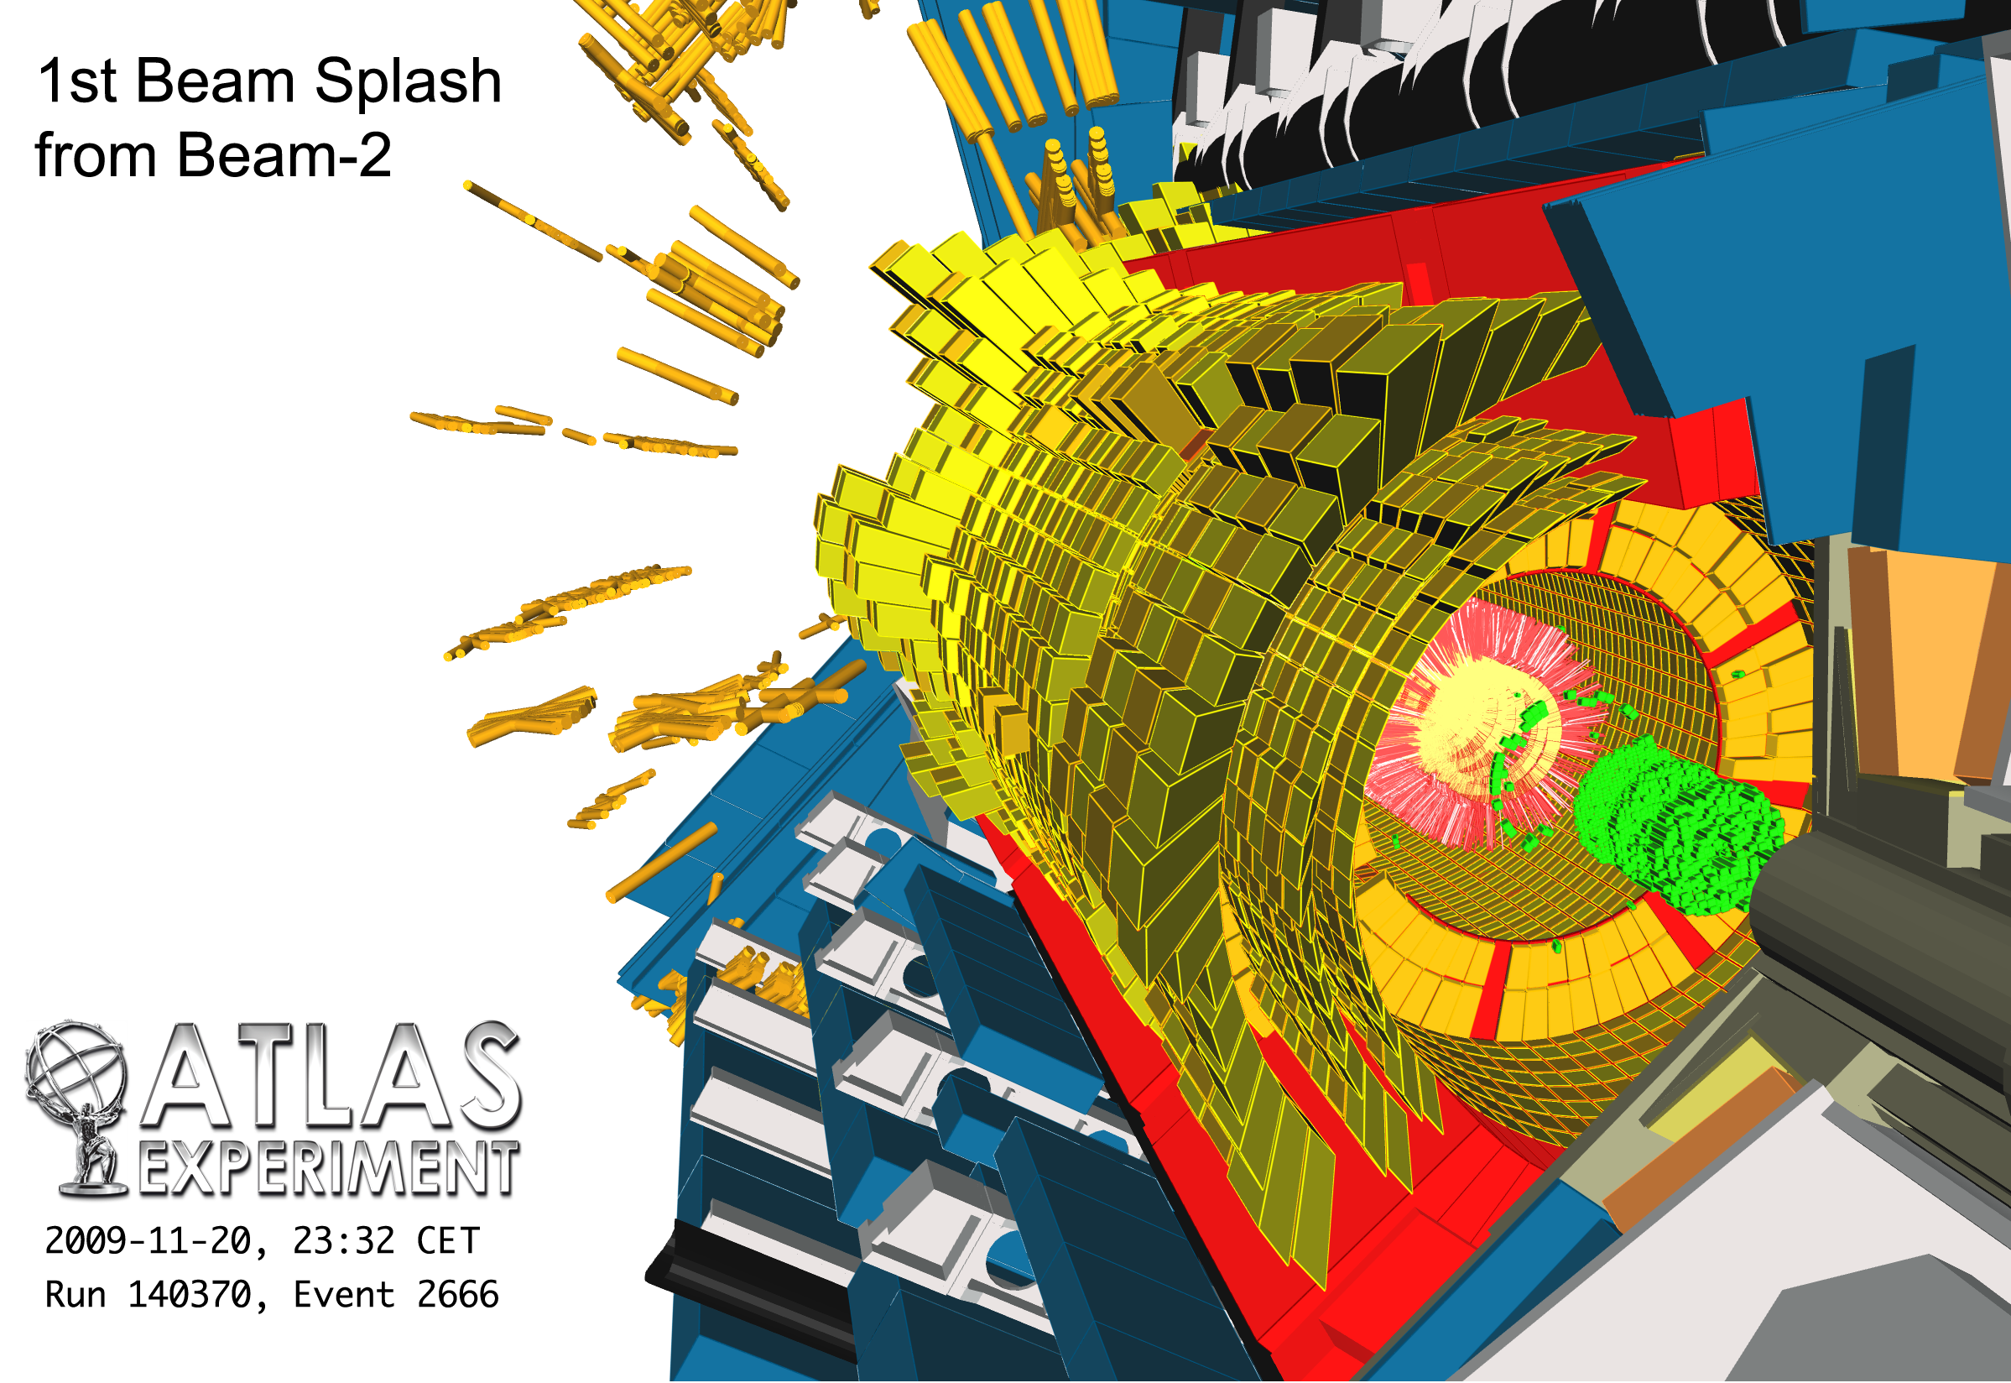

Slide 6
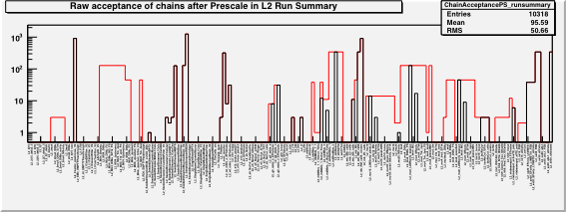
Only Level 1 items active during the splashes:
  MBTS (Min. Bias Trigger Scintillator)
  EM14 – set to fire on central barrel energy deposits
Used splash events to time-align BPTX (Beam pickups)
High Level trigger ran offline in CAF on collected events – ready a few hours after each run was taken
# events selected by High Level Trigger before (red) and after (black) prescales for run 140462 (running trigger offline in CAF)
First HLT plot from 2009 LHC run
Nov
Dec
20 21 22 23 24 25 26 27 28 29 30 1 2 3 4 5 6 7 8 9 10 11 12 13 14 15 16

Slide 7
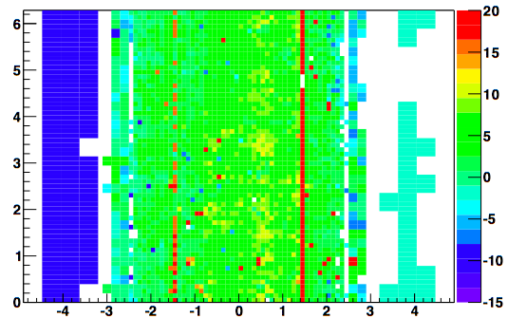
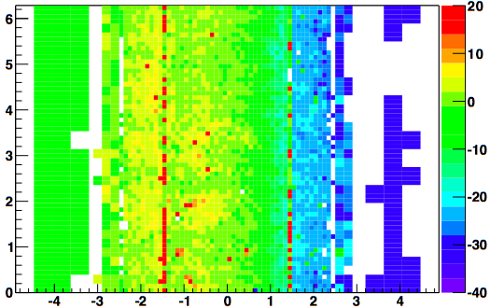
L1 Calo Time
Corrected EM Tower Timing delays [ns]
Uncorrected EM Tower Timing delays [ns]
Φ
Φ
Overlap regions
not commissioned
Beam
η
η
TL1Calo timing distribution of first night’s splash event
Observed time differences between up/downstream towers are mainly due to time of flight
Time of Flight corrected timing from splash event
L1CaloEM timing accuracy mostly already at the ±10 ns level (notice scale change)
J.Lundberg, 25/09

Slide 8
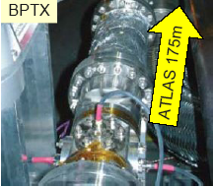
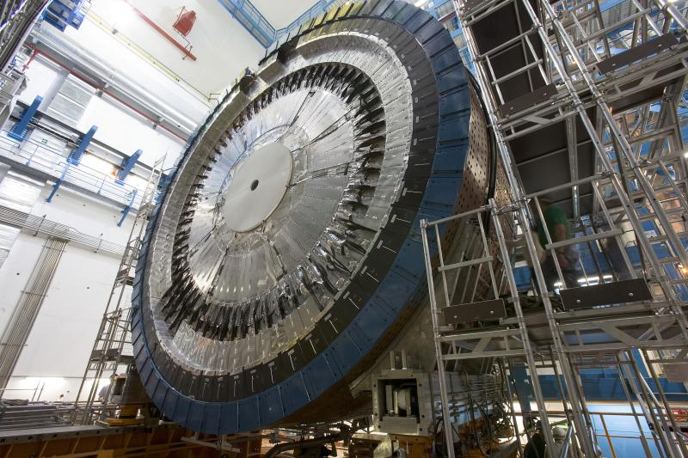
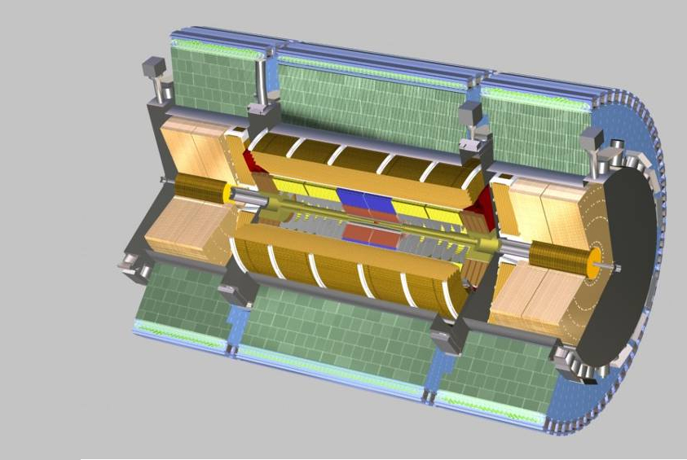
Time Alignment With 1st Splashes
BPTX
time
BPTX time aligned wrt L1 Calo (which was aligned with cosmics)
Trigger signal arriving late initially – removed
MBTS
Eventually, MBTS time adjusted – MBTS timing later used to select collision candidates
Level 1 Central Trigger Processor (CTP)
Calo
t

Slide 9
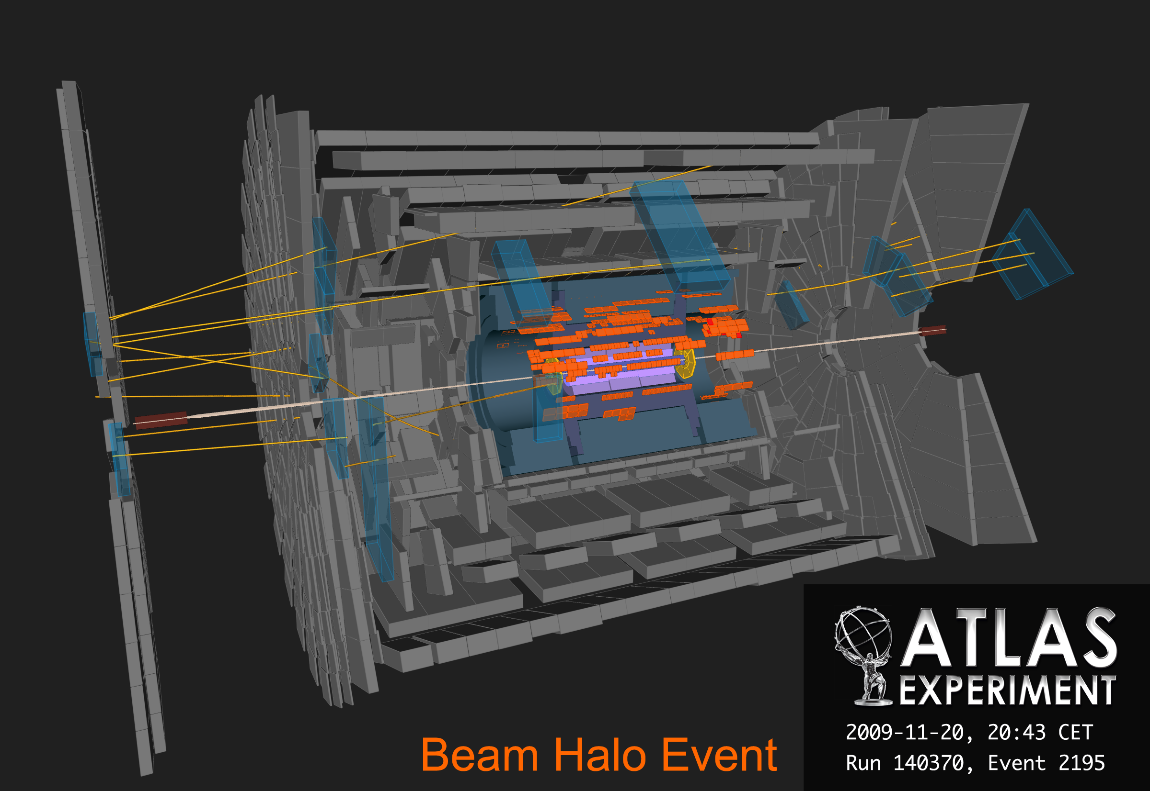

Slide 10
Beam-gas and Halo Events
After BPTX timed in, used it in coincidence (AND) with other trigger items
  To suppress cosmics and enhance beam-related events
Used this scheme in single-beams and collisions
  Caveat: BPTX efficient only for large enough currents (> 1.5x10⁹ proton in bunch)
To avoid loosing events when current was too low, used the bunch-group mechanism:
  A bunch group is a set of Bunch-Crossing IDs (BCID). E.g.:
    beam1=2554 on November 20th
    beam2=1358 before Sunday 22nd
    beam2=2554 afterwards – i.e. bunches cross in ATLAS at the right time
Several changes were made to the menu, to respond to problems
First tracks from beam were registered!
Nov
Dec
20 21 22 23 24 25 26 27 28 29 30 1 2 3 4 5 6 7 8 9 10 11 12 13 14 15 16

Slide 11
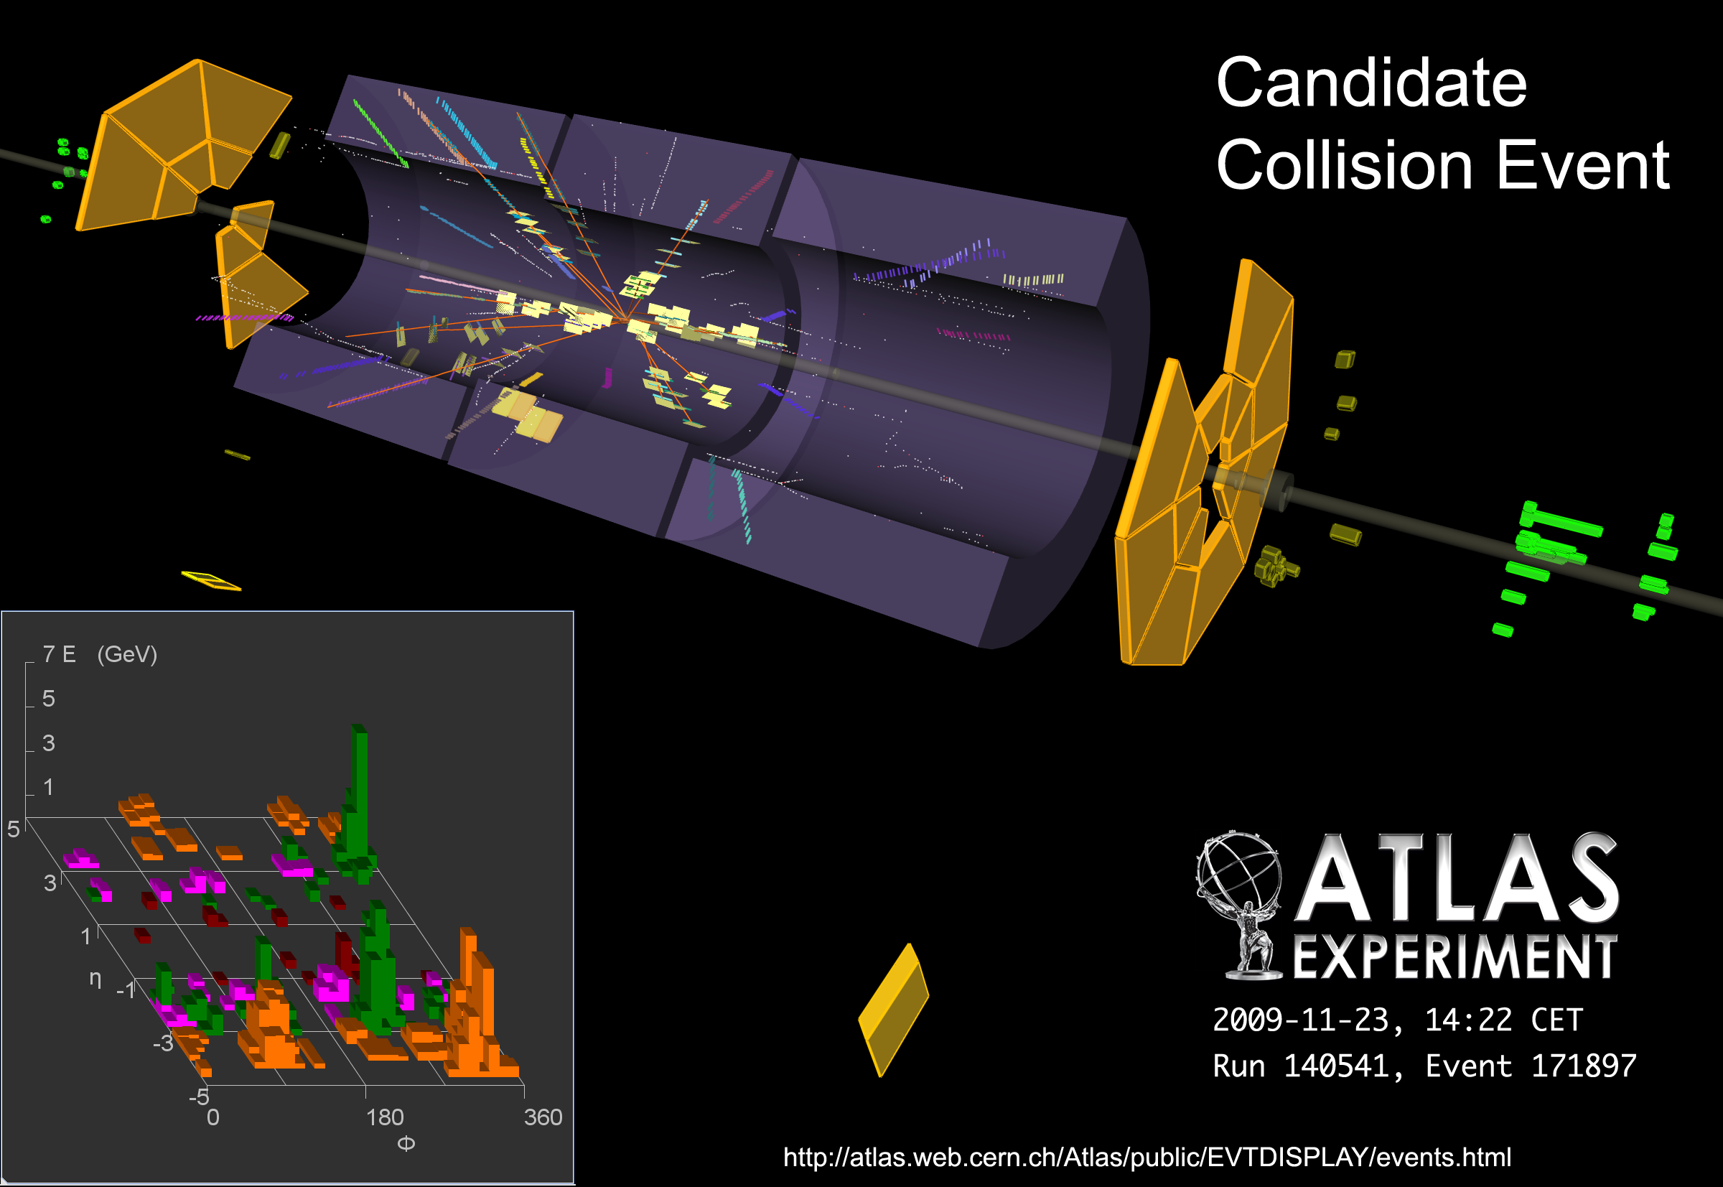

Slide 12
At this point the question was how to be sure these events were collisions and not beam-gas or beam halo
Proof came within hours with frantic email exchanges and bright ideas flying around
Detailed analysis of LAr signal times: selected events coming from the centre of ATLAS
Later, got more confident when vertex Z distribution was seen to move after LHC phase adjustment (“RF cogging”) of 900ps
Some days later, MBTS timing coincidence on sides A and C of ATLAS was used to have a collision trigger
Nov
Dec
20 21 22 23 24 25 26 27 28 29 30 1 2 3 4 5 6 7 8 9 10 11 12 13 14 15 16

Slide 13
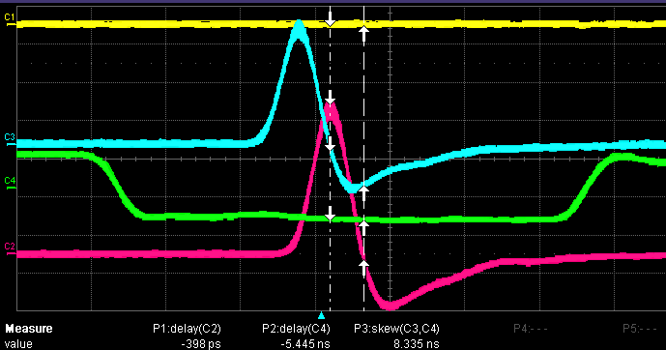
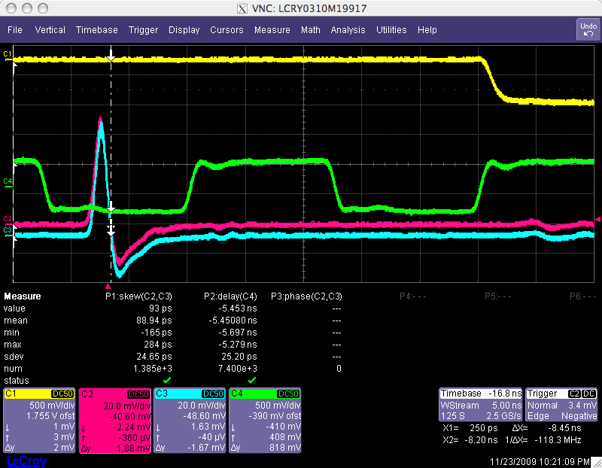
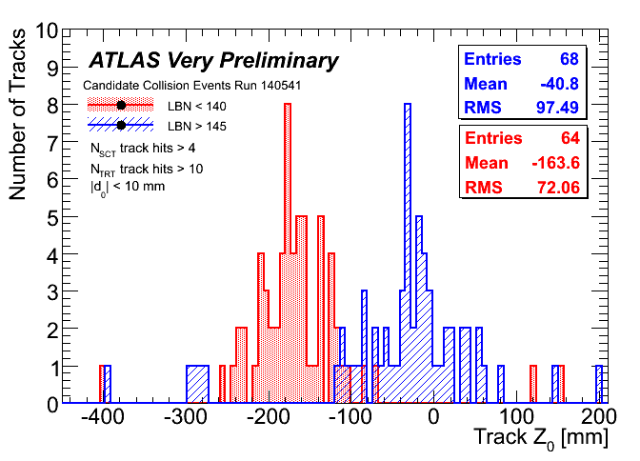
T.Pauly
900ps off
900 ps corresponds to a vertex shift of 13.5 cm
SCT track Z position before and after adjustment: Mean moved 12.3 cm towards zero!
Nov
D. Miller
Dec
#SCT > 4; #TRT > 10; d₀ < 10mm
20 21 22 23 24 25 26 27 28 29 30 1 2 3 4 5 6 7 8 9 10 11 12 13 14 15 16

Slide 14
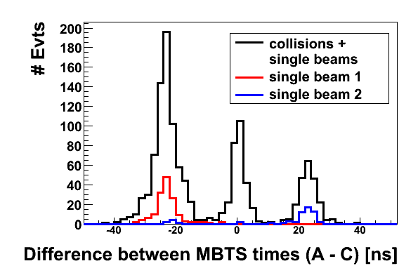
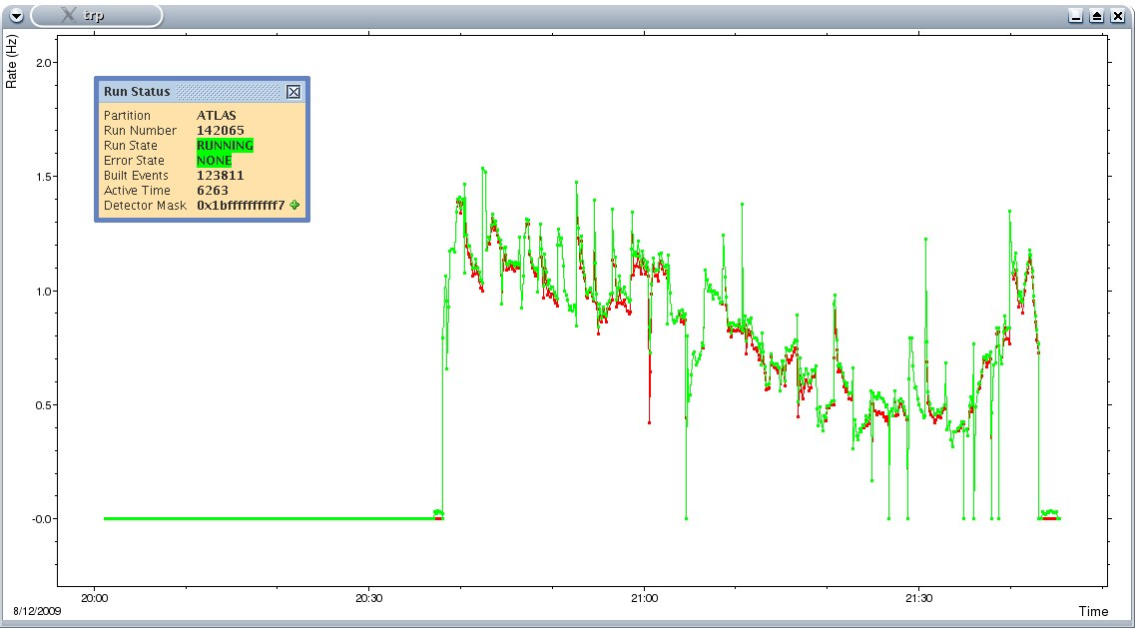
MBTS time coincidence in sides A and C provides a Level 1 trigger for collision events
  MBTS_1_1_Col has a strict coincidence requirement; MBTS_1_1 doesn’t
Could see beam conditions are very clean: no difference between two rates => not much beam gas/beam halo
  Ramp starts shortly after 21:30 and one clearly sees the collision rate increase as the energy increases.
Rate of MBTS_1_1 – no time coincidence – sensitive to beam halo
Rate of MBTS_1_1_Col –time coincidence – insensitive to beam halo

Slide 15
So far, High Level Trigger was running offline on all interesting runs in CAF/Tier0
  Analyzed debug streams to classify errors
  Processed bytestream files and produced ESD/ntuple with high level trigger information for commissioning analysis
  Major step forward was to run jobs automatically
  In general, High Level Trigger ran successfully with little or no errors and no crashes – gave us enough confidence to run it online
On December 6th, full High Level Trigger running online – run 141811, lumi bl.142
  Full menu running, and all calibration streams active
  No event rejection – special chains to accept all events regardless of high level trigger decision
Primary vertex position measured in real time in Level 2 trigger!
On December 11th (2am) High Level Trigger algorithms used to perform active event rejection
  On one stream only (physics_BPTX)
  Fed by Level 1 BPTX
  Level 2 minimum bias chains used inner detector algorithms to reject events
  Other streams still accepting all events
Nov
Dec
20 21 22 23 24 25 26 27 28 29 30 1 2 3 4 5 6 7 8 9 10 11 12 13 14 15 16

Slide 16
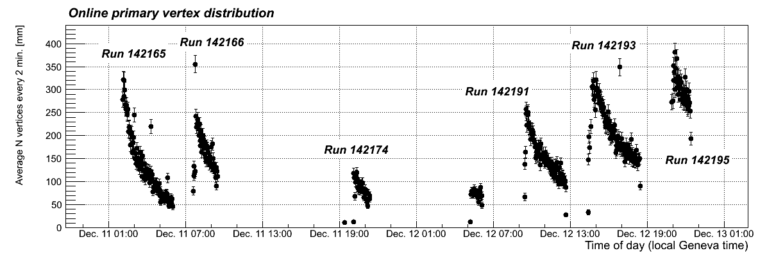
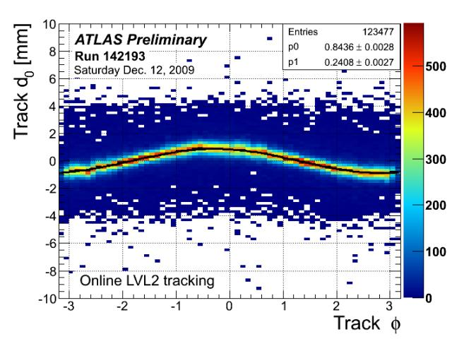
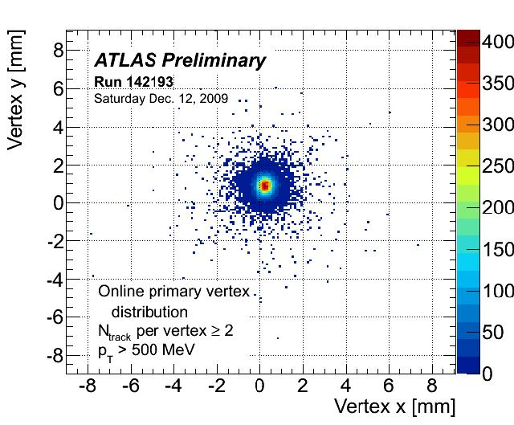
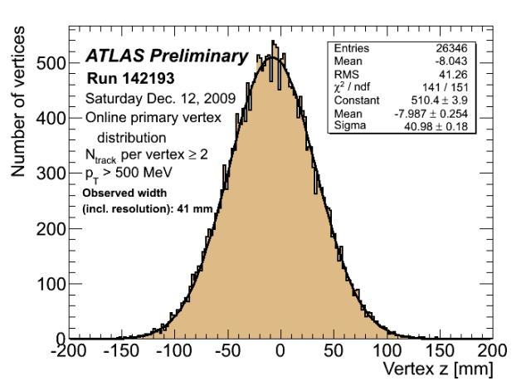
Vertex position determined online from fit to impact parameter of Level 2 trigger tracks versus φ
Z vertex distribution width ~40mm (including resolution)
Number of vertices can be seen to decay with decreasing luminosity in fill

Slide 17
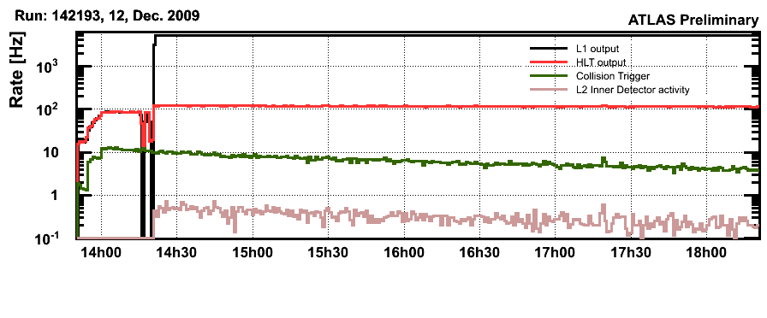
Typical “Stable Beams” run
Beam injection, record collision events.
HLT algos off.
Rejection factor of ~10⁴ looking for space points in the Inner Detector at Level 2 trigger – active event rejection
L1 BPTX prescale lowered => L1 rate increases
HLT active after LHC declares stable beam
T.Bold
(MBTS)
~20
BPTX prescaled by x20 at input to L2
Holding trigger as stable beams declared
Nov
Dec
20 21 22 23 24 25 26 27 28 29 30 1 2 3 4 5 6 7 8 9 10 11 12 13 14 15 16

Slide 18
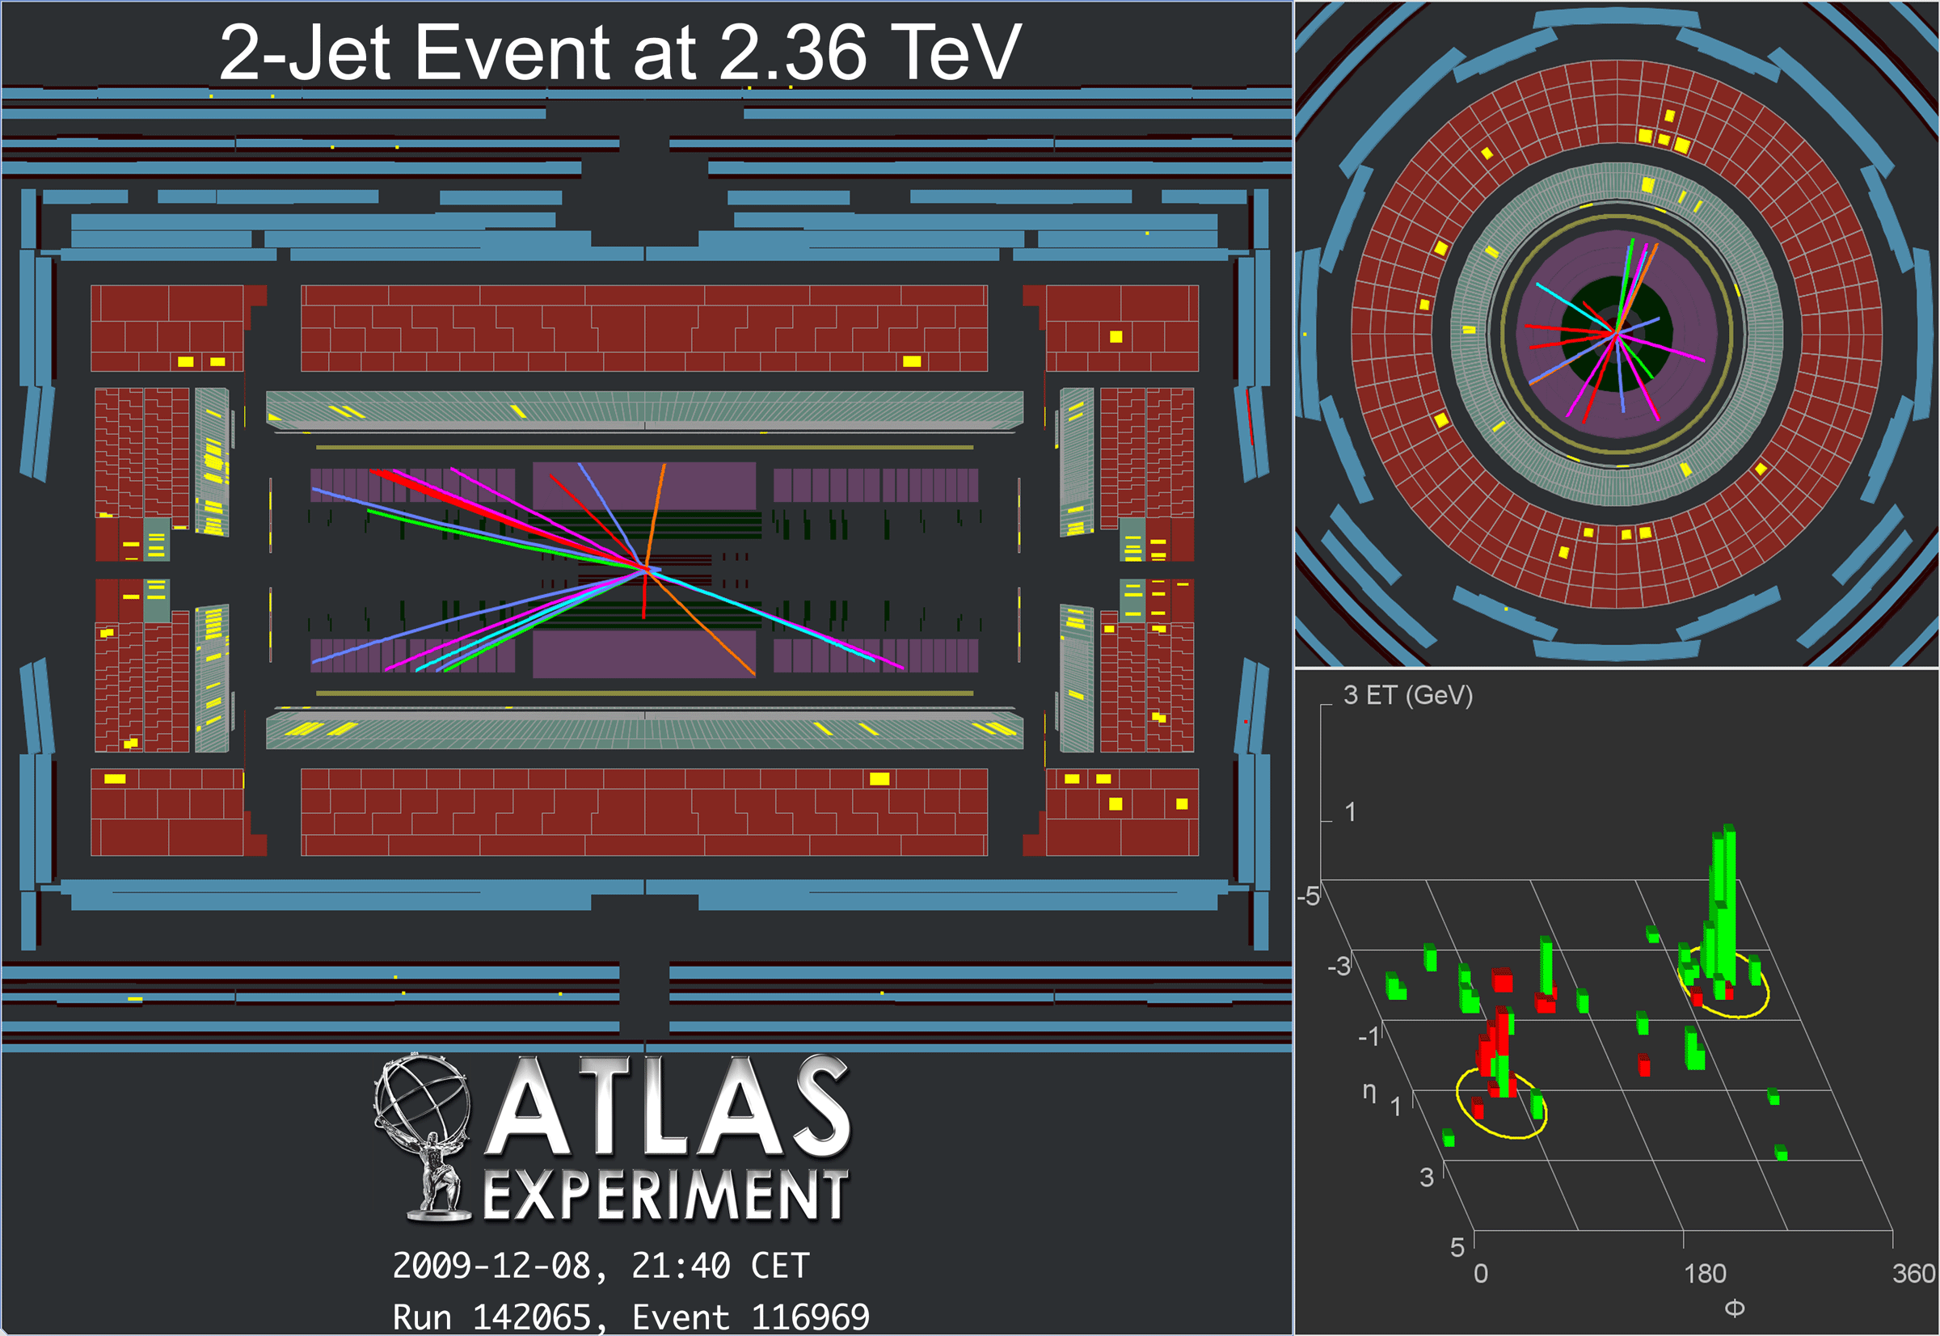
16 GeV
6 GeV

Slide 19
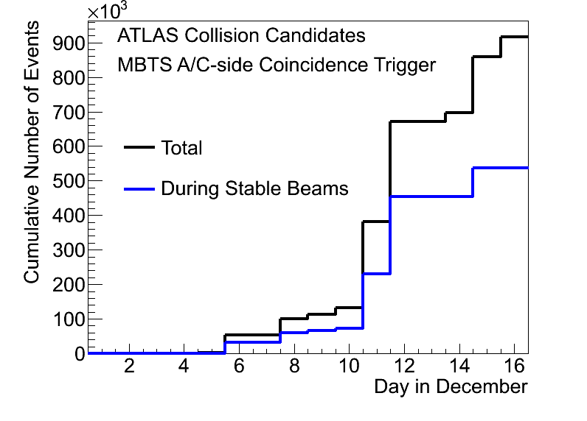
Conclusions
It was an incredibly exciting end of a busy year!
  The Level 1 trigger behaved very well and successfully selected single-beam and collision events
  The High Level trigger was carefully exercised offline, and later used online – first parasitically and then to reject events
All of this was possible due to an enormous amount of work done in the last few years (both “online” and “offline”)
  Much of this work was done by the UK institutes involved in the trigger

Slide 20
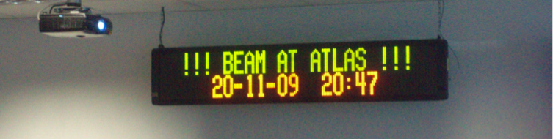
The Future…
There are very exciting times ahead!
The next step is to turn our trigger into a well-tuned tool to select physics events with good efficiency – after the commissioning, focus on physics performance
An excellent trigger performance is fundamental to doing physics with ATLAS
Now it’s time to exploit the ATLAS potential, and (with a bit of luck) to change the physics textbooks!

Slide 21
Backup slides…

Slide 22
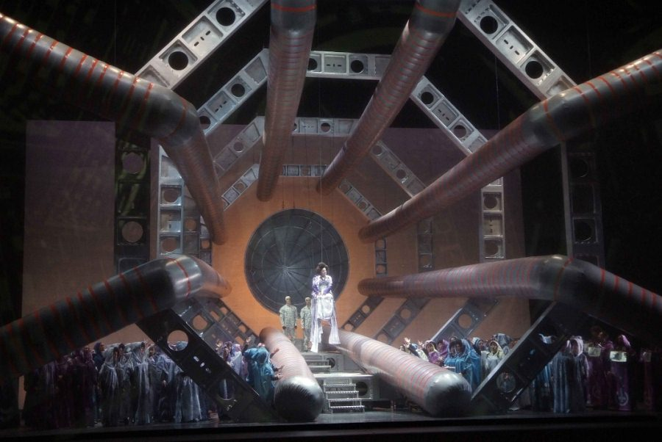
Hector Berlioz, “Les Troyens”, opera in five acts
Valencia, Palau de les Arts Reina Sofia, 31 October -12 November 2009
Many thanks to the accelerator team for the excellent
machine performance, for the impressive progress over a
few days of operation, and for the very pleasant and
constructive interactions with ATLAS
F.Gianotti

Slide 23
Friday, 20 November:
~ 20h: beam-1 threading → 6 beam splashes to ATLAS
~ 22h: beam-1 RF capture
~ 23h: beam-2 threading → 7 beam splashes to ATLAS
~ 24h: beam-2 RF capture
Saturday, 21 November:
~ 1h: beam-2 splashes dedicated to ATLAS → 27 events (side C)
~ 4h: beam-1 splashes dedicated to ATLAS → 26 events (side A)
RF consolidated → estimated beam lifetime up to ~ 10 hours
Sunday, 22 November:
~6h: 15 splash events to test beam abort by BCM→ successful
Then single beams …
Monday 23 November:
~ 6:30: last series of splashes to ATLAS → 25 events (side C)
~13:30: two beams injected, one bunch per beam ~ 4x10⁹ p, both in bucket 1 for collisions at IP1 and IP5
~ 14:22: first collision event observed in ATLAS (first experiment !)
~ 16:00: beams set up for collisions at IP2 and IP8
~ 19:00: beams again in bucket 1 for collisions at IP1 and IP5
~ 20:30 CERN Press release out → our event can go public
~ 24: beam 1 ramped up to 540 GeV

Slide 24
Calo
MuTrCh
40 MHz
Other detectors
1 PB/s
LVL1
2.5 μs
Calorimeter
Trigger
Muon
Trigger
LVL1 Acc.
75 kHz
ROD
ROD
ROD
120 GB/s
H
L
T
LVL2
ROS
~40ms
L2SV
ROB
ROB
ROB
L2P
RoI data
L2P
L2N
3 GB/s
L2P
Event Builder
2 kHz
Event Filter
~4sec
EB
EFP
EFP
EFP
EFN
200 Hz
300 MB/s

Slide 25
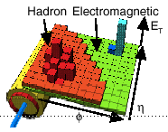
Architecture
Trigger
DAQ
Calo
MuTrCh
LVL1
40 MHz
Other detectors
2.5 μs
Det.
R/O
140M
Channels
LVL1 accept
(75 kHz)
RoI
ROD
ROD
ROD
High Level
Trigger
Dataflow
150
nodes
~40 ms
500
nodes
LVL2
ROS
RoI requests
ROB
ROB
ROB
ROIB
L2SV
L2N
RoI data (~2%)
L2P
EB
100
nodes
EBN
DFM
LVL2 accept (~3 kHz)
SFI
1800
nodes
~4 sec
EFN
EF
EFP
EF accept
(~0.2 kHz)
SFO
~100
nodes
Infrastructure
Control &
Monitoring
Communication
Databases

Slide 26
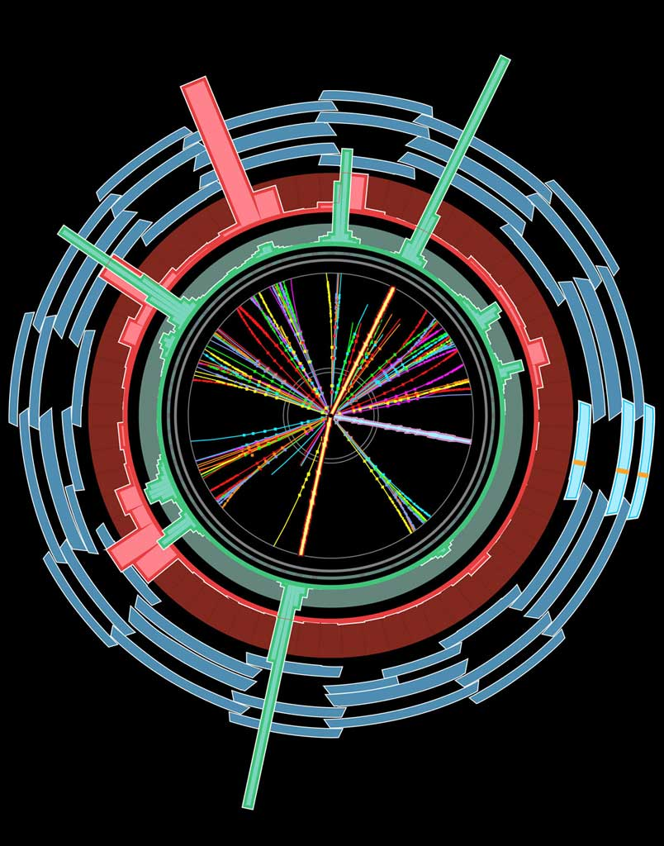
Selection method
Level1 Region of Interest is found and position in EM calorimeter is passed to Level 2
EMROI
Event rejection possible at each step
L2 calorim.
Electromagnetic
clusters
cluster?
Level 2 seeded by Level 1
Fast reconstruction algorithms
Reconstruction within RoI
L2 tracking
track?
match?
E.F.calorim.
E.F.tracking
track?
Ev.Filter seeded by Level 2
Offline reconstruction algorithms
Refined alignment and calibration
e/γ reconst.
e/γ OK?

Slide 27
Steering
EMROI
Algorithm execution managed by Steering
  Based on static trigger configuration
  And dynamic event data (RoIs, thresholds)
Step-wise processing and early rejection
  Chains stopped as soon as a step fails
  Reconstruction step done only if earlier step successful
  Event passes if at least one chain is successful
Prescale (1 in N successful events allowed to pass) applied at end of each level
Specialized algorithm classes for all situations
  Topological: e.g. 2 μ with m_{μμ} ~ m_{Z}
  Multi-objects: e.g. 4-jet trigger, etc……
L2 calorim.
L2 calorim.
cluster?
cluster?
L2 tracking
track?
match?
E.F.calorim.
E.F.calorim.
E.F.tracking
track?
e/γ reconst.
e/γ reconst.
γ OK?
e± OK?

Slide 28
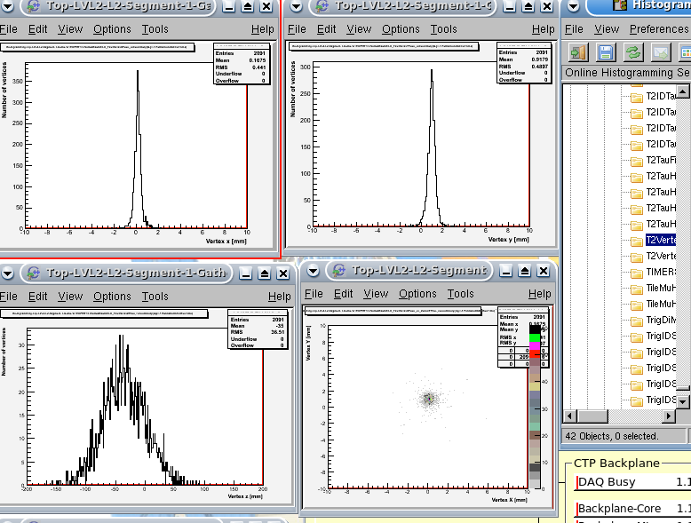
8/2009

Slide 29
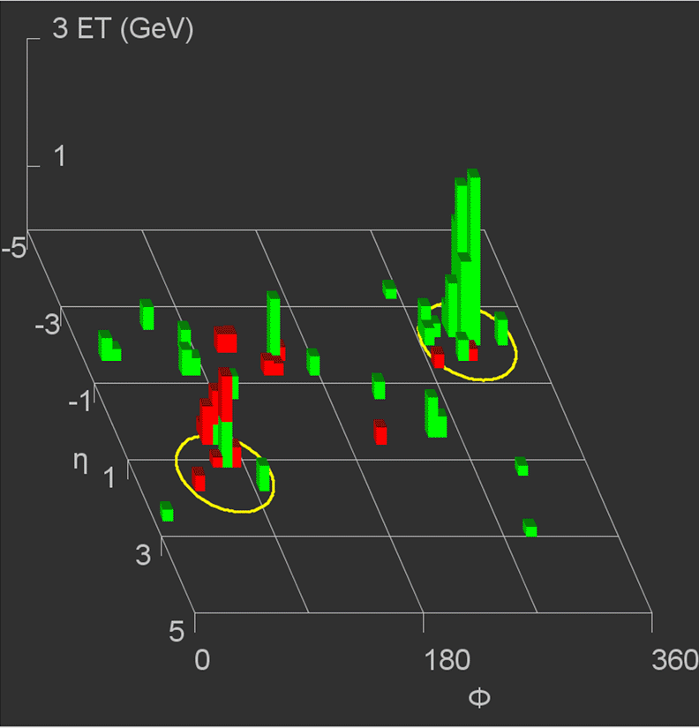
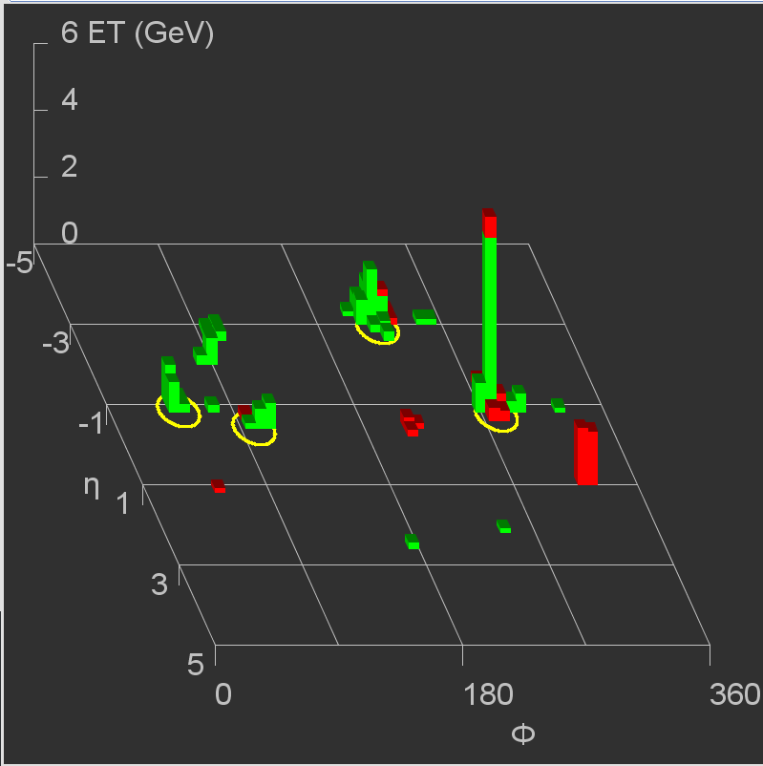
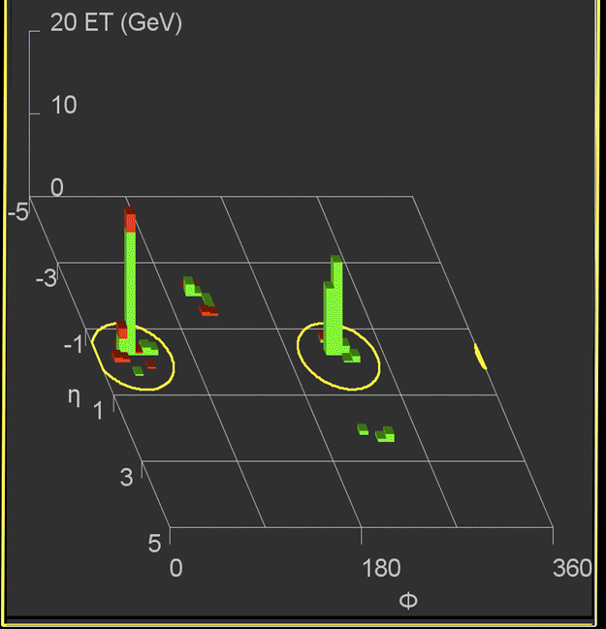
√s=2.36 TeV
√s=2.36 TeV
Jets
Jet1: E_{T} (EM scale)~ 15 GeV
Jet2: E_{T} (EM scale) ~ 12.5 GeV
Jet1: E_{T} (EM scale)~ 16 GeV
Jet2: E_{T} (EM scale) ~ 6 GeV
√s=900 GeV
Jet1: E_{T} (EM scale)~ 37 GeV
Jet2: E_{T} (EM scale) ~ 37 GeV
F.Gianotti

Slide 30
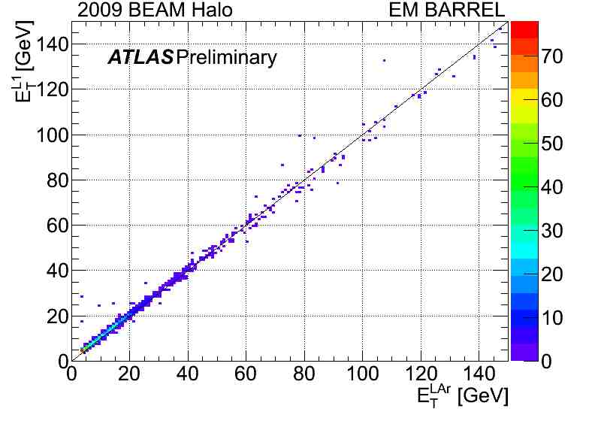
LVL1 CALO plots The entry in LVL1 Calo Et correlation to Offline plot is on Trigger Tower (0.1*0.1 in eta-phi range) bases, L1Et is calculated from the L1Calo ADC readout using (MaxADC-Pedestal)/4., which MaxADC is fitted by a parabola around the peak. And pedestal is calculated from recent run 136379 random events. LArgEt is the summation of energy from the cells connected to the corresponding trigger tower, convert to transverse energy. Trigger Towers with both L1Et and LArgEt greater than 3 GeV are kept. The resolution of LVL1 Calo Et with respect to LArgEt is divieded into LArgEt bin [3,5],[5,9],[9,17],[17,33],[33,65]GeV, and in each bin, the resolution fitted by a Gaussion. These plots are produced from data09_1beam physics_L1Calo.

Slide 31
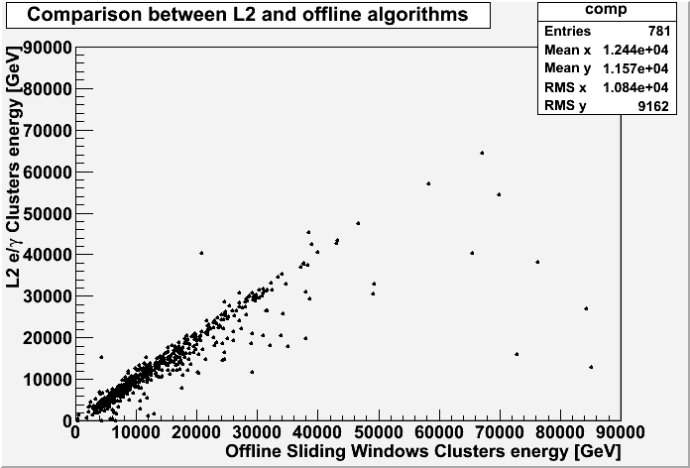
Offline to L2 egamma comparison of the clusters energy.
Differences understood to come from offline over-correction for clusters with higher energy in the back of the cluster.
Accumulation of runs 142144, 142149, 142165, 142171, 142191, 142193, 142195, 142383

Slide 32
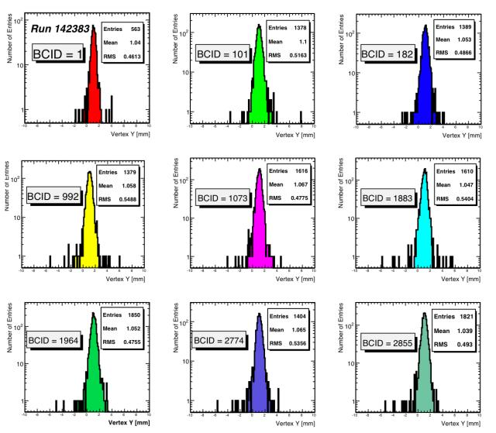
Y distributions of online reconstructed vertices for each of the 8+1 (1 pilot bunch) pairs of colliding bunches separately. No evidence for shifts beyond the few x10 um level.

Slide 33
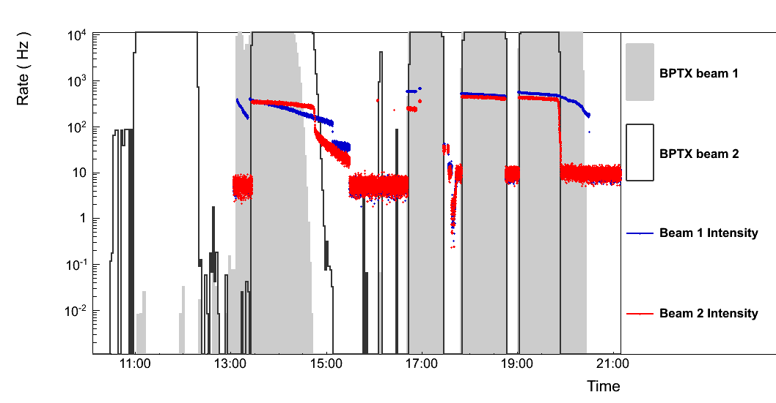
Beam pickup trigger rates
Beam intensity drops below trigger threshold
2.5 x 10⁹ protons

Slide 34
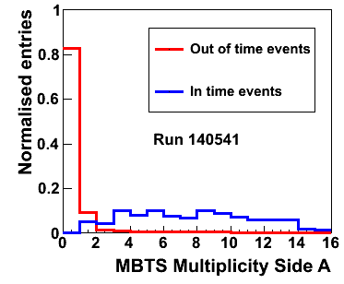
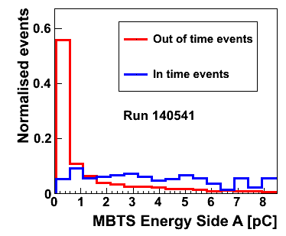
Beam related MBTS data
Readout timing information
In time: +- 10 ns
Out of time: the rest

